Slide 1
Accounts Payable Value Framing Business Case
A Process Mining Analysis of P2P Deviations and Improvement Opportunities Using Celonis Methodology
Made by – Komal Harshita Karanakota
Celonis × AICTE Virtual BA Internship | March 2026
Notes:
This deck presents a structured business case for two Accounts Payable improvement opportunities identified through process mining analysis of a 812-case, 4,927-event Purchase-to-Pay event log. The analysis applies Celonis's 6-Step Value Framing Methodology.

Slide 2
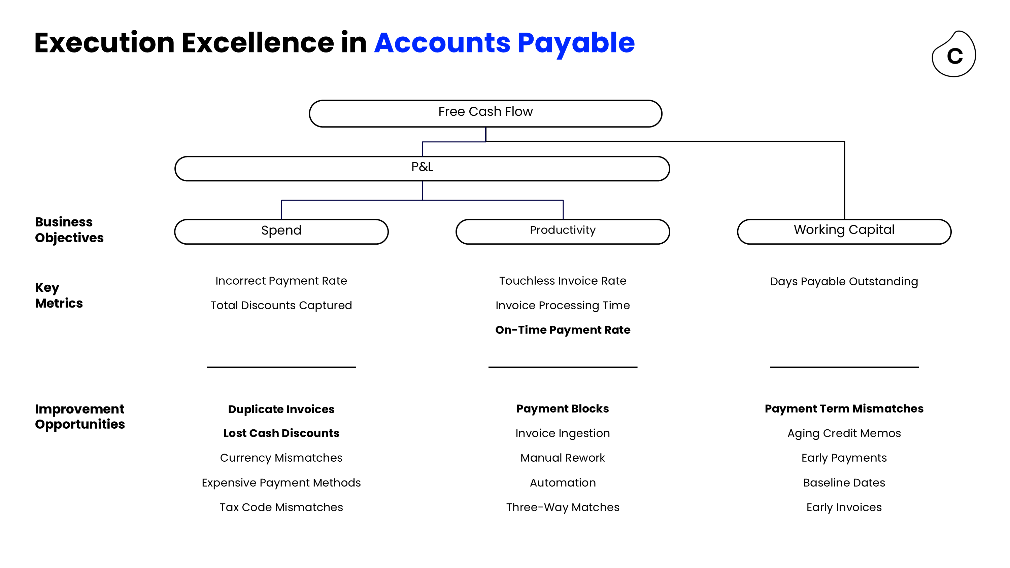
Why Accounts Payable? The Value Framework
SPEND:
• Incorrect payment rate
• Total discounts captured
→ Opportunities: Duplicate Invoices, Lost Cash Discounts
PRODUCTIVITY:
• Touchless invoice rate
• Invoice processing time
• On-time payment rate
→ Opportunities: Payment Blocks, Manual Rework
WORKING CAPITAL:
• Days Payable Outstanding
→ Opportunities: Payment Term Mismatches, Early Payments
"Source: Celonis AP Value Tree — Execution Excellence Framework
Both focus opportunities in this project target the Productivity pillar,
directly impacting Free Cash Flow through P&L improvement
Notes:
The Celonis AP Value Tree maps every improvement opportunity to a business objective — Spend, Productivity, or Working Capital — each of which flows up to P&L and ultimately Free Cash Flow. Our two focus opportunities (Payment Blocks and Price Deviations) sit under the Productivity pillar, impacting invoice processing time and on-time payment rate.

Slide 3
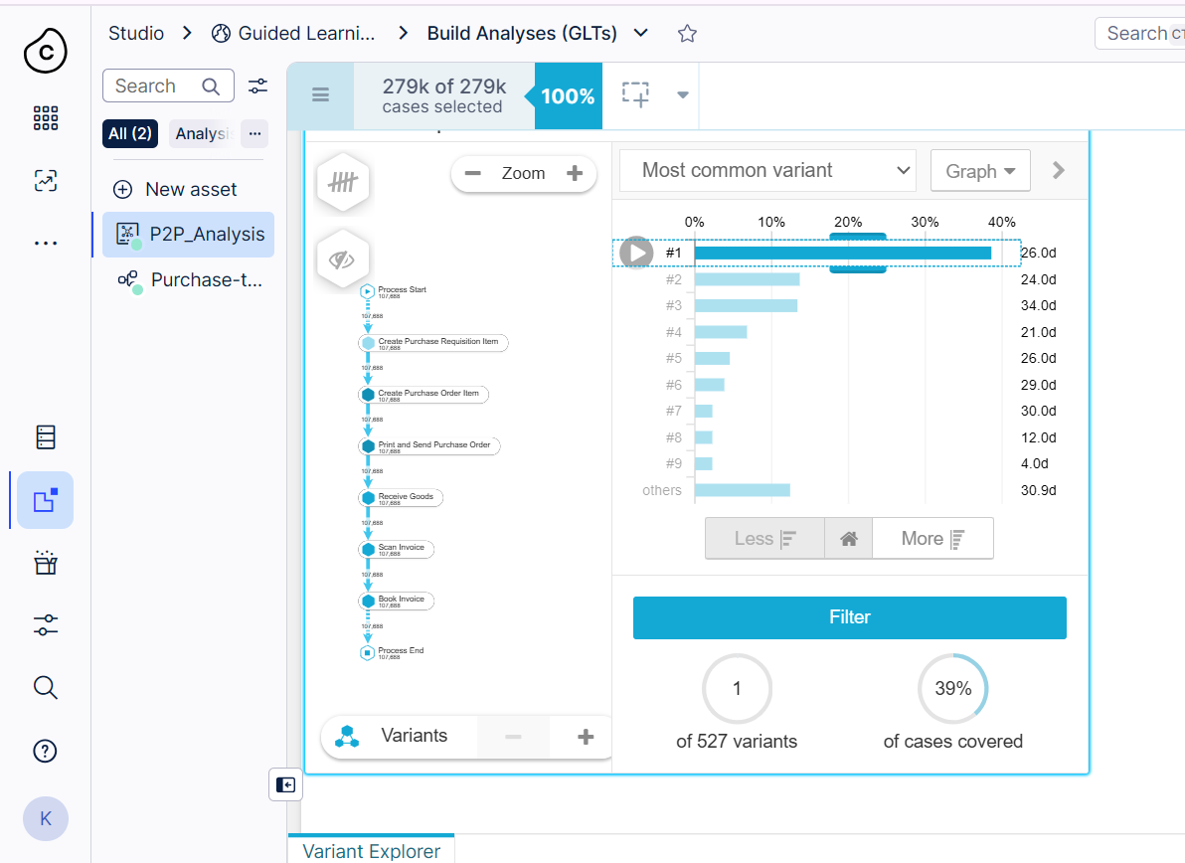
The Dataset: P2P Event Log — Key Statistics
812 Cases
4,927 Events
20 Vendors
29.6 Days
Process Flow
Create PR
Create PO
Send PO
Goods receipt
Invoice receipt
Clear invoice
Process Composition
• Happy Path Cases: 537 (66.1%)
• Deviant Cases: 275 (33.9%)
• Deviation Events: 310 of 4,927 (6.3%)
Automation Profile
• Automated Events: 2,341 (47.5%)
• Manual Events: 2,586 (52.5%)
• Automation Gap: ▼ Target: 70%+

Slide 4
Where Does the Process Break Down?
⚠️ CRITICAL
110 price corrections
= highest rework type
(35.5% of all deviations)
🔒 BLOCKED
58 block events
(PO + Payment)
delay invoice clearance
📈 SCALE
33.9% of all cases
affected by at least
one deviation event
💡 OPPORTUNITY
Reducing 50% of
deviation events saves
~35 FTE-days annually
Notes:
Change Price is the dominant deviation — 110 events representing 35.5% of all 310 deviation events. This single activity type alone indicates systematic pricing misalignment between POs and vendor invoices, likely concentrated in specific vendor relationships.

Slide 5
Opportunity 1: Resolve Payment Blocks & PO Holds
Challenge
Root Cause
- 20 Set Payment Block events across 20 unique PO cases
- 38 Block Purchase Order Item events = 58 total blocking events
- Each block requires manual investigation and resolution
- Blocks cause: delayed payments → missed early-pay discounts
→ strained vendor relationships → increased DPO
- Price/quantity mismatches between PO and vendor invoice
(upstream cause: Change Price events)
- Missing goods receipt confirmation auto-triggers block
- 52.5% manual activity rate = high human error exposure
- No automated block detection or escalation workflow
- Vendor 0000001001 drives 31% of Change Price events
(upstream root cause of many blocks)
Solution
Implement automated block detection via Celonis
Parked & Blocked Invoices Starter Kit App
- Set up Action Flows: notify AP team + buyer when a block event occurs
- Automate goods receipt confirmation for trusted vendors
- Vendor alignment session for top-5 deviation vendors
Assumptions:
$90K FTE cost/yr
15 min/block
Source: Celonis Value Framing Guide
Value
Committed Value
Blocking events
Effort per rework activity
FTE cost per minute
Improvement w/ Celonis
$292
Potential Savings p.a.
58
x
15 min
x
$0.42 / min
x
80%
=
Notes:
This opportunity directly maps to the Celonis Parked & Blocked Invoices Execution App. The 15-minute effort estimate per block removal is sourced from Celonis's published Value Framing Guide benchmark. The enterprise-scale figure is extrapolated from the ratio of 58 blocking events in 812 cases applied to the 279k case dataset visible in our Celonis platform screenshots.

Slide 6
Opportunity 2: Eliminate Price Deviation Rework
Challenge
Root Cause
- 110 Change Price events = the #1 deviation in the entire process
- 13.5% of all PO items require a post-issuance price correction
- Vendor 0000001001: 34 events (31% of all Change Price)
- Vendor R1000: 21 events (19% of all Change Price)
- Top 2 vendors account for 50% of all price correction effort
ATTRIBUTE-BASED: Vendor-specific
→ Vendors 0000001001 & R1000 = 50% of price events
→ Price lists not synchronized between SAP and vendor ERP
PROCESS-BASED: No pre-PO price validation step
→ PO issued with catalog price
→ Vendor invoices at contracted/current price
→ Mismatch discovered only at invoice receipt stage
TIME-BASED: Corrections spike at period-end
→ Budget pressure drives faster (less accurate) PO creation
Solution
- Master data fix: update vendor price lists in SAP for top-5 deviation vendors
- Implement 3-way match automation (PO–GR–Invoice)to catch mismatches before manual intervention needed
- Set up Celonis alerts for price delta > 5% threshold
- Quarterly vendor price reconciliation process
- Target: reduce Change Price events by 70%
Assumptions:
$90K FTE cost/yr | 10 min/correction 70% realization (master data fix)
Value
Committed Value
Price correction events
Effort per rework activity
FTE cost per minute
Improvement w/ Celonis
$323
Potential Savings p.a.
110
x
10 min
x
$0.42 / min
x
70%
=
Notes:
Change Price is the most actionable opportunity because its root cause is attribute-based — concentrated in just two vendors. This means a targeted vendor master data correction can eliminate 50% of the problem without any technology investment, making it an immediate quick win before any automation is deployed.

Slide 7
Business Case Summary: AP Value Journey Both opportunities target the Productivity pillar → impact P&L → improve Free Cash Flow
Objective | Opportunity | Owner | Time-To-Value | Framed | Committed | Realized
Productivity | Payment & PO Blocks | AP Team Lead | Short (1–2 sprints) | $292* | TBD | -
 | Price Deviation Rework | AP Team Lead | Short (1–2 sprints) | $323* | TBD | -
Total Annual Impact (P&L) |  |  |  | $615 | - | -
Total Spend Analyzed |  |  |  | €207,096
Deviation Rate |  |  |  | 33.9% of cases
Current Automation |  |  |  | 47.5% (target: 70%+)
📌 METHODOLOGY NOTE
Value calculated using: Affected Events × Realization Potential × (Effort × FTE Cost/min)
FTE assumption: $90,000/year | $0.42/min | Source: Celonis Value Framing Guide
Notes:
The Business Case Overview format is the standard Celonis executive sign-off document. The Committed column would be populated after a Value Validation Workshop with the AP team lead and finance sponsor. The Realized column is populated after implementation, tracked against the KPI formulas defined in the methodology.

Slide 8
Root Cause Analysis: Who & Why?
Vendor ID | Change price | Total | Risk level
0000001001 | 34 | 34 | 🔴 HIGH
R1000 | 21 | 21 | 🔴 HIGH
0000003021 | 12 | 12 | 🟡 MEDIUM
0000001011 | 10 | 10 | 🟡 MEDIUM
R3000 | 8 | 8 | 🟢 LOW
"Not all root causes are visible in the data.
Talking to business users reveals what the data can't show."
— Celonis Value Framing Methodology
Notes:
The vendor concentration finding is highly actionable. Vendor 0000001001 alone accounts for 31% of all Change Price events — a single vendor alignment meeting to synchronize price lists could eliminate one-third of this entire deviation category. This is a perfect example of an attribute-based root cause with a low-effort, high-impact fix.

Slide 9
Prioritization: Where to Act First
Priority 3
Big bets
High value + fast
Priority 1
Opportunities –
1] payment and PO blocks
2] price deviation rework
Priority 4
Long term projects
Medium value + slow. Consider in future
Priority 2
Medium value + fast quick wins with moderate impact
RECOMMENDED EXECUTION ORDER
PHASE 1 (Immediate — 0–4 weeks)
[1] Price Deviations
• Vendor master data fix (top 2 vendors)
• No technology required
• Eliminate 50% of problem immediately
PHASE 2 (Short-term — 4–12 weeks)
[2] Payment & PO Blocks
• Celonis Parked & Blocked Invoices App
• Automated detection + Action Flows
• Integrate with AP workflow
Combined Annual Value: $615 (sample) | $2M–$2.7M (enterprise scale)
Timeline to first value realization: 4–6 weeks
Notes:
Both opportunities land in the Gold Nuggets quadrant — high value impact combined with fast implementation timelines. This is the ideal starting position: we're not recommending risky long-term projects, we're recommending targeted, data-backed fixes with measurable outcomes. Phase 1 requires no technology investment at all — just a vendor meeting.

Slide 10
Thank You!

