Slide 1
Title: Liner Regression Model To Predict Housing Saleprice
Author: <Enter your name here>

Slide 2
Introduction
In this project, I aimed to create a predictive model for house prices using linear regression. The goal was to build a model that can accurately estimate the sale price of houses based on various features, providing valuable insights for buyers, sellers, and real estate professionals.
Here are the key steps I followed to solve this problem and create the prediction model:
Data Preprocessing: To prepare the data for analysis, I cleaned it by handling missing values. I also explored the dataset to gain a better understanding of the variables and their distributions.
Exploratory Data Analysis (EDA): EDA involved visualizing the data through histograms, scatter plots, and correlation matrices. This helped me identify relationships between variables and determine which ones had a significant impact on sale prices.
Data preparation: I prepared for the model by adjusting the set of independent variables. This aimed to improve its predictive accuracy.
Model Building: I implemented a linear regression model using Python and libraries like NumPy, pandas, and scikit-learn. The model used selected independent variables to predict house prices.
Best of all Model : I created other two group of independant variables to get the best working model.
Test Model : I tested my model on given test data to check its accuracy.
Conclusion: I summarized the project's findings, highlighting the model's ability to make accurate predictions, providing a comprehensive analysis of factors affecting house prices.
*Please add slides as required.

Slide 3
The Data
For this model building I imported necessary data such as csv file which contains all housing data and another csv file to test model.
I also imported some of the libraries of python,
pandas, matplotlib.pyplot , numpy , from sklearn import linear_model , from sklearn.impute import SimpleImputer.
libraries are collections of pre-written code that provide various functionalities and tools to simplify common tasks.
*Please add slides as required.

Slide 4
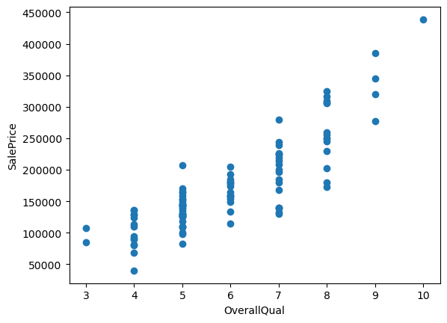
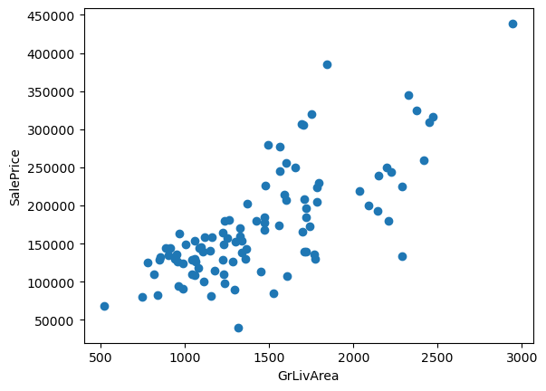
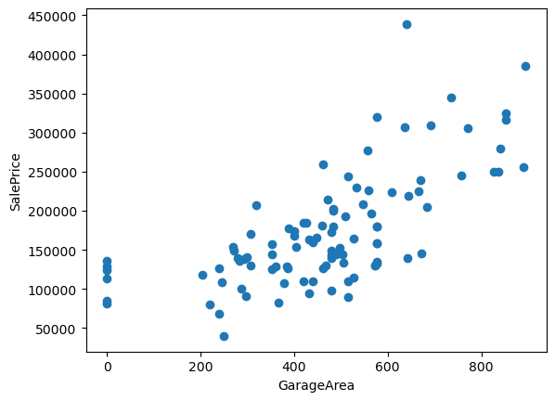
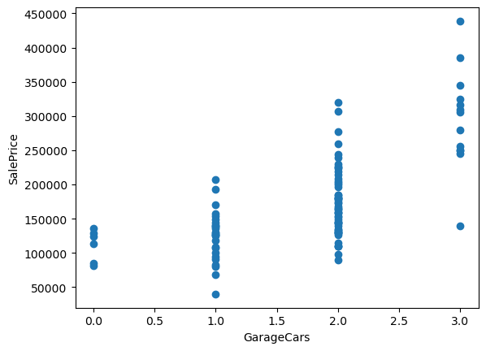
Data Exploration
Here are some scatter plots of highly correlated variables with SalePrice.
*Please add slides as required.

Slide 5
Data Preparation
Cleaning and reshaping data for linear regression involves preparing dataset so that it can be effectively used to build a regression model. Here are the essential steps I followed for data preprocessing in linear regression:
I use data manipulation libraries like Pandas to load data into a DataFrame.
I considered first 100 rows and all columns from houseSmallData.csv and named as ‘train’.
Pull out and describe saleprice data from ‘train’.
Check distribution of SalePrice by plotting histogram.
Histogram look skewed and not normally distributed, then I considered log of Saleprice as ‘target’.
Search for, if there are some missing values and if there are some ,reshape them.
Repairing all the nulls using interpolate().
Checking data types: Ensure that data types are appropriate (e.g., numerical for numerical features)
Search for correlation of different independent variables and select highly correlated data for model building.
Created three different variable groups with different correlations with dependant variable to get more predictable model.
*Please add slides as required.

Slide 6
Correlation
Summary of results I have found about the correlation between variables :
I have calculated correlation of independent variables with Saleprice.
Then sort then descending way to get highly correlated variables.
That returns correlation percentage as,
SalePrice 1.000000
OverallQual 0.855061
GrLivArea 0.735129
GarageArea 0.688249
GarageCars 0.663441
YearBuilt 0.658636
TotalBsmtSF 0.616297
GarageYrBlt 0.589361
FullBath 0.579505
MasVnrArea 0.571836

Slide 7
Project Description
Summary of algorithms I have used to analyze the data :
I have cleaned and reshaped imported data first.
I have then calculated correlation of independent variables with Saleprice.
Then sort then descending way to get highly correlated variables.
I considered three different group of variables to get best variable group to predict Saleprice more accurately.
First I considered 10 highly correlated variables that gave me prediction 0.85.
Secondly , I considered first 14 correlated variables that returned with 0.88 prediction.
And last I considered group of 10 least correlated variables and that calculated prediction of 0.89.
*Please add slides as required.

Slide 8
Analysis and Results
I have tested all three variable groups out of which third group with least correlated independent variables, returned prediction od Saleprice data highest accurately with 0.89 percent
Resulted in third group of variables gave me maximum prediction accuracy .
I tested this analysis with given test data and that resulted in 0.89 accurate prediction.
*Please add slides as required.

Slide 9
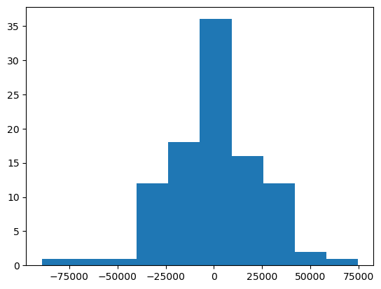
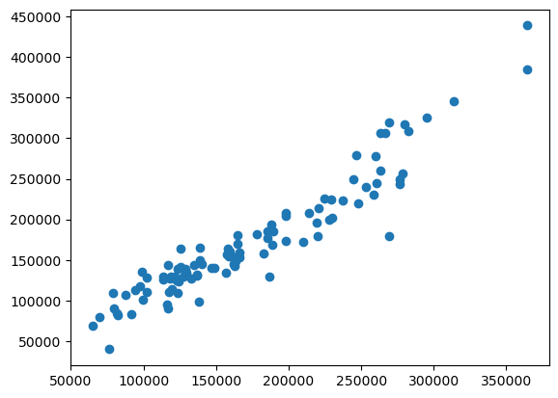
Verification
I have used my best worked analysis on given tested data that returned 0.89 percent accurate prediction.
Following are graphs I have plotted, histogram distribution and scatter plot distribution to see its results
*Please add slides as required.

Slide 10
Conclusion
According to my model building variable group with least correlation with target variable predicted higher accurately. Creating a house sale price prediction model enhanced my understanding of data analysis techniques. I learned to clean and preprocess data, select relevant features, perform correlation analysis, and build predictive models, particularly linear regression.
*Please add slides as required.

Slide 11
References
Use this as a sample for websites:
Instructor - - Team ManifoldAILearning Website - Udemy.com URL - https://udemy.com/course/statistics-probability-for-data-science/learn/lecture/34156008#overview
Instructor - BI insight inc Website- youtube.com URL - https://youtu.be/ogr_oiq0zQA?si=PvFg9SHetKXw1nuz
*Please add slides as required.

