Slide 1
About
Designation : SDE-II
Current Company : ZEE5
Project - Middleware Service
Roles & Responsibilty: Owns and Maintain one of the microservice project. Responsible for providing assets(video/ episodes, news) related data.
Load 200 QPS
Achievements
Have been awarded as team performer for ILT20 live event

Slide 2
Functional Requirements: 1. Driver Signup 2. OnBoarding process(Document upload, Background Verification, Tracking Shipment Device) 3. Allow driver to mark when they are ready to take a ride.
Non - Functional Requirements: 1. Highly Available 2. Eventual consistent 3. Partition Tolerant
4. Resiliency(Assumption made - Retry mechanism)

Slide 3
Assumptions & Implementations:
Onboarding service - This service is already implemented that handles onboarding process(Document collection, Background verification & shipping of Tracking device) of Driver once signup is completed on ride service. Once onboarding is completed then that will be notified to ride service that now driver is onboarded.
Message Broker - RabbitMQ used as message broker that push messages to Queue so flow will work in async(background). Ex- Onboarding Queue & Shipment tracking
Authentication – JWT Token based authentication is implemented with expiry time.
Postgres, S3 is used for Data storage.
Logging - SL4J lombok

Slide 4
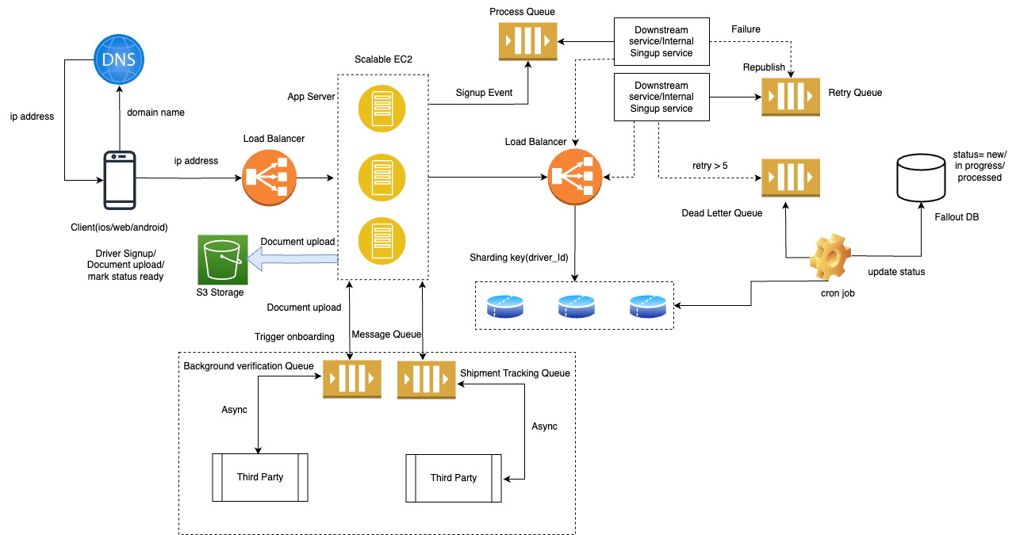

Slide 5
API Interface: 1. POST /api/drivers/singup: To allow a driver to sign up and enter their profile information. 2. POST /api/drivers/{driverId}/documents: To upload the necessary documents for verification and trigger onboarding task 3. asynchronously. 3. GET /api/drivers/{driverId}/verification: To check the status of the background verification. 4. PUT /api/drivers/{driverId}/status: To mark when a driver is ready to take a ride.
Data Stores PostgreSQL: To store the driver's profile information, document details, verification, onboarding and availability status. Amazon S3: To store the uploaded documents.
Tech Stack:
RabbitMQ: For handling asynchronous tasks like background verification and shipping tracking device.

Slide 6
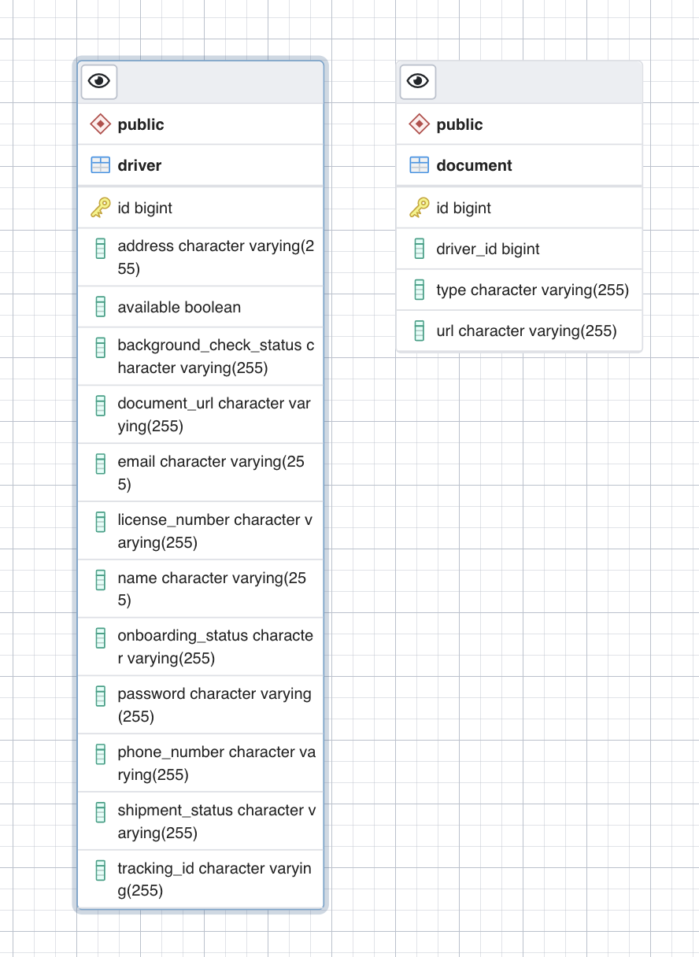
Data Model

