Slide 1
PCB designing of
Transmitter side
Sagar Pasricha (C0765531)
Notes:
1

Slide 2
What is pcb?
A printed circuit board (PCB) mechanically supports and electrically connects electrical or electronic components using conductive tracks, pads and other features.
Components are generally soldered onto the PCB to both electrically connect and mechanically fasten them to it.
Electronic computer-aided design software is available to do much of the work of layout.
PCBs can be single-sided (one copper layer), double-sided (two copper layers on both sides of one substrate layer), or multi-layer (outer and inner layers of copper, alternating with layers of substrate).

Slide 3
Software available for pcb designing
PROTEL (Altium Designer)
PADS (PowerPCB)
ORCAD
Allegro
Eagle
Kicad
EasyEda
Fritzing
and some more…

Slide 4
Easy EDA
Easy EDA is a web based EDA tool that enables the hardware engineers to design, simulate, share and discuss schematics, simulations and printed circuit boards. Features may include Bill of Materials, Gerber files and pick and place files and documentary outputs in PDF, PNG and SVG formats.
Most of the things, such as libraries, projects, custom-made parts, packages and shared files are accessible via a simple drop down menu at the top left side of the software interface. This makes it easy for you to navigate through the software regardless of whether you are beginner or pro.

Slide 5
Components and communication protocol used
Components used at Transmitter Side:
Beaglebone Black Wireless
Xbee Module
Nextion Touch LCD
Communication Protocol Used:
UART1

Slide 6
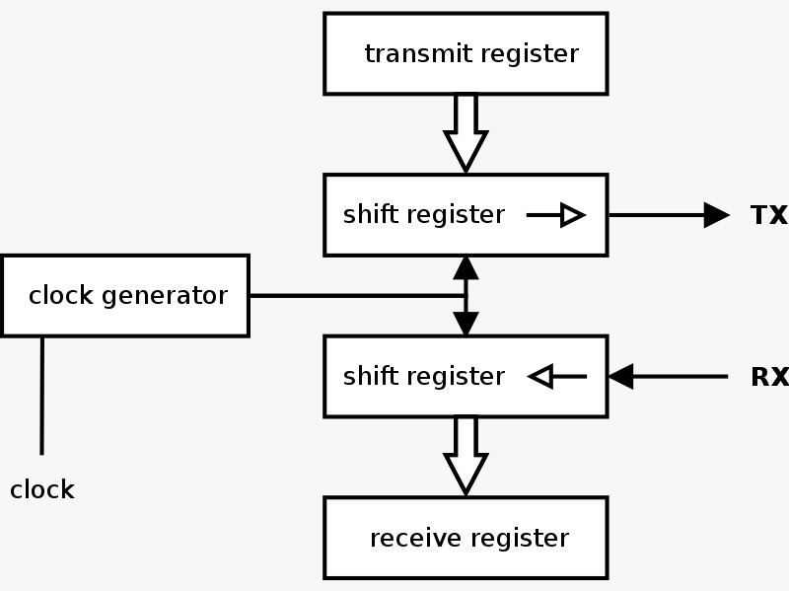
Interfacing communication protocol: UART
A universal asynchronous receiver-transmitter (UART) is a computer hardware device for asynchronous serial communication in which the data format and transmission speeds are configurable.
It sends data bits one by one, from the least significant to the most significant, framed by start and stop bits so that precise timing is handled by the communication channel.

Slide 7
Interfacing communication protocol: UART
Beaglebone Black Wireless have 4.5 serial UARTs.
For interfacing with touch screen display, we can use either of UART1, UART2, UART4.
We cannot use UART3 for interfacing with touch screen display, because UART3 has only transmit pin.

Slide 8
What is xbee?
XBee S2C is a RF module designed for wireless communication or data exchange and it works on ZigBee mesh communication protocols.
The module provides wireless connectivity to end-point devices in any ZigBee mesh networks including devices from other vendors.

Slide 9
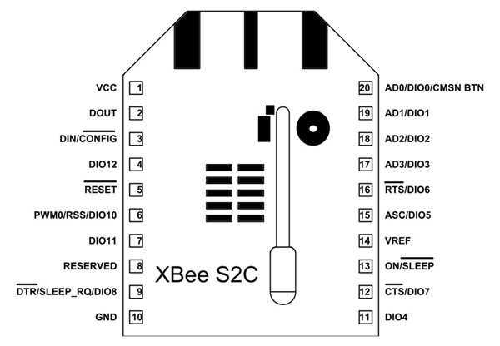
Pin diagram of xbee

Slide 10
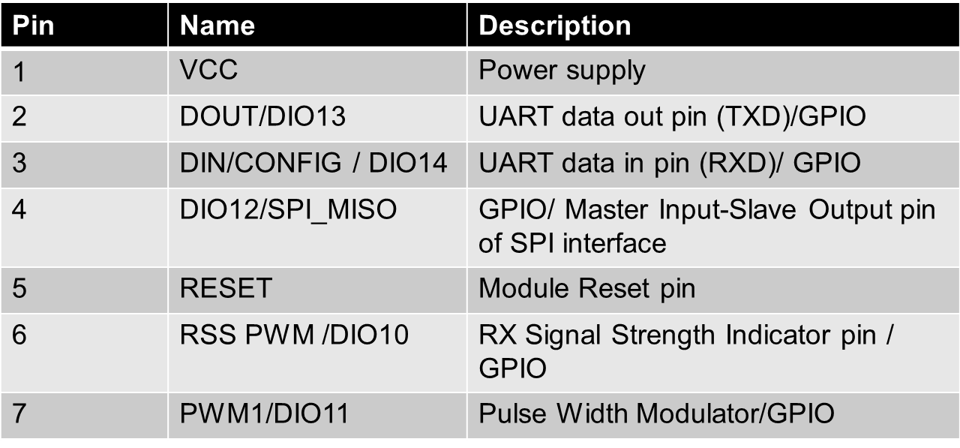
Pin description of xbee

Slide 11
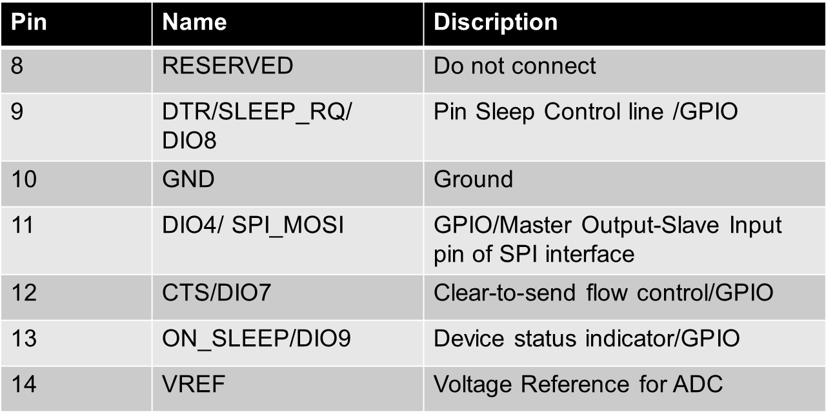
Pin description of xbee

Slide 12
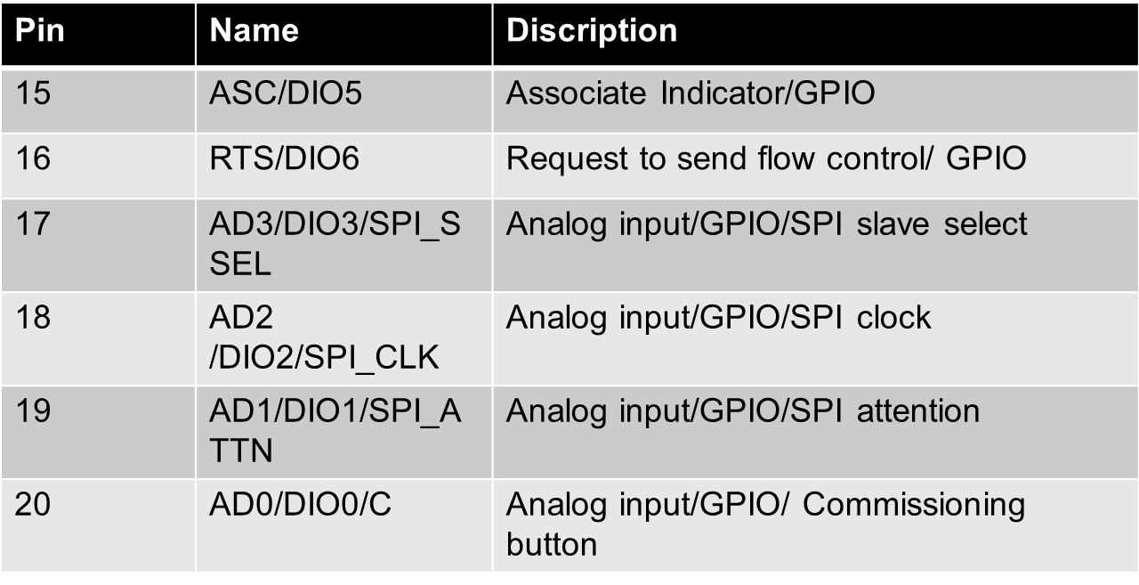
Pin description of xbee

Slide 13
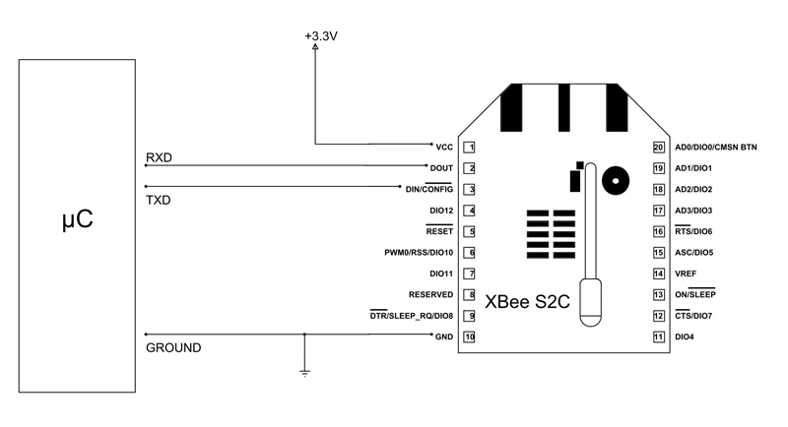
UART interfacing of Xbee

Slide 14
Xbee Interfacing with BBB wireless
Connect pin 1 (Vcc) of XBEE to pin4 (Vdd) of BBB wireless (P9 Header)
Connect pin 10 (GND) of XBEE to Pin 46 (GND) of BBB wireless (P9 header )
Connect pin 2 (Dout) of XBEE to pin26 (UART1_Rx) of BBB wireless (P9 Header)
Connect pin 3 (Din) of XBEE to Pin 24 (UART1_Tx) of BBB wireless (P9 header )

Slide 15
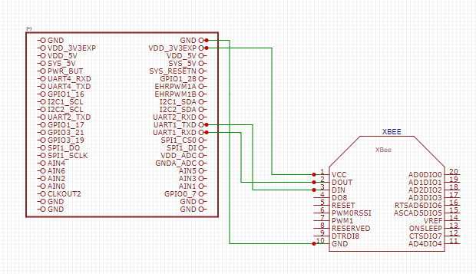
Xbee Interfacing with BBB wireless

Slide 16
Nextion Touch LCD
Nextion NX4827T043 4.3 Inch HMI Intelligent Smart UART Serial Touch TFT LCD Screen Module Display Panel.
Nextion is a Seamless Human Machine Interface (HMI) solution that provides a control and visualization interface between a human and a process, machine, application or appliance. Nextion includes hardware part (a series of TFT boards) and software part (the Nextion Editor).
The Nextion TFT board uses only one serial port to communicate. It lets you avoid the hassle of wiring..
In Nextion editor, has mass components such as button, text, progress bar, slider, instrument panel etc. to enrich your interface design.

Slide 17
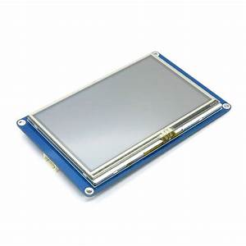
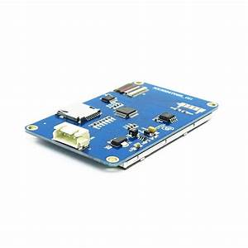
Nextion Touch LCD

Slide 18
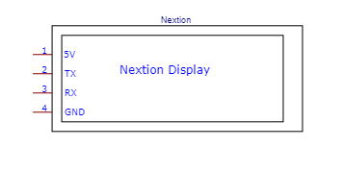
Pin description of Nextion Touch LCD

Slide 19
Features of Nextion Touch LCD
480 x 272 Resolution
RGB 65K true to life colors
TFT Screen with integrated 4-wire Resistive Touch Panel
Easy 4 pin interface to any TTL Serial Host
16M Flash memory for User Application Code and Data
On board micro-SD card for firmware upgrade
Visual Area:95.04mm(L)×53.86mm(W)
Adjustable Brightness:0~230 nit, the interval of adjustment is 1%
5V250mA power consumption

Slide 20
Touch lcd Interfacing with BBB wireless
Connect pin 1 (Vcc) of XBEE to pin4 (Vdd) 0f BBB wireless (P9 Header)
Connect pin 4 (GND) of XBEE to Pin 46 (GND) of BBB wireless (P9 header )
Connect pin 2 (Tx) of XBEE to pin26 (UART1_Rx) 0f BBB wireless (P9 Header)
Connect pin 3 (Rx) of XBEE to Pin 24 (UART1_Tx) of BBB wireless (P9 header )

Slide 21
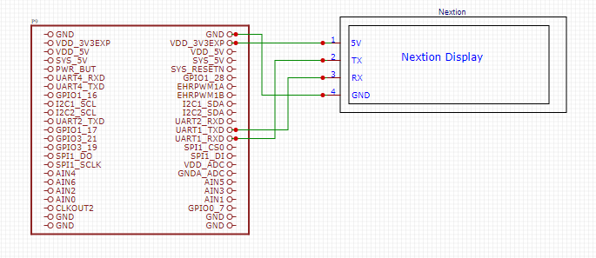
Touch lcd Interfacing with BBB wireless

Slide 22
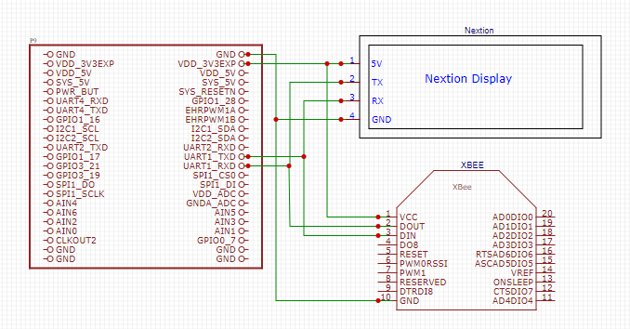
Final schematic of transmitter side

Slide 23
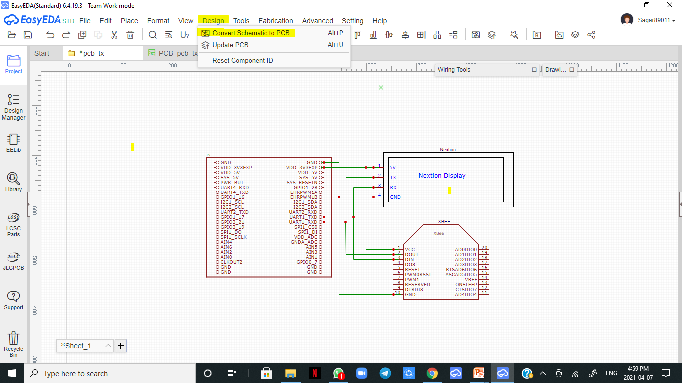
First method for pcb designing
Schematic with connections

Slide 24
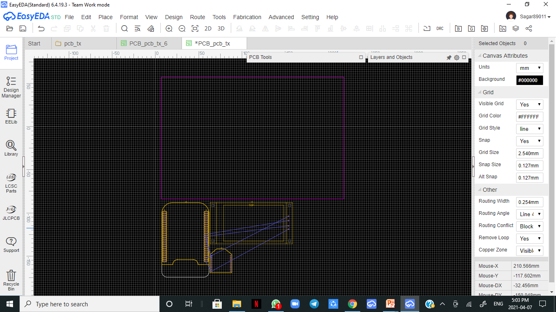
First method for pcb designing
PCB before
arrangement

Slide 25
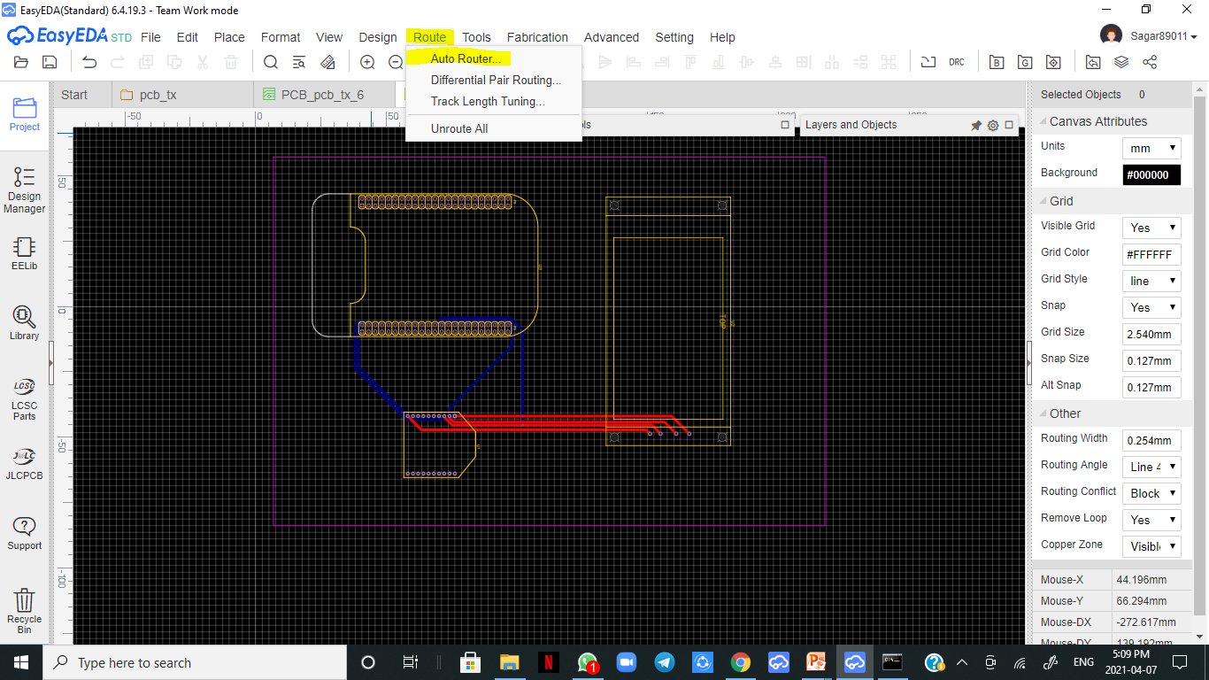
First method for pcb designing
PCB after
auto routing

Slide 26
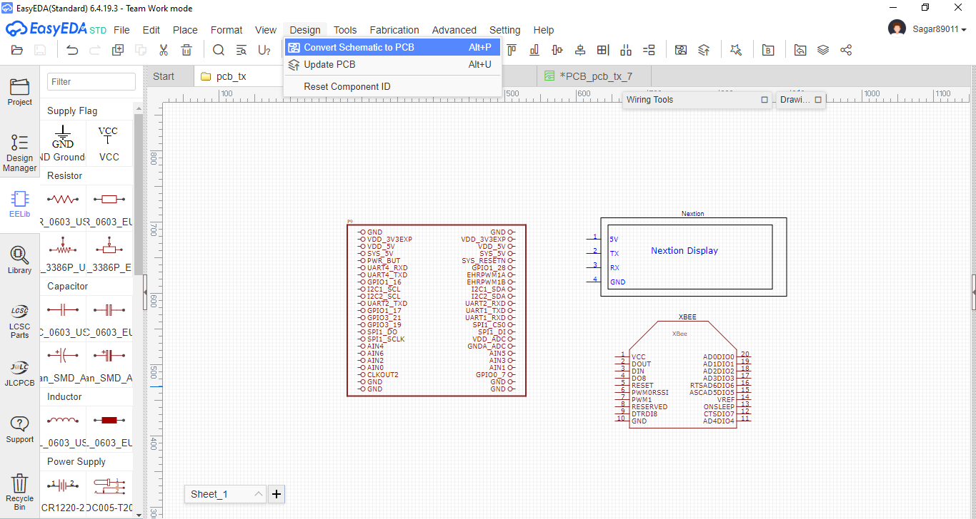
second method for pcb designing
Schematic without connections

Slide 27
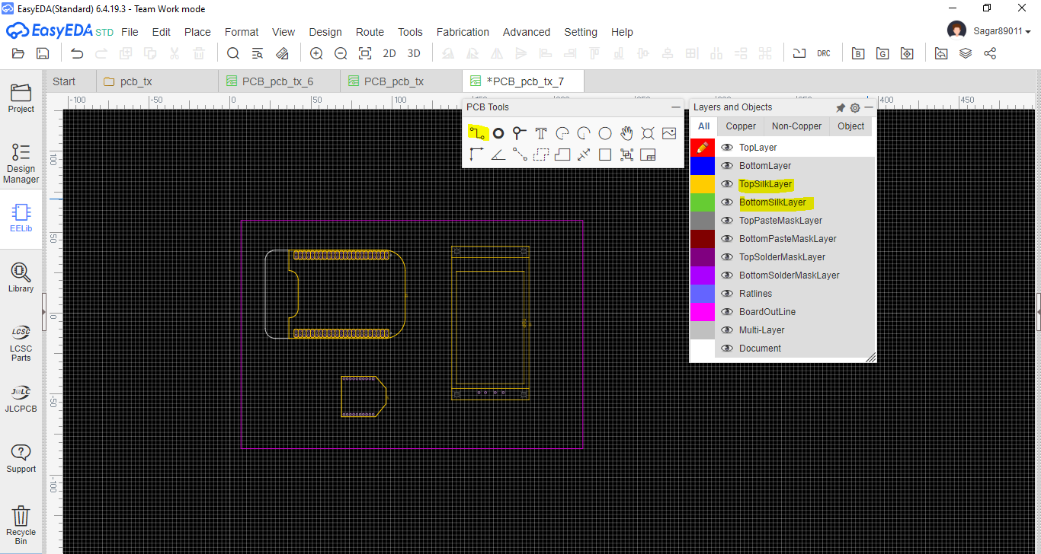
second method for pcb designing
PCB without connections

Slide 28
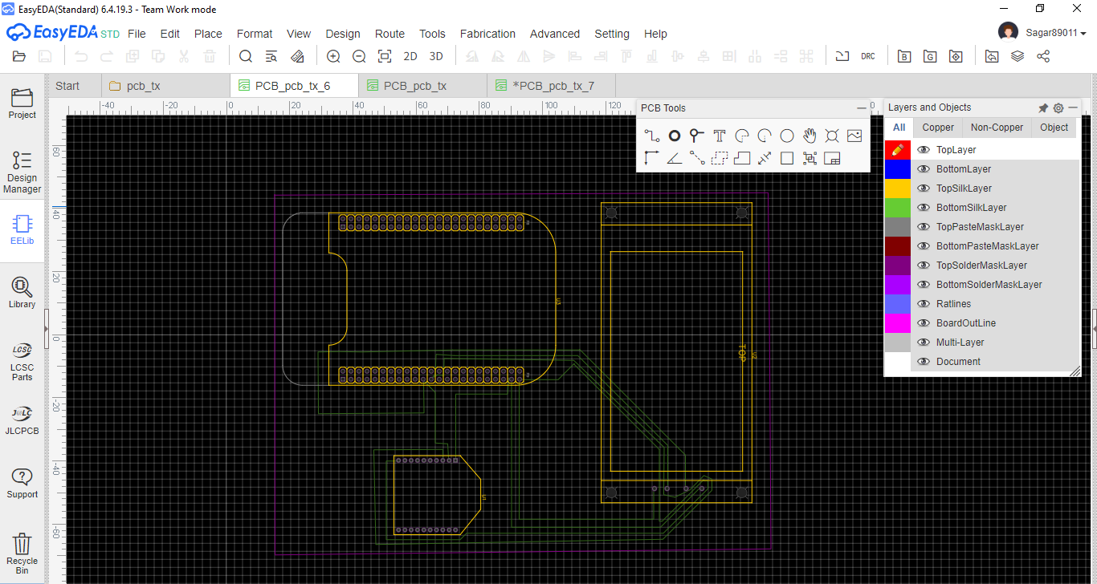
second method for pcb designing
Top Layer

Slide 29
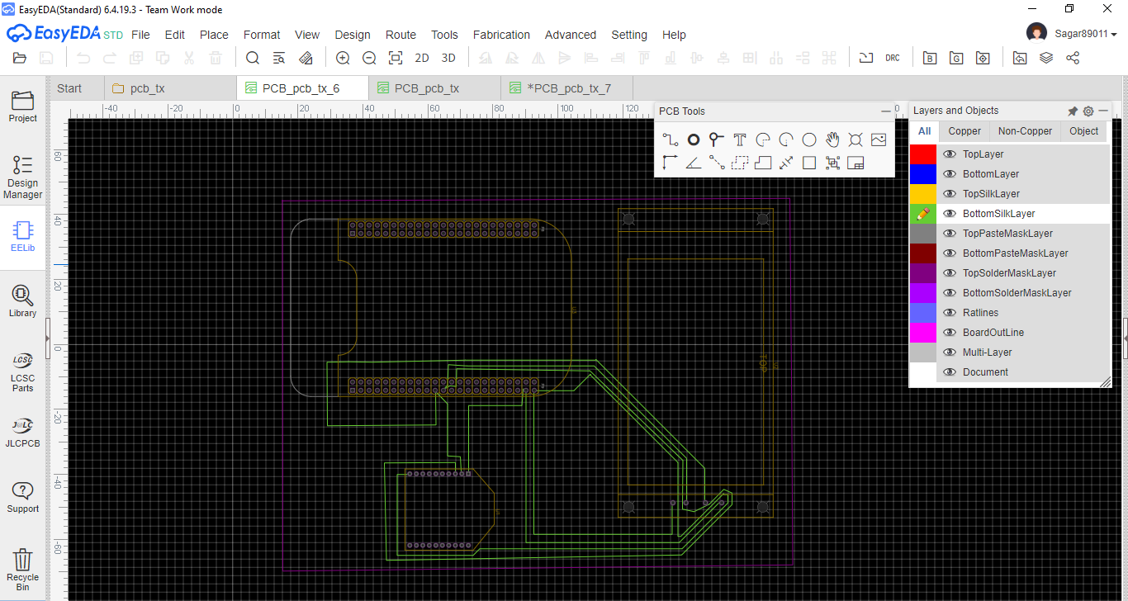
Another method for pcb designing
Bottom Layer

Slide 30
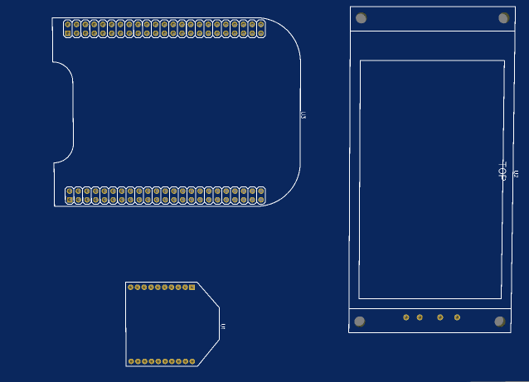
Pcb design top layer

Slide 31
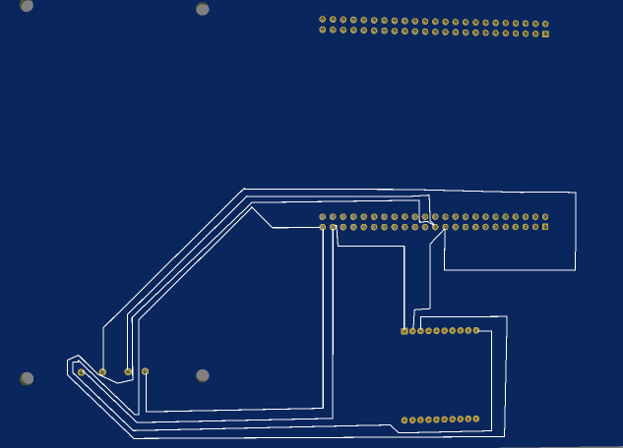
Pcb design bottom layer

Slide 32
references
EasyEDA tutorial. Retrieved from easyeda.com:
https://docs.easyeda.com/en/FAQ/Editor/index.html
XBee S2C ZigBee (Wire Antenna). Retrieved from elediy.com:
https://elediy.com/products/xbee-s2c-zigbee-wire-antenna
Zigbee Wireless Mesh Networking. Retrieved from www.digi.com
https://www.digi.com/solutions/by-technology/zigbee-wireless-standard
XBee pin-out description. Retrieved from components101.com
https://components101.com/wireless/xbee-s2c-module-pinout-datasheet#:~:text=XBee%20S2C%20is%20a%20RF,including%20devices%20from%20other%20vendors

Slide 33
references
What is PCB. Retrieved from wikipedia.org
https://en.wikipedia.org/wiki/Printed_circuit_board
List of PCB design Software. Retrieved from seeedstudio.com
https://www.seeedstudio.com/blog/2017/03/13/pcb-design-software/
Specifications of touch screen display. Retrieved from aliexpress.com
https://pl.aliexpress.com/item/32874330873.html
Interfacing of BB-WI with touch screen display. Retrieved from 14core.com
https://www.14core.com/working-with-nextion-hmi-gui-tft-touch-display/

Slide 34
Any questions?

Slide 35
Thank you

