Slide 1
Developing database for
LCD screen
Sagar Pasricha (C0765531)
Notes:
1

Slide 2
What is database?
A database is an organized collection of data, generally stored and accessed electronically from a computer system. Where databases are more complex they are often developed using formal design and modeling techniques.
The database management system (DBMS) is the software that interacts with end users, applications, and the database itself to capture and analyze the data. The DBMS software additionally encompasses the core facilities provided to administer the database. The sum total of the database, the DBMS and the associated applications can be referred to as a "database system".
Computer scientists may classify database-management systems according to the database models that they support. These models data as rows and columns in a series of tables, and the vast majority use SQL for writing and querying data.

Slide 3
Mysql
MySQL is an open-source relational database management system(RDBMS) based on Structured Query Language (SQL).
It is developed and managed by oracle corporation and initially released on 23 may, 1995.
It is widely being used in many small and large scale industrial applications and capable of handling a large volume of data.
After the acquisition of MySQL by Oracle, some issues happened with the usage of the database and hence MariaDB was developed.

Slide 4
Mariadb
MariaDB Server is one of the most popular open source relational databases. It’s made by the original developers of MySQL and guaranteed to stay open source.
It is an open source relational database management system (RDBMS) that is a compatible drop-in replacement for the widely used MySQL database technology.
It is developed by MariaDB Foundation and initially released on 29 October 2009.
It has a significantly high number of new features, which makes it better in terms of performance and user-orientation than MySQL.

Slide 5
Difference between MariaDB and MySQL
MariaDB
MySQL
MariaDB is written in C, C++, Perl and Bash languages.
It was initially released on 2009.
The performance of MariaDB is far better than MySQL.
It provides a drop-in replacement for MySQL
There is no data masking.
Proprietary code is not accessible in MariaDB.
MySQL is written in C and C++ languages.
It was initially released on 1995.
The performance of MySQL is not that great when compared to MariaDB.
It does not provide a replacement for MariaDB.
Data masking is done in MySQL.
Proprietary code is accessible in MySQL enterprise edition.

Slide 6
Difference between MariaDB and MySQL
MariaDB
MySQL
It supports temporary table Space and binary encryption.
It can handle large-sized data easily.
Privilege checks are done faster in MariaDB.
It does not support binary logs or temporary table Space.
It can not handle large-sized data easily.
Privilege checks are not that fast in MySQL.

Slide 7
Install mariadb on beaglebone
First update the apt packages index by using following command:
sudo apt update
Once the packages list is updated, install MariaDB by running the following command:
sudo apt install mariadb-server
The MariaDB service will start automatically. You can verify it by using folllowing command:
sudo systemctl status mariadb

Slide 8
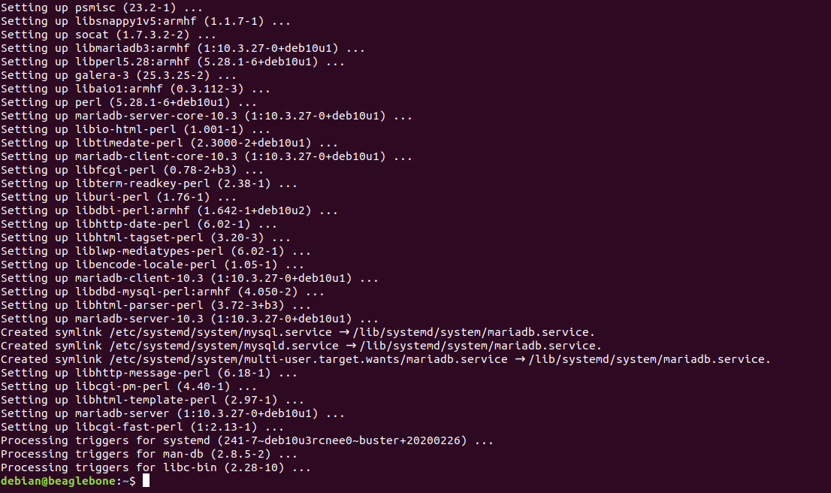
Install mariadb on beaglebone

Slide 9
Verification of mariadb status
In this step we can check MariaDB is properly installed on beaglebone and to check the status oh MariaDB whether it is active or not.
For this, we use following command:
sudo systemctl status mariadb

Slide 10
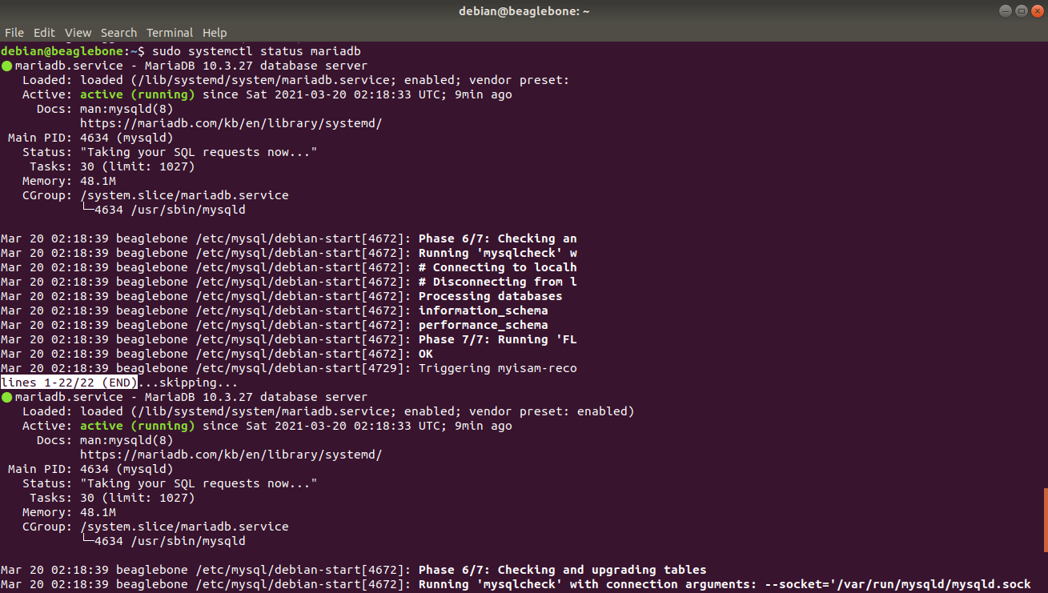
Verification of mariadb status

Slide 11
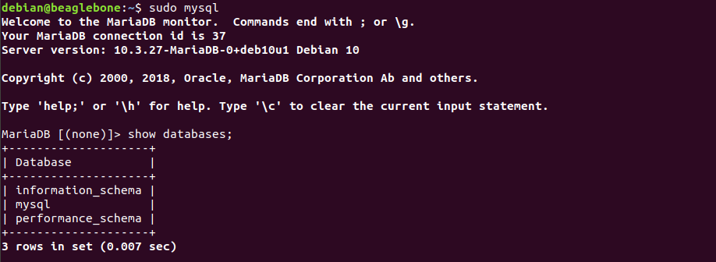
Show databases
You can check the available databases as shown below −
mySQL> SHOW DATABASES;

Slide 12
Create new database
The mySQL CREATE DATABASE statement is used to create a new mySQL database.
The basic syntax of this CREATE DATABASE statement is as follows −
CREATE DATABASE DatabaseName;
Example:
If you want to create a new database <restaurant_menu>, then the CREATE DATABASE statement would be as shown below −
mySQL> CREATE DATABASE restaurant_menu;

Slide 13
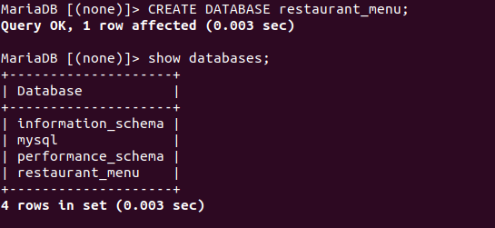
Create new database

Slide 14
Use database for further process
The basic syntax of the USE statement is as shown below −
USE DatabaseName;
Example:
> mySQL> use restaurant_menu;

Slide 15
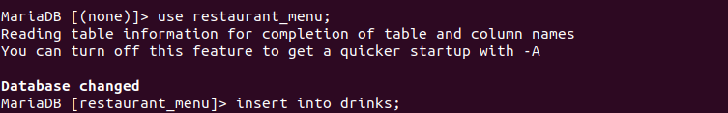
To get into a database for further process

Slide 16
Create table in database
The mySQL CREATE TABLE statement is used to create a new table.
The basic syntax of the CREATE TABLE statement is as follows −
CREATE TABLE drinks(
-> item varchar(20) not null,
-> price_small varchar(20) not null,
-> price_medium varchar(20) not null,
-> price_large varchar(20) not null,
-> type varchar(20) not null,
-> availability varchar(20) not null);

Slide 17
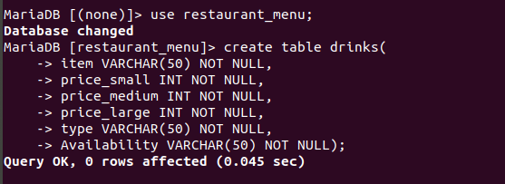
Create table in database

Slide 18
Insert values in table
The basic syntax of the INSERT INTO statement which are shown below.
INSERT INTO TABLE_NAME value (column1, column2, column3,...columnN);
Here, column1, column2, column3,...columnN are the names of the columns in the table into which you want to insert the data.
Example:
INSERT INTO drinks value("mango shake","$2.50", "$3.79", "$4.99", "cold", "no");

Slide 19
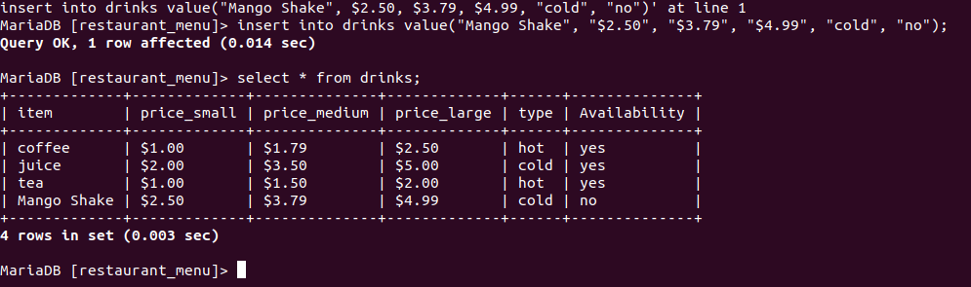
Insert values in table

Slide 20
Select query to view values inserted in table
The basic syntax of the SELECT statement is as follows −
To fetch all the fields available, then you can use the following syntax.
SELECT * FROM table_name;
Example:
SELECT * FROM drinks;

Slide 21
Select query to view values inserted in table

Slide 22
update query in table
The mySQL UPDATE Query is used to modify the existing records in a table.
You can use the WHERE clause with the UPDATE query to update the selected rows, otherwise all the rows would be affected.
Syntax: The basic syntax of the UPDATE query with a WHERE clause is as follows −
UPDATE table_name SET column = value WHERE [condition];
Example
UPDATE drinks SET price_small="$1.99" WHERE price_small="$2.00";

Slide 23
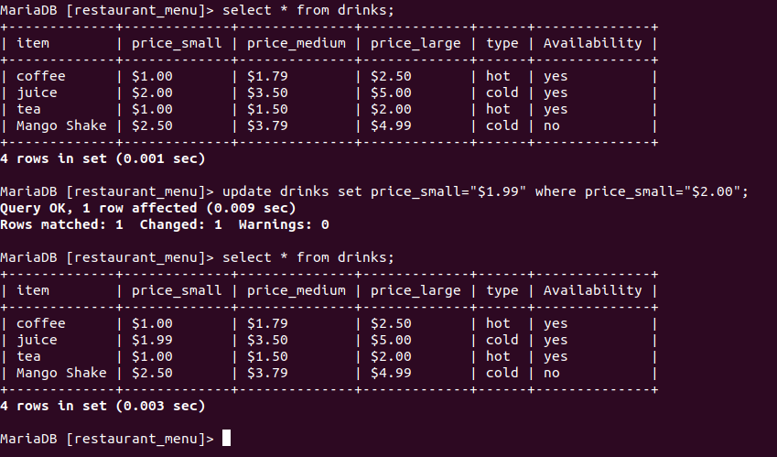
update query in table

Slide 24
Column modification in table
The mySQL ALTER TABLE command is used to add, delete or modify columns in an existing table.
You should also use the ALTER TABLE command to add and drop various constraints on an existing table.
Syntax:
The basic syntax of an ALTER TABLE command to add a New Column in an existing table is as follows –
ALTER TABLE table_name ADD column_name datatype;
The basic syntax of an ALTER TABLE command to DROP COLUMN in an existing table is as follows –
ALTER TABLE table_name DROP COLUMN column_name;

Slide 25
Column modification in table
The basic syntax of an ALTER TABLE command to change the DATA TYPE of a column in a table is as follows –
ALTER TABLE table_name MODIFY COLUMN column_name datatype;
The basic syntax of an ALTER TABLE command to add a NOT NULL constraint to a column in a table is as follows -
ALTER TABLE table_name MODIFY column_name datatype NOT NULL;
Example:
ALTER TABLE drinks MODIFY column price_medium varchar(12) not null;

Slide 26
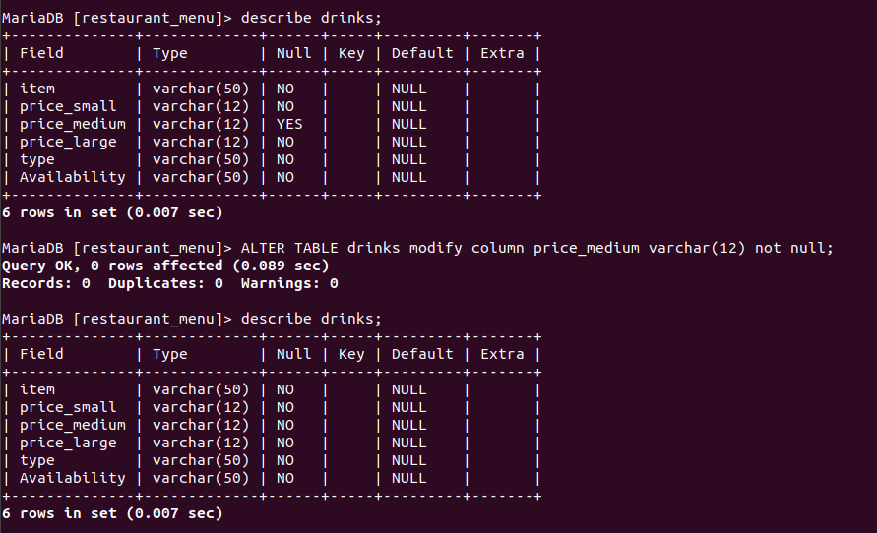
update query in table

Slide 27
references
What is Database?. Retrieved from en.wikipedia.org
https://en.wikipedia.org/wiki/Database
Difference between MariaDB and MySQL. Retrieved from geeksforgeeks.org
https://www.geeksforgeeks.org/difference-between-mysql-and-mariadb/
MariaDB Installation tutorial. Retrieved from linuxize.com
https://linuxize.com/post/how-to-install-mariadb-on-debian-9/
Database development tutorial. Retrieved from tutorialspoint.com
https://www.tutorialspoint.com/sql/sql-alter-command.htm

Slide 28
Any questions?

Slide 29
Thank you

