Slide 1
KMPG Project- Data Analytics & Visualizations
1

Slide 2
Overview
KPMG , a worldwide network of independent professional firms, offers diverse services to organizations in different sectors. Within KPMG Digital Solutions, our Data, Analytics & Modeling team will analyze data sets to support Sprocket Central Pty Ltd, a company specializing in bicycles and bike accessories, in the development and enhancement of their marketing strategies, leveraging our expertise and insights.
The client provided KPMG with 3 datasets:
Customer demographics
Customer addresses
Transactions this slide when you’re done editing the presentation
2

Slide 3
Table of contents
Task1
Task2
Task3
Data Quality Assesment-
Review and evaluate the data based on Standard Data Quality Dimensions.
Data Insights-
Analyzing customer trends, behaviour, and demographic.
Data Insights and Presentation -
Using visualizations to present insights.
3

Slide 4
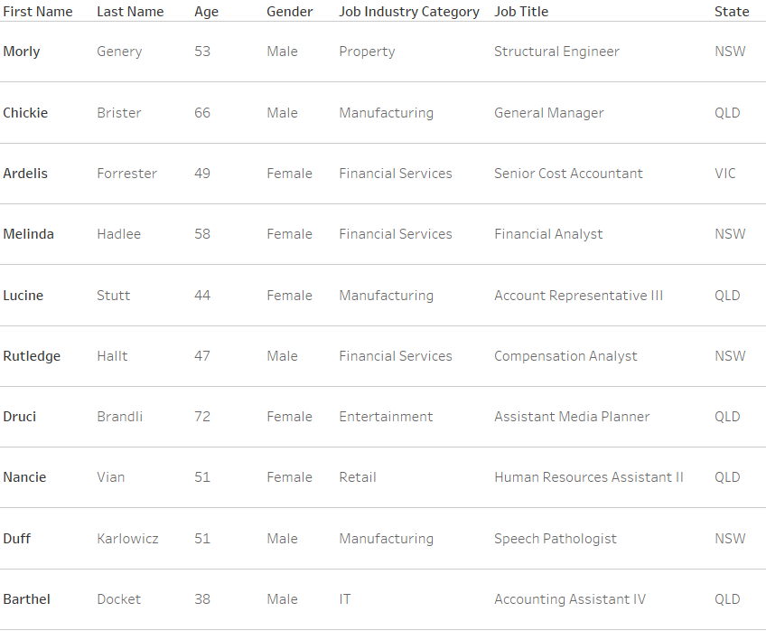
Task1 -
To inspect the quality of the given data with respect to all qualities mentioned in the Data Quality Framework Table which includes various dimensions of data, such as :
Accuracy
Completeness
Currency
Uniqueness
Validity
Consistency
Relevancy
4

Slide 5
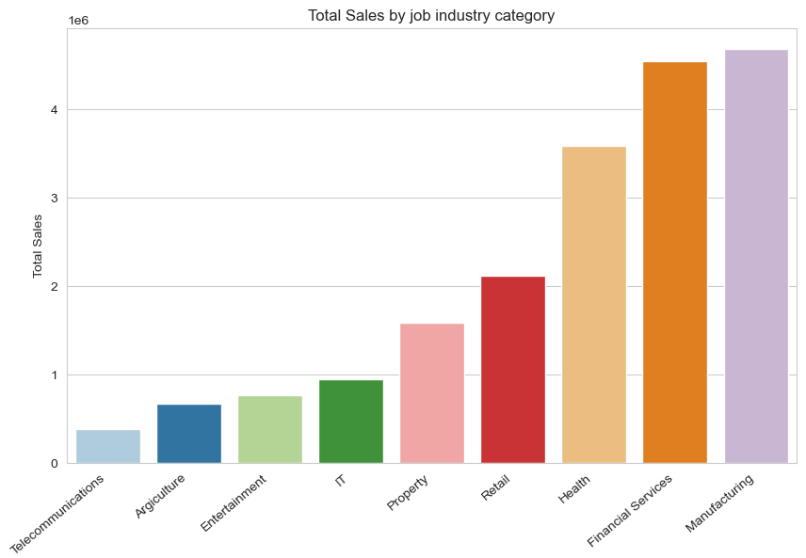
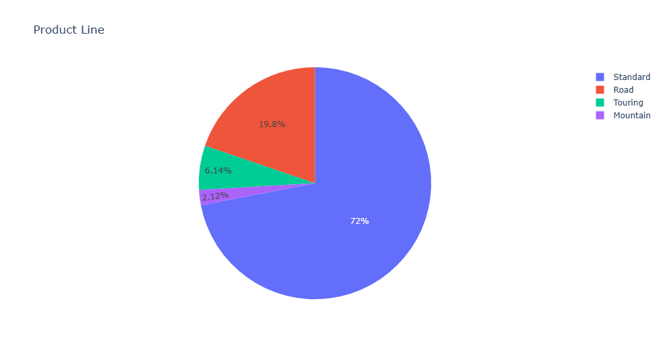
Task2 -
Targeting high value customers based on customer demographics and attributes or qualities.
This task is divided into 3 phases as follows:
Data Exploration
Model Development
Interpretation.
5

Slide 6
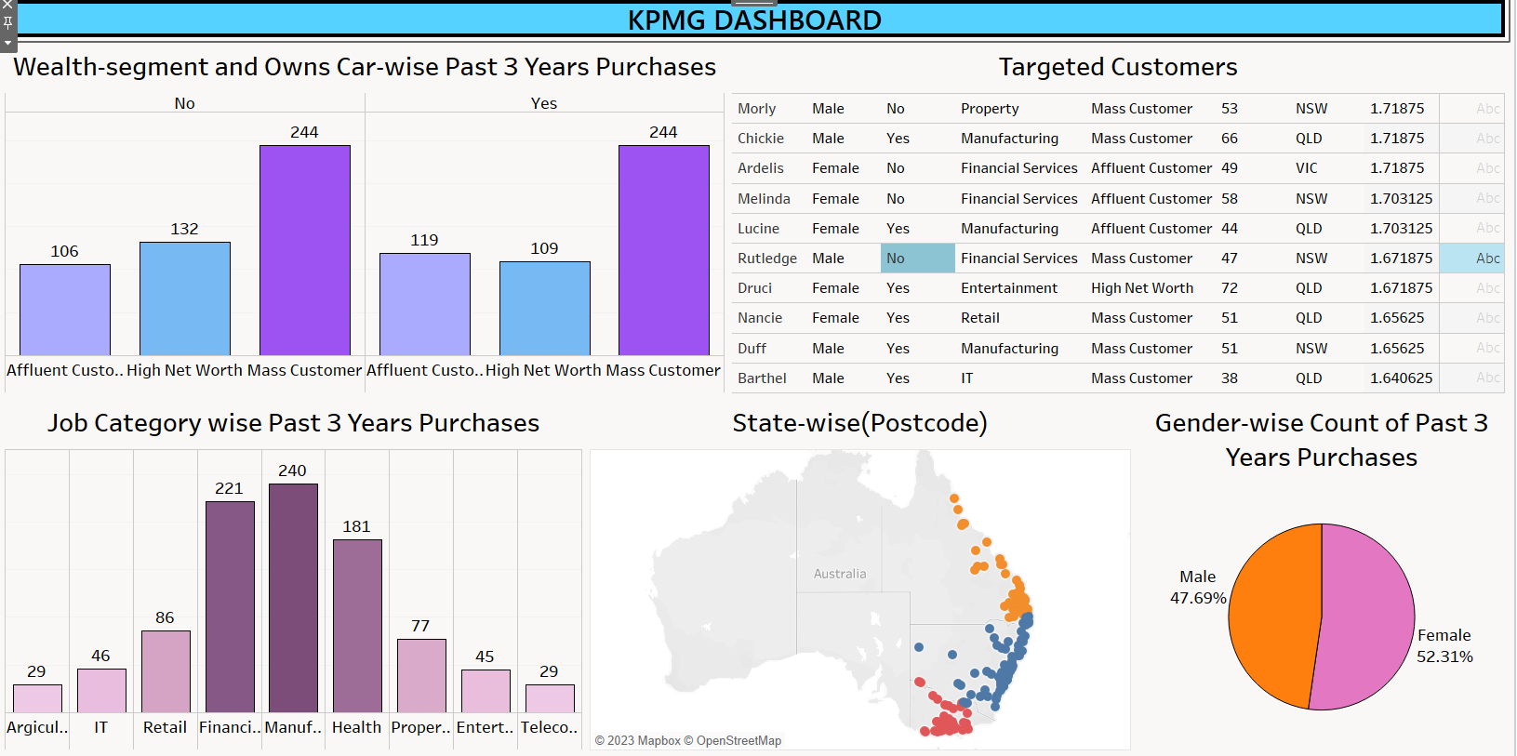
Task3- Data Insights and Presentation
6

Slide 7
Thankyou!
For joining us , by:
Agniva Das
Komal Khanna
7

