Slide 1
Chat Scholar
AI-Powered PDF Chatbot and Essay Grading Assistant
Python
Flask
LangChain
FAISS
LLMs
A Flask web app where students chat with their own PDFs and get rubric-based essay feedback.
1

Slide 2
Project Overview
What is Chat Scholar?
Why was it developed?
A Flask web app that lets students chat with their own PDF documents and get essay feedback, powered by LangChain, FAISS and an LLM.
Reading long papers and textbooks is slow. Chat Scholar helps students find answers and understand the material faster.
PDF question answering
Rubric-based essay grading
Upload a PDF, ask a question in plain English, and get an answer based on the content of that document.
Provide an essay and a rubric. The AI returns feedback for each rubric criterion.
2

Slide 3
Problem Statement
Long documents
Slow searching
Vague essay feedback
Research papers and textbooks run to dozens of pages, so students spend hours just reading.
Finding one fact by hand means scrolling and skimming. Plain keyword search misses meaning.
Essays often get unclear comments. A rubric gives structured, criterion-by-criterion feedback.
Our answer: Chat Scholar retrieves the right passages from a PDF and lets an LLM answer from them. It also grades essays against a rubric.
3

Slide 4
Project Objectives
1. Upload PDFs
2. Extract text
3. Search
Accept academic PDF documents through the web page.
Read the text from every page of the PDF.
Find the passages most relevant to the question.
4. Generate answers
5. Grade essays
6. Help learning
Use an LLM to write a clear answer from those passages.
Evaluate essays with a rubric and give feedback.
Make academic material easier for students to understand.
4

Slide 5
Theory: Important Technologies
AI
Generative AI
LLM
Machines doing tasks that need human-like thinking. Example: a spam filter.
AI that creates new text, images or code. Example: ChatGPT writing an email.
A huge model trained on text to predict words. Example: GPT answering questions.
NLP
Embeddings
Vector DB + semantic search
Helping computers understand human language. Example: translating English to Hindi.
Text turned into numbers that capture meaning. Example: "car" and "automobile" get similar numbers.
Stores embeddings and finds similar meaning. Example: "cheap phone" finds "budget mobile".
5

Slide 6
What Is RAG?
R Retrieval
A Augmentation
G Generation
Find the parts of the document that are relevant to the question.
Add those parts to the prompt as context for the model.
The LLM writes the answer using that context.
Example: a student uploads a research paper and asks, "What is the main objective of this paper?" Chat Scholar finds the abstract and introduction chunks, adds them to the prompt, and the LLM states the objective in simple words.
6

Slide 7
Complete Project Workflow
User
Upload PDF
Extract Text
Split into Chunks
Generate Embeddings
Opens the web app in a browser.
Selects a PDF study file.
PyPDF2 reads text from every page.
Text is cut into small overlapping parts.
Each chunk becomes a list of numbers.
Store in FAISS
Retrieve Chunks
Send to LLM
Display Answer
Vectors are saved for fast similarity search.
Finds chunks closest to the question.
Question and context go to the model.
The answer appears on the chat page.
7

Slide 8
Software and Prerequisites
You will need
Check your Python installation
Python 3.12
Visual Studio Code
Python extension for VS Code
PowerShell terminal
Internet connection
Valid API key for your LLM provider
py --version
Shows the default Python version.
py -0p
Lists every installed Python and its path.
Both should show Python 3.12. If not, install it from python.org and tick "Add python.exe to PATH".
8

Slide 9
Create the Project Folder
mkdir C:\ChatScholar
mkdir creates a new folder called ChatScholar on the C: drive.
cd C:\ChatScholar
cd moves the terminal into that folder. The project lives inside C:\ChatScholar.
code .
Opens the current folder in VS Code (the dot means "here").
Create folder
Move inside
Open in VS Code
Tip: the PowerShell prompt shows your current path, for example PS C:\ChatScholar>.
9

Slide 10
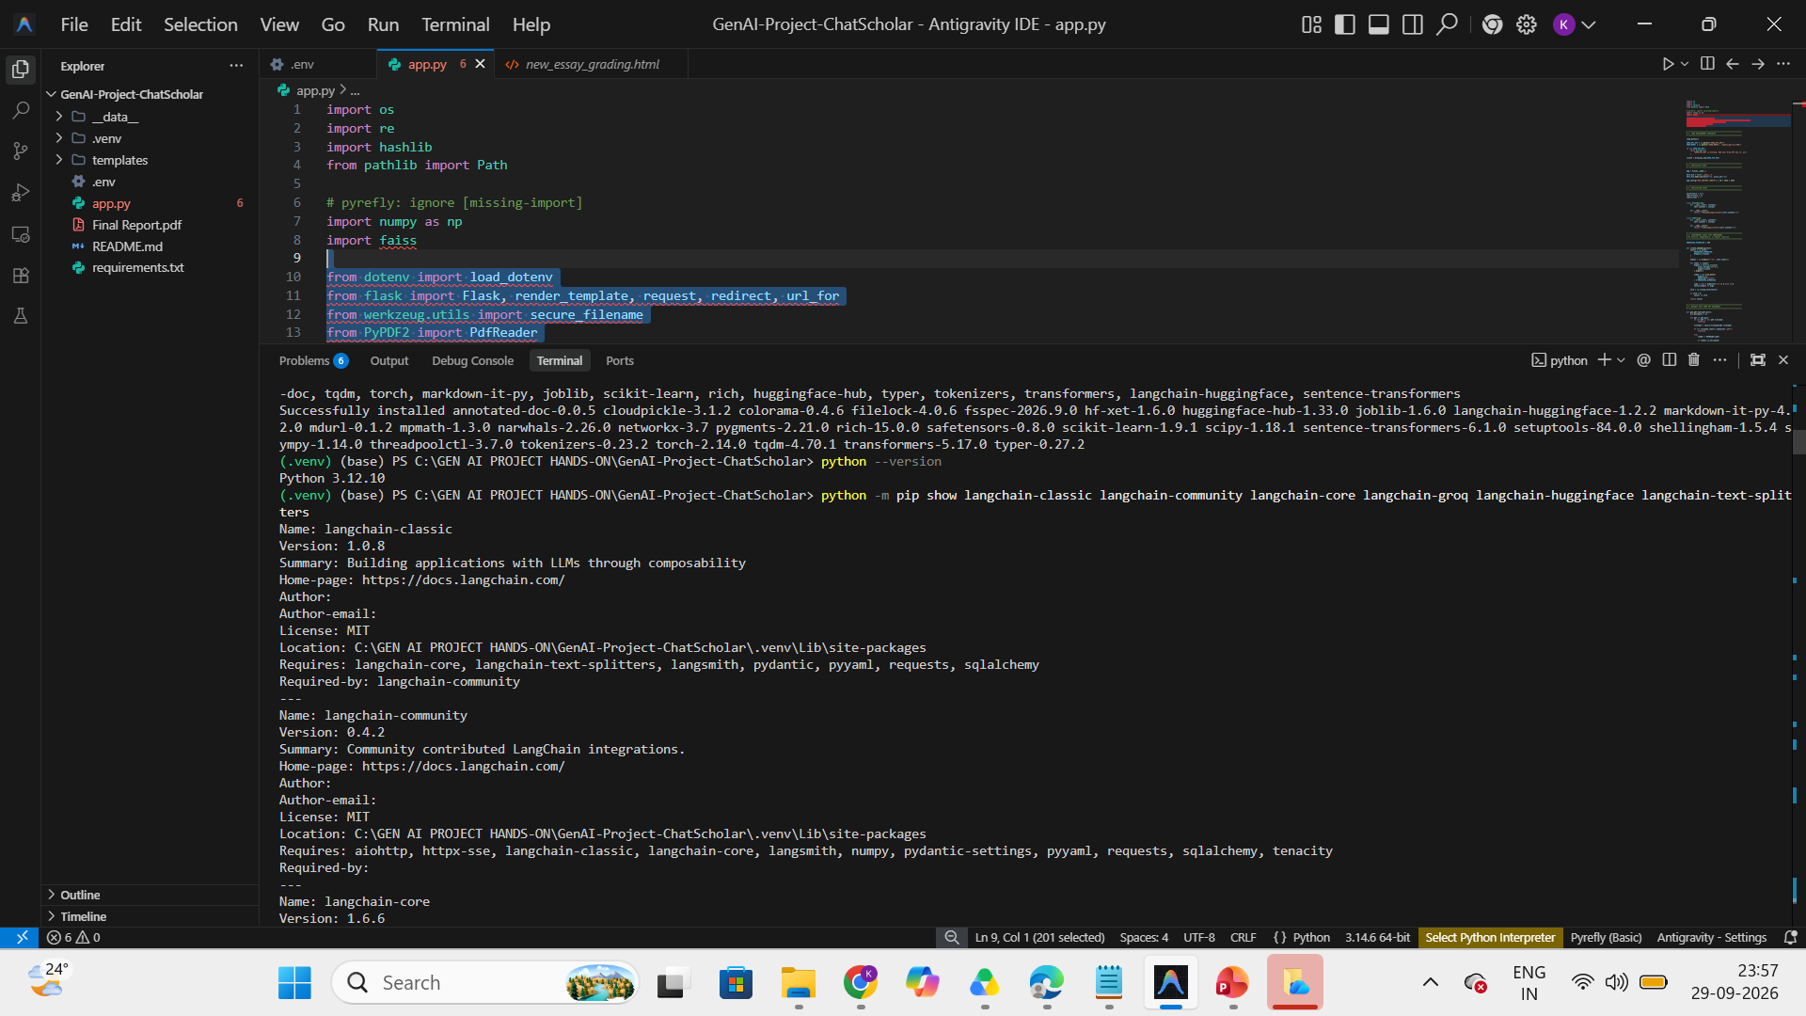

Slide 11
Create a Virtual Environment
A virtual environment is a private Python workspace for one project
It stops package versions from clashing between projects
.venv is simply the folder name where it lives
Activated means (.venv) appears at the start of the prompt
py -3.12 -m venv .venv
Creates the environment in the .venv folder using Python 3.12.
.\.venv\Scripts\Activate.ps1
Turns the environment on.
python --version
Confirms Python 3.12 is active.
Set-ExecutionPolicy -Scope Process -ExecutionPolicy Bypass
Only if activation is blocked. Applies to this PowerShell window only.
.\.venv\Scripts\Activate.ps1
Run activation again after the change.
10

Slide 12
Create the Project Files and Folders
C:\ChatScholar
├── .venv/ virtual environment
├── templates/ HTML pages
│ ├── new_home.html
│ ├── new_chat.html
│ ├── new_pdf_chat.html
│ ├── new_essay_grading.html
│ └── new_essay_rubric.html
├── __data__/ temporary uploads
├── app.py Flask application
├── requirements.txt package list
├── .env API key
├── .gitignore files Git ignores
└── README.md project notes
mkdir templates, __data__
New-Item app.py, requirements.txt, .env, .gitignore, README.md
"new_home","new_chat","new_pdf_chat","new_essay_grading","new_essay_rubric" | % { New-Item "templates\$_.html" }
mkdir makes folders. New-Item creates empty files. The % { } loop creates the five HTML files. Empty files are not enough: every template must contain real HTML with the forms the routes expect.
11

Slide 13
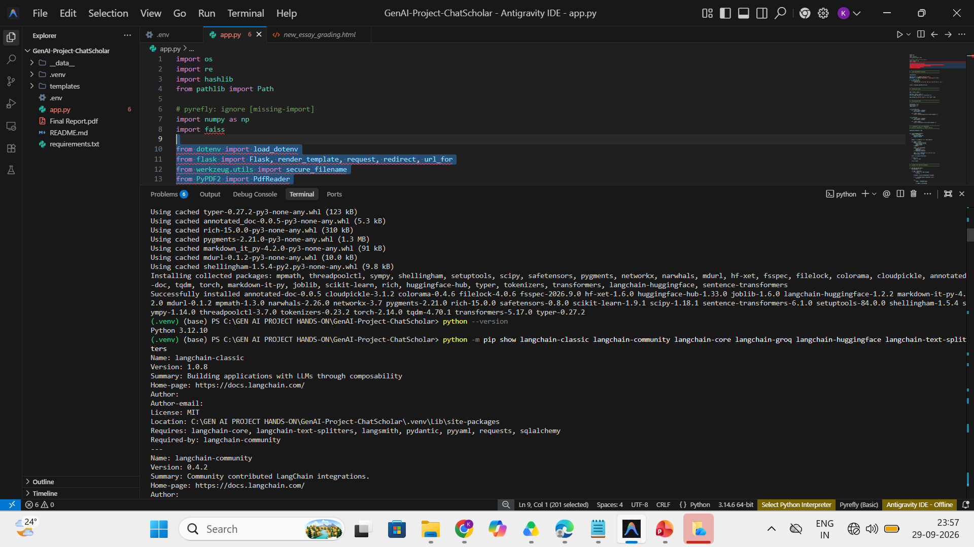

Slide 14
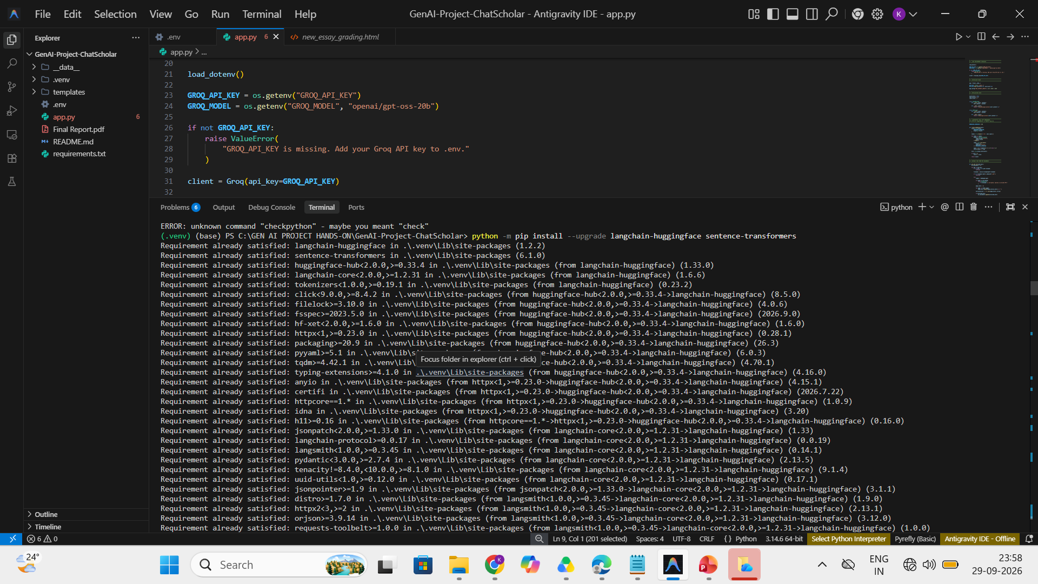

Slide 15
Install Required Python Packages
python -m pip install --upgrade pip
Updates pip, the Python package installer.
python -m pip install flask python-dotenv PyPDF2 faiss-cpu tiktoken
Installs the web, .env, PDF, vector-search and token packages.
python -m pip install langchain langchain-community langchain-openai openai
Installs LangChain and the OpenAI connection.
Flask: builds the web app
python-dotenv: reads .env
PyPDF2: extracts PDF text
FAISS: vector similarity search
LangChain: connects LLM and retrieval
langchain-openai: OpenAI integration
OpenAI: API client
tiktoken: token counting
Done when pip prints "Successfully installed ...". Verify with: python -m pip list
12

Slide 16
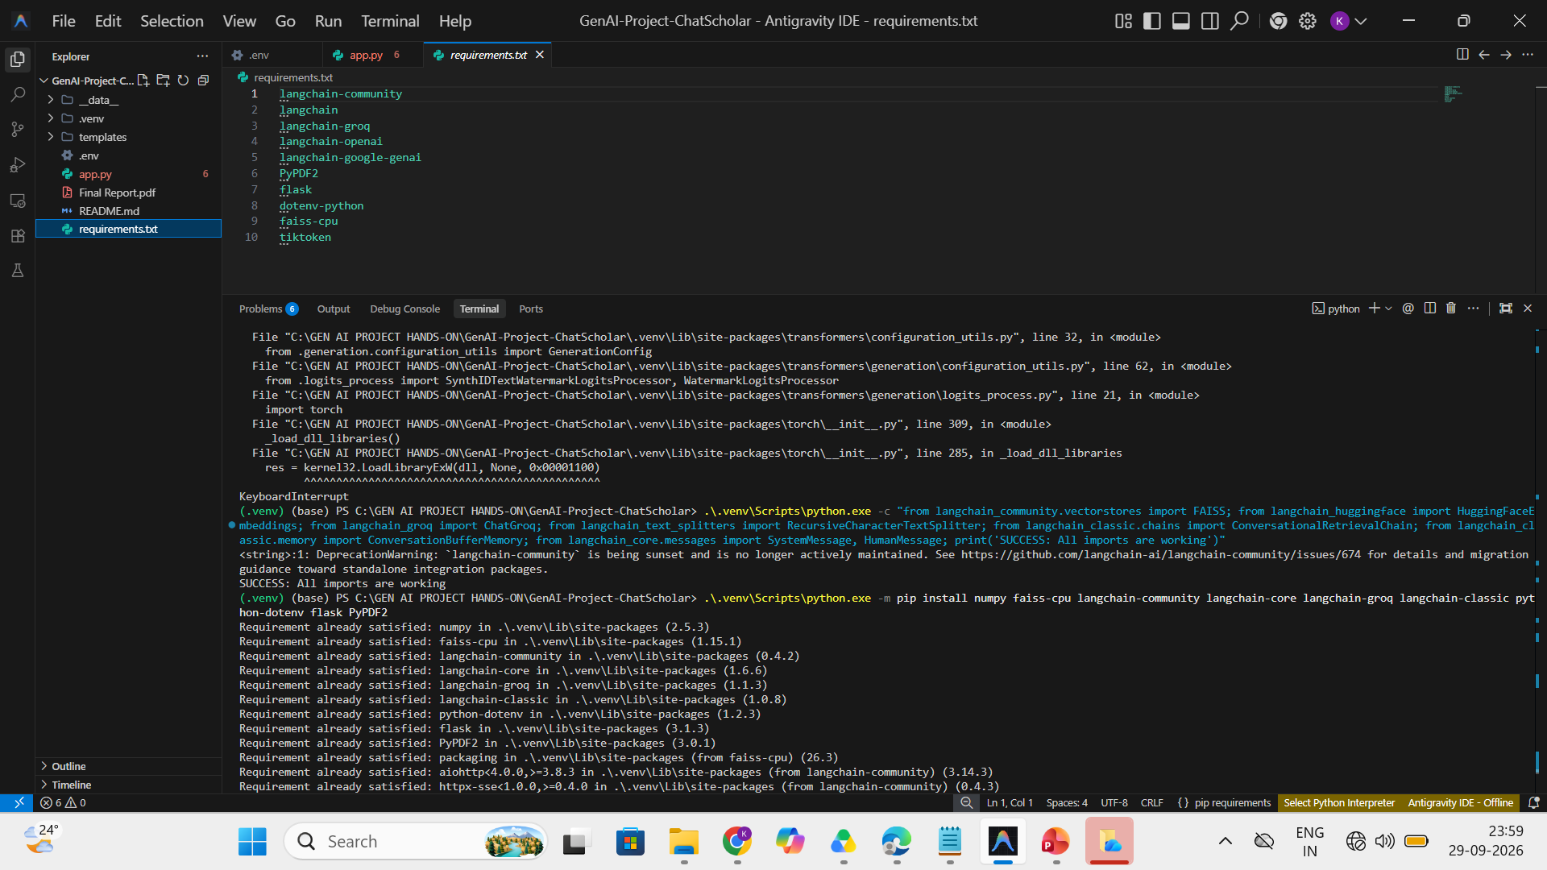

Slide 17
Configure requirements.txt
flask
python-dotenv
PyPDF2
faiss-cpu
tiktoken
langchain
langchain-community
langchain-openai
openai
python -m pip install -r requirements.txt
Installs every package listed in the file.
requirements.txt lists every Python package the project needs, so anyone can rebuild the same setup with one command.
Dependency errors? Package versions may not match. Install compatible versions (for example pin them as flask==3.0.0) and run the command again.
13

Slide 18
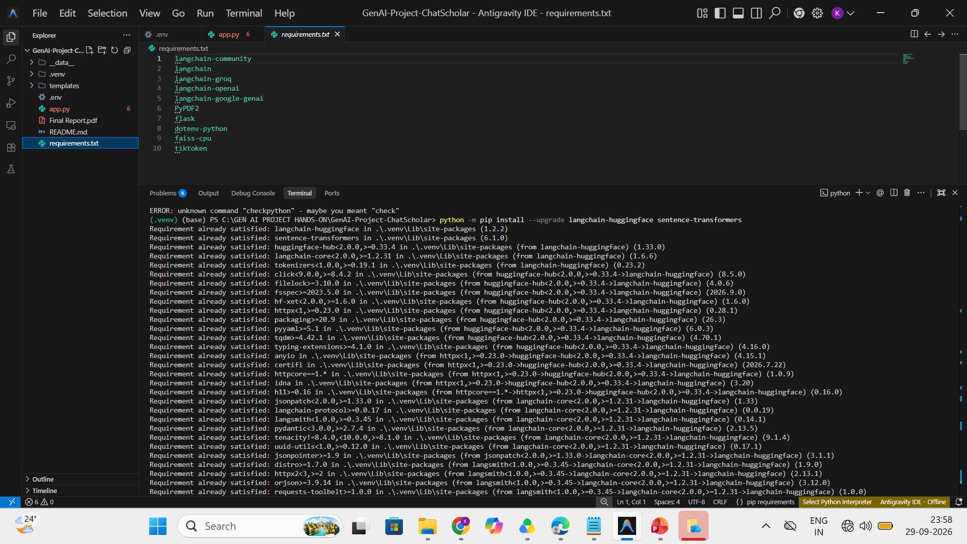

Slide 19
Configure the API Key Using .env
An API key is a secret password that lets your app use an LLM provider. The provider uses it to identify and bill you.
GROQ_API_KEY=your_openai_api_key_here
Replace the placeholder with a valid key
Never show it on slides or GitHub
Never hard-code it in app.py
Keep .env in the project root
Add .env to .gitignore
Provider mismatch
The supplied project has a Groq key in .env, but app.py uses OpenAI. The provider and the code must match: use an OpenAI key with the OpenAI classes, or change app.py to use Groq. The real key is never shown in these slides.
14

Slide 20
Load Environment Variables in Python
import os
from dotenv import load_dotenv
load_dotenv()
api_key = os.getenv("OPENAI_API_KEY")
if not api_key:
raise ValueError("OPENAI_API_KEY is missing")
import os: lets Python read environment variables
load_dotenv(): copies values from .env
os.getenv(): fetches the key by name
if not api_key: checks whether it is missing
raise ValueError: stops with a clear message
Why: the app fails early with a clear message instead of a confusing API error later.
15

Slide 21
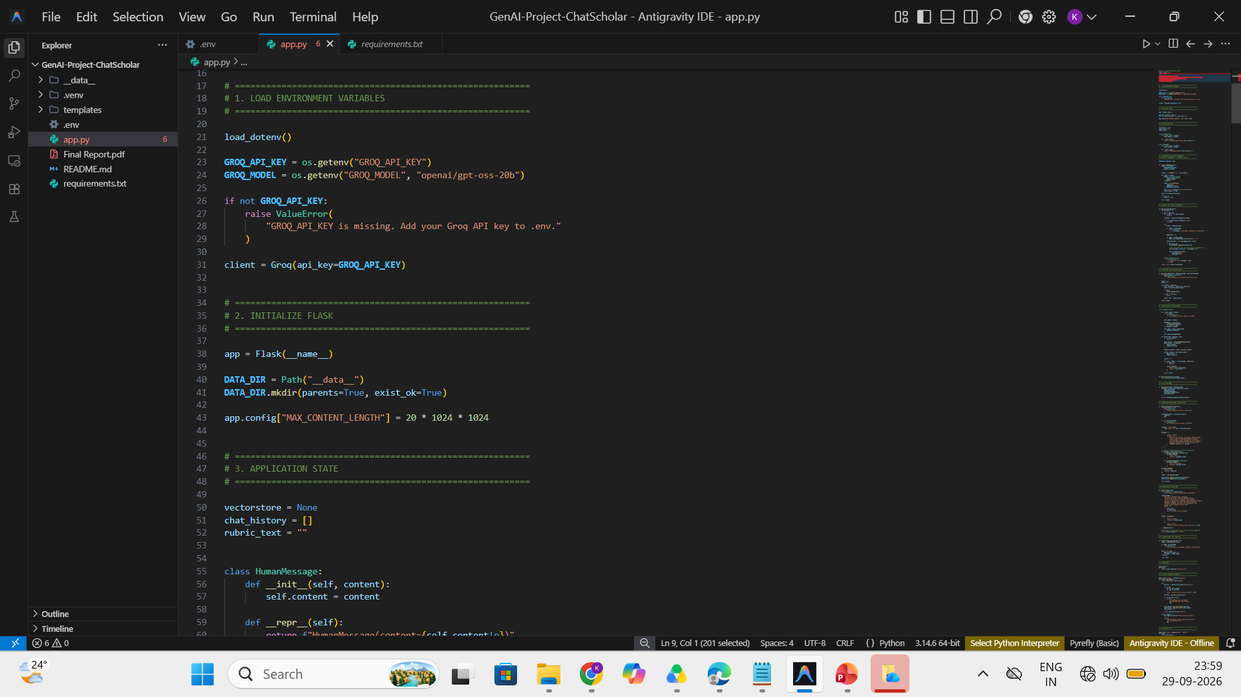

Slide 22
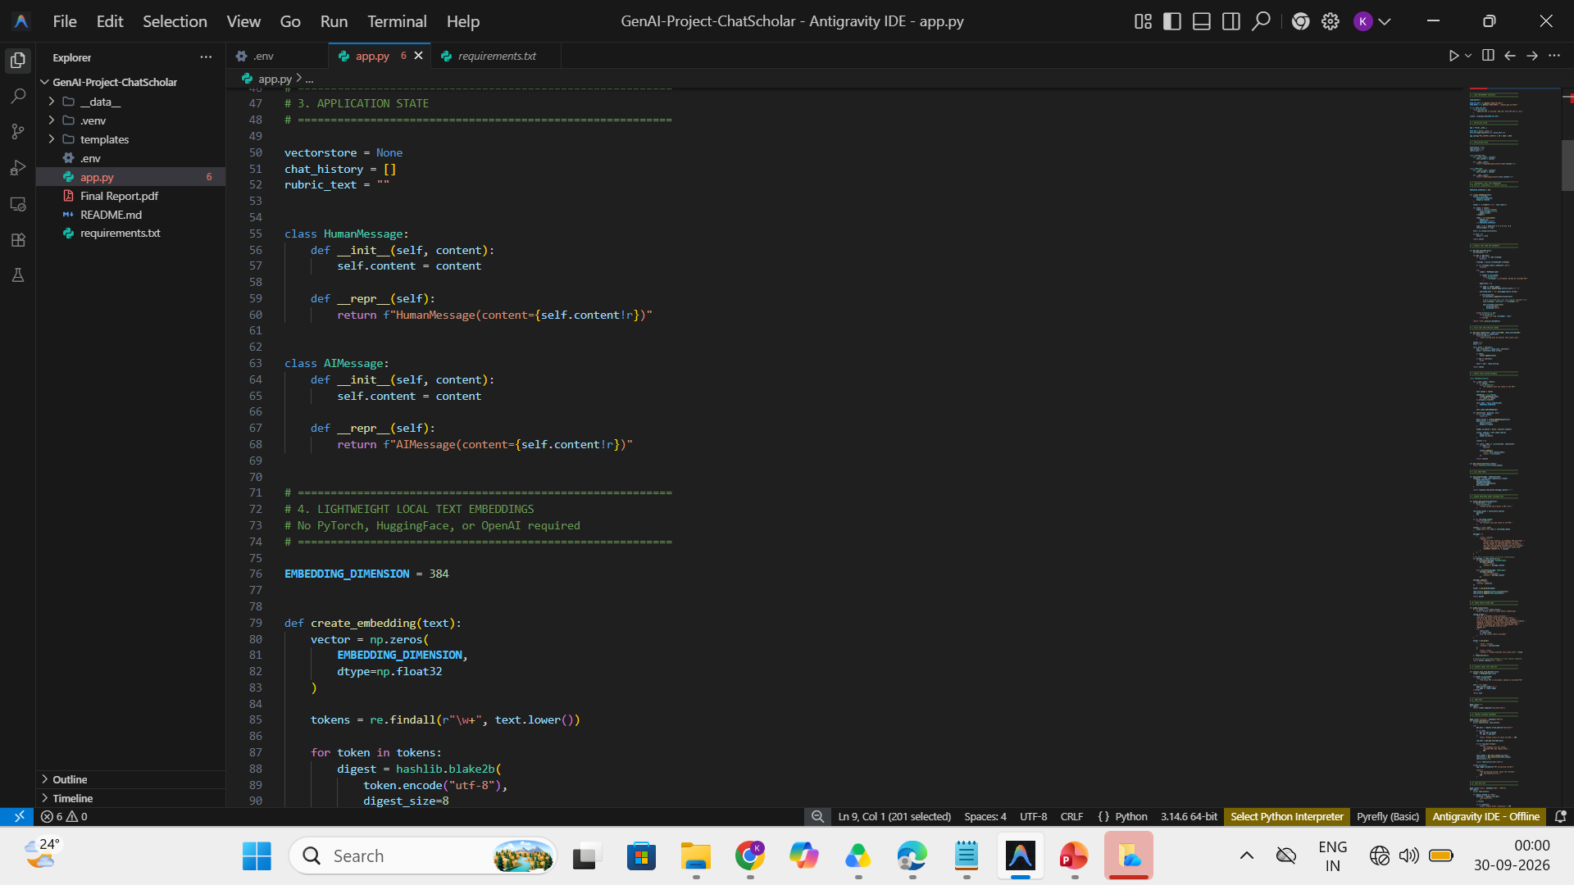

Slide 23
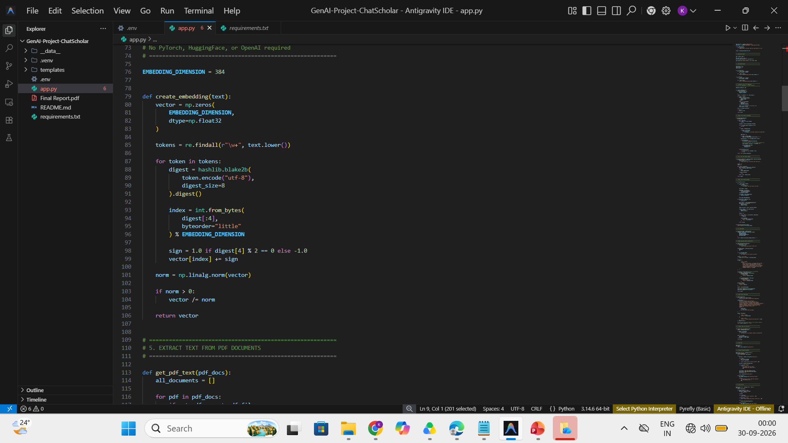

Slide 24
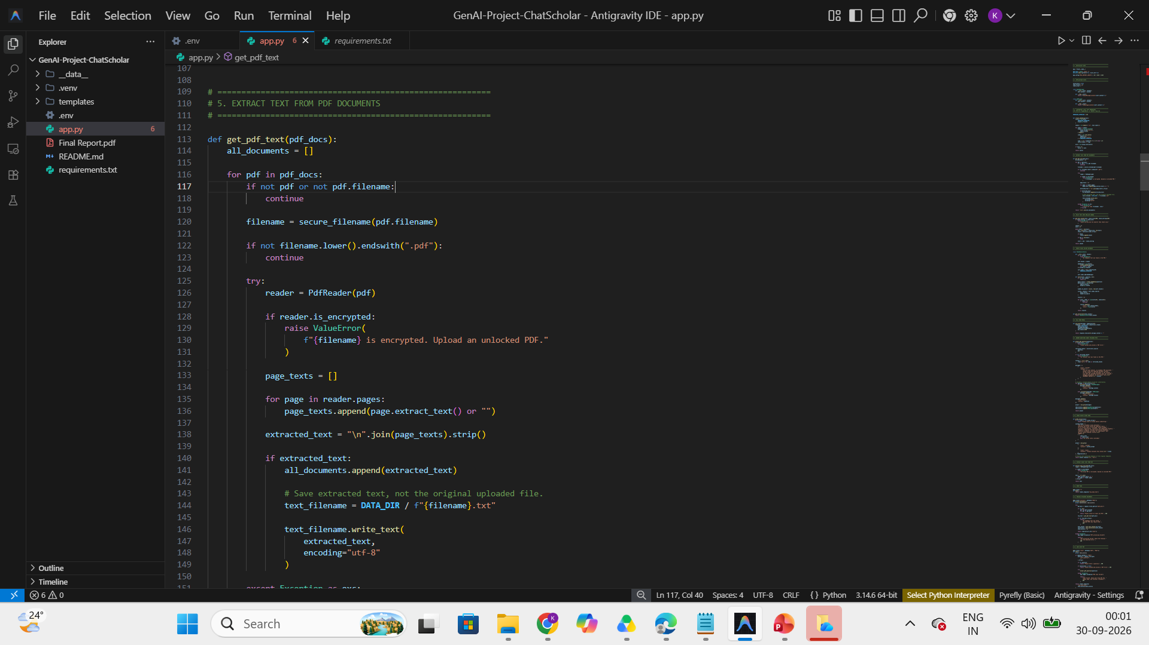

Slide 25
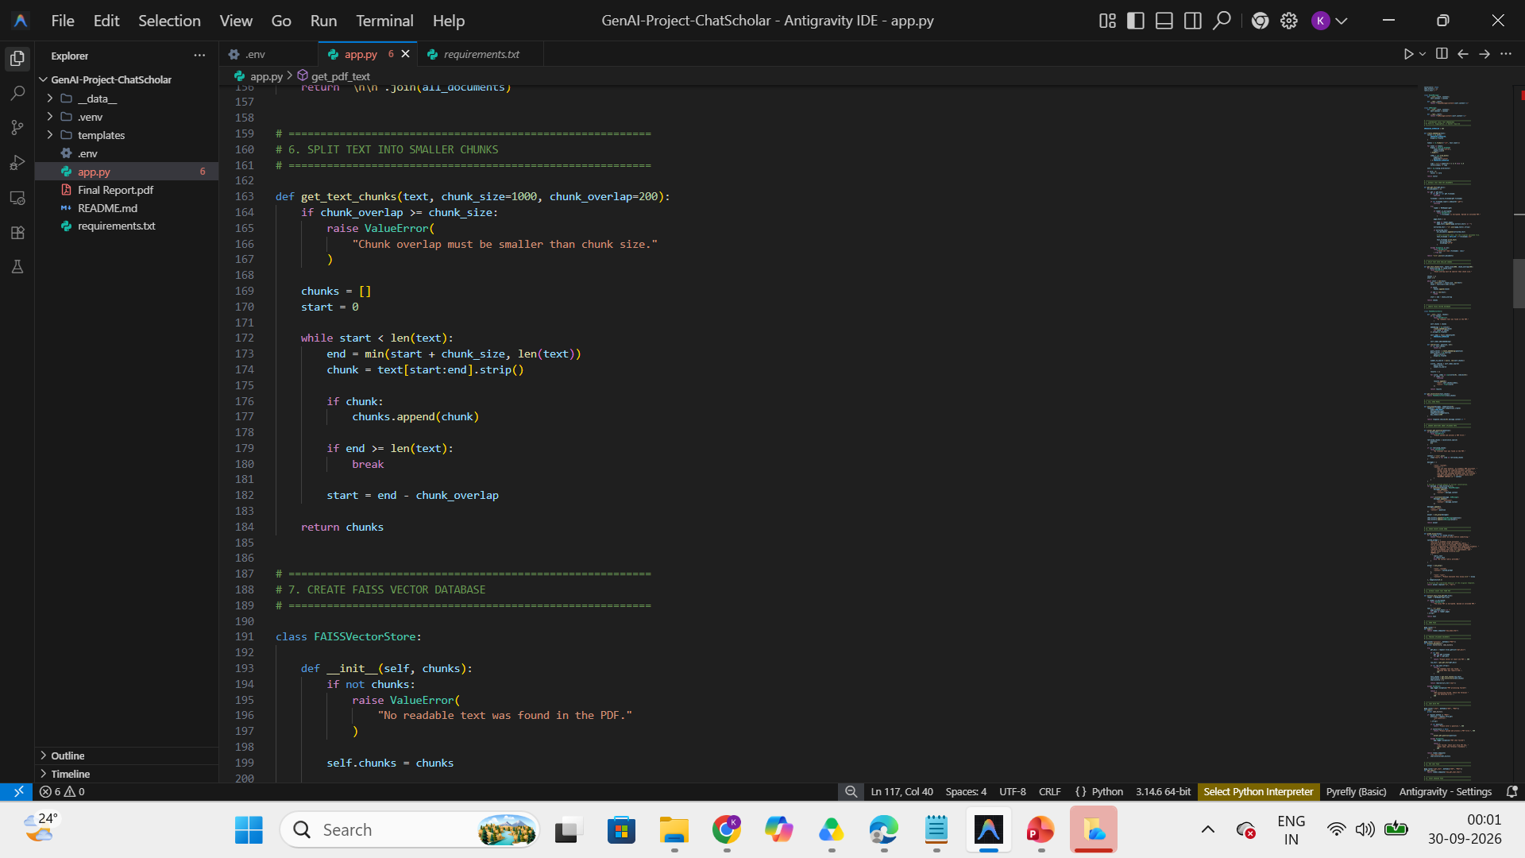

Slide 26
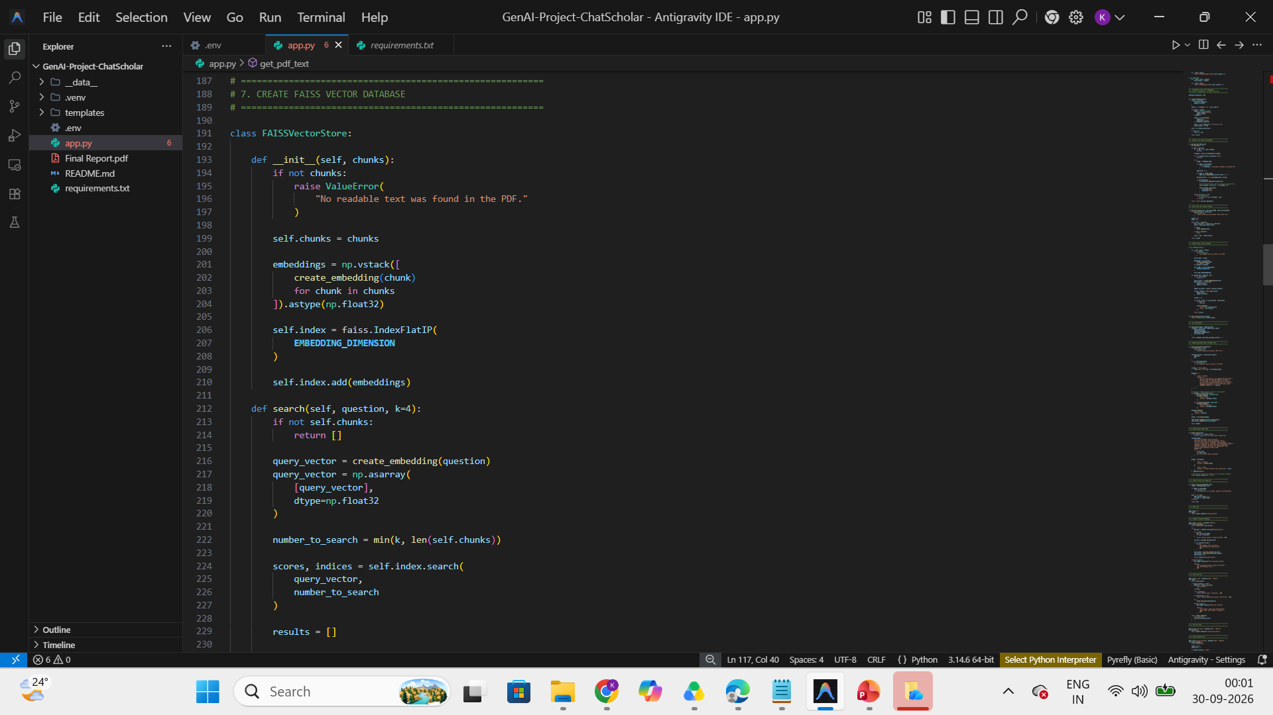

Slide 27
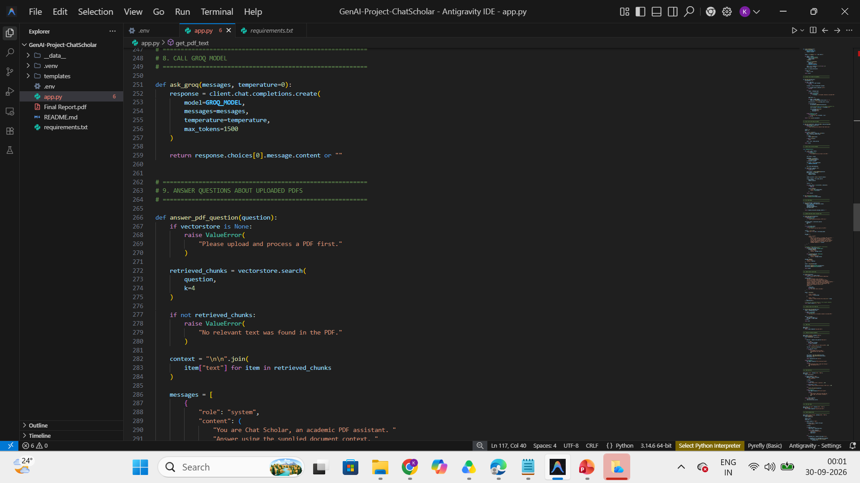

Slide 28
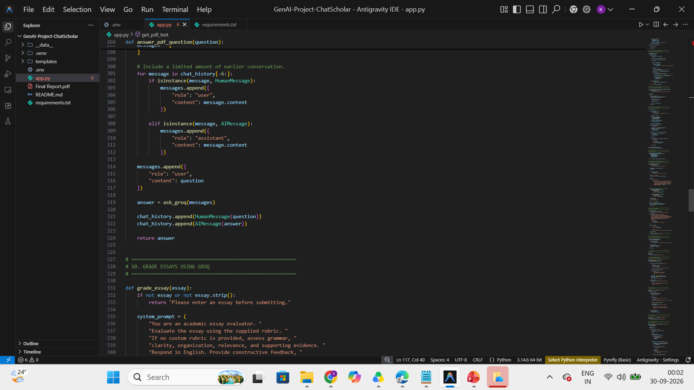

Slide 29
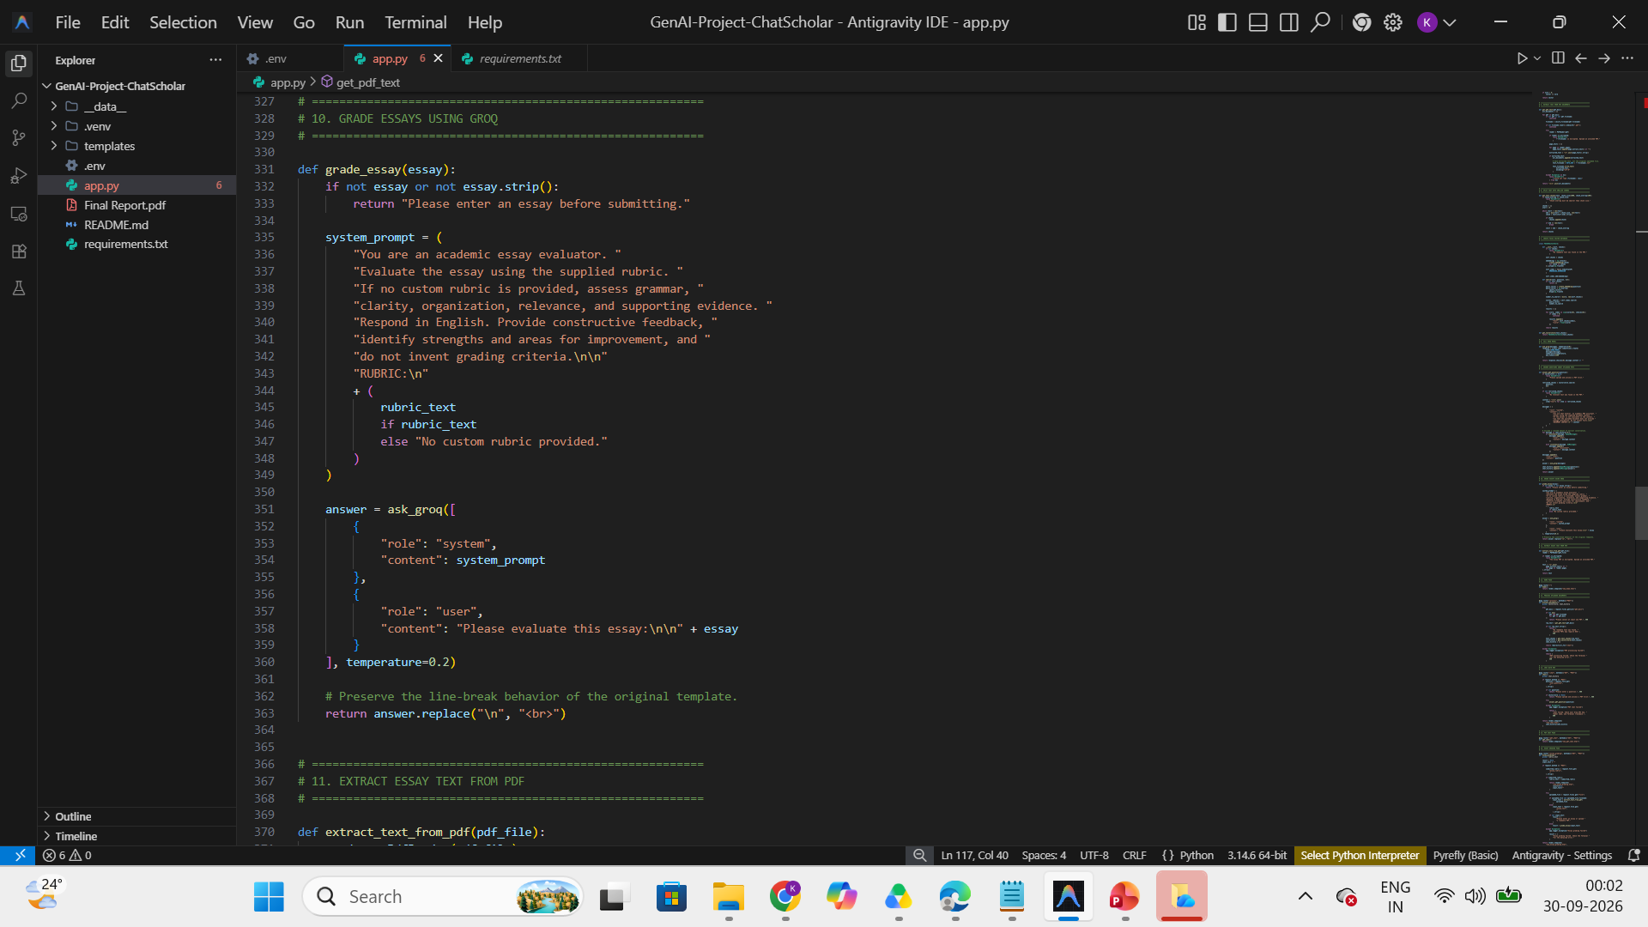

Slide 30
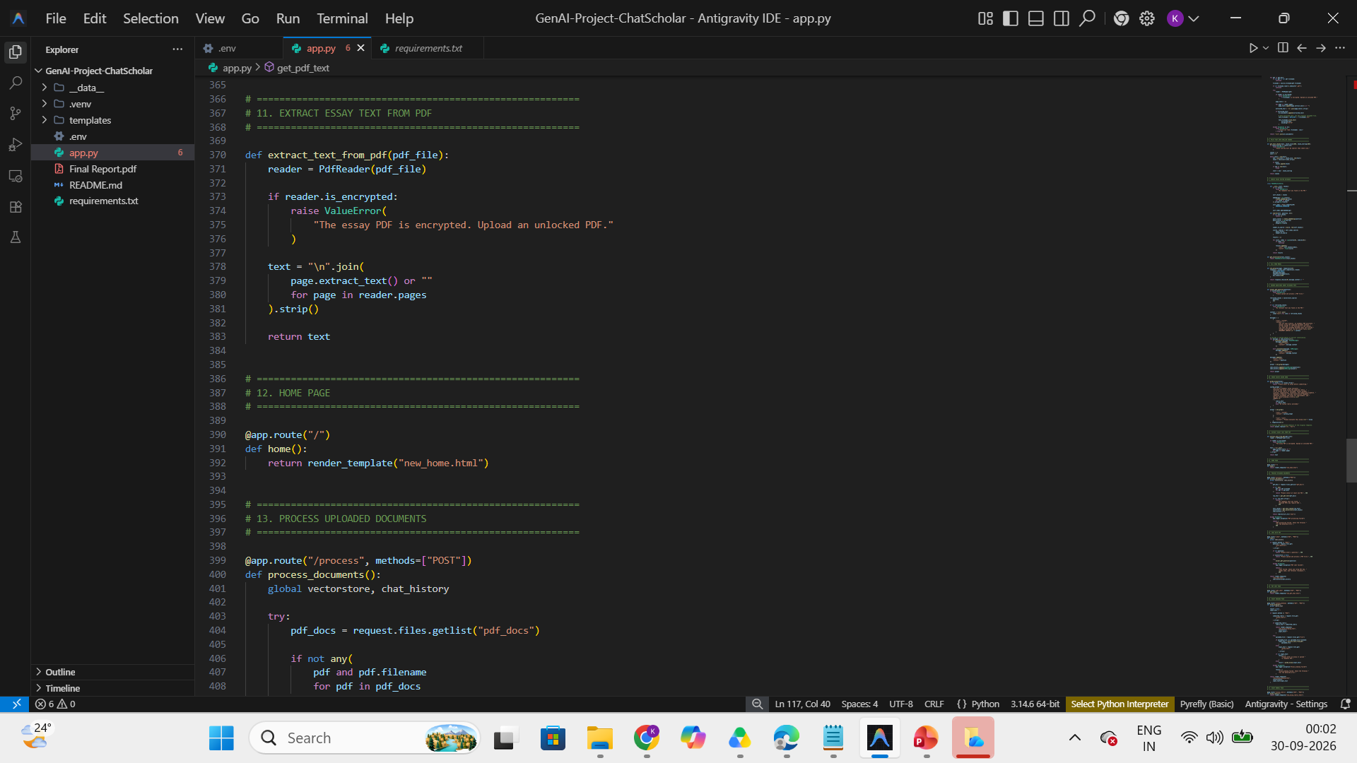

Slide 31
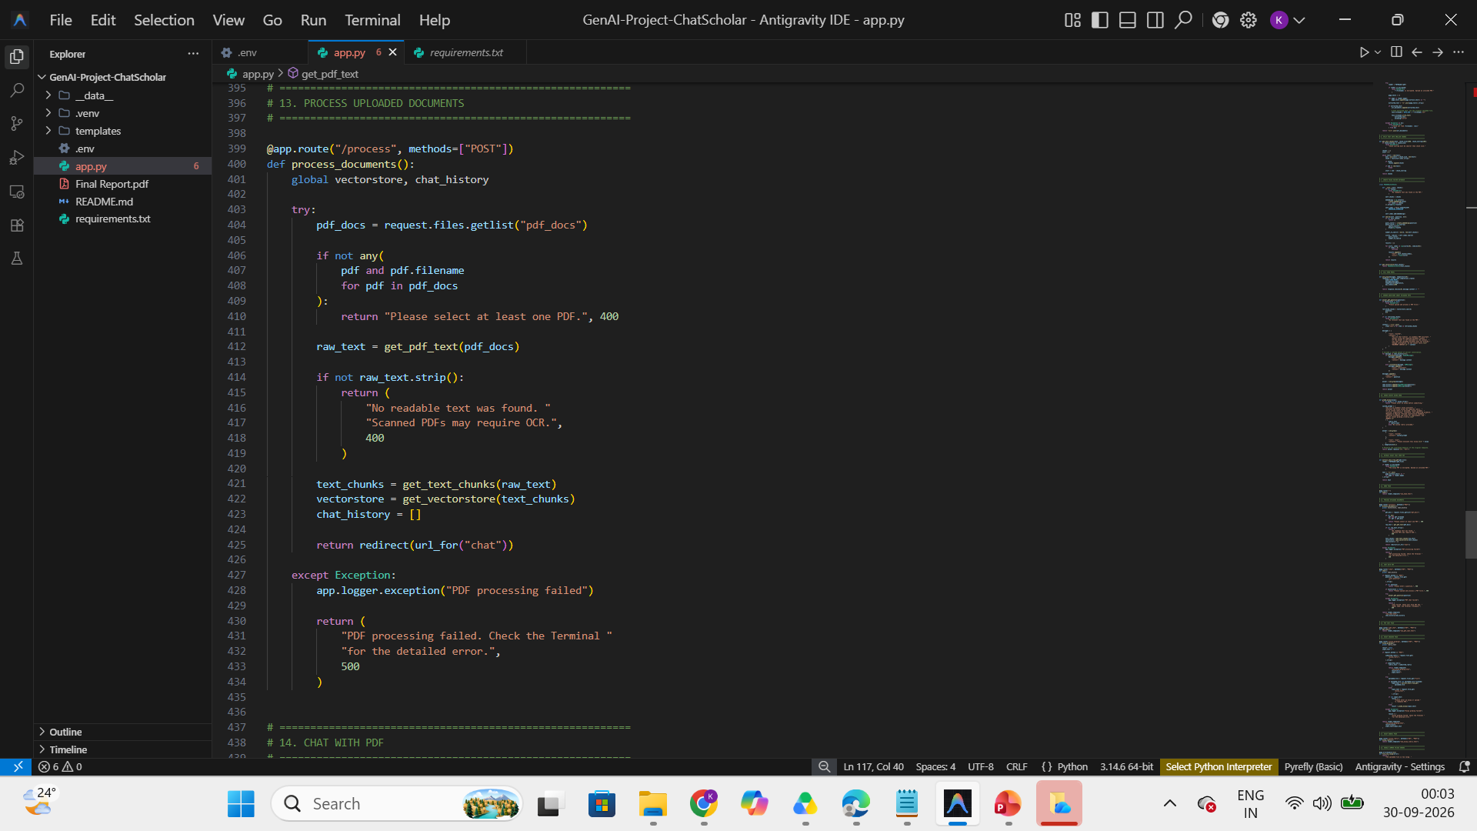

Slide 32
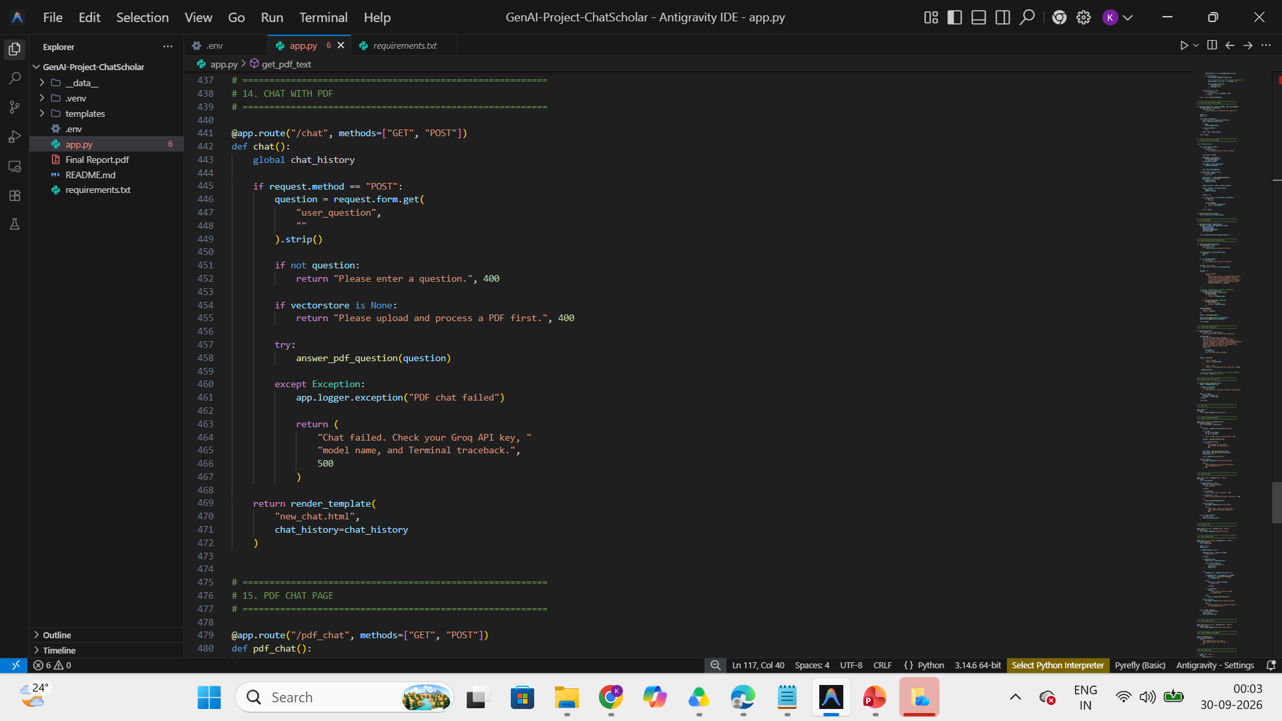

Slide 33
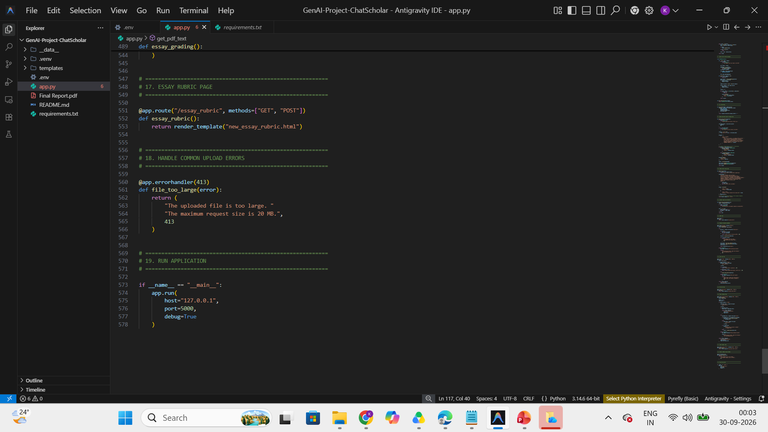

Slide 34
Extract Text from PDF Files
from PyPDF2 import PdfReader
def get_pdf_text(pdf_file):
reader = PdfReader(pdf_file)
text = ""
for page in reader.pages:
text += (page.extract_text() or "") + "\n"
return text
PdfReader opens the PDF
The loop visits each page
extract_text() reads the page text ("or" handles empty pages)
All text is joined into one string
return passes it on for chunking
Scanned, image-only PDFs contain no real text. They need OCR (for example Tesseract).
16

Slide 35
Split Text into Chunks
SUGGESTED FIX
from langchain.text_splitter import CharacterTextSplitter
splitter = CharacterTextSplitter(
separator="\n",
chunk_size=1000,
chunk_overlap=200,
length_function=len
)
chunks = splitter.split_text(document_text)
One long document
Chunk 1
Chunk 2
Chunk 3
chunk: a small section of text
chunk_size=1000: target length of a chunk
chunk_overlap=200: text repeated between chunks
Small sections make retrieval more precise
Neighbouring chunks share 200 characters, so text at the edges keeps its context.
On LangChain 1.x use: from langchain_text_splitters import CharacterTextSplitter
17

Slide 36
Generate Embeddings and Build FAISS
from langchain_openai import OpenAIEmbeddings
from langchain_community.vectorstores import FAISS
embeddings = OpenAIEmbeddings()
vectorstore = FAISS.from_texts(
texts=chunks,
embedding=embeddings
)
Embeddings turn text into number vectors
Similar meanings get similar vectors
FAISS stores and searches those vectors
The embedding model needs a valid API key
Chunk of text
Vector [0.12, -0.83, ...]
FAISS index
18

Slide 37
Create the Conversational Retrieval Chain
SUGGESTED FIX
Question
Retriever
Relevant Context
LLM
Answer
python -m pip install langchain-classic
from langchain_classic.chains import ConversationalRetrievalChain
from langchain_classic.memory import ConversationBufferMemory
from langchain_openai import ChatOpenAI
memory = ConversationBufferMemory(
memory_key="chat_history", return_messages=True)
chain = ConversationalRetrievalChain.from_llm(
llm=ChatOpenAI(),
retriever=vectorstore.as_retriever(),
memory=memory)
Retriever: finds relevant chunks
LLM: writes the answer
Memory: keeps earlier messages
Newer LangChain moved the old chain API into the langchain-classic package. Install it first, and do not mix classic and new imports.
19

Slide 38
Understand the Flask Application
Create Flask app
PDF extraction
Text chunking
app = Flask(__name__) starts the web app
Reads text from uploaded PDFs
Splits text into small pieces
FAISS vectorstore
Retrieval chain
Home route
Turns chunks into searchable vectors
Links retriever, memory and LLM
Shows the home page
Document route
Chat route
Essay routes
Processes the uploaded PDFs
Takes a question, returns an answer
Essay grading and rubric pages
@app.route() tells Flask which URL runs which Python function, like a signpost. Every template used in app.py must exist and contain the form fields the code expects.
20

Slide 39
Create the HTML Templates and .gitignore
Templates folder
PDF upload form
.gitignore
Flask looks for HTML inside templates/
new_home.html
new_chat.html
new_pdf_chat.html
new_essay_grading.html
new_essay_rubric.html
Each needs the right forms, inputs and buttons
<form action="/process"
method="POST"
enctype="multipart/form-data">
<input type="file"
name="pdf_docs" multiple>
<button type="submit">
Process PDF
</button>
</form>
.venv/
.env
__pycache__/
*.pyc
__data__/
Never commit API keys or temporary data. Anyone who sees a public repo could use your key and run up your bill.
Field names must match what the Flask route reads.
21

Slide 40
Run the Project
cd C:\ChatScholar
Go to the project folder.
.\.venv\Scripts\Activate.ps1
Turn on the virtual environment.
python -m pip install -r requirements.txt
Make sure all packages are installed.
python app.py
Start the Flask server.
http://127.0.0.1:5000
Open this local URL in your browser. Keep the terminal open while the app runs. Press Ctrl+C to stop the server.
22

Slide 41
Test the Chatbot and Essay Grading
1. Open the home page
2. Upload a text-based PDF
3. Process the PDF
4. Ask a question answered in the PDF
5. Ask a follow-up question
6. Check the answer against the source
7. Open the essay grading page
8. Enter a rubric and an essay
9. Review the generated feedback
10. Record any errors and fixes
Example questions
"Summarize this document."
"What is the main objective?"
"Explain the conclusion in simple words."
23

Slide 42
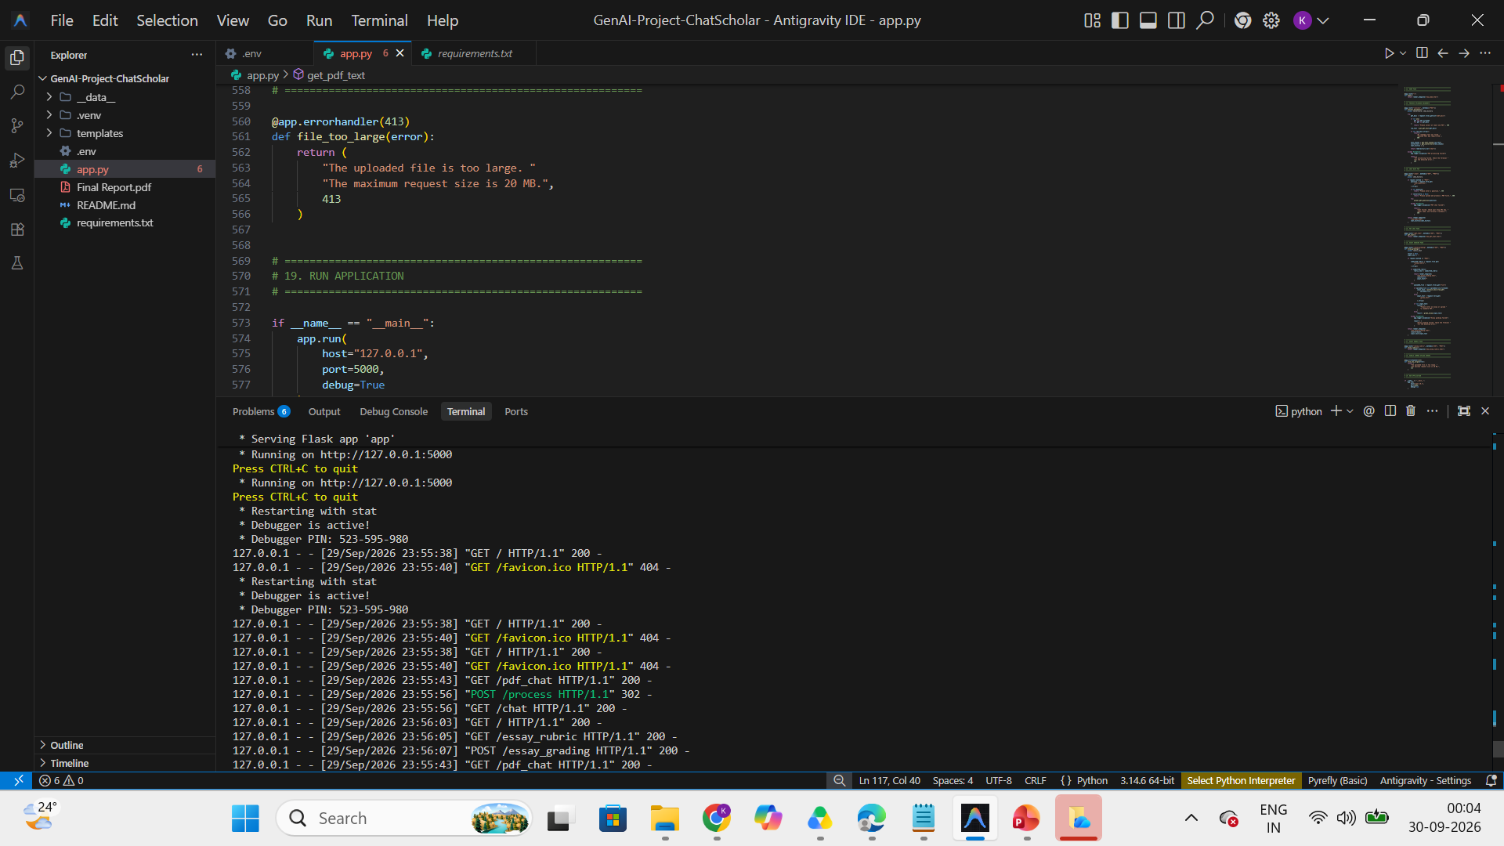

Slide 43
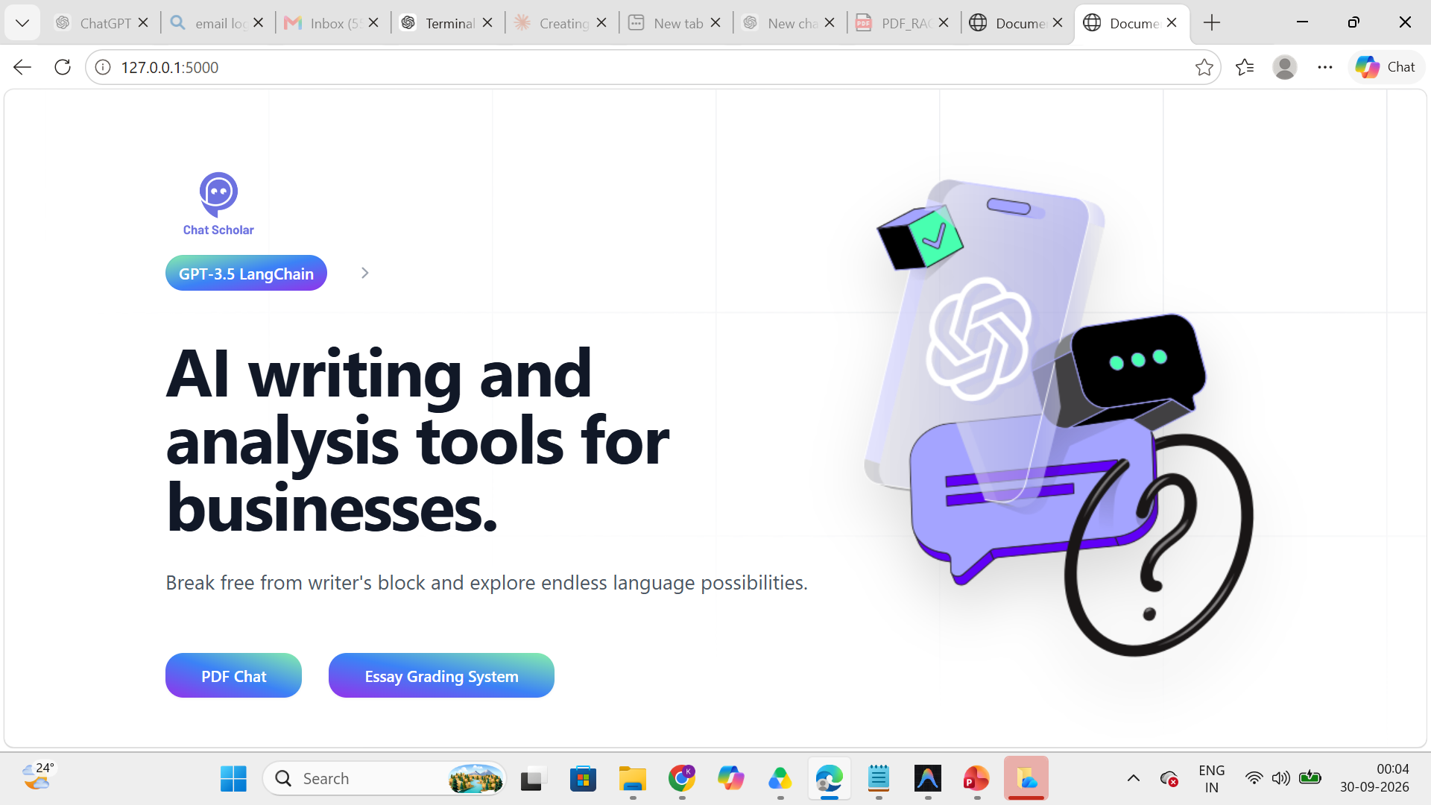

Slide 44
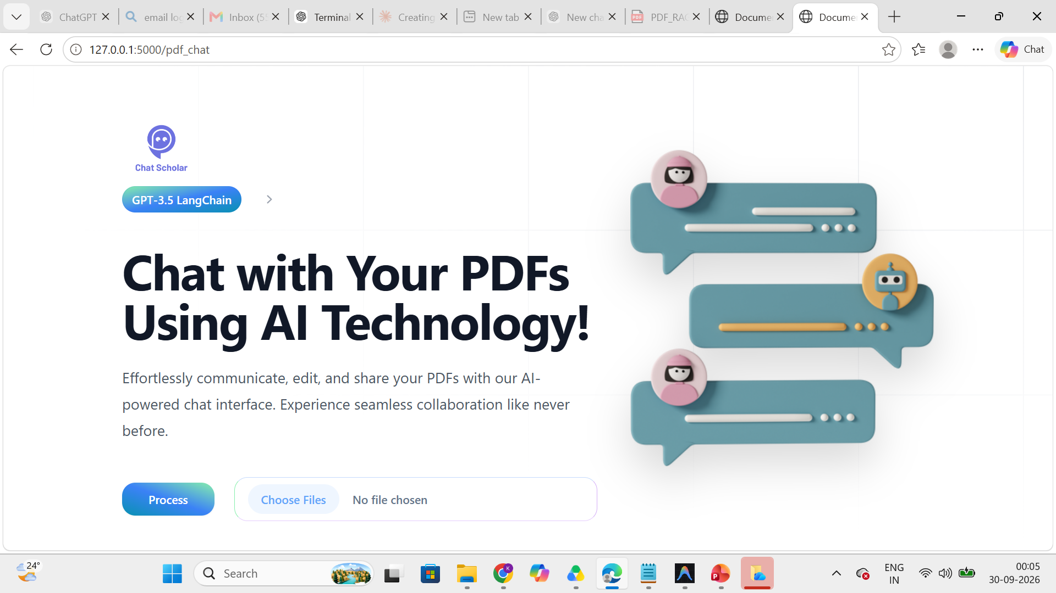

Slide 45
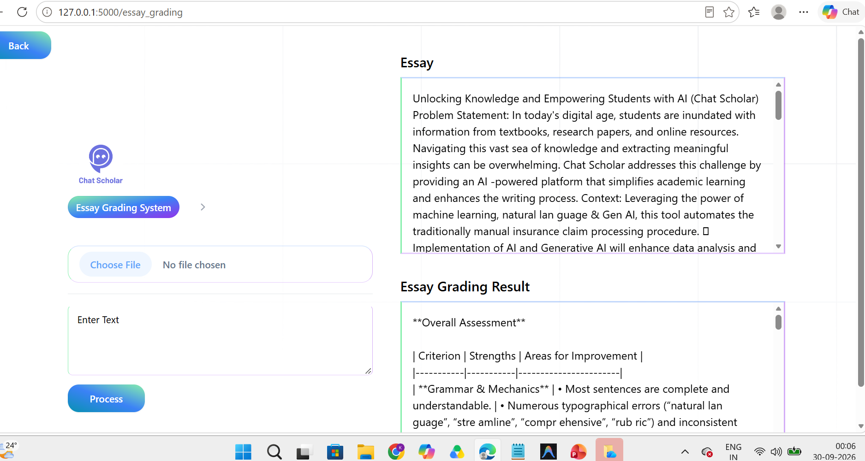

Slide 46
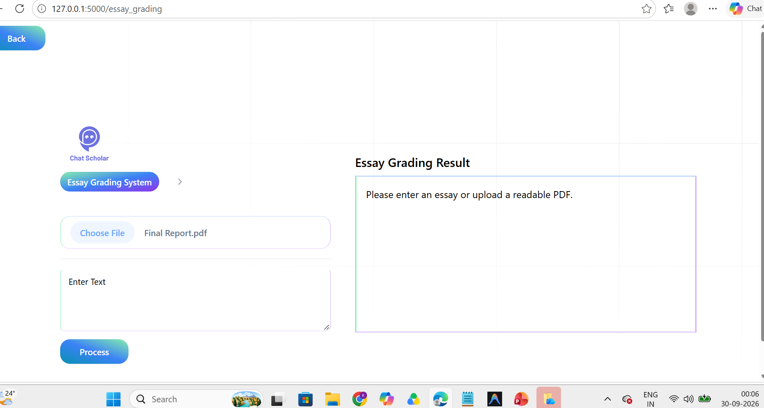

Slide 47
Common Errors and Troubleshooting
Error | Solution
ModuleNotFoundError | Activate the correct virtual environment, then install the missing package.
TemplateNotFound | Check the template filename and that it is inside the templates folder.
API authentication error | Check the provider and the key in .env match the code (OpenAI vs Groq).
Missing PDF text | Use a text-based PDF, or add OCR for scanned files.
FAISS installation error | Check the Python version and that the right environment is active.
LangChain import error | Check installed versions and use compatible import paths (see slide 19).
Port already in use | Stop the other process or run on another port, e.g. app.run(port=5001).
Copy the full traceback: select the error text in the terminal, right-click to copy, and paste all of it when asking for help.
24

Slide 48
Conclusion and Thank You
Chat Scholar answers questions from uploaded PDFs
RAG = retrieval plus LLM generation
FAISS gives fast local vector search
Flask provides the web interface
Essay grading uses a rubric to guide feedback
Needs correct API setup, complete templates and testing
Future improvements
Show PDF source references
Improve error handling
Add OCR support
Improve upload validation
Deploy securely
Thank You
Testing status: not claimed fully functional until templates and configuration are completed and tested.
25

