Slide 1
S&P Global & Crisil Campus Hackathon 2026
AI/NLP Risk Signal Platform
From news and social text to sentiment, event and impact signals, driving a tactical index rebalancer and an event-driven stress tester
Kurapati Komal Kumar | Vellore Institute of Technology, Andhra Pradesh (VIT-AP)
47
2
8
signals
modules
event types
Notes:
Introduce yourself, the problem and the one-line promise: text in, structured risk signals out, two live applications.

Slide 2
Problem and approach
Analysts read far more headlines and posts than they can handle, yet trading and capital decisions need clear numbers they can compare. I wanted to turn raw text into those numbers quickly.
Ingest
1
News + social, cleaned, de-duplicated, credibility-weighted
My approach: build one NLP engine whose output I can explain, then feed it into two different tools: a fast index rebalancer and a slower portfolio stress tester.
Analyse
2
Sentiment -1..1, 8 event types, impact 1..10
Act
3
Rebalance weights; stress the bank book

Slide 3
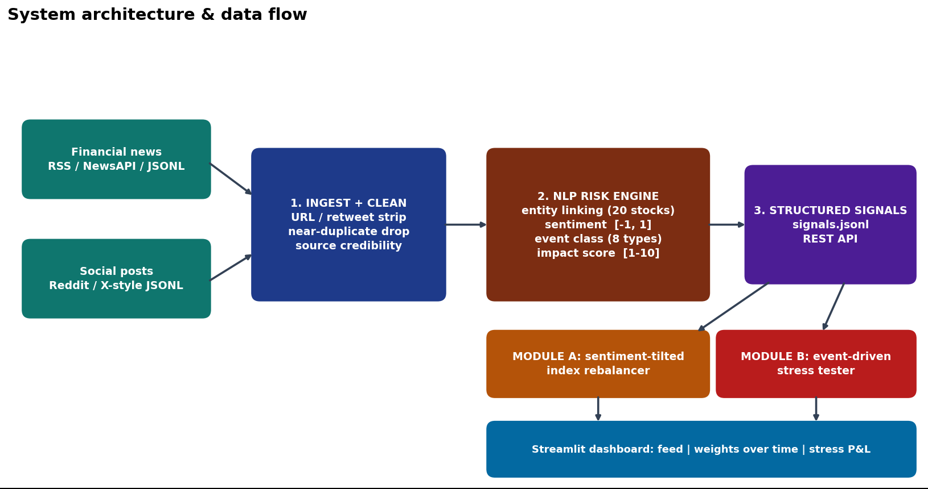
System design and data flow

Slide 4
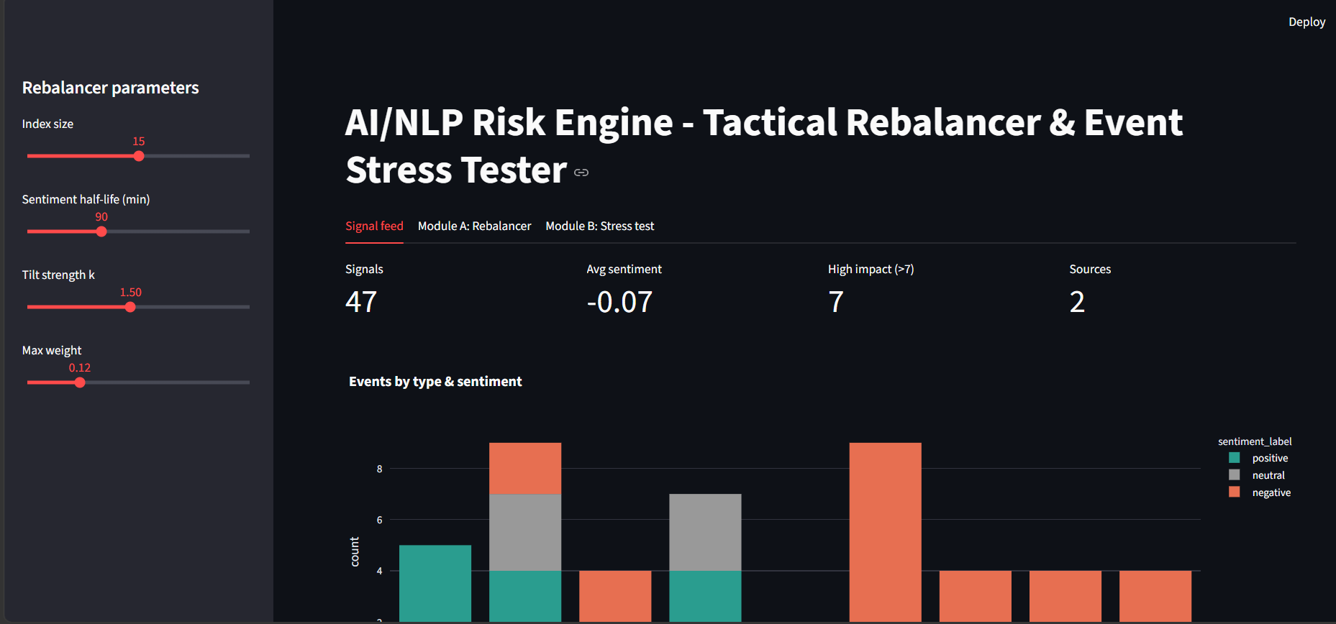
Implementation
NLP engine
Word lexicon with negation, regex-based event types, and impact = 0.55 x event prior + 3 x |sentiment| + 2 x intensity + 1.5 x source credibility.
Module A: Rebalancer
Each stock keeps a sentiment score that fades with a 90 min half-life. Weights tilt up or down, kept between 2% and 12%.
My Streamlit dashboard, running on the sample data. The sidebar controls the rebalancer.
Module B: Stress test
47
7
2
If impact is above 7 and sentiment is negative, shocks (equity, rates, spreads, FX, defaults) are applied to a 36-position bank book.
signals
high impact
sources

Slide 5
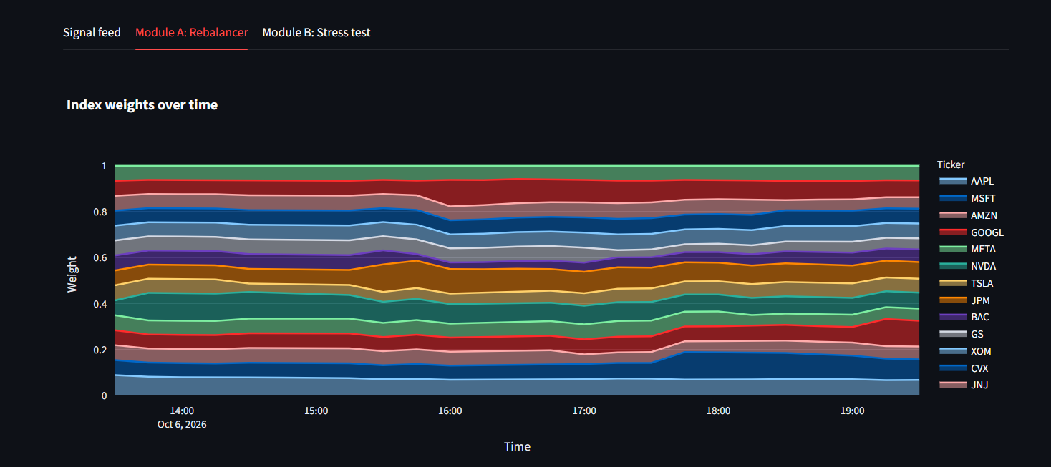
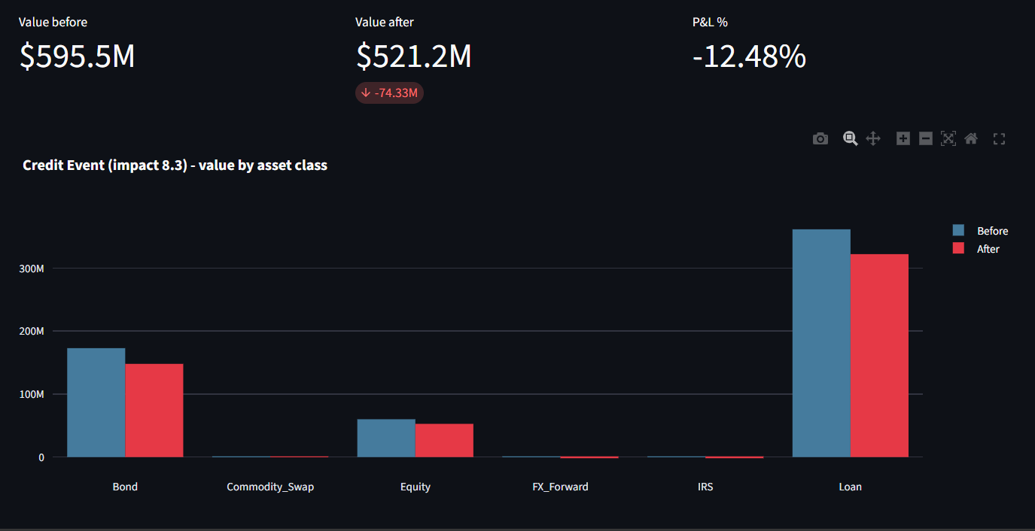
Results
Module A: weights shift through the day as news arrives. GOOGL gains 4.7 points, AAPL loses 2.2.
Module B: a Credit Event at impact 8.3 takes the book from $595.5M to $521.2M, a 12.48% loss.
47
7
2.2%
5.6 bps
signals from 48 docs
stress triggers
avg turnover per step
total trading cost

Slide 6
Domain impact
1
Speed
2
One signal, two horizons
A headline becomes a risk number in seconds instead of hours of reading
The same feed supports quick index tilts and longer-term stress planning
3
Explainable
4
Extensible
Each score can be traced to specific words and a written formula, so a reviewer can check it
New data sources or a FinBERT model can be added without redoing the rest

Slide 7
Limitations and next steps
Limitations
Next steps
Lexicon and regex miss sarcasm and context
Demo corpus is synthetic and small
Rebalancer not backtested on real prices
Stress shocks are illustrative, not calibrated
Fine-tune FinBERT on labelled finance text
Backtest vs equal-weight with market data
Streaming ingestion (Kafka) and alerts
Factor-based and reverse stress tests

