Slide 1

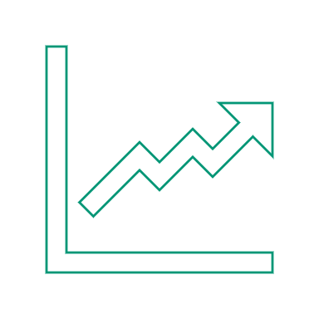
INSTAGRAM USER ANALYTICS
BY – KOMAL PANDITA

Slide 2
Contents
INTRODUCTION
ANALYSIS FOR MARKTING TEAM
ANALYSIS FOR INVESTORS
SUMMARY

Slide 3
INTRODUCTION
- This ppt provides a detailed report for marketing and investors metrics department.
- This analysis will provide the best help to make a decision based on different metrics and insights

Slide 4
MARKETING
1 . Rewarding most loyal users –
2. Remind Inactive users to start posting –
3. Declaring Contest winners –
4. Hashtags Researching –
5. Launch AD Campaign -
5 oldest users on Instagram from the dataset provided
Users who have never posted a single photo on Instagram
Winners of the contest and providing details to the team
Top 5 most commonly used Hashtags by the users of Instagram
Providing the day of the week on which the most users register

Slide 5
INVESTOR METRICS
User management
Provide how many times does average user posts on Instagram. Also, provide the total number of photos on Instagram/total number of users
2. Bots and Fake accounts
Provide data on users (bots) who have liked every single photo on the site (since any normal user would not be able to do this).

Slide 6
Rewarding the most loyal users
Top 5 oldest users
1 | 2 | 3 | 4 | 5
DARBY HERZOG 2016-05-06 | EMILIO_BERNIER52 2016-05-06 | ELENOR88 2016-05-08 | Nicole 2016-05-09 | JORDYN_JACOBSON 2016-05-14

Slide 7
Remind Inactive Users to Start Posting
list of 26 people with their user id who have never posted a single photo on Instagram.
5-Aniya_Hackett
7-Kasandra_Homenick
14-Jaclyn81
21-Rocio33
24-Maxwell.Halvorson
25-Tierra.Trantow
34-Pearl7
36-Ollie_Ledner37
41-Mckenna17
45-David.Osinski47
49-Morgan.Kassulke
53-Linnea59
54-Duane60
57-Julien_Schmidt
66-Mike.Auer39
68-Franco_Keebler64
71-Nia_Haag
74-Hulda.Macejkovic
75-Leslie67
76-Janelle.Nikolaus81
80-Darby_Herzog
81-Esther.Zulauf61
83-Bartholome.Bernhard
89-Jessyca_West
90-Esmeralda.Mraz57
91-Bethany20

Slide 8
Declaring Contest Winner
In this contest, User with the most likes on a single picture won
User Id 52 | Username Zack_Kemmer93 | Image_url https://jarret.name | Likes 48

Slide 9
HASHTAG RESEARCHING
Top 5 hashtags that are most frequently used on the platform

Slide 10
USER ENGAGEMENT
Based on the results, there are –
active users who have posted atleast once - 74
Total users in our database – 100
Total no. of posts – 257
Average no. of times users post - 257/74 = 3.47
So average user posts 3-4 times

Slide 11
Bots and Fake Accounts
The users who have liked every single photo on the site will be considered as bots
We have 13 such users based on the data who have liked all 257 posts, user-Id for the same are specified below.
5
14
21
24
36
41
54
57
66
71
75
76
91

Slide 12
APPROACH
- For this project, I have used SQL to extract the required data from the given database using the Join function, subqueries, Aggregation, where condition, Group by, Distinct and other functions required.
- keeping the Primary key and foreign key in consideration provided all the reports asked by the marketing department and Investor metrics department.

