Slide 1
BANK ANALYSIS
Group -2

Slide 2
Project Objective
In the Bank Loan Customer Analysis project, we leveraged two datasets, each containing 39k rows, to assess the bank's loan growth over specified years.
Utilizing MS-Excel and MySQL, we conducted data cleaning, including duplicate removal. The analysis was further enriched by creating interactive dashboards in Tableau and PowerBI, where we performed data merging and conducted various calculations to visualize the bank's loan growth metrics effectively.

Slide 3
Content
KPI-1 : Year wise loan amount Stats
KPI-2 : Grade and sub grade wise revol_bal
KPI-3 : Total Payment for Verified Status Vs Total Payment for Non Verified Status
KPI-4 : State wise and last_credit_pull_d wise loan status
KPI-5 : Home ownership Vs last payment date stats
KPI-6 : Purpose Vs Loan

Slide 4
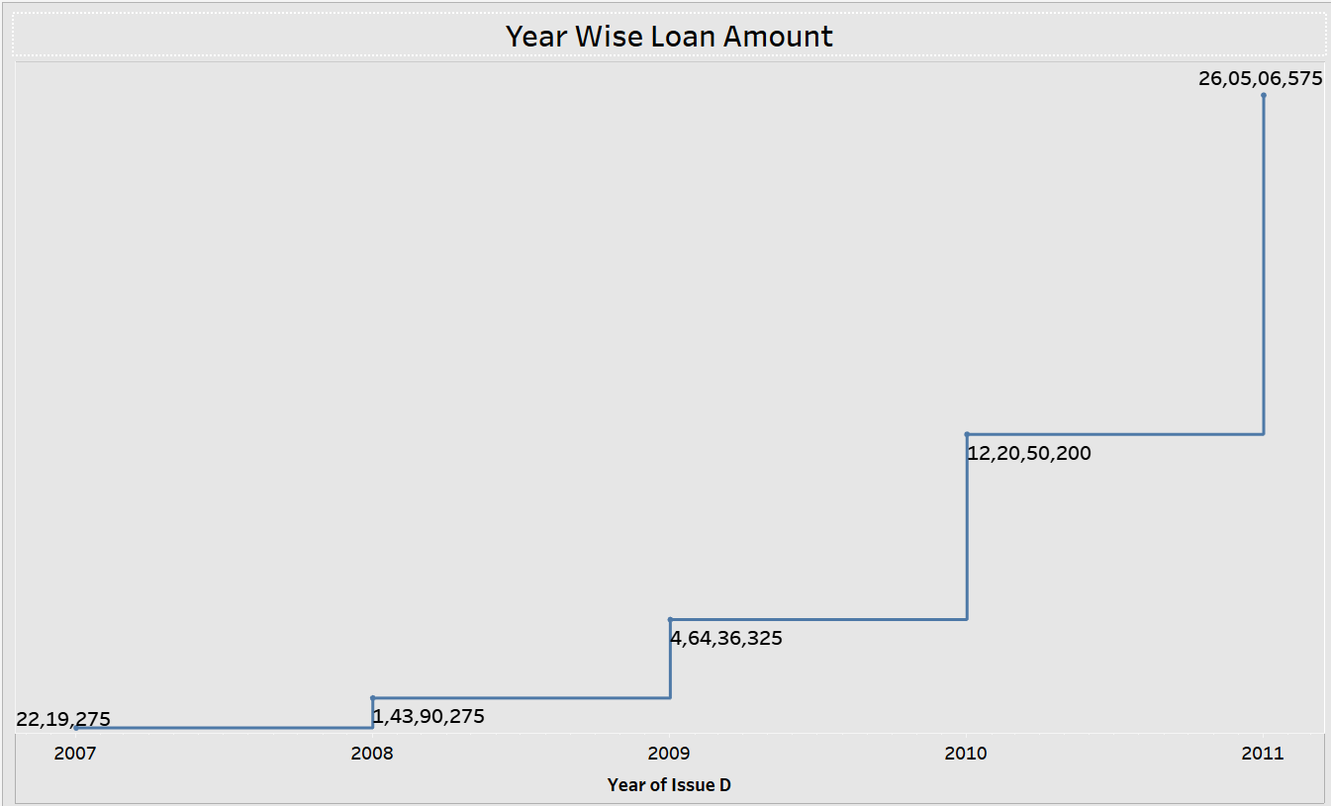
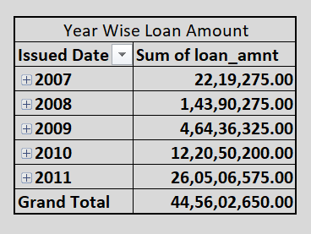
KPI-1
Year wise loan amount Stats
Analyzing the chart, it's observed that the loan amount has experienced significant growth from 2007 to 2011.
Specifically, it increased from 22,19,275(2M) to 26,05,06,575(26M) amounting to a rise of 258287300 over four years.
Additionally, the cumulative total of the loan amounts across all observed years amounts to 44,56,02,650.00

Slide 5
KPI-1

Slide 6
KPI-2
Grade, Subgrade Vs Revol Bal
It's evident that Grade B holds the highest revolving balance compared to other grades, while Grade G records the lowest.
Our observation that customers within Grade B, have been employed for over 10 + years.
This pattern extends across other grades as well, with the revolving balance following the order of Grade B > A > C > D > E > F > G, aligning with the sequence of annual incomes.

Slide 7
KPI-3
Total Payment for Verified Status Vs Non Verified Status
The initial phase of the verification process requires a loan application to begin collecting and verifying documents.
Based on the pie chart, it's evident that 58.88% of the total payments are from verified statuses, while the remaining 41.12% are from statuses that are not verified concerning the loan amount.

Slide 8
KPI-4
Map

Slide 9
KPI-5
T

Slide 10
KPI-6
Purpose Vs Loan Amount

