Slide 1
Fundamentals of Git

Slide 2
Outline
Distributed V.S Centralized Version Control
Getting started
Branching and Merging
Working with remote
Summary

Slide 3
Version control systems
Version control (or revision control, or source control) is all about managing multiple versions of documents, programs, web sites, etc.
  Almost all “real” projects use some kind of version control
  Essential for team projects, but also very useful for individual projects
Some well-known version control systems are CVS, Subversion, Mercurial, and Git
  CVS and Subversion use a “central” repository; users “check out” files, work on them, and “check them in”
  Mercurial and Git treat all repositories as equal
Distributed systems like Mercurial and Git are newer and are gradually replacing centralized systems like CVS and Subversion

Slide 4
Why version control?
For working by yourself:
  Gives you a “time machine” for going back to earlier versions
  Gives you great support for different versions (standalone, web app, etc.) of the same basic project
For working with others:
  Greatly simplifies concurrent work, merging changes
For getting an internship or job:
  Any company with a clue uses some kind of version control
  Companies without a clue are bad places to work

Slide 5
Why Git?
Git has many advantages over earlier systems such as CVS and Subversion
  More efficient, better workflow, etc.
  See the literature for an extensive list of reasons
  Of course, there are always those who disagree
Best competitor: Mercurial
  I like Mercurial better
  Same concepts, slightly simpler to use
  In my (very limited) experience, the Eclipse plugin is easier to install and use
  Much less popular than Git

Slide 6
Centralized Version Control
Traditional version control system
  Server with database
  Clients have a working version
Examples
  CVS
  Subversion
  Visual Source Safe
Challenges
  Multi-developer conflicts
  Client/server communication

Slide 7
Distributed Version Control
Authoritative server by convention only
Every working checkout is a repository
Get version control even when detached
Backups are trivial
Other distributed systems include
  Mercurial
  BitKeeper
  Darcs
  Bazaar

Slide 8
Git Advantages
Resilience
  No one repository has more data than any other
Speed
  Very fast operations compared to other VCS (I’m looking at you CVS and Subversion)
Space
  Compression can be done across repository not just per file
  Minimizes local size as well as push/pull data transfers
Simplicity
  Object model is very simple
Large userbase with robust tools

Slide 9
Some GIT Disadvantages
Definite learning curve, especially for those used to centralized systems
  Can sometimes seem overwhelming to learn
    Conceptual difference
    Huge amount of commends

Slide 10
Download and install Git
There are online materials that are better than any that I could provide
Here’s the standard one:
http://git-scm.com/downloads
Here’s one from StackExchange:
http://stackoverflow.com/questions/315911/git-for-beginners-the-definitive-practical-guide#323764
Note: Git is primarily a command-line tool
I prefer GUIs over command-line tools, but…
The GIT GUIs are more trouble than they are worth (YMMV)

Slide 11
Introduce yourself to Git
Enter these lines (with appropriate changes):
  git config --global user.name “manish sharma"
  git config --global user.email manish.sharma0201cs@gmail.com
You only need to do this once
If you want to use a different name/email address for a particular project, you can change it for just that project
  cd to the project directory
  Use the above commands, but leave out the --global

Slide 12
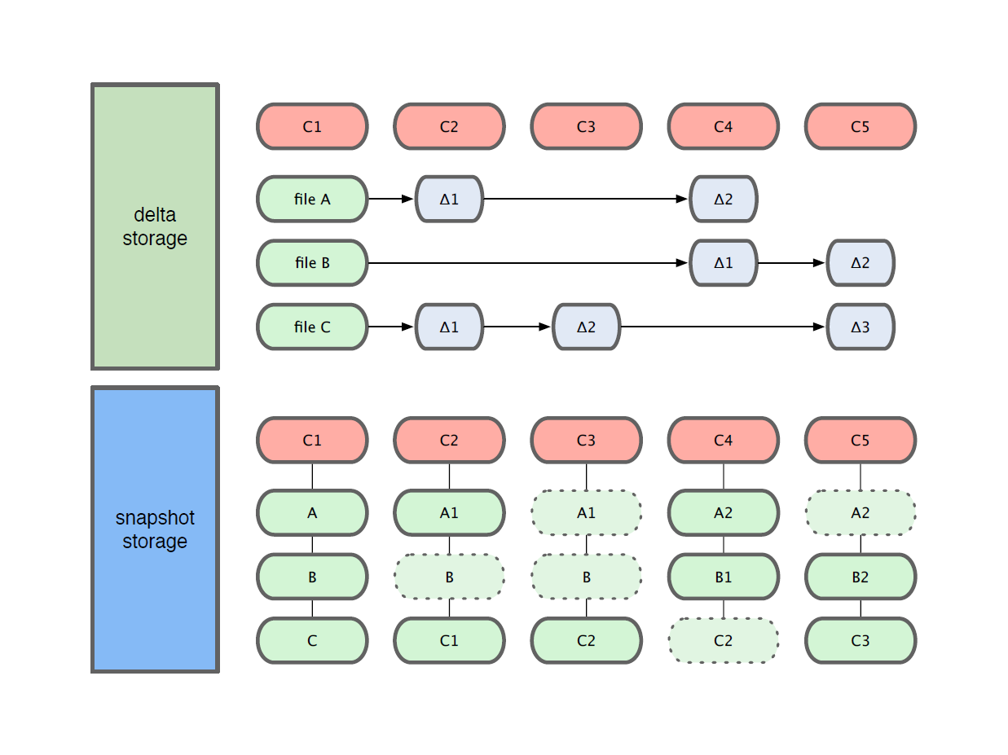
Getting Started
Git use snapshot storage

Slide 13
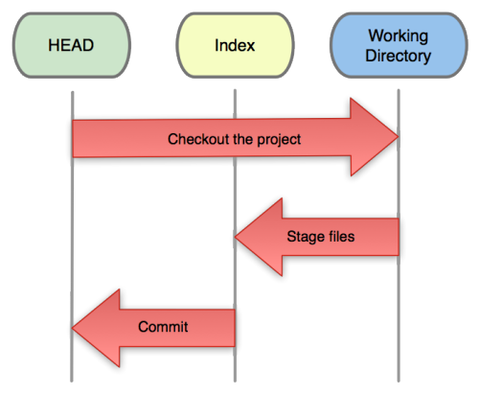
Getting Started
Three trees of Git
  The HEAD
    last commit snapshot, next parent
  Index
    Proposed next commit snapshot
  Working directory
    Sandbox

Slide 14
Getting Started
A basic workflow
  (Possible init or clone) Init a repo
  Edit files
  Stage the changes
  Review your changes
  Commit the changes

Slide 15
Getting Started
Init a repository
Git init
manish@manish-desktop:~/code/gitdemo$ git init
Initialized empty Git repository in /home/manish/code/gitdemo/.git/
manish@manish-desktop:~/code/gitdemo$ ls -l .git/
total 32
drwxr-xr-x 2 manish manish 4096 2011-08-28 14:51 branches
-rw-r--r-- 1 manish manish 92 2011-08-28 14:51 config
-rw-r--r-- 1 manish manish 73 2011-08-28 14:51 description
-rw-r--r-- 1 manish manish 23 2011-08-28 14:51 HEAD
drwxr-xr-x 2 manish manish 4096 2011-08-28 14:51 hooks
drwxr-xr-x 2 manish manish 4096 2011-08-28 14:51 info
drwxr-xr-x 4 manish manish 4096 2011-08-28 14:51 objects
drwxr-xr-x 4 manish manish 4096 2011-08-28 14:51 refs

Slide 16
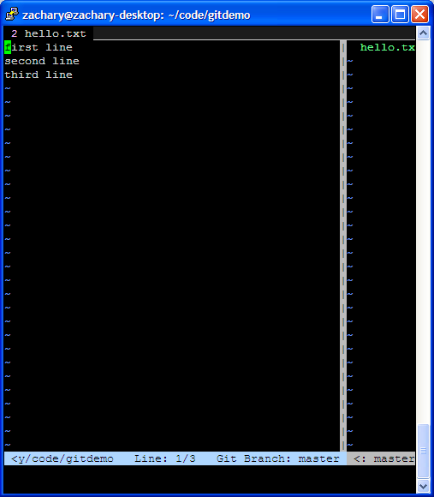
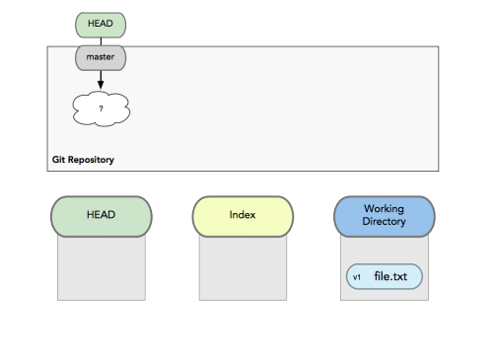
Getting Started
A basic workflow
  Edit files
  Stage the changes
  Review your changes
  Commit the changes
Use your favorite editor

Slide 17
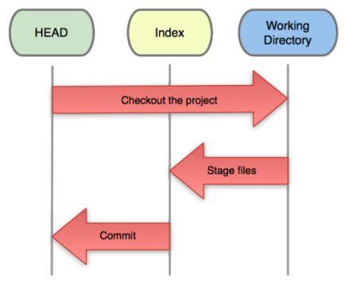
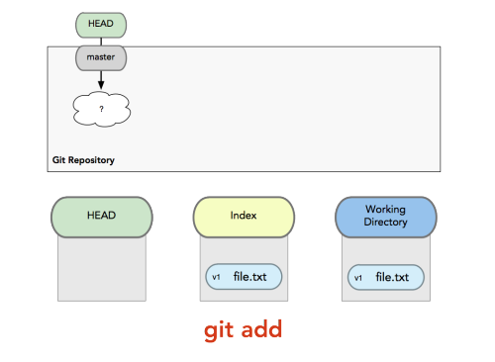
Getting Started
A basic workflow
  Edit files
  Stage the changes
  Review your changes
  Commit the changes
Git add filename
manish@manish-desktop:~/code/gitdemo$ git status
# On branch master
# Changes not staged for commit:
# (use "git add <file>..." to update what will be committed)
# (use "git checkout -- <file>..." to discard changes in working directory)
#
# modified: hello.txt
#
no changes added to commit (use "git add" and/or "git commit -a")

Slide 18
Getting Started
A basic workflow
  Edit files
  Stage the changes
  Review your changes
  Commit the changes
Git status
manish@manish-desktop:~/code/gitdemo$ git add hello.txt
manish@manish-desktop:~/code/gitdemo$ git status
# On branch master
# Changes to be committed:
# (use "git reset HEAD <file>..." to unstage)
#
# modified: hello.txt
#

Slide 19
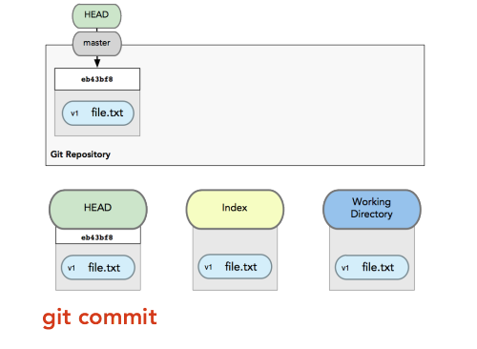
Getting Started
A basic workflow
  Edit files
  Stage the changes
  Review your changes
  Commit the changes
Git commit
# Please enter the commit message for your changes. Lines starting
# with '#' will be ignored, and an empty message aborts the commit.
# On branch master
# Changes to be committed:
# (use "git reset HEAD <file>..." to unstage)
#
# modified: hello.txt
#

Slide 20
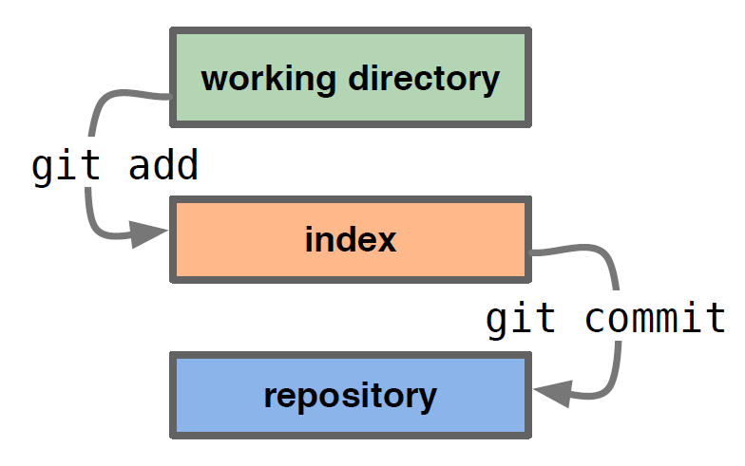
Getting Started
A basic workflow
  Edit files
  Stage the changes
  Review your changes
  Commit the changes

Slide 21
Getting Started
View changes
Git diff
  Show the difference between working directory and staged
Git diff --cached
  Show the difference between staged and the HEAD
View history
Git log
manish@manish-desktop:~/code/gitdemo$ git log
commit efb3aeae66029474e28273536a8f52969d705d04
Author: manish Ling <zacling@gmail.com>
Date: Sun Aug 28 15:02:08 2011 +0800
Add second line
commit 453914143eae3fc5a57b9504343e2595365a7357
Author: manish Ling <zacling@gmail.com>
Date: Sun Aug 28 14:59:13 2011 +0800
Initial commit

Slide 22
Getting Started
Revert changes (Get back to a previous version)
  Git checkout commit_hash
manish@manish-desktop:~/code/gitdemo$ git log
commit efb3aeae66029474e28273536a8f52969d705d04
Author: manish Ling <zacling@gmail.com>
Date: Sun Aug 28 15:02:08 2011 +0800
Add second line
commit 453914143eae3fc5a57b9504343e2595365a7357
Author: manish Ling <zacling@gmail.com>
Date: Sun Aug 28 14:59:13 2011 +0800
Initial commit
manish@manish-desktop:~/code/gitdemo$ git checkout 4539
Note: checking out '4539'.
You are in 'detached HEAD' state. You can look around, make experimental
changes and commit them, and you can discard any commits you make in this
state without impacting any branches by performing another checkout.
If you want to create a new branch to retain commits you create, you may
do so (now or later) by using -b with the checkout command again. Example:
git checkout -b new_branch_name
HEAD is now at 4539141... Initial commit

Slide 23
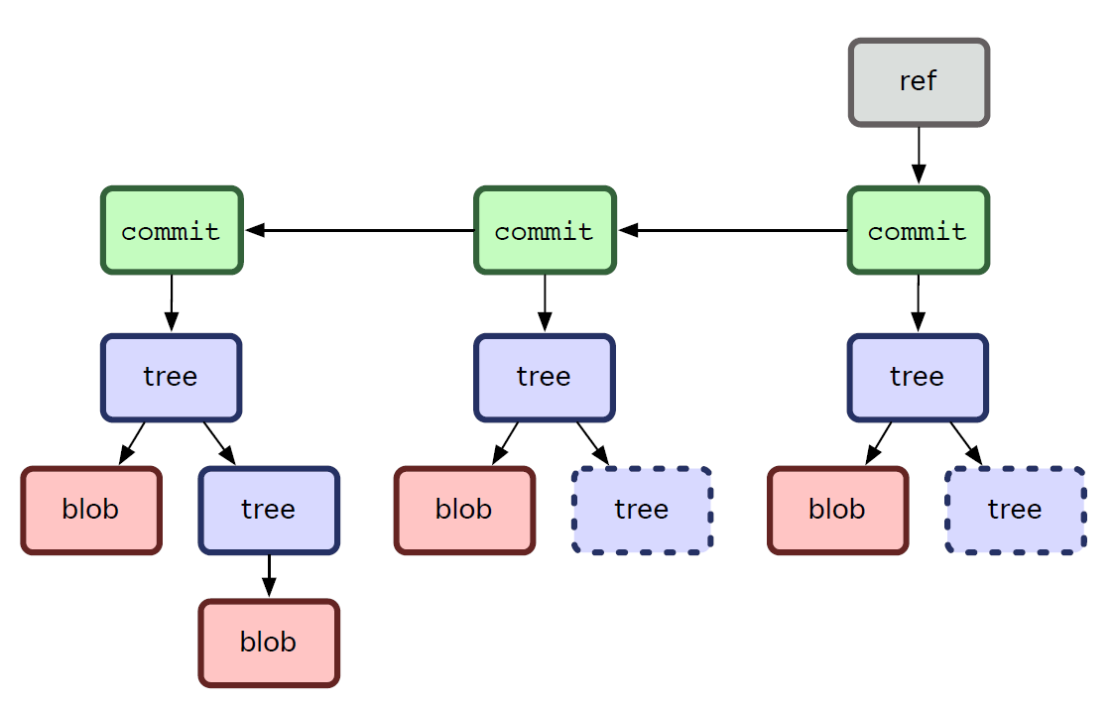
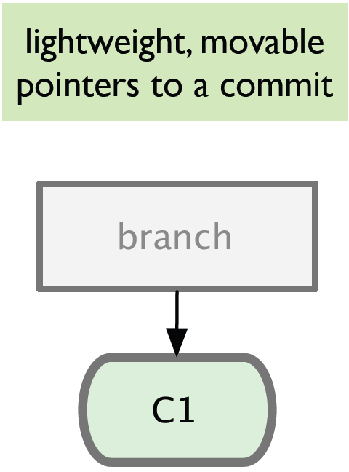
Branching
Git sees commit this way…
Branch annotates which commit we are working on

Slide 24
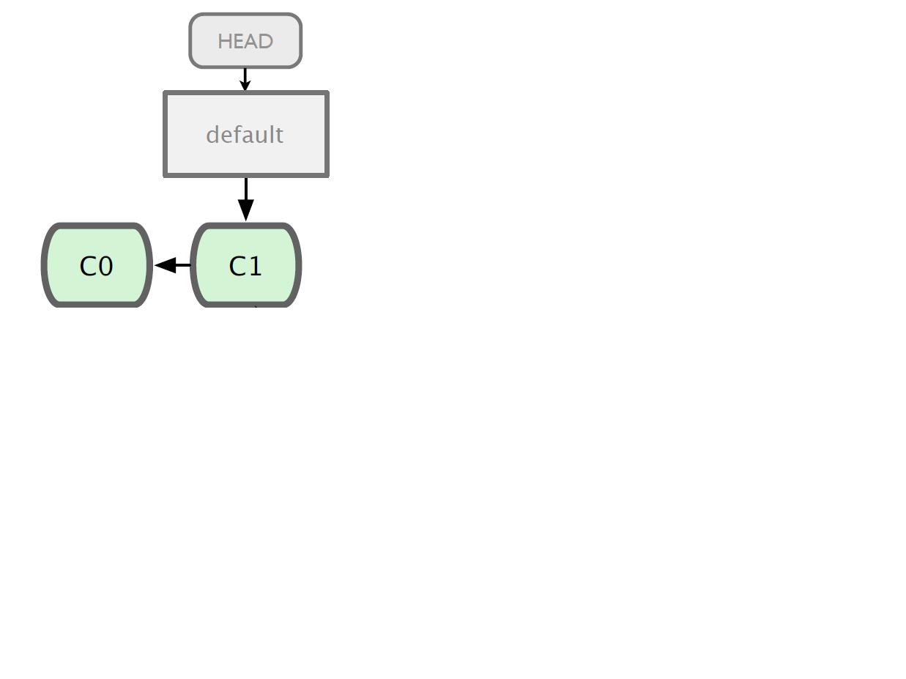

Branching

Slide 25
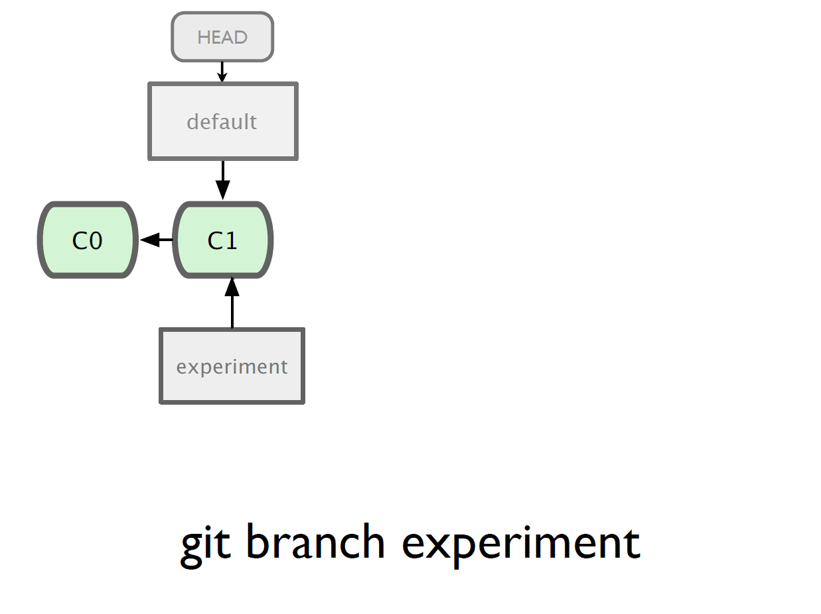

Slide 26
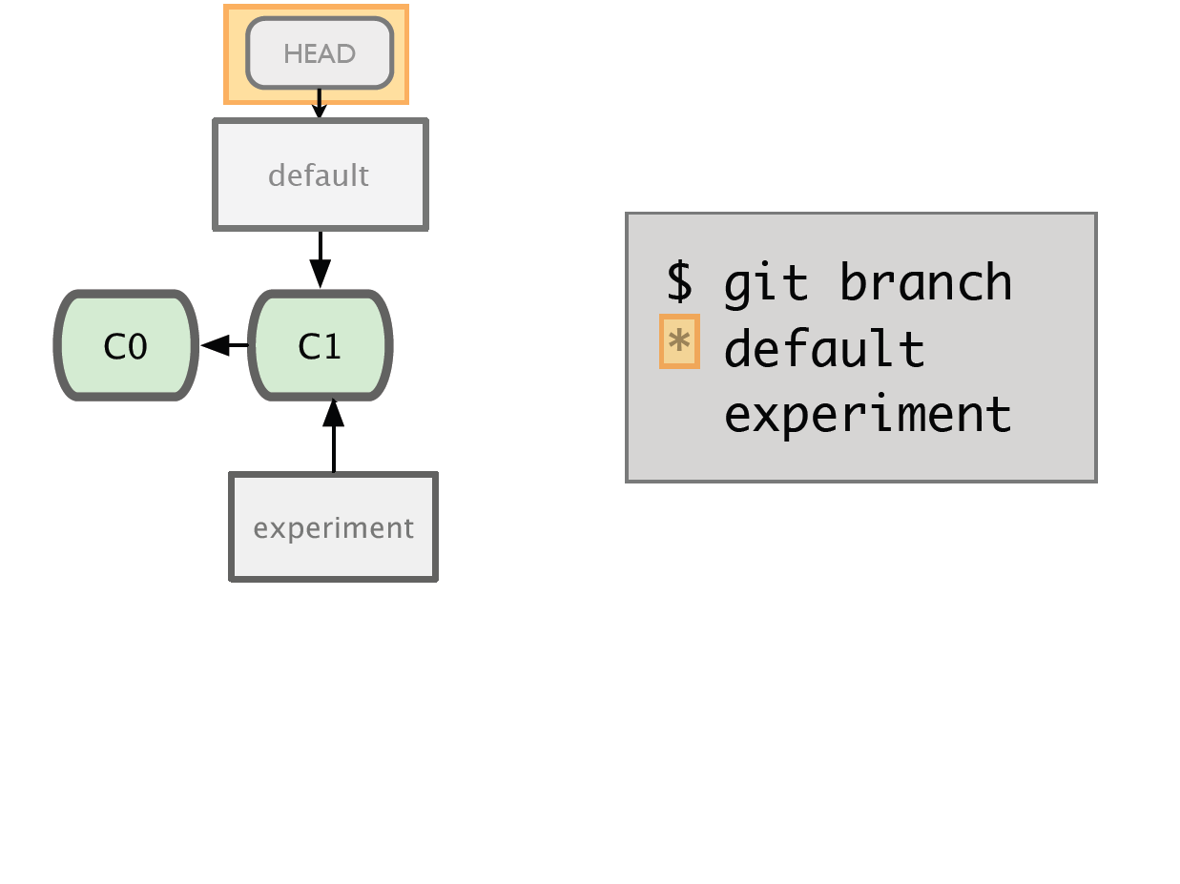

Slide 27
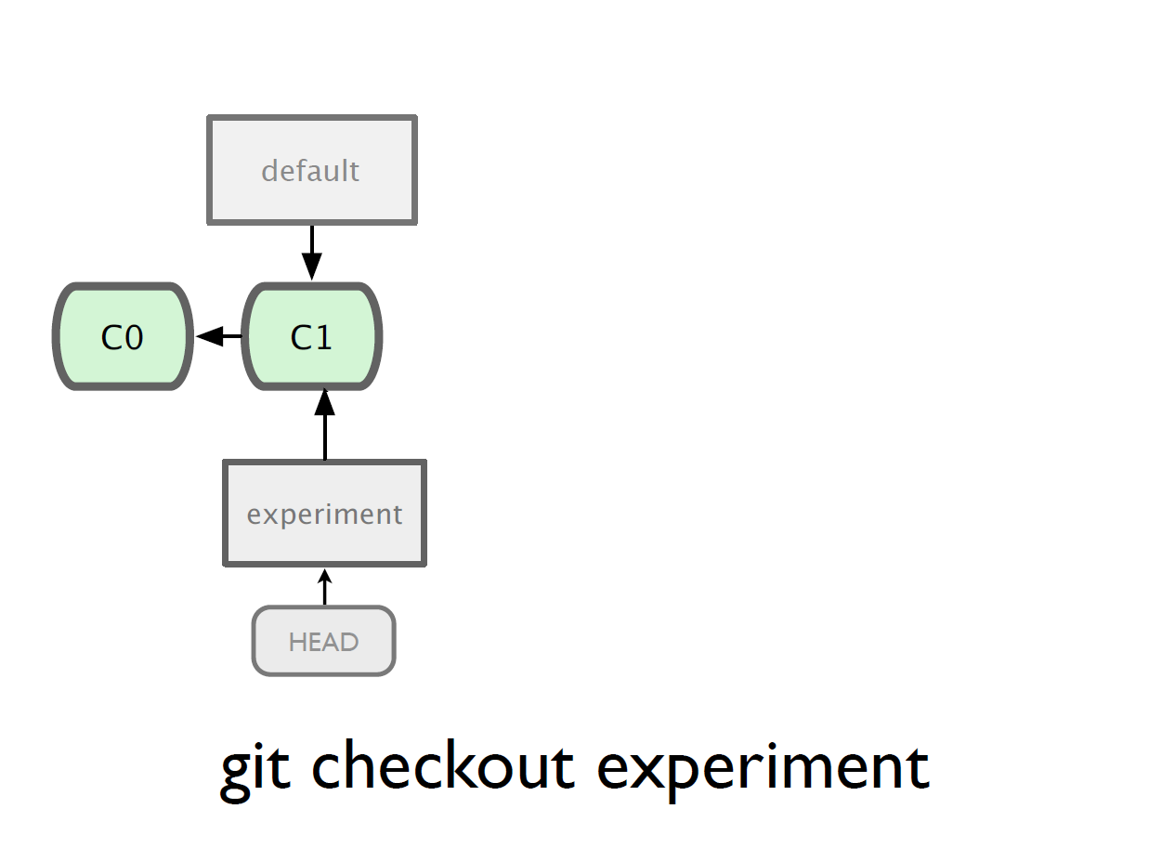

Slide 28
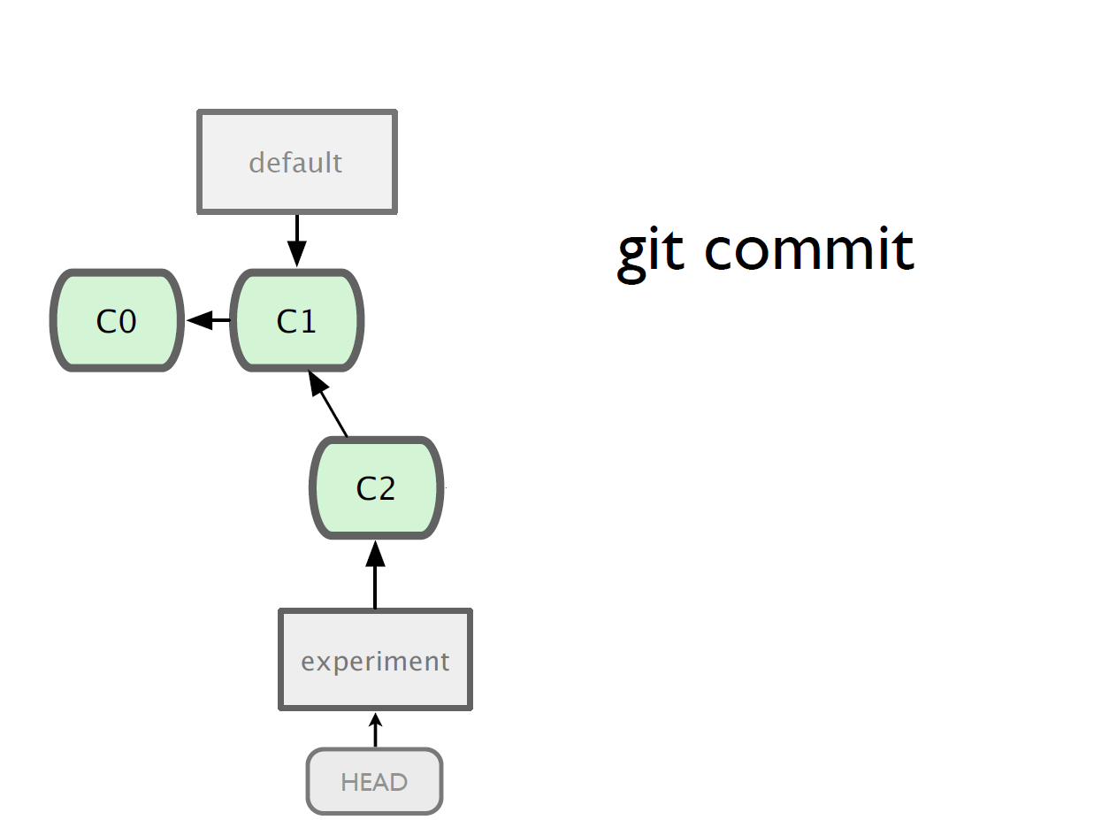

Slide 29
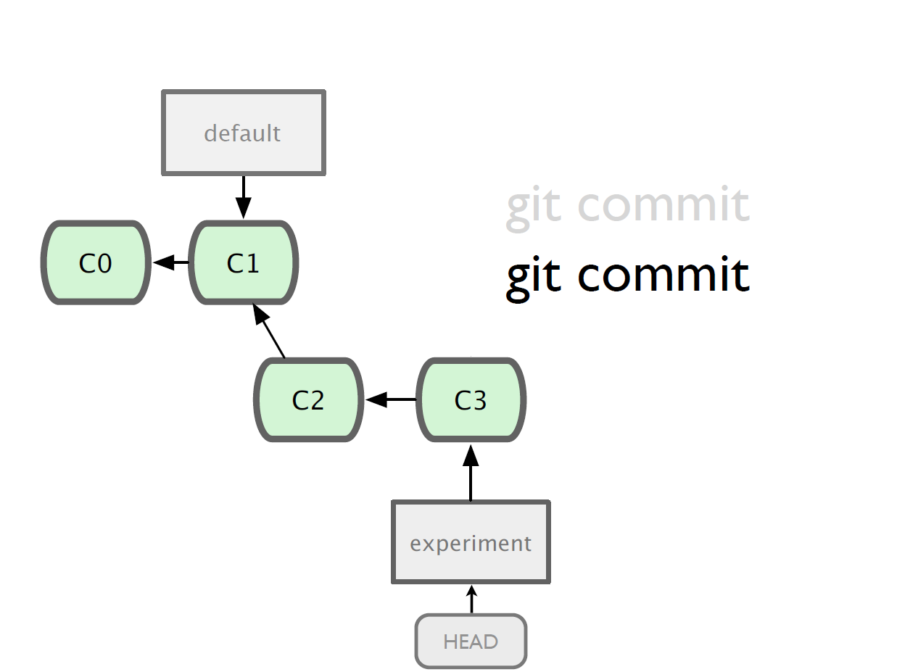

Slide 30
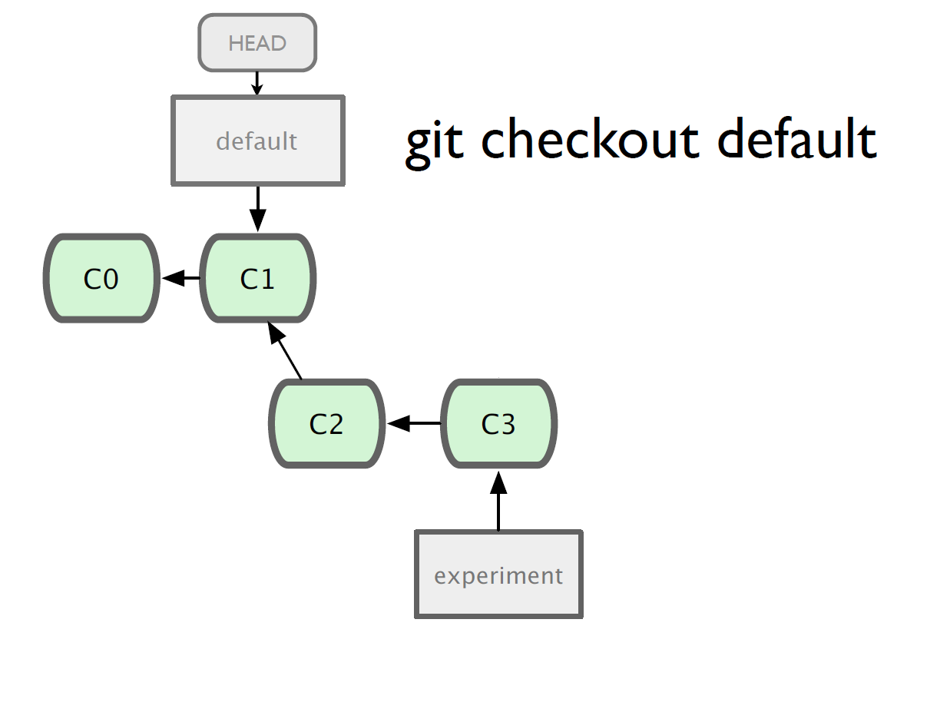

Slide 31
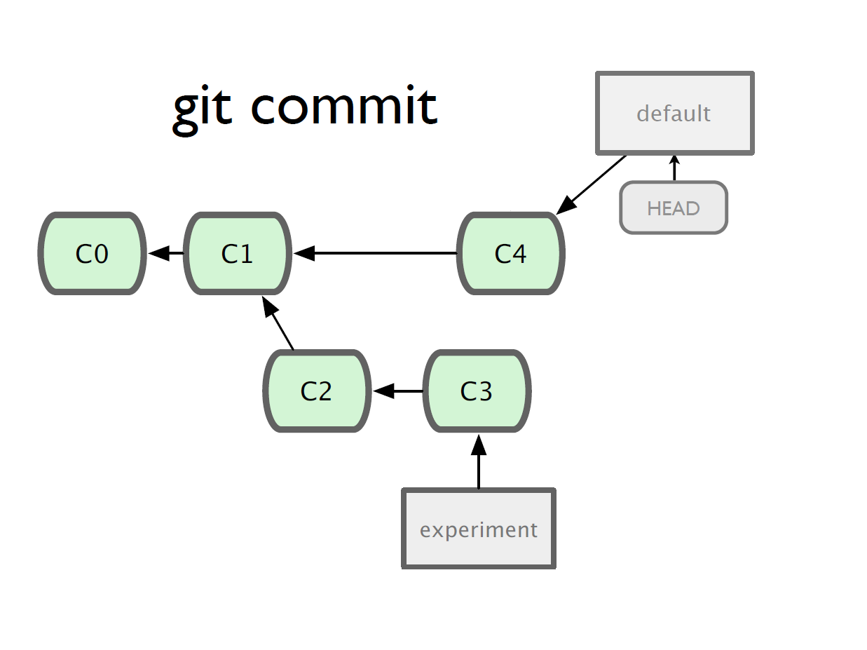

Slide 32
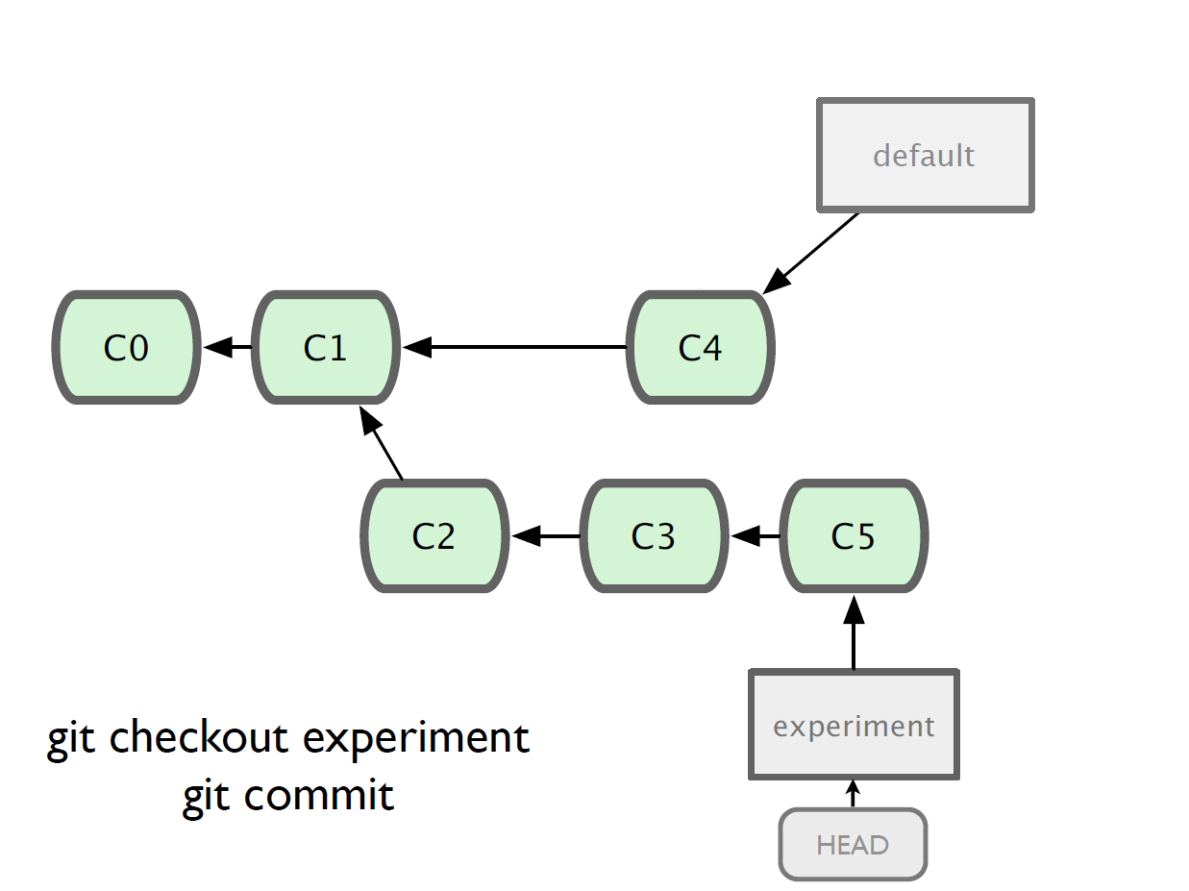

Slide 33
Merging
What do we do with this mess?
  Merge them

Slide 34
Merging
Steps to merge two branch
  Checkout the branch you want to merge onto
  Merge the branch you want to merge

Slide 35
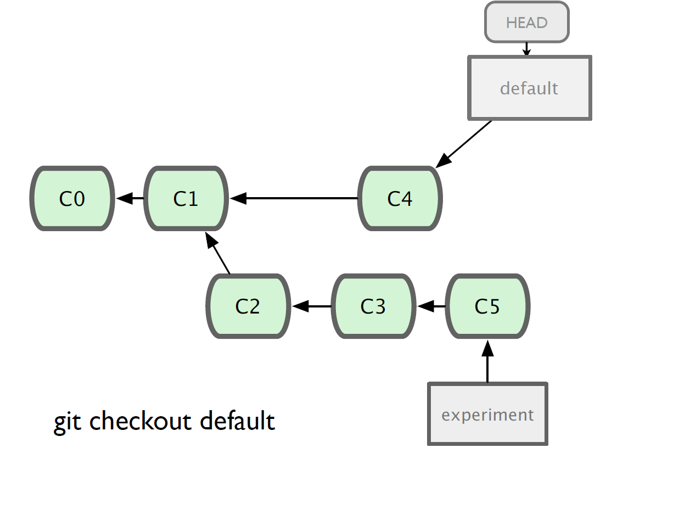

Slide 36
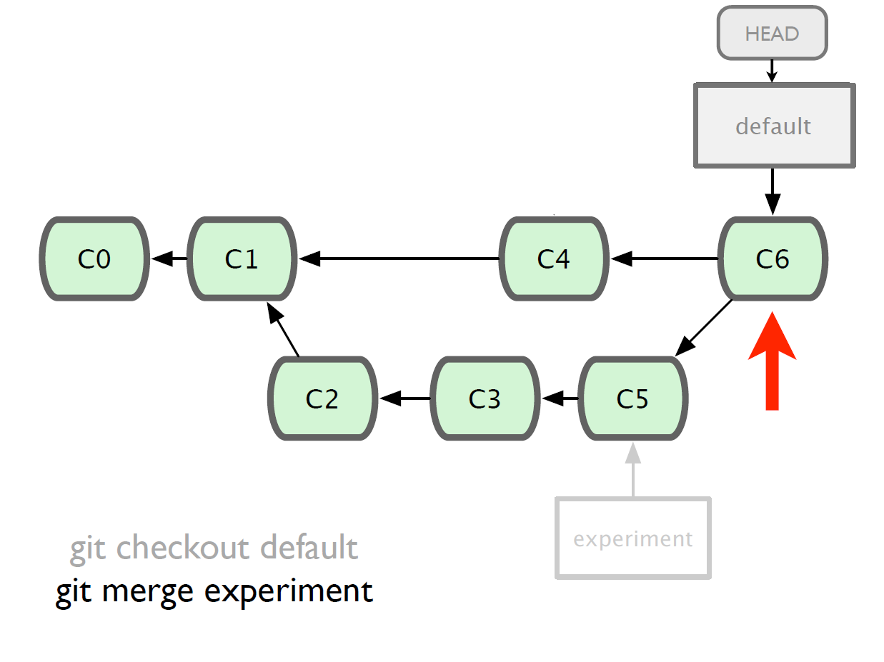

Slide 37
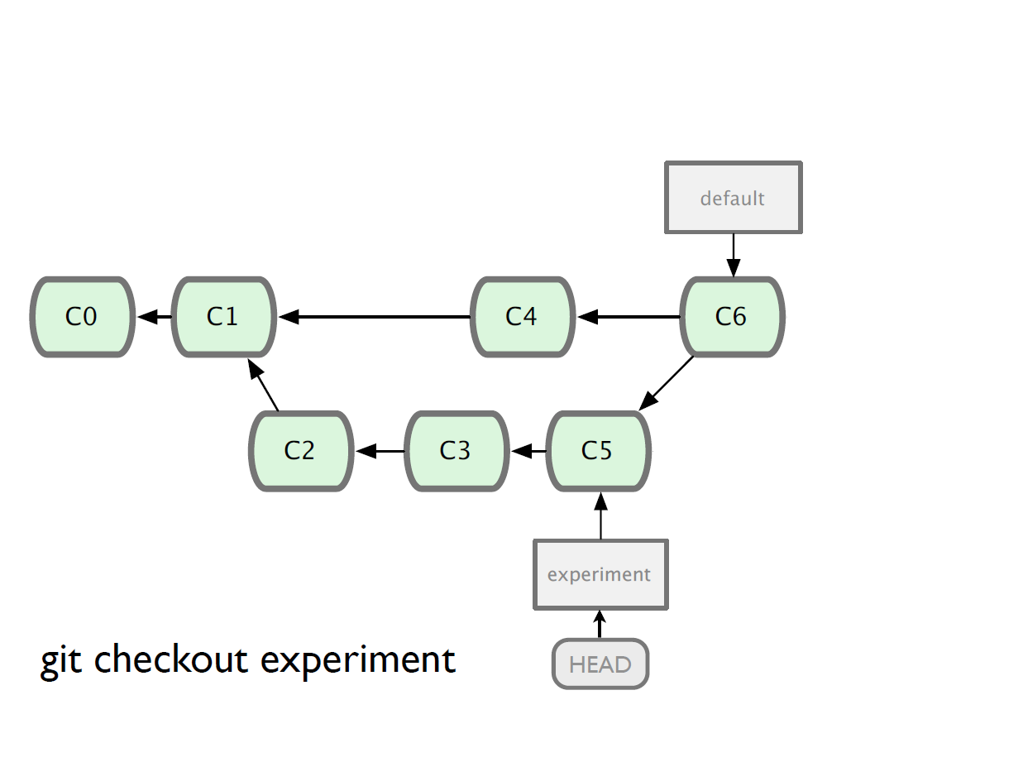

Slide 38
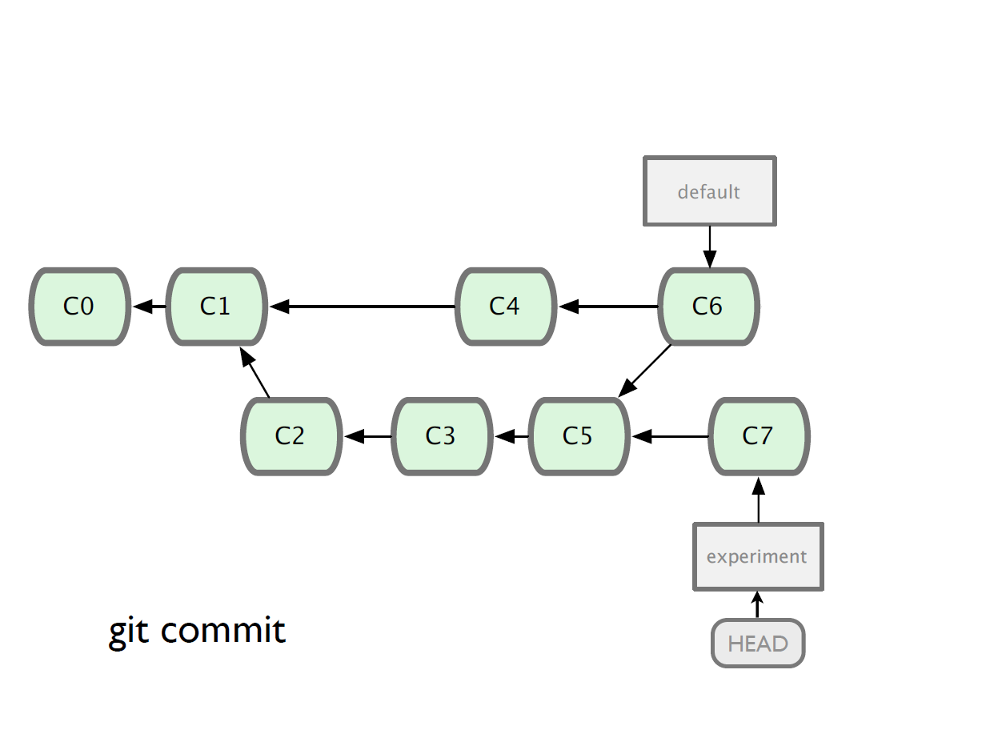

Slide 39
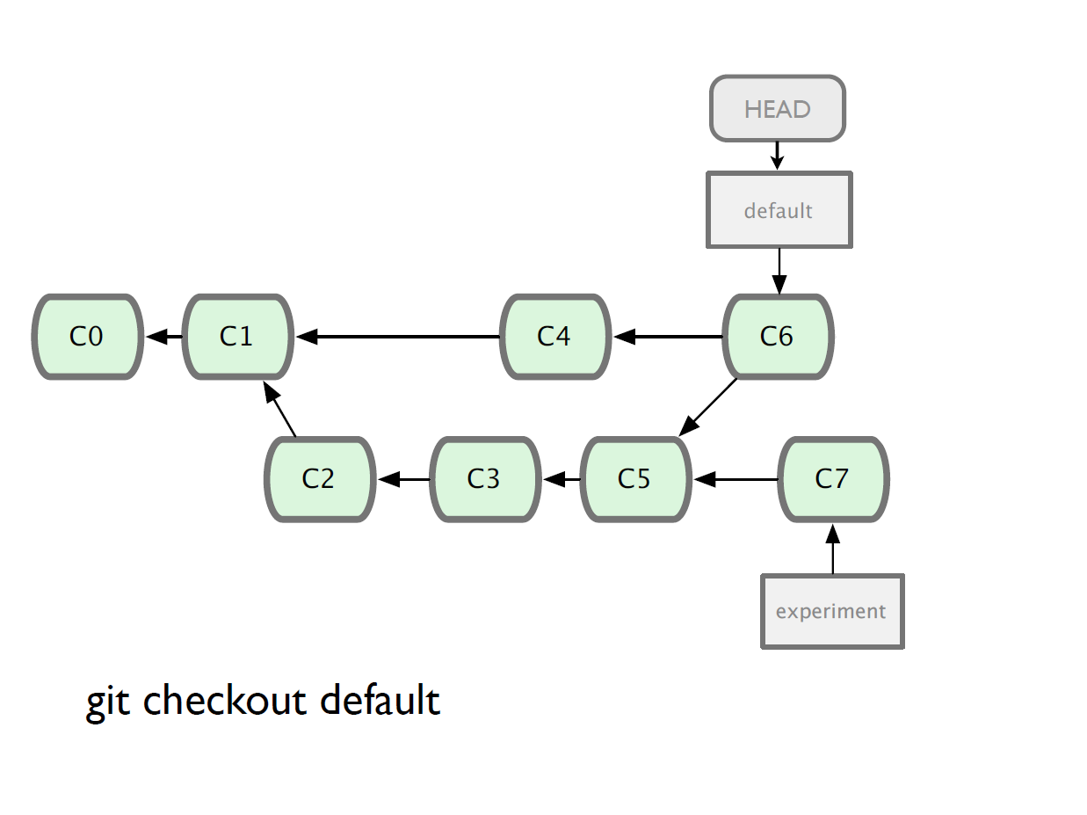

Slide 40
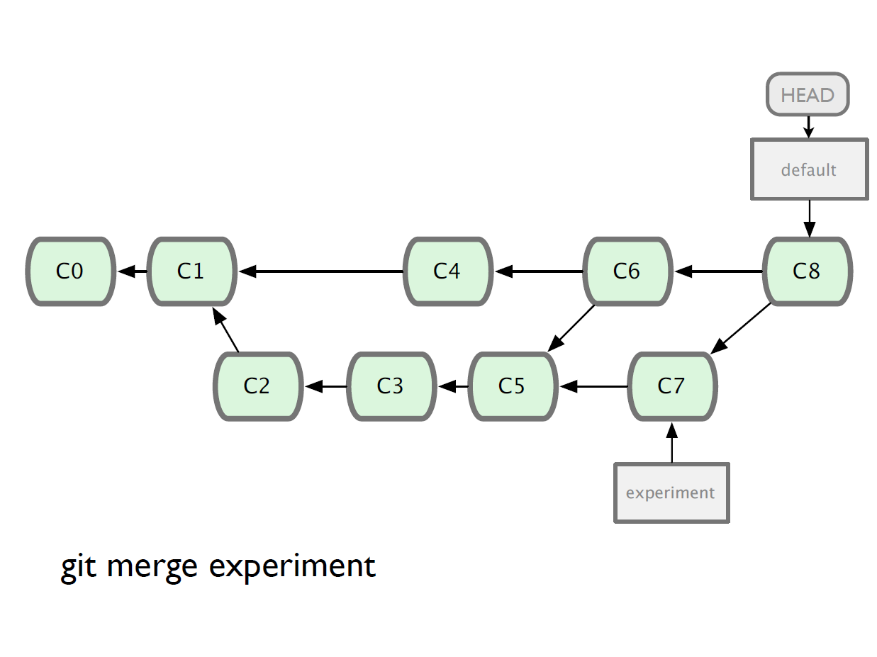

Slide 41
Branching and Merging
Why this is cool?
  Non-linear development
clone the code that is in production
create a branch for issue #53 (iss53)
work for 10 minutes
someone asks for a hotfix for issue #102
checkout ‘production’
create a branch (iss102)
fix the issue
checkout ‘production’, merge ‘iss102’
push ‘production’
checkout ‘iss53’ and keep working

Slide 42
Working with remote
Use git clone to replicate repository
Get changes with
  git fetch
  git pull (fetches and merges)
Propagate changes with
  git push
Protocols
  Local filesystem (file://)
  SSH (ssh://)
  HTTP (http:// https://)
  Git protocol (git://)

Slide 43
Working with remote
One person project
  Local repo is enough
  No need to bother with remote
Small team project
  SSH write access for a few core developers
  GIT public read access

Slide 44
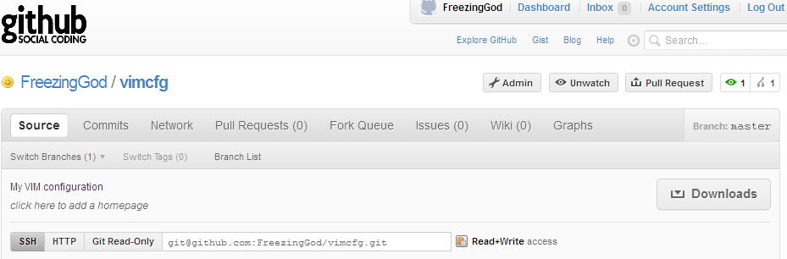
Working with remote
Use git remote add to add an remote repository
Git remote add origin git@github.com:FreezingGod/vimcfg.git
manish@manish-desktop:~/.vim_runtime$ git remote
origin

Slide 45
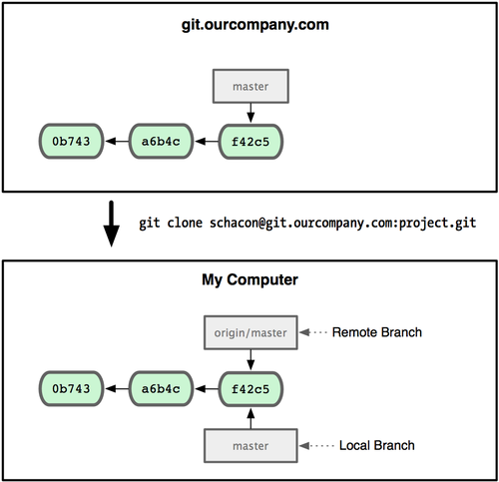
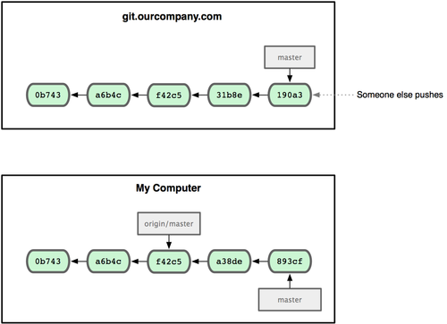
Working with remote
Remote branching
  Branch on remote are different from local branch

Slide 46
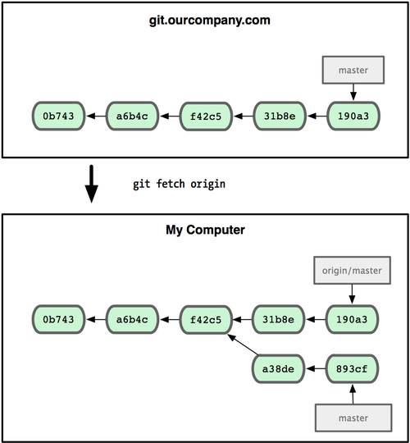
Working with remote
Remote branching
  Branch on remote are different from local branch
  Git fetch origin to get remote changes
  Git pull origin try to fetch reomte changes and merge it onto current branch

Slide 47
Working with remote
Git push remote_name branch_name
  Share your work done on branch_name to remote remote_name

Slide 48
Summary
We covered fundamentals of Git
  Three trees of git
    HEAD, INDEX and working directory
  Basic work flow
    Modify, stage and commit cycle
  Branching and merging
    Branch and merge
  Remote
    Add remote, push, pull, fetch
  Other commands
    Revert change, history view

Slide 49

Summary
However, this is by no means a complete portray of git, some advanced topics are skipped:
  Rebasing
  Commit amend
  Distributed workflow
For more information, consult
  Official document
  Pro Git
    Free book available at http://progit.org/book/

