Slide 1
WELCOME
TO OUR PRESNETATION

Slide 2
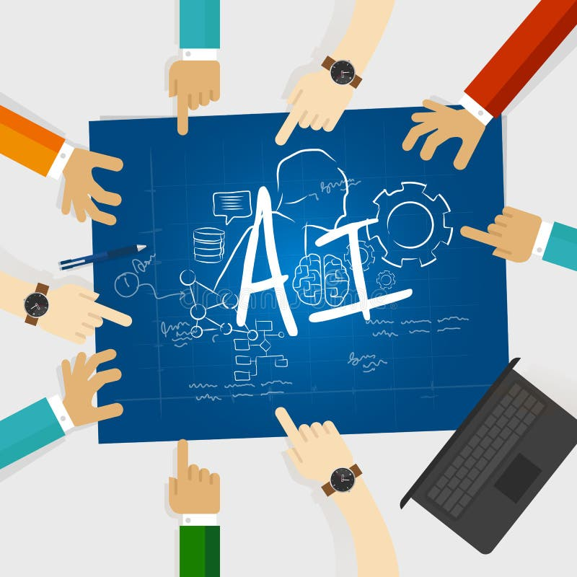
AI in the Future
. What is the Future of AI?
Artificial Intelligence is expected to become more advanced and integrated into our daily lives. It will help people work more efficiently, solve complex problems, and improve services across many industries

Slide 3
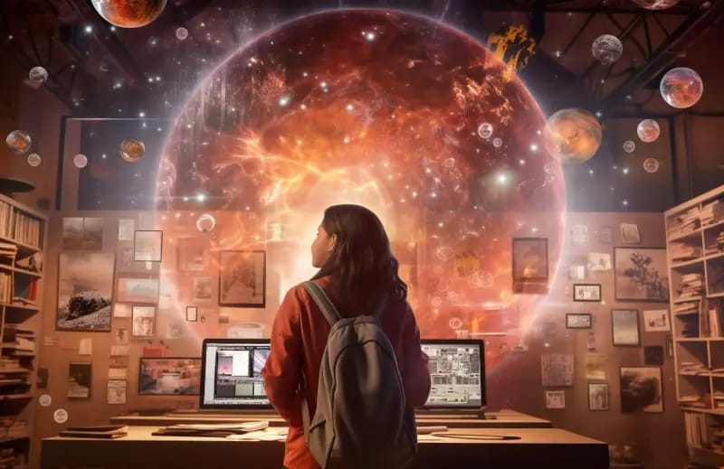
What is the Future of AI?
INTRODUCTION
Artificial Intelligence is expected to become more advanced and integrated into our daily lives. It will help people work more efficiently, solve complex problems, and improve services across many industries.

Slide 4
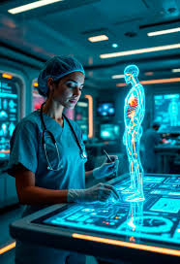
AI in Healthcare
Future Applications:
Early disease detection
Personalized treatment plans
AI-assisted robotic surgeries
Faster drug discovery
Remote patient monitoring
Explanation: AI will help doctors diagnose diseases more accurately, recommend treatments based on individual needs, and improve patient care.

Slide 5
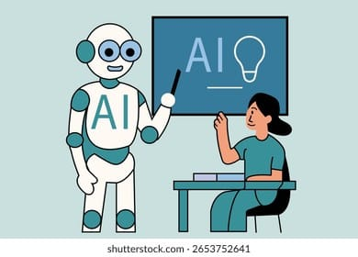
AI in Education
Future Applications:
Personalized learning for every student
AI tutors available 24/7
Automatic grading and feedback
Virtual classrooms with AI assistants
Better support
for students with disabilitiesExplanation: AI will make learning more interactive and adapt lessons to each student's pace and learning style.

Slide 6
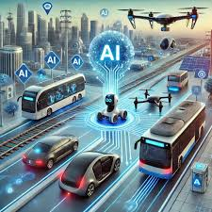
AI in Transportation
Future Applications:
Self-driving cars
Smart traffic management
AI-powered public transport
Safer roads with accident prevention
Explanation: AI will improve transportation by reducing traffic congestion, improving safety, and making travel more efficient.

Slide 7
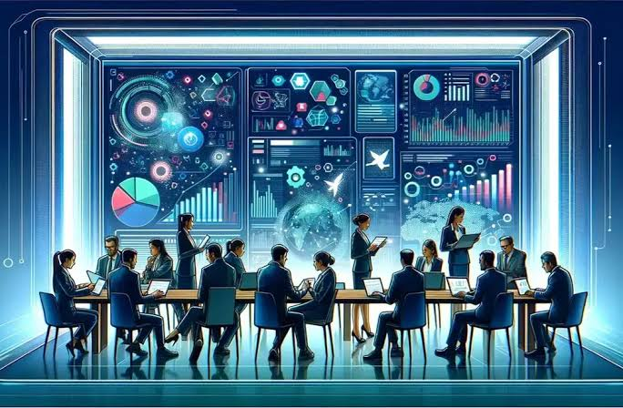
AI in Business
Future Applications:
Customer service chatbots
Market trend prediction
Automated business operations
Personalized shopping experiences
Explanation: Businesses will use AI to increase productivity, improve customer satisfaction, and make better decisions.

Slide 8


