Slide 1

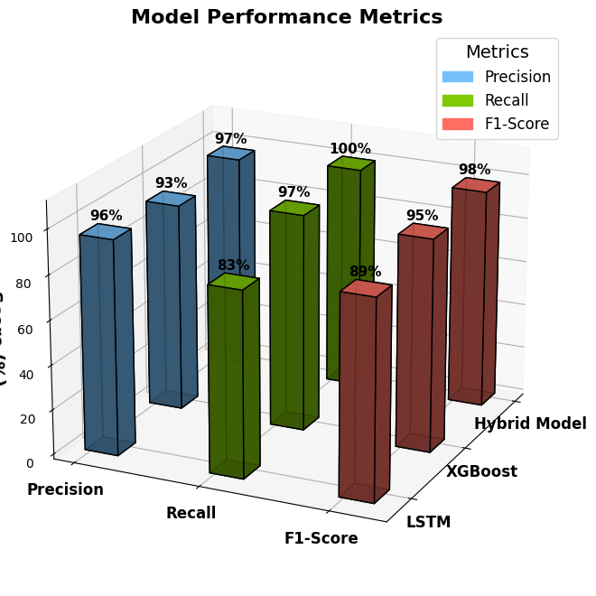
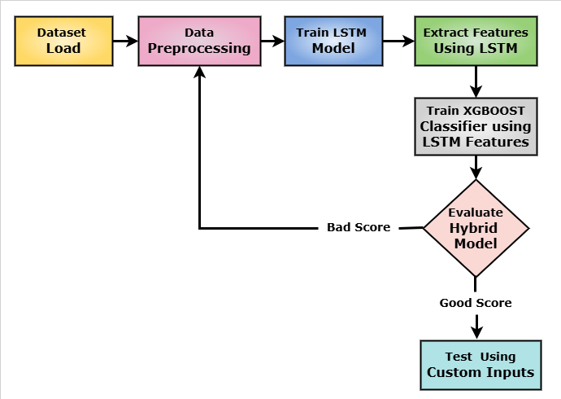
HYBRID XGBOOST-LSTM MODEL FOR identification OF Parkinson's disease using VOICE DATA
Presenter Names: Komal, Rishitha, Varsha, Manjusha
Guide Name: Chandrakanta Mahanty
INTRODUCTION
FINDINGS AND RESULTS
Parkinson's Disease (PD) is a progressive neurodegenerative disorder impacting movement, speech, and coordination as a result of damage to dopamine-producing neurons within the brain.
Hybrid Model (LSTM + XGBoost) for PD Diagnosis at an Early Stage
Non-invasive, cost-effective substitute for traditional methods.
Extracts vocal features (MFCCs, jitter, shimmer) for classification.
LSTM for feature extraction, XGBoost for ultimate prediction.
Web interface for real-time vocal data analysis.
Improves accessibility and clinical decision-making.
METHODS
CONCLUSIONS
The proposed hybrid model efficiently integrates XGBoost and LSSTM to enhance the accuracy and efficiency of Parkinson's Disease diagnosis. With performance metrics showing high accuracy (0.97) precision (0.97), recall (1.00), F1-score (0.98) and ROC-AUC (0.99) the model offers a significant improvement over traditional diagnostic approaches. PD detection is a rapidly changing system which can transform early PD detection and enhance patient care
DATA ANALYSIS
REFERENCES
The data has voice-based features (22 parameters) from patients with and without Parkinson's.
Important features: MDVP:Fo(Hz), Jitter, Shimmer, HNR, PPE, Spread1, Spread2, D2 (measuring vocal instability).
Target variable (status): 1 (Parkinson's) or 0 (Healthy).
Methods Used:-
✔ Data Preprocessing – Standardization using StandardScaler, train-test split (80-20).
✔ Feature Extraction – LSTM (128→64 units) learns deep speech patterns.
✔ Classification – XGBoost predicts Parkinson's from LSTM-extracted features.
✔ Web Deployment – Web-based UI for user interaction and prediction.
1. Fang, Zhaozhao. "Improved KNN algorithm with information entropy for the diagnosis of Parkinson's disease." 2022 International Conference on Machine Learning and Knowledge Engineering (MLKE). IEEE, 2022.
2. Alshammri, Raya, et al. "Machine learning approaches to identify Parkinson's disease using voice signal features." Frontiers in artificial intelligence 6 (2023): 1084001.
3. Govindu, Aditi, and Sushila Palwe. "Early detection of Parkinson's disease using machine learning." Procedia Computer Science 218 (2023): 249-261.
4. Nalini, M., Mary Joy Kinol, and N. Vijayaraj. "Parkinson's Disease Detection by Machine Learning." 2023 Intelligent Computing and Control for Engineering and Business Systems (ICCEBS). IEEE, 2023.
5. Hussain, Sayyed Shahid, et al. "Classification of Parkinson’s disease in patch-based MRI of substantia nigra." Diagnostics 13.17 (2023): 2827.
CSE, GST, Visakhapatnam

