Slide 1

Presented By:
RakheeKumari Singh
Komal Raval

Slide 2
Technologies Used
User- Interface
Cordova
Angular JS
HTML5 with ionic framework
Server
Web API with ASP.Net
Entity Framework
Backend
Sql server (* we have used entity framework so we can transit to MySql very quickly and easily with minimal effort)

Slide 3
Pre-requisition
Visual Studio 2013 onwards
SQL server (As of now)
Install Cordova (if required)
npm install -g cordova – Run this command in CMD
Install Ionic from NuGet package
Geo Location

Slide 4
Functional Achievements
It is working on below platforms .
Android
IOS
Windows
It is not a native app
Used entity framework, so database technology can be changed easily with minimal efforts.
User interface is user friendly so it is very easy to use
By using Ionic , look and fell of UI is good.
It can be run on mobile without going through multiple processes.
It is very easy to install on any mobile (Android, IOS, windows)

Slide 5
List Of Modules:
Login (Change Password/ Forgot password)
Signup
Inventory
In Transit
Personnel
Reports

Slide 6
Login (Change Password/ Forgot password)
It allows user to login into Inventory management app using their login credentials.
Login credentials being created while doing SignUp with the APP.
From this screen it allows user to do forgot password if required.
New user can do new registration from tis screen
UserName or Password is not correct it throws an error saying that username or password is not correct
User can do forgot password if they have forgot it.
If user want to do forgot password , they have to just enter their username and they will receive email for new password.
They can login into app using that password

Slide 7
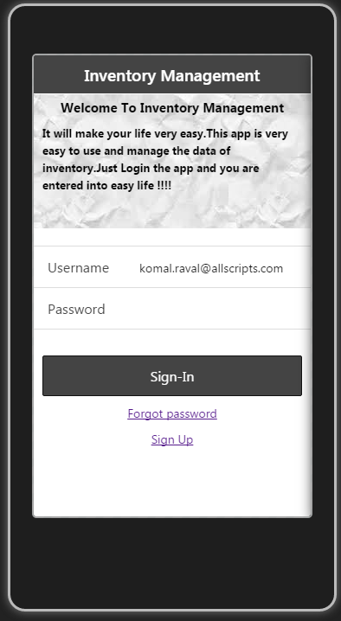
This is the first screen, which user will be able to see on clicking upon the icon of Inventory Management App.

Slide 8
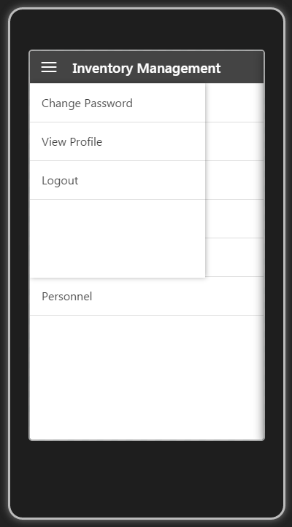
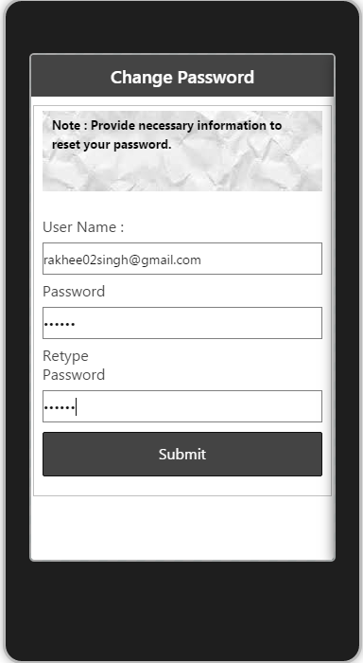
Clicking upon the Change Password link, user will get the screen shown in right side.
Where they have to enter username, password and confirm password.

Slide 9
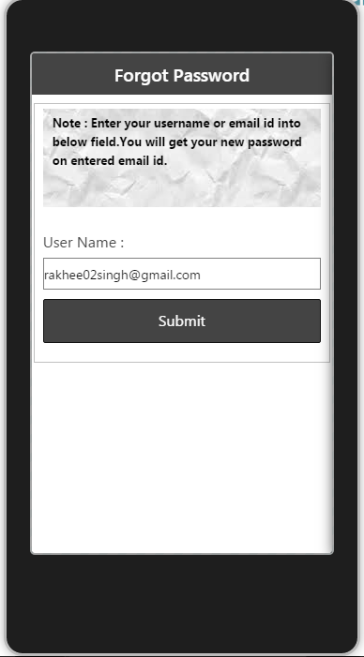
User needs to enter their email Id(username) and they will get am email on entered email id with their new password. By using that password user can login into the app.
Clicking upon this link, user will get the screen shown in right side.

Slide 10
Sign-Up
It allows user to do first time registration for new user
It prevents user to create multiple account if they have already registered with us
User don’t have to enter their password while doing registration
Password being send via email to the user , It sent password to the
Email contains new user password (It would be unique random number)
Once user has done with the registration , it will redirect to login page
User has to take their password from email and login into the App using that password
Once user is able to login into the app successfully they can change their password if they want

Slide 11
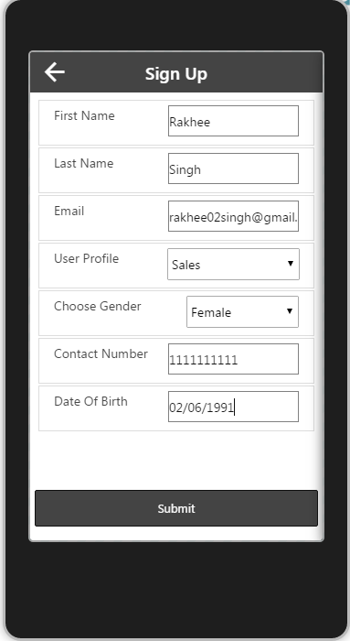
User need to add basic details of them , and they will get the email on mentioned email id. When user will verify that email then only he/she can able to login the app.
Clicking upon this link, user will get the screen shown in right side.

Slide 12
Inventory
It shows list of inventory exists in the system
It allows to save the inventory details to the system
We can search the inventory items using search option
Search option is customized so that user can search it easily
If user wants to delete the inventory details they can delete it using the swap
Navigation of inventory functionality is very user friendly so anyone (Technical or nontechnical ) person use it easily.
We can see all the inventory details which is exists in our system
We can see specified items details
We can see summarized items details using specific search option

Slide 13
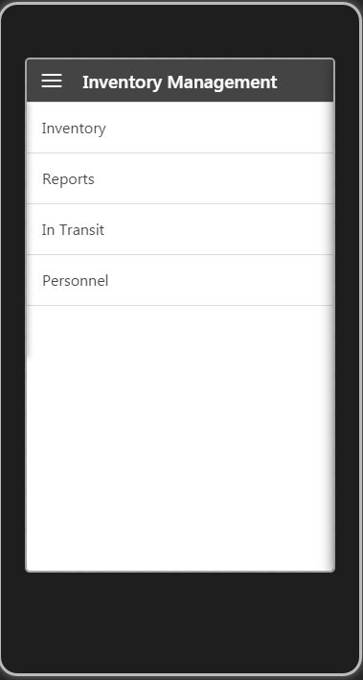
When user will login into the app,he would be able to see this screen first. Which contains list of main functionalities.
On clicking of toggle icon it will display the drawer with the settings of the app.

Slide 14
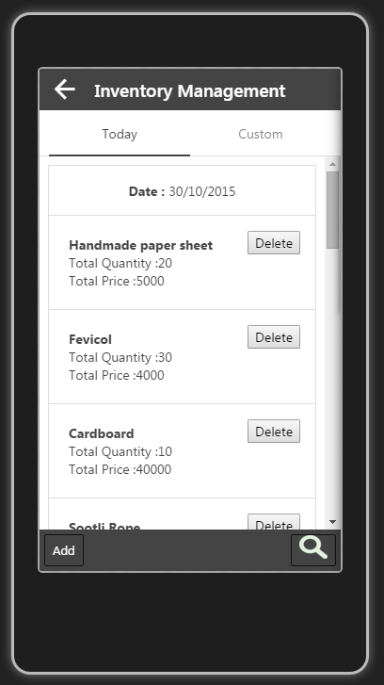
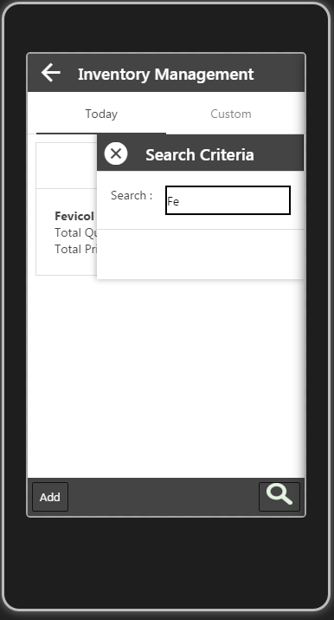
When user will write any latter in the search box, it will display only the inventory items which is having that latter at that moment. As you can see I have written only Fe, and the list below this box is already sorted.
When user will click on Inventory menu, they would be able to list of inventory items with the details of Total Cost of that item and the total Quantity.
Displaying todays date.
Back button will take user again to the main menu screen
When user will click on this search icon one drawer will come from the right hand side. To hide that drawer use can click again on the search button or on the close button of the drawer.

Slide 15
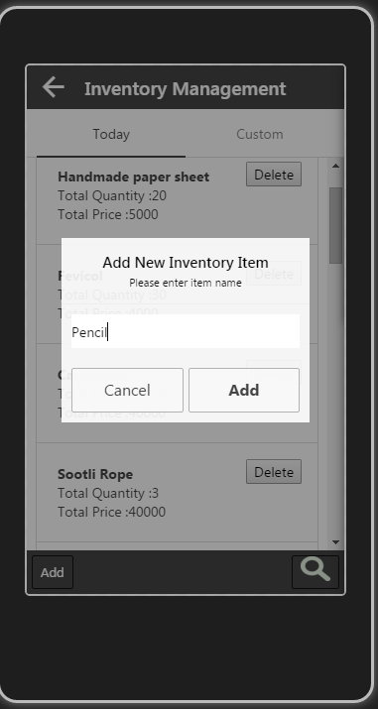
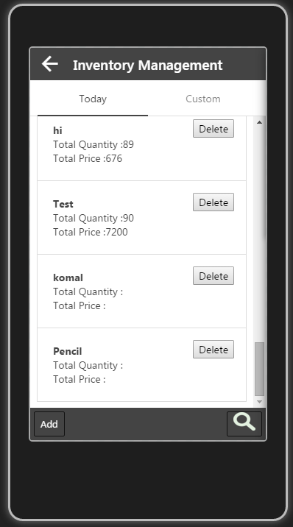
Here Pencil object is has been added to the list items with Total Quantity and total price with 0. This values would be updated when user will click on this item and will insert the values.
When user will click on Add button, he will get this popup. Here I am adding Pencil Item into the system.

Slide 16
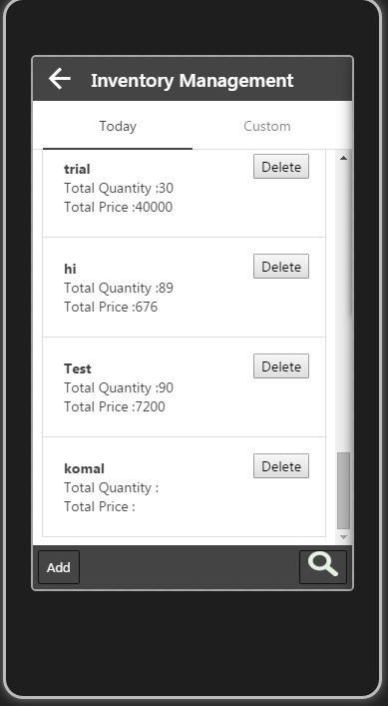
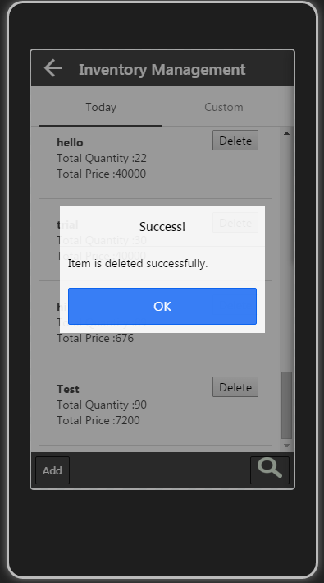
As shown in the left image ,I am deleting Komal item from the list. And in the right side image it is showing that Komal is deleted immediately and it is showing the Success message

Slide 17
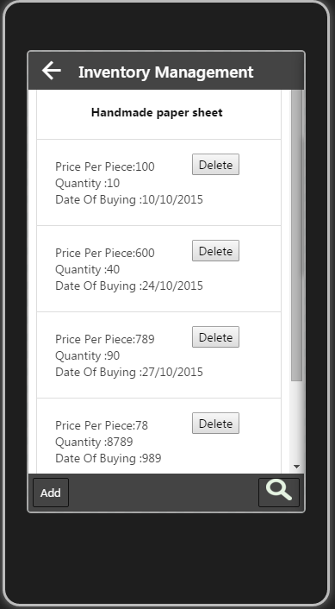
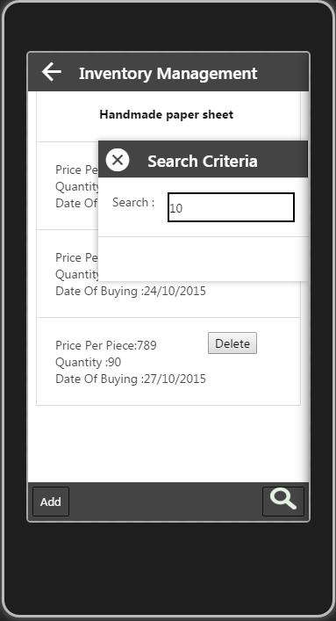
When user will select any Inventory item, then they will get this page. Suppose Handmade Paper Sheet is selected
Here each item of this list is showing the details of buying date, what was the price per piece at that time and how much quantity user had ordered that item.
Add button click will take the user to the new screen.
Here also user have functionality of search. It has the same functionality as explain ago.

Slide 18
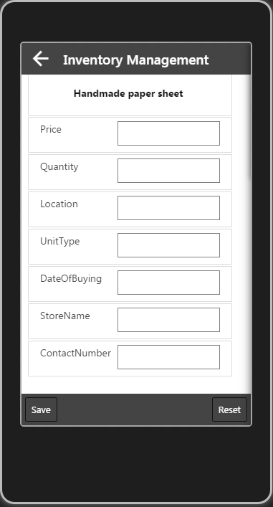
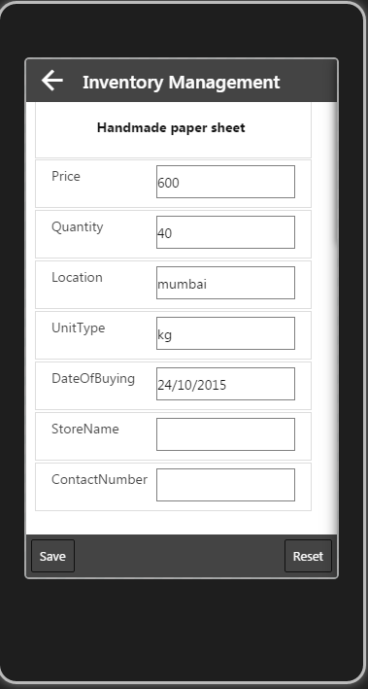
Add /Create New Entry View :
Here user need to add details of the ordered items.
Update View :
User can update the details by using this screen and also reset the values by clicking on Reset Button.

Slide 19
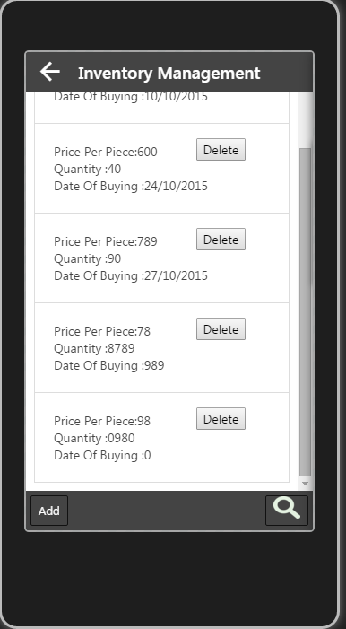
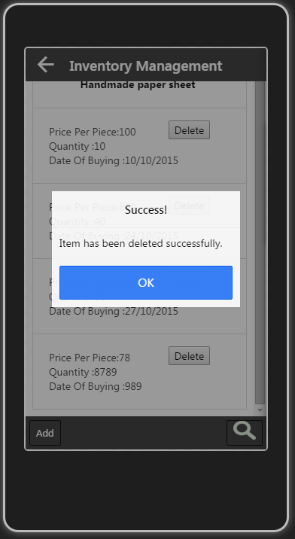
Here also we have the same functionality of delete the item details as explained before.

Slide 20
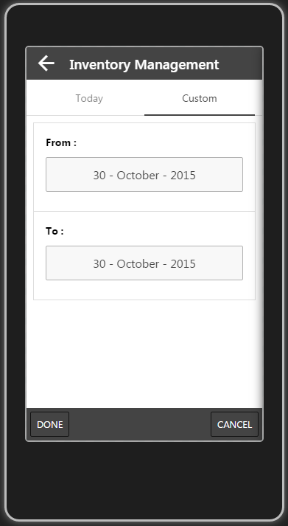
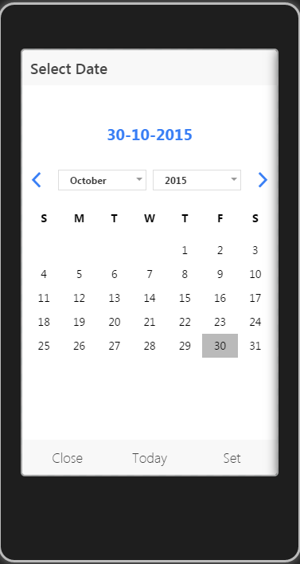
This is the custom view of the Inventory Items .
When user will click on this button, he will get the view which has shown on the right side. From there user can select date and he need to click on the set.

Slide 21
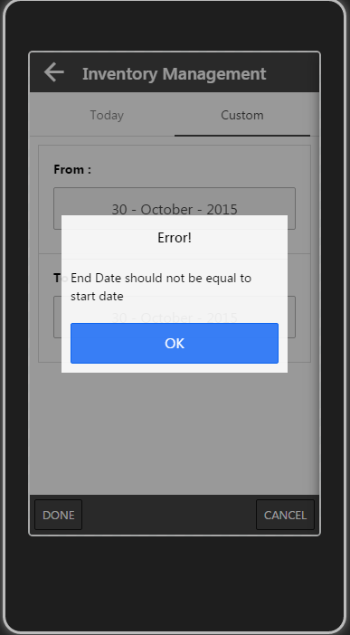
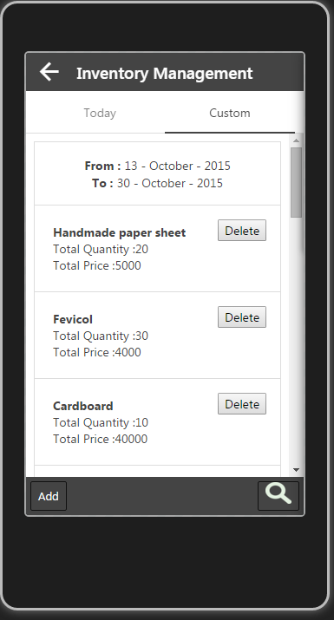
If user will keep Start date and end date same then he will get this error message, also user will get this kind of error message if he has chosen from date in future or end date is smaller than the from date.
If all validations will go right then user will get these data with From Date and To Date.
-> Here also user have the same functionality like Add and Search and update.

Slide 22
Personnel
It provides functionality to keep track of attendance of the users
Once user started their work they have to fill their attendance using this module
It askes User name and absent or present details for the specific date
If user are on leave or some reason they could not fill the attendance for that particular date then User can fill their absent or present details after one days also using the date change
It will save the data to the table, so reports can be easily generated using the that

Slide 23
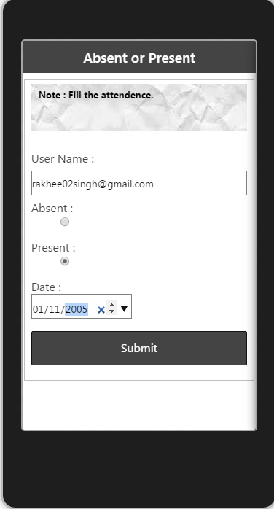
On selecting of Personnel item from the menu user will get the screen as shown on the right side
From this screen we can take a details of person’s attendance at NGO.

Slide 24
In Transit
It will track the location of inventory items
It requires to fill the truck or any transport vehicle details like Vehicle number, Driver name
It save the location information to the table
It will only save the data when internet is available and user has selected to do transit

Slide 25
Reports
Reports will display pie chart of Stock details.
User will be able to see pie chart on basis of total Items and also if he/she will choose radio button of total cost and user will be able to see pie chart of total cost.
Export functionality is under construction for the report.

Slide 26
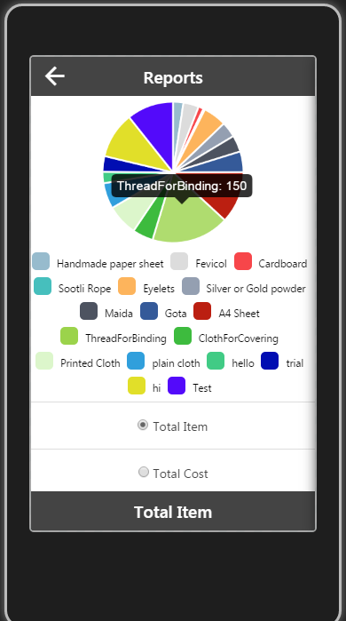
From this menu user can go to the Reports screen.
This pie chart is showing on basis of Total Items, As Total Item radio button is selected and footer also is showing Total Item. When user will hover the chart then it will display the value of total items

Slide 27
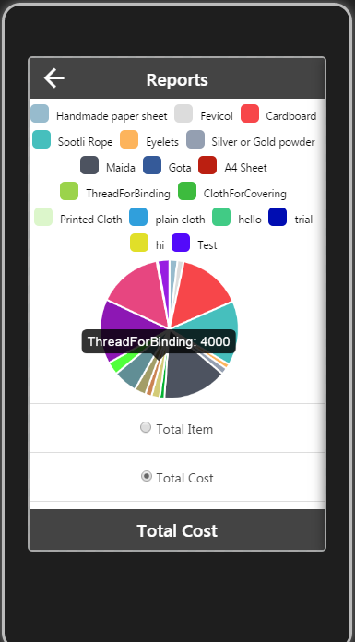
If user will select the Total cost radio button then it will display different pie chart for the costs. On hover of that portion of the chart, it will display total cost of that item.

Slide 28


