Slide 1
Candidate Workforce Analytics Dashboard
An interactive Power BI project on candidate data
Notes:
Introduce the project: a Power BI dashboard that turns raw candidate data into insights for recruiters.

Slide 2
Objectives & Tools
Objectives
Tools & Techniques
Summarize the candidate pool with KPIs
Show spread across cities and states
Analyse candidates by role
Understand experience levels
Filter everything with slicers
Microsoft Power BI Desktop
KPI cards and calculated measures
Bar, stacked bar and pie charts
List and range slicers
Consistent purple theme
Notes:
Explain what the dashboard sets out to do and the Power BI features used.

Slide 3
Dataset & Headline KPIs
263
5 yrs
58
19
7
Total candidates
Average experience
Cities
States
Roles
One record per candidate, identified by a unique Candidate ID
Key fields: Position (role), City, State and Experience (years)
Data quality check shows 100% complete records
Notes:
Describe the dataset and the headline numbers shown at the top of the dashboard.

Slide 4
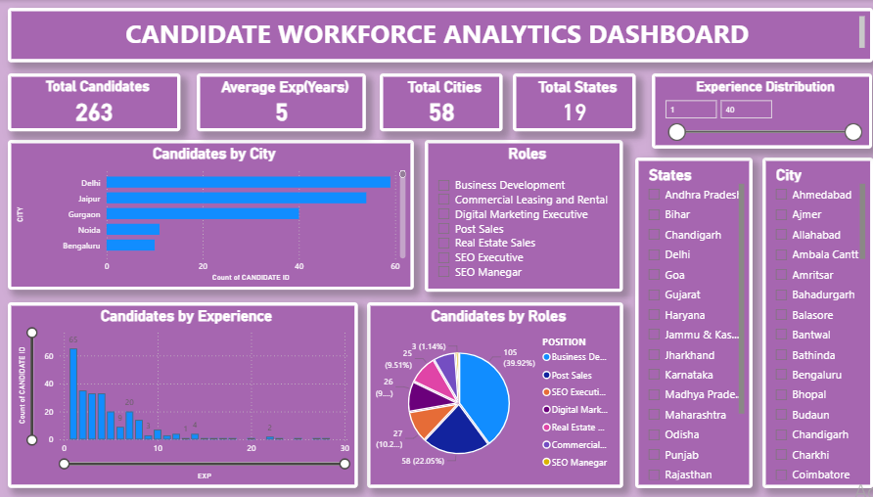
Dashboard Page 1: Overview
KPI cards and a title banner
Slicers for roles, states, cities and experience
Candidates by City, Experience and Role
Every visual updates when a slicer changes
Notes:
Walk through the overview page: KPIs, slicers and the three main charts.

Slide 5
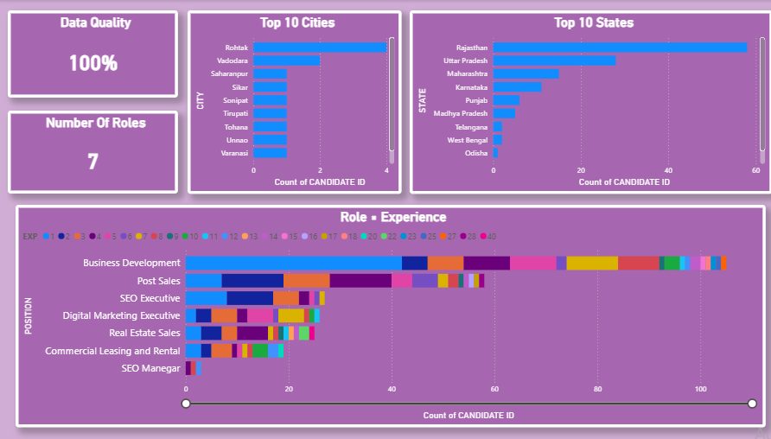
Dashboard Page 2: Detailed Analysis
Data Quality: 100%
Number of Roles: 7
Top 10 Cities and Top 10 States
Role × Experience stacked bar shows the experience mix within each role
Notes:
Explain the deeper analysis page, especially the Role by Experience chart.

Slide 6
Key Findings
Delhi, Jaipur and Gurgaon lead on city counts; Rajasthan is the top state
Many cities contribute only 1 to 4 candidates each (a long tail)
Business Development is the largest role: 105 candidates (about 40%)
Post Sales follows with 58 (about 22%); together they are about 62% of the pool
Experience is early-career heavy: the biggest group has about 1 year
Data quality is 100%, so the figures are reliable
Notes:
Summarize the main insights. Figures are read from the dashboard visuals, so quote them as approximate where needed.

Slide 7
Conclusion & Future Scope
Conclusion
Future Scope
One interactive view of the whole candidate pool
Slicers make drill-down simple
Shows practical Power BI skills end to end
Add a hiring funnel by role
Add salary and notice period fields
Add a map visual
Clean role and city names
Publish with scheduled refresh
Notes:
Close the presentation and invite questions.

