Slide 1
KOMAL SINHA
COMMANDS AND THEIR DESCRIPTIONS

Slide 2
cat – displaying the contents of the file
Touch – creating a new file
Nano – editing the required file (ctr+s-saving, ctr+x-returing to the terminal)
Ls – listing all the files
Ls –a – listing all the hidden files
Clear – clearing the screen
Wc – word count
Wc –l – counting the number of lines
Wc –w – counting the number of words
Wc –c – counting the number of characters
Pwd – displaying the present working directory
Whoami – getting your own info
Date- displaying the date
Cal – displaying the current calender month and other details

Slide 3
Cp – copying the contents ( src file destination file)
Mv – moving the contents of one file to another (src file destination file)
Rm – removing the files
Rm –r – removing the directories
Mkir – making a directory
Chmod – changing the permissions of the file or directory
Umask – getting the hidden permission number
Chown – changing the owners
Chgrp – changing the groups
Echo – displaying a message

Slide 4
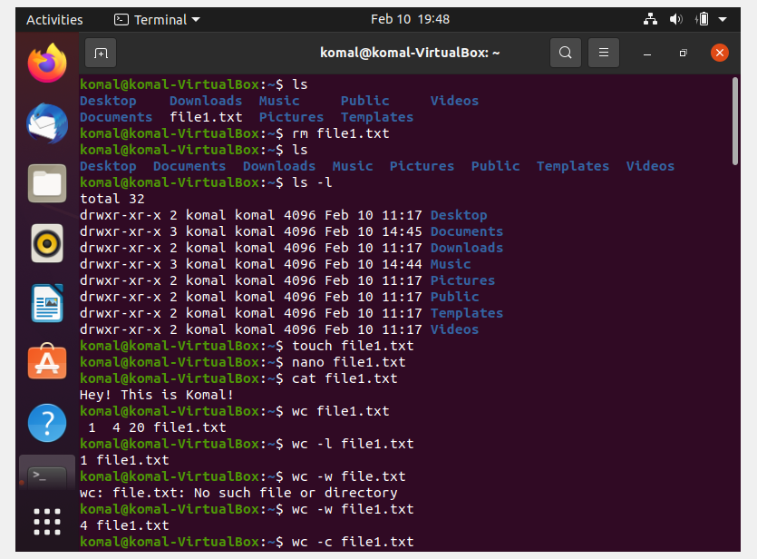

Slide 5
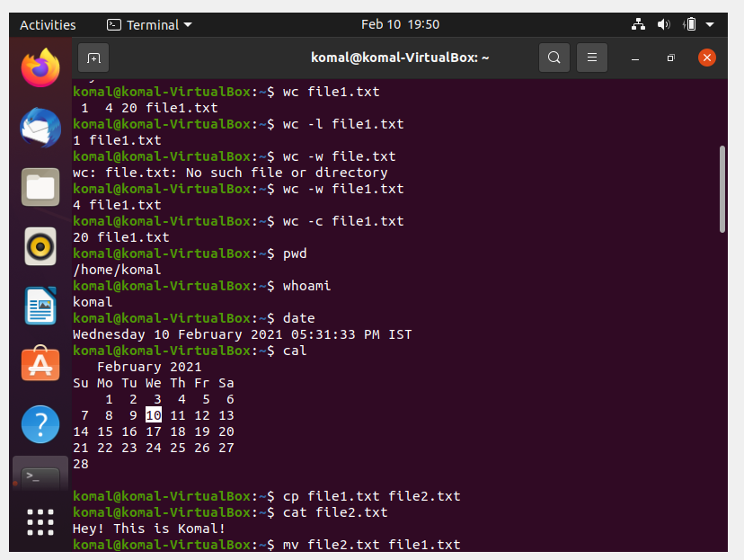

Slide 6
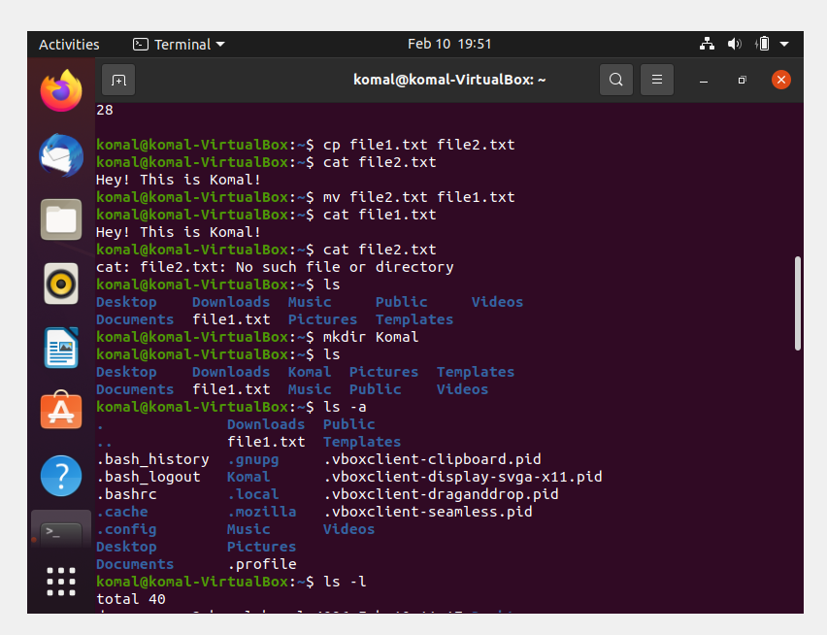

Slide 7
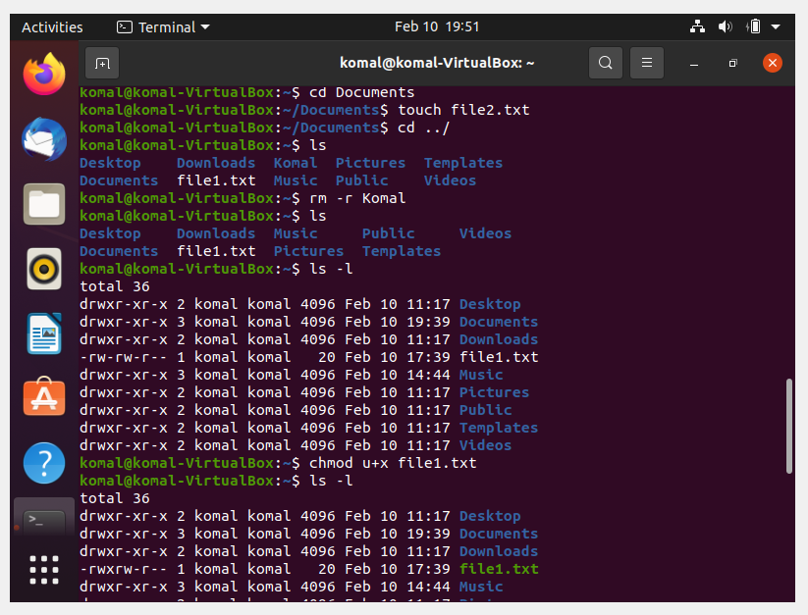

Slide 8
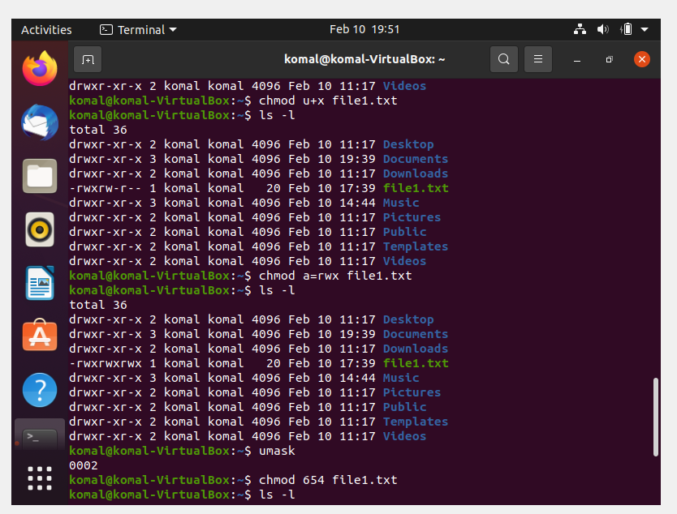

Slide 9
