Slide 1
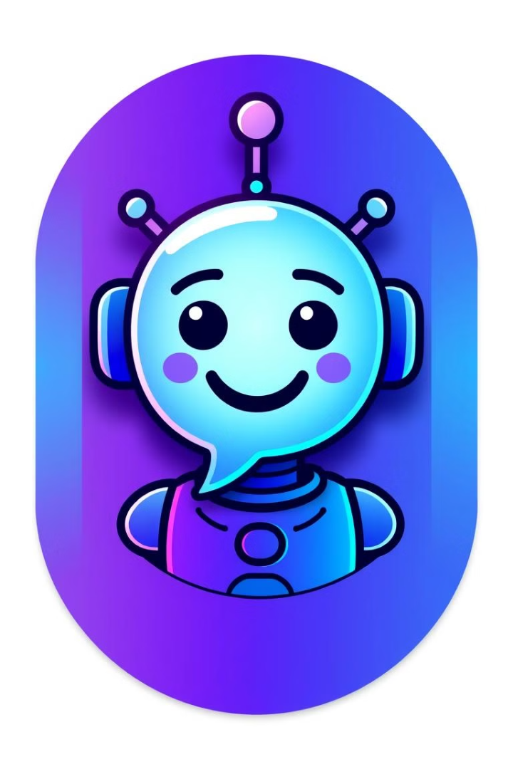
ChatEase: Smart WhatsApp Bot for Businesses
ChatEase is an AI-powered WhatsApp bot designed for small/large businesses. It helps reduce customer support workload and provides instant, intelligent communication solutions.

Slide 2
The Customer Support Challenge
Repetitive Queries
Operational Costs
Small businesses are often overwhelmed by repetitive customer queries.
Manual responses lead to slow response times, high operational costs, and customer frustration.
Support teams spend 3-4 hours daily on basic questions.

Slide 3
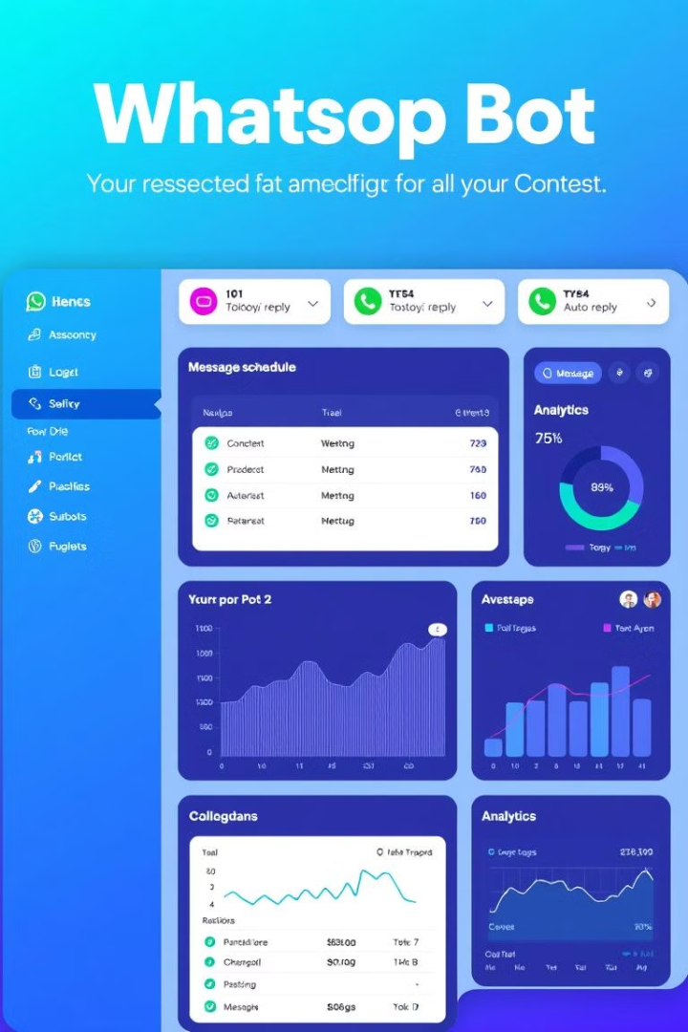



ChatEase: Your Smart Communication Solution
No-Code Dashboard
Quick Setup
15-minute setup process.
Easy-to-use WhatsApp bot dashboard.
Customizable Workflows
Customizable auto-reply workflows.

Slide 4
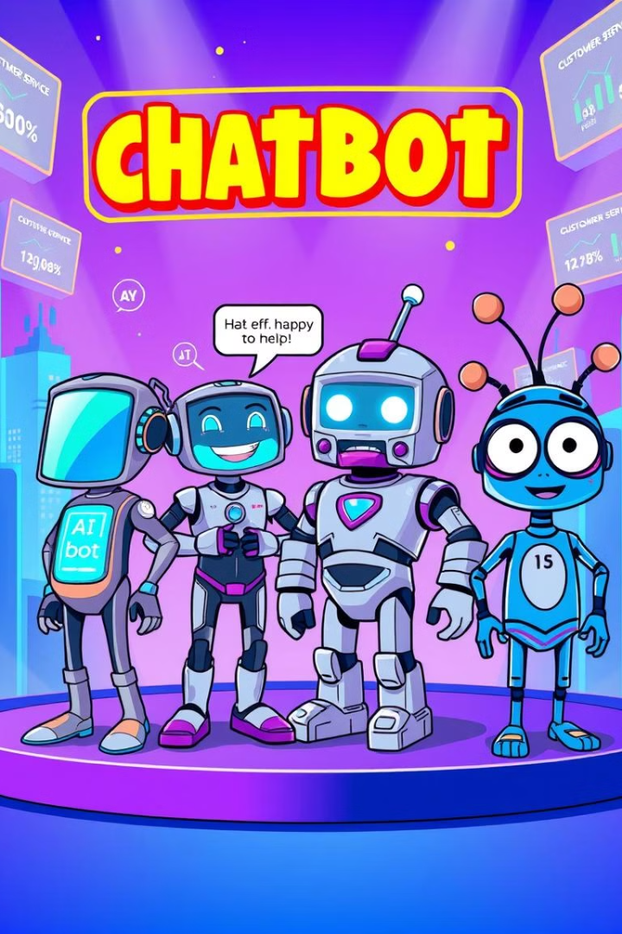
Competitive Landscape
Competitor
Pros
Cons
WATI
Feature-rich
Complex setup, higher pricing
Zoko
Easy to use
Limited customization
Yellow.ai
AI powered bot, uses NLP
High pricing

Slide 5




Why ChatEase Stands Out
AI-powered
smart replies
Ideal for small
businesses
Quick replies &
suggestions
Cost-effective
24/7 Support

