Slide 1
Instagram User Analysis – SQL Project
An Analytical Approach to User Engagement & Product Strategy
Presented by : Komal Tayade
Tool Used : MySQL Workbench
Date : 23 April 2025

Slide 2
Project Overview
Purpose : To analyze Instagram user behavior and derive actionable insights for marketing, product, and investor decisions.
Role : Data Analyst, working closely with product & marketing teams.

Slide 3
Tech Stack Used
Tools :
MySQL Workbench :
For querying and managing the database.
SQL : For data extraction, filtering, aggregation, and complex joins.
Microsoft PowerPoint :
For presenting analytical findings and insights.

Slide 4
Project Approach
Connected to Instagram user database using MySQL Workbench.
Developed SQL queries aligned with business goals.
Captured outputs and visualized findings.
Compiled results into this presentation.

Slide 5
Project Approach
1) Database Creation :
executed SQL scripts to set up Tables : user ,photos , comments , likes, tags and follows
populated tables with provided data .
2) Analysis tasks :
addressed marketing and investor specific queries
using SQL .
3) Insights reporting :
extracted results presented vain SQL output's and visualizations .

Slide 6
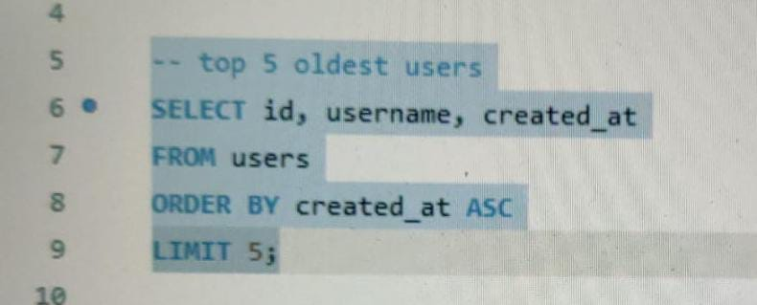
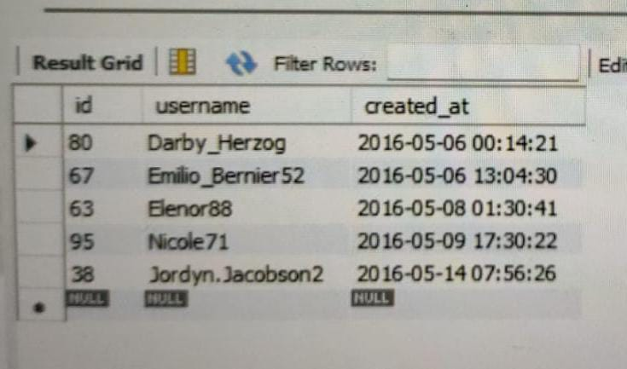
1) Loyal User Reward
A) Marketing Analysis
Goal : Identify top 5 oldest users.
SQL Query :
Output :
Insight : Prioritize these users for loyalty
programs.

Slide 7
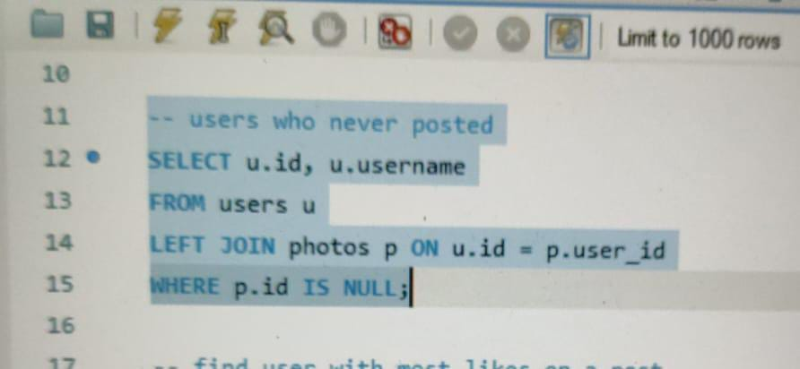
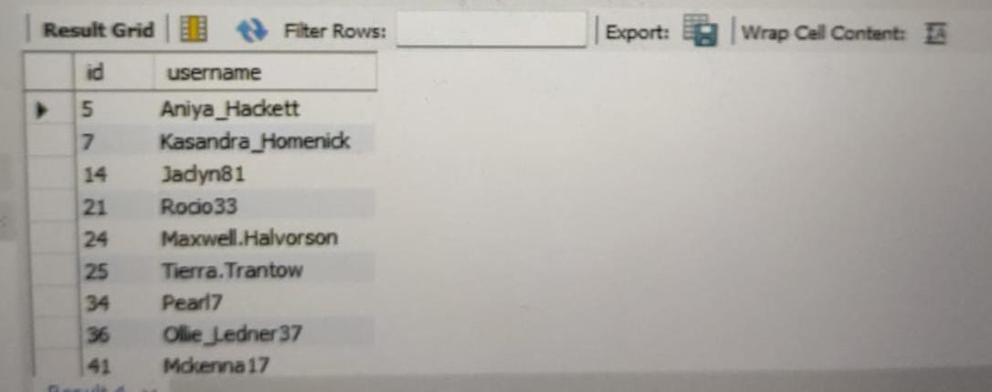
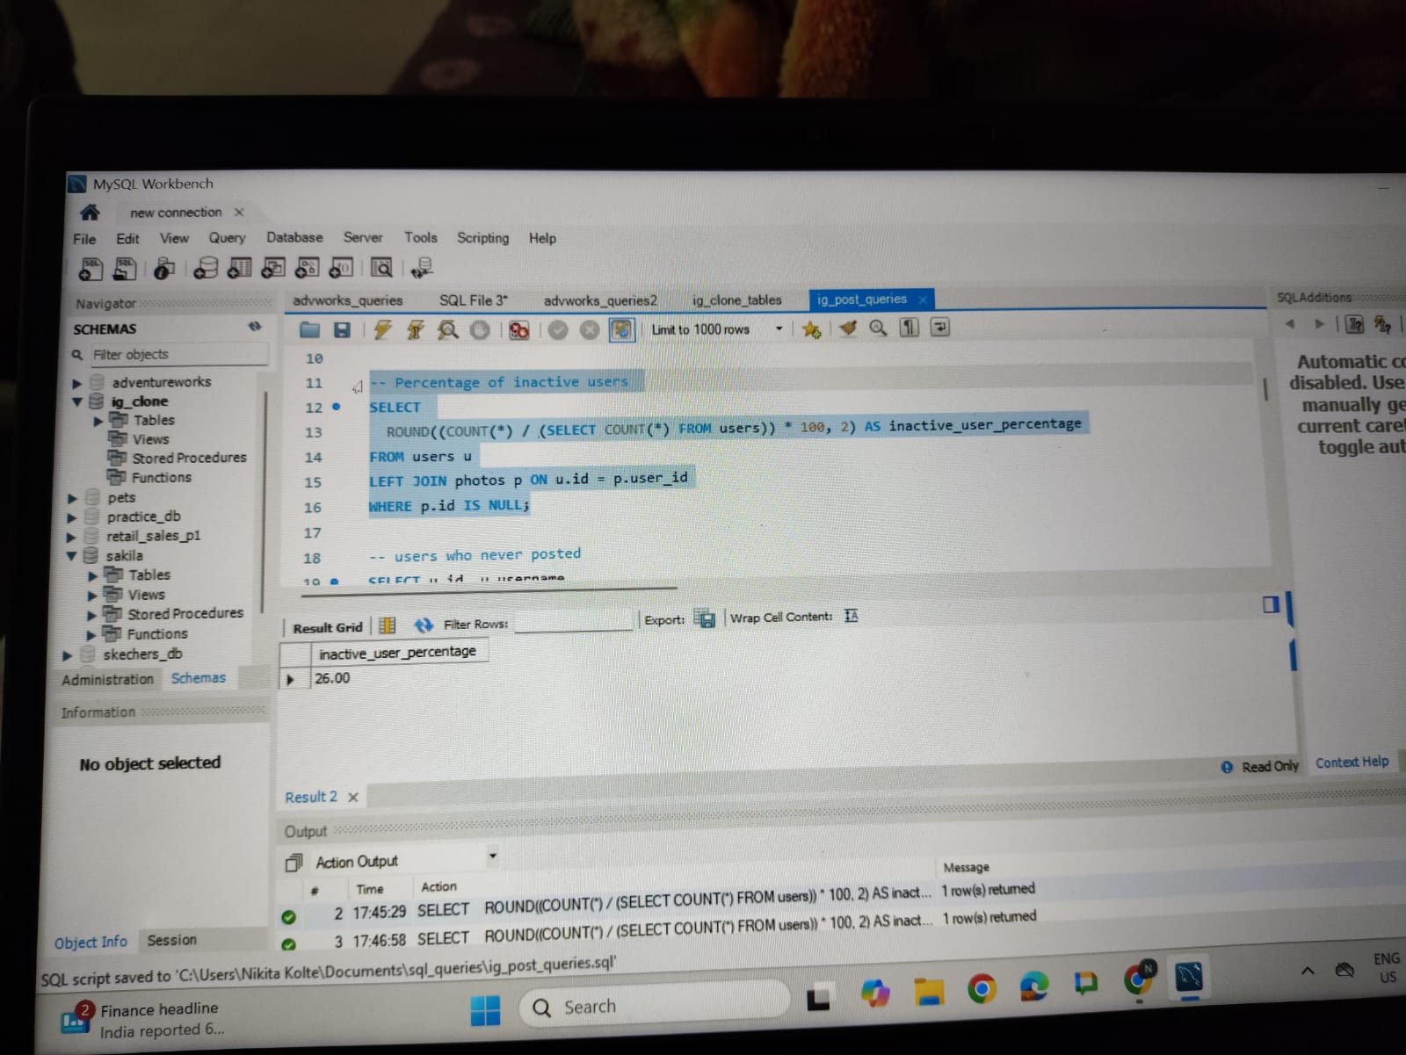
2) Inactive User Engagement
Goal : Find users who never posted & signified percenatge.
SQL Query :
Output :
Insight : Re-engage these users with promotions
or campaigns.

Slide 8
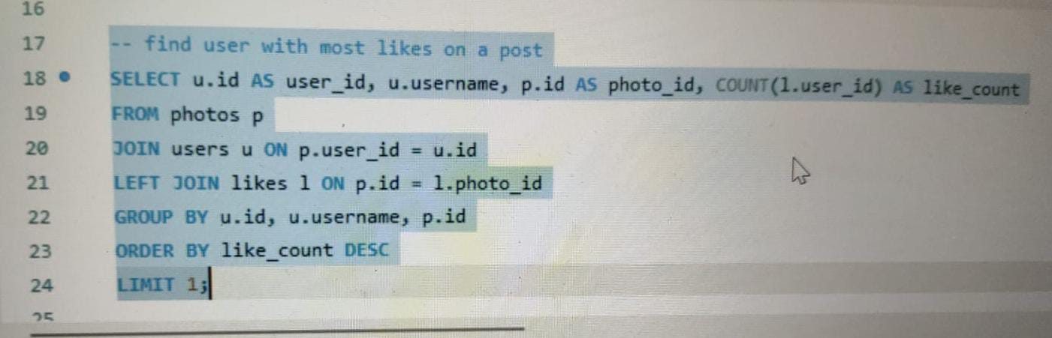
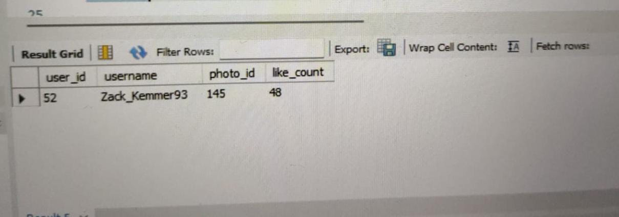
3) Contest Winner
Goal : Find user with most likes on a post.
SQL Query :
Output :
Insight : Reference this content for high engagement strategy.

Slide 9
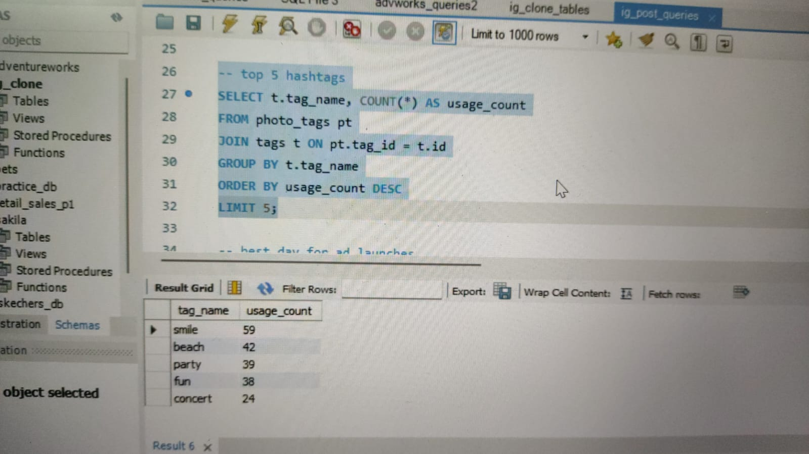
4) Hashtag Research
Goal : Identify top 5 hashtags.
SQL Query :
Output :
Insight : Helps with brand collaborations and
boosting reach.

Slide 10
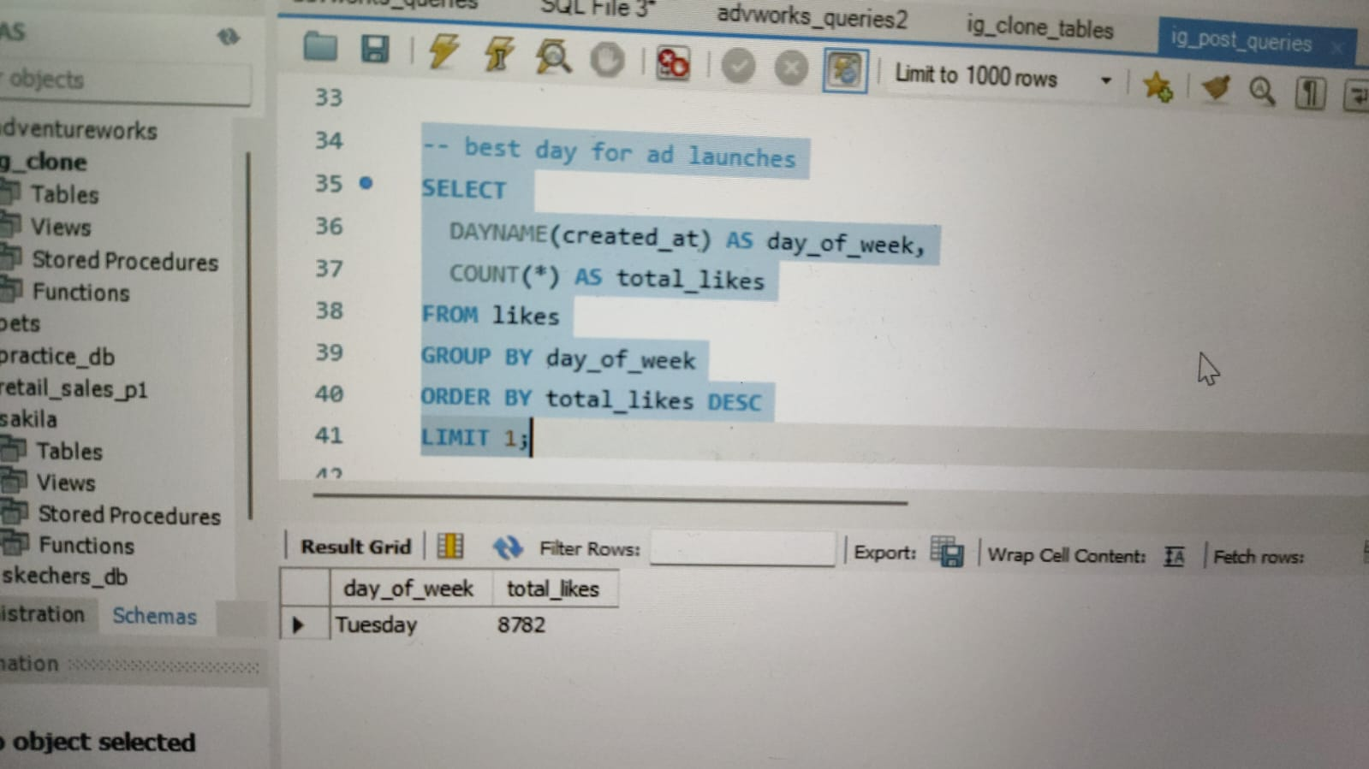
5) Ad Campaign Launch
Goal : Find the best day for ad launches.
SQL Query :
Output :
Insight : Schedule ads on high-traffic days.

Slide 11
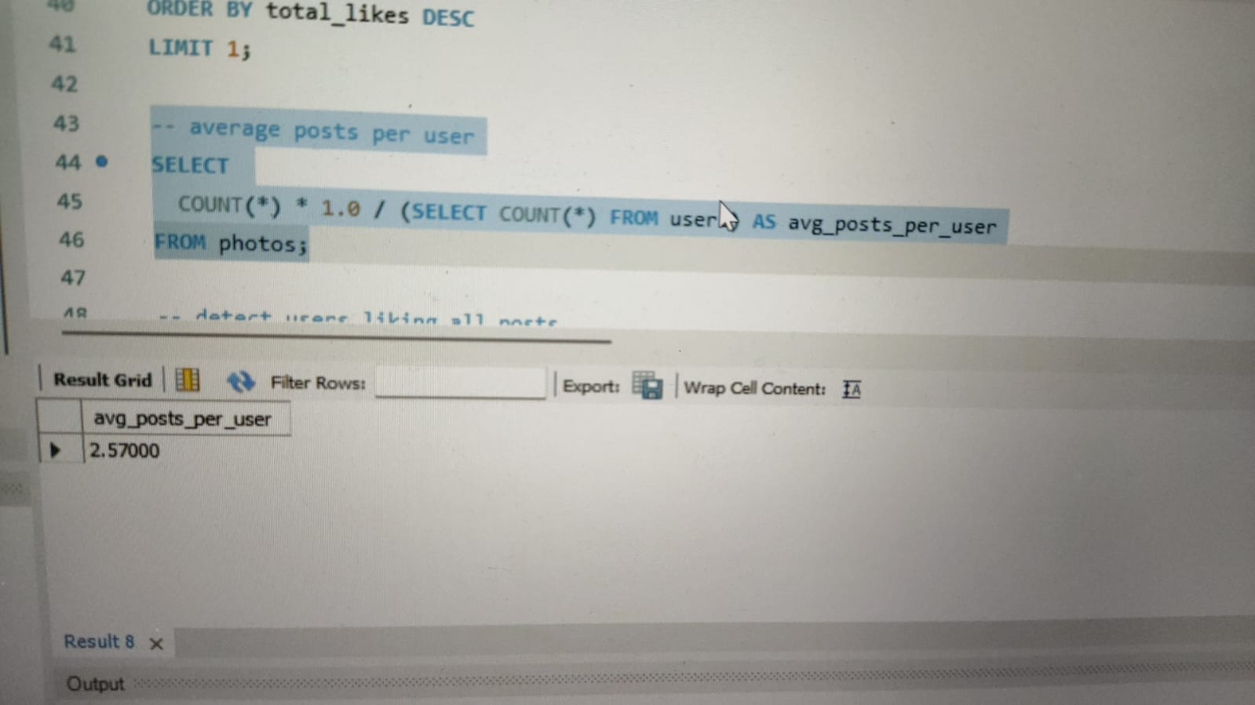
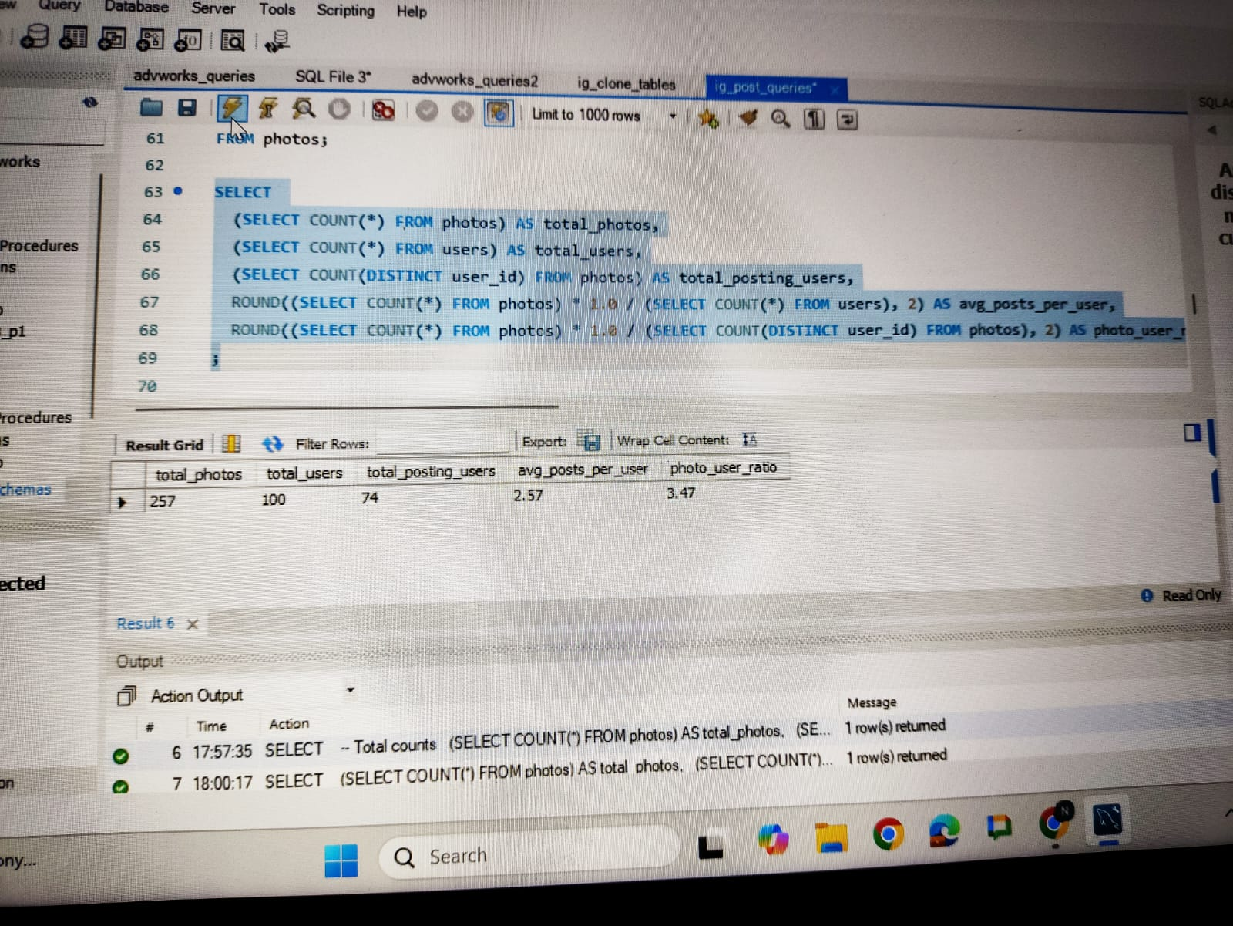
1) User Engagement
B) Investor Metrics
Goal : Calculate average posts per user &
Total no. of photos divide by Total no. of users.
SQL Query :
Output :
Insight : Indicates platform stickiness.

Slide 12
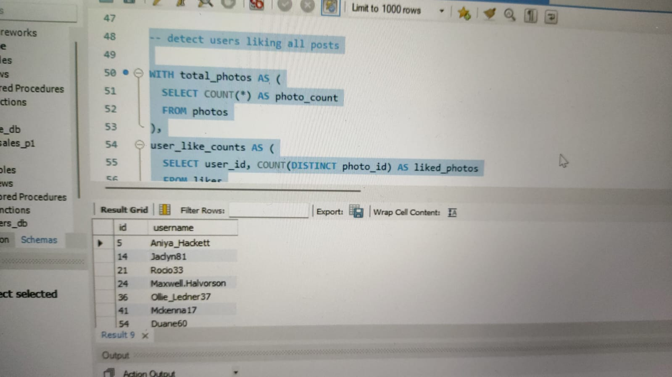
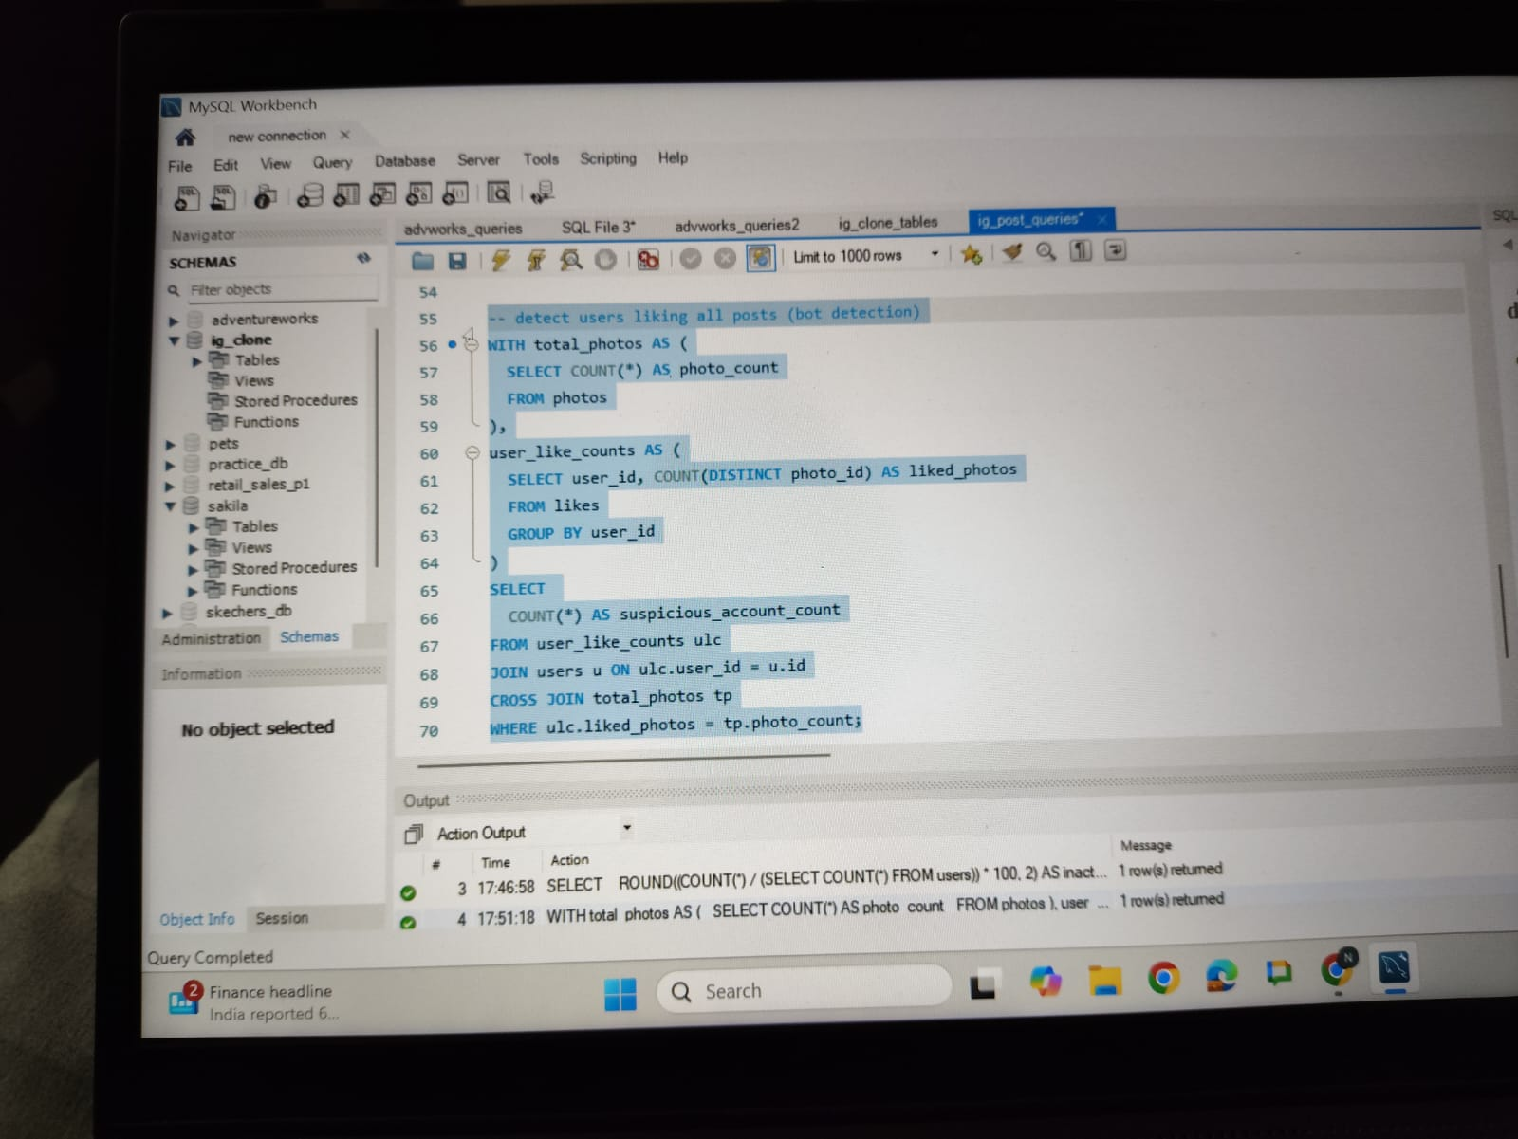
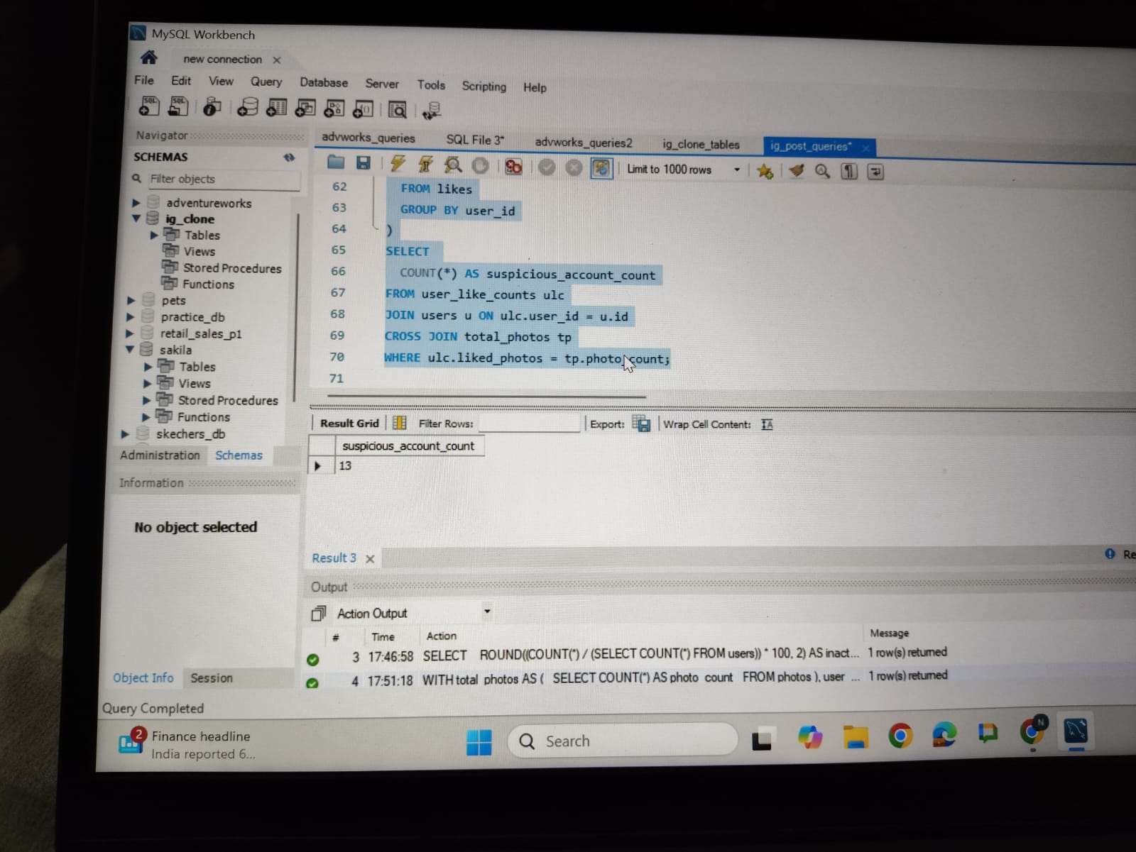
2) Bots & Fake Accounts
Goal : Detect users liking all posts (likely bots).
SQL Query :
Output :
Insight : Improves integrity and investor
trust.

Slide 13
Insights
Loyal users : top 5 users with oldest registration dates
Inactive users : identified a significant percentage for reactivation campaigns .
Contest winner : user X with Y likes on photo ID z
Hashtags : top 5 popular hashtags : #hashtag1 , #hashtage2 …
Ad scheduling : most registrations occur on [ day].
Engagements metrics : average posts/user: X; photo/user ratio: y.
Bot detection : identified [N] suspicious accounts .

Slide 14
Key Insights
Reward loyal users.
Engage inactive users.
Detect and remove bots.
Optimize ad timing and hashtag usage.

Slide 15
FINDINGS
1) Loyal Users
Top 5 users with the oldest registration dates:
User1 : Registered on 2016-05-06 00:14:21
User2 : Registered on 2016-05-06 13:04:30
User3 : Registered on 2016-05-08 01:30:41
User4 : Registered on 2016-05-09 17:30:22
User5 : Registered on 2016-05-14 07:56:26
2) Inactive users
Identified a significant inactive users for reactivation campaigns :
26% of users are inactive based on activity over the past year.

Slide 16
3) Contest Winner:
User: Zack_Kemmer93
Photo ID: 145
Likes: 48
4) Hashtags:
Top 5 popular hashtags:
#smile
#beach
#party
#fun
#concert

Slide 17
5) Ad Scheduling:
Most registrations occur on: Tuesday
6) Engagement Metrics:
Average posts/user: 2.57 posts/user
Photo/user ratio: 3.47 photos/user
7) Bot Detection:
Identified 13 suspicious account

Slide 18
Results :
Achivements accomplished through projects
1. Comprehensive Data Analysis Skills:
- Successfully utilized SQL and MySQL Workbench to analyze a complex dataset, demonstrating my ability to query, process, and extract actionable insights efficienctly.
2) Actionable Business Recommendation2. 2. AcActionable Business Recommendations:
- Delivered insights that directly influenced potential decisions for marketing campaigns, product feature enhancements, and platform security.

Slide 19
Conclusion
SQL analysis provided actionable insights .
Data driven decisions can enhance user engagements, streamline marketing, and improve investor confidence

Slide 20
THANK YOU

