Slide 1

Optimizing Hospital Operations Through Data Insights
  Presented by: Komal Rani
  AUID: 222706011
  Course: BCA (H) Data Analytics (2022–2025)
  Akal University, Talwandi Sabo
  Mentor- Er. Zubair Fayaz
  Company Mentor – Miss Tamanna Singh

Slide 2
Table of Content
About the company
Introduction to hospital operations
Why do hospital operations need optimization
Problem statement
Data source and novelty
Datasets used
Project workflow
Technologies used
Dashboard pages
Output snapshots
Real world impact
Learning outcomes
Conclusion

Slide 3




About the Company
Pisoft Informatics Pvt. Ltd. – Mohali, Punjab
IT solutions provider – Software Dev, ERP solutions, Digital Marketing, App dev, BI, Cloud Services
Industry clients across healthcare, finance, retail
Focus on bridging academic learning with real-world industry projects
Provided real hospital datasets for this project
Website: https://www.pisoftinformatics.com/

Slide 4
Introduction to Hospital Operations & Importance
OPD (Outpatient Department)
IPD (Inpatient Department)
Billing & Revenue Management
Laboratory & Diagnostics (LAB)
Resource & Staff Management
Importance: Ensuring smooth, efficient, and quality hospital service delivery.

Slide 5
Why Do Hospital Operations Need Optimization?
Key Issues:
Inefficient resource allocation
Revenue management gaps
Issues in IPD
No clear identification of top services/doctors
No clear identification of good supplier
Data Analytics Benefits:
Optimizing staff & resources – right allocation of doctors/nurses at the right time
Improving patient experience
Revenue management
Disease trend analysis – track rising cases

Slide 6
Problem Statement
Problem Statement:
Hospitals collect large volumes of operational data (OPD, IPD, LAB, inventory, staff scheduling).
Data is stored in different systems, making it hard to integrate.
Decision-making is often based on intuition or outdated reports.
Lack of tools for real-time monitoring and performance tracking.

Slide 7
Data Source & Novelty
Real hospital data, not simulated/public datasets
Data Source: Pisoft Informatics Pvt. Ltd
Company Website: https://www.pisoftinformatics.com/
Focus on operational efficiency rather than diagnosis only
Delivers data-driven decisions hospitals can use in real time

Slide 8
Datasets Used
OPD.xlsx – 45K+ records (consultations, billing, services)
IPD.xlsx – 8.6K records (admissions, treatment, payments)
LAB.xlsx – 9K+ records (tests, charges, results)
Inventory_data – 451 records (items, suppliers, cost)
Staff_Scheduling – 1.8K records (shifts, roles, availability)

Slide 9
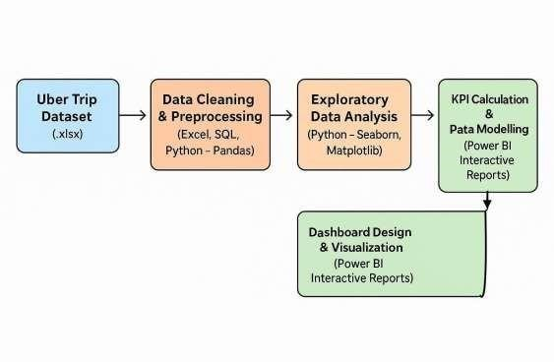




Project Workflow
Hospital Dataset
(
IPD, OPD, LAB,
Inventory, Staff
scheduling
)
1. Data acquisition from hospital
2. Data cleaning & preprocessing (Python & Excel)
3. Exploratory Data Analysis (EDA)
4. KPI calculation & data modeling (Power BI + DAX)
5. Dashboard design & publishing on Power BI Service

Slide 10

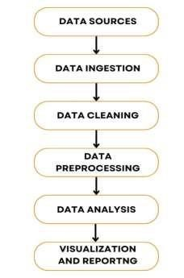
Workflow of Data Analytics Project

Slide 11
Technologies Used
Power BI – Data modeling, DAX measures, interactive reports
DAX Queries– Data querying, joins, aggregations
Jupyter Notebooks – EDA & documentation
Python – Pandas, NumPy, Matplotlib

Slide 12
Dashboard Pages
1. Hospital Performance Overview – KPIs, revenue, patient distribution
2. Doctor Insights – OPD visits, staff role distribution
3. Time & Flow Analysis – busiest days, peak hours
4. Inventory Insights – supplier performance, cost analysis
5. Service Insights Hub – service utilization & revenue contribution
Web Link : Optimizing Hospital Operations Dashboard

Slide 13
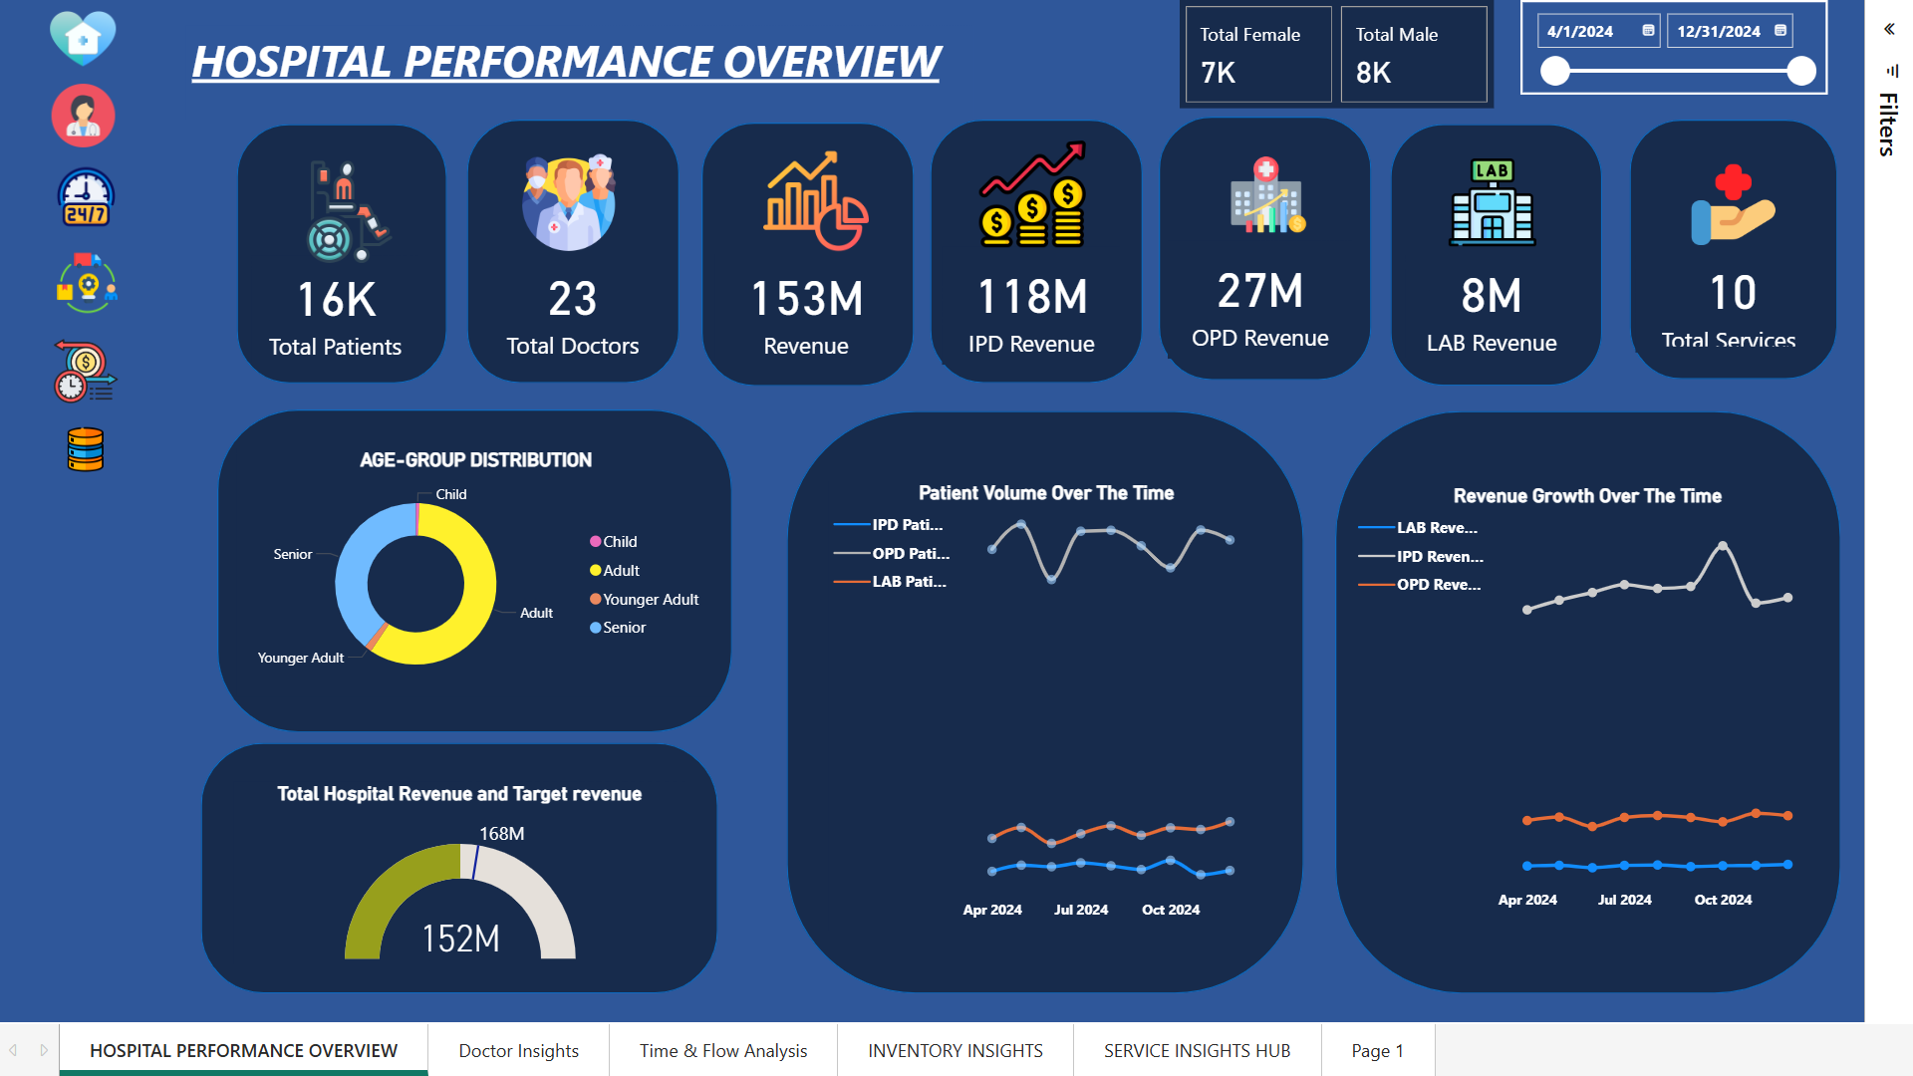
Hospital Performance Overview – KPIs, revenue, patient distribution

Slide 14
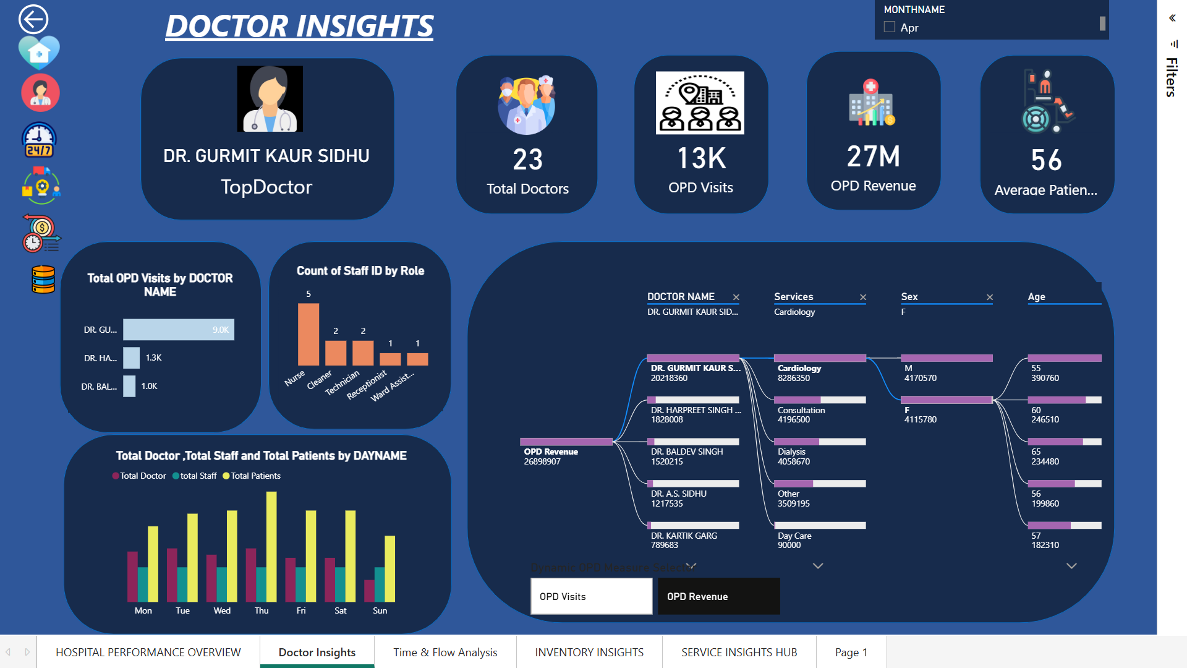
Doctor Insights – OPD visits, staff role distribution

Slide 15
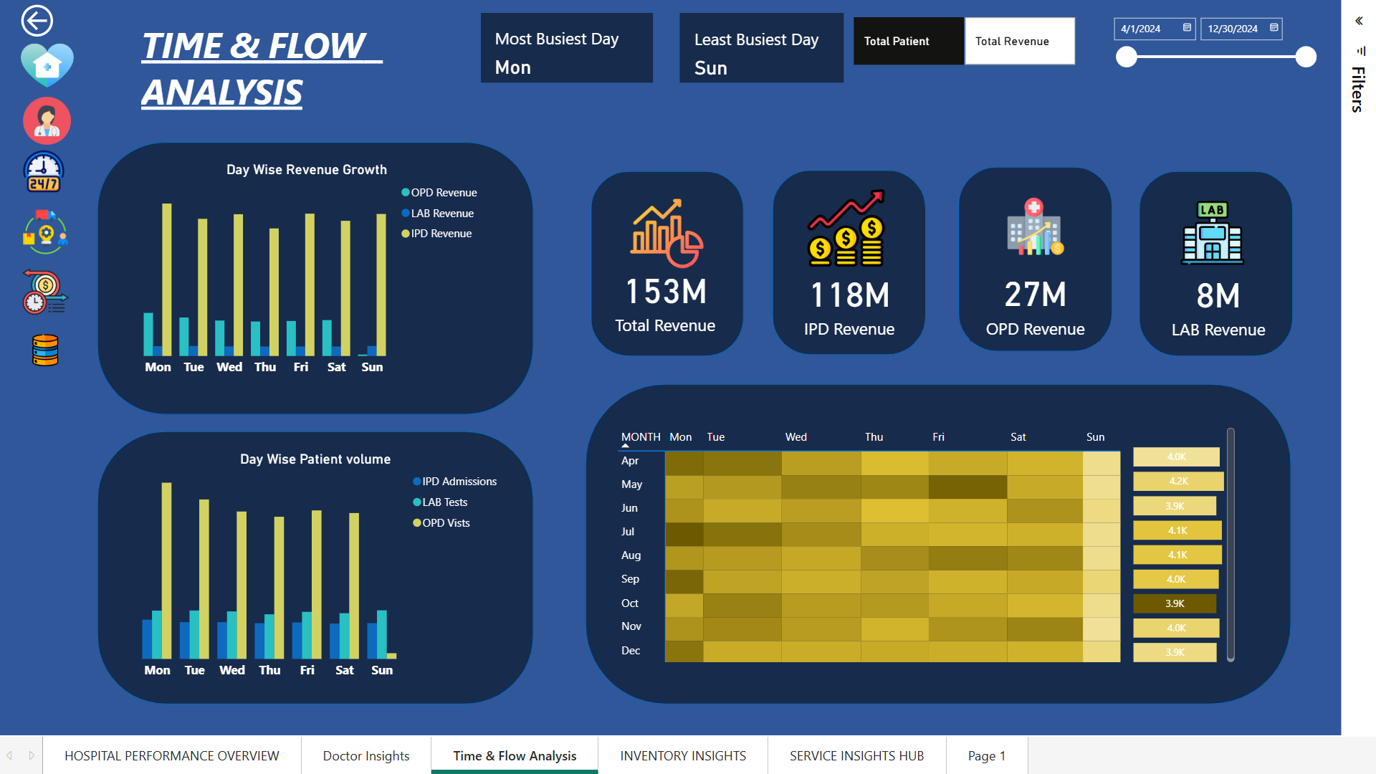
Time & Flow Analysis – busiest days, peak hours

Slide 16
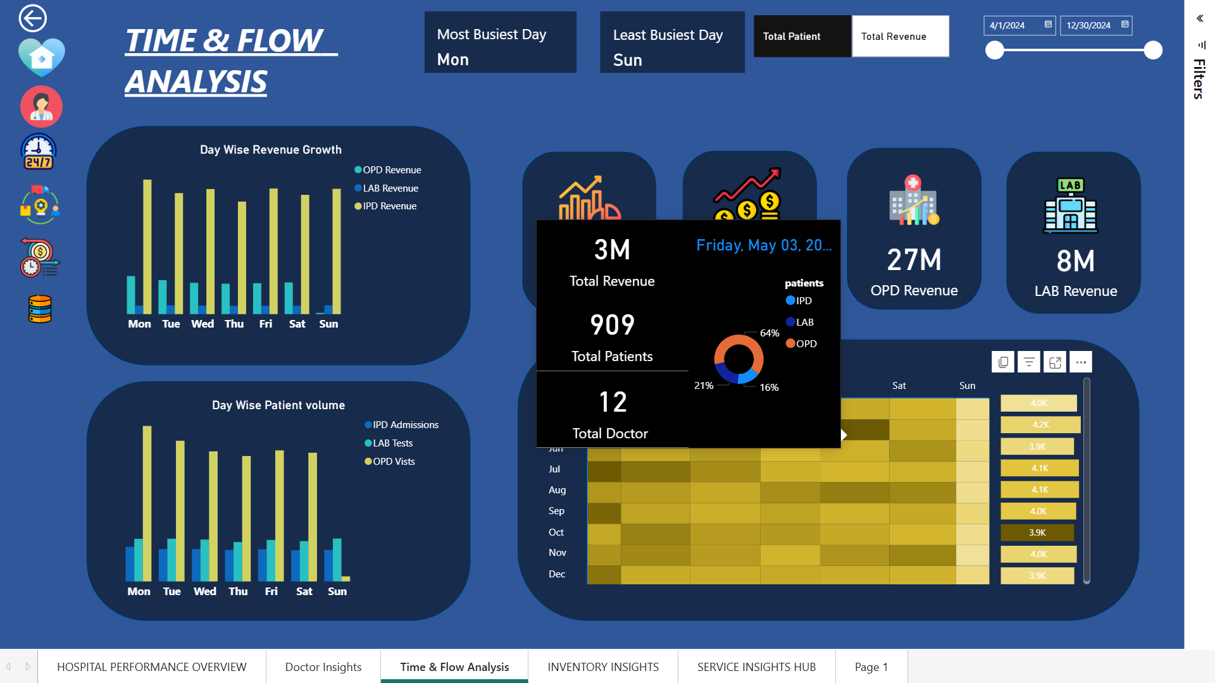

Slide 17
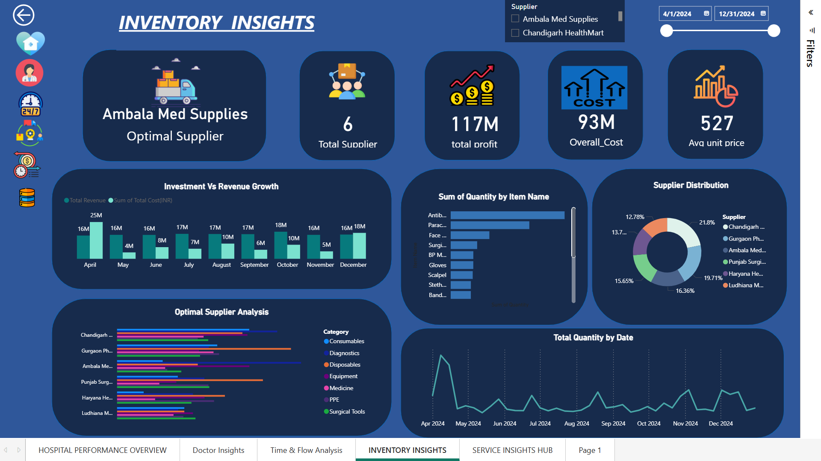
Inventory Insights – supplier performance, cost analysis

Slide 18
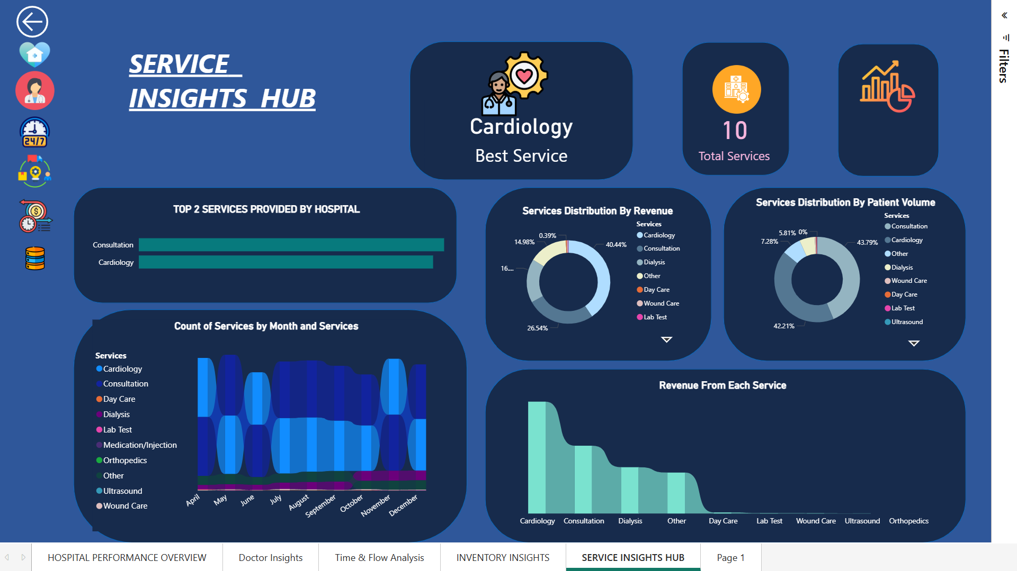
Service Insights Hub – service utilization & revenue contribution

Slide 19
Real-World Impact
Management: Allocate resources & staff based on real demand patterns
Finance: Monitor revenue, cut unnecessary expenses
Operations: Identify low-performing areas & improve workflows
Patients: Reduced wait times by allocating more doctors on busiest day & better service availability

Slide 20
Prescriptive Recommendations
Add extra OPD doctors on busiest day (Monday)
Tailor services & marketing toward adult patients
Replace high-cost/low-performance suppliers
Promote Cardiology & Orthopedics through campaigns

Slide 21
Learning Outcomes
End-to-end analytics project execution
Real hospital data handling & ethical use
KPI creation in Power BI with DAX
Professional dashboard design for decision-making
Enhanced Python & Data analysis skills

Slide 22
Conclusion
Delivered a user-friendly analysis
Enabled data-driven hospital decisions
Ready for future upgrades with predictive analytics

Slide 23
Thank you

