Slide 1
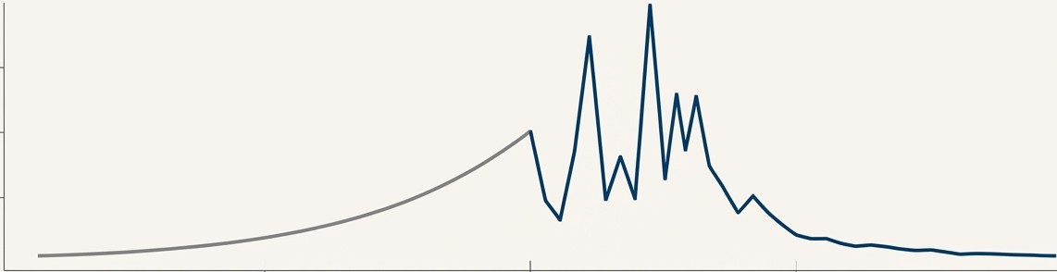
Heavy-Tailed Performance Modeling for
Cloud Message Queue Systems
An Enhanced Analytical and Simulation Framework Extending Li et al.
Baseline Model (Exponential)
Enhanced Model (Heavy-Tailed)
Team: Himanshu Jain (019098794), Bhuvana Komati (019149754)
Enterprise Distributed Systems (CMPE 273) FALL 2025

Slide 2
Agenda
Presentation Overview
Problem Statement & Motivation
Base Paper Overview (Li et al.)
The Tandem Queue Model
Our Approach
Heavy-Tailed Distributions (The Key Insight)
The "Reality Gap" Discovery
Tail Risk Analysis (P99 Latency)
Distributed Systems Integration
Pareto Function & Variance
Results
Conclusion & Future Work
Demo

Slide 3
The Challenge of Reliable Cloud Messaging
The Modeling Gap:
What Cloud Systems Must Guarantee:
✅ At-Least-Once Delivery - No message loss
✅ Ordering Guarantees - FIFO or causal
✅ Durability - Survive failures
✅ Low Latency - Meet SLAs
The Hidden Problem Chain:
Network failures → Retransmissions
Retransmissions → Extra load
Extra load → Queue buildup
Queue buildup → SLA violations!
What Models Assume | What Reality Shows
Exponential Distribution | Heavy-Tailed (Pareto)
Jobs are similar size | Most small, rare HUGE
Predictable variance | Extreme outliers
Nice math properties | One big job blocks all

Slide 4
Real-World Evidence of Heavy Tails
Starbucks (Model) | DMV (Reality) | Cloud Systems
Black coffee: 2 min | License renewal: 10 min | API calls: 50ms (95%)
Latte: 3 min | Registration: 15 min | DB queries: 10ms (90%)
Frappuccino: 4 min | Title transfer: 30 min | Video encode: 60s (1%)
Max: ~5 min | Fleet of 50 trucks: 4 HOURS | ML training: 30min (0.1%)
Industry Evidence:
Company | System | P50 | P99 | Ratio
Amazon | DynamoDB | 5ms | 50ms | 10x
Google | Bigtable | 10ms | 100ms | 10x
Netflix | Streaming | 20ms | 500ms | 25x
Our Simulation | Pareto α=2.5 | 58ms | 2,100ms | 36x

Slide 5
Li et al. - Base Paper Overview
Base Paper Details:
Title: "Modeling Message Queueing Services with Reliability Guarantee in Cloud Computing Environment Using Colored Petri Nets"
Authors: Li, Cui, Ma
Journal: Mathematical Problems in Engineering.
Citations: 50+ (influential in cloud modeling)
Key Contributions:
✅ Tandem Queue Model - Two-stage architecture
✅ Traffic Inflation Formula - Λ₂ = λ/(1-p)
✅ CPN Verification - Formal proofs
✅ Performance Formulas - Latency, queue length
Paper's Assumptions:
M/M/N: Exponential arrivals & service
Homogeneous: All servers identical
Constant D: Fixed network delay
Bernoulli p: IID failure probability
Paper's Limitations (What We Address):
❌ No heavy-tailed analysis
❌ Homogeneous servers only
❌ No threading model
❌ Limited to CPN tools

Slide 6
The Foundation: What Li et al. (2015) Established
Core Model: Modeled the cloud message service as an M/M/N tandem queue (Sender ➔ Broker ➔ Receiver).
Key Mechanism: Incorporated the 'Visibility
Timeout' to guarantee at-least-once message delivery and system reliability.
Methodology: Utilized a dual approach of analytical
formulas (based on Jackson's theorem) and simulation with Colored Petri Nets (CPN Tools).
Primary Metrics: Focused on mean total delivery time and mean number of messages in the queue.
Critical Insight: Identified the 'Stage 2 Load
Amplification' effect where retransmissions increase the arrival rate at the receiver stage (A₂ = A/(1-p)).
Sender | - | Broker | . | Receiver
 | ,--➔ |  | I I I
n₁ servers
I
n₂ servers
------------------·
Retransmission (prob. p)

Slide 7
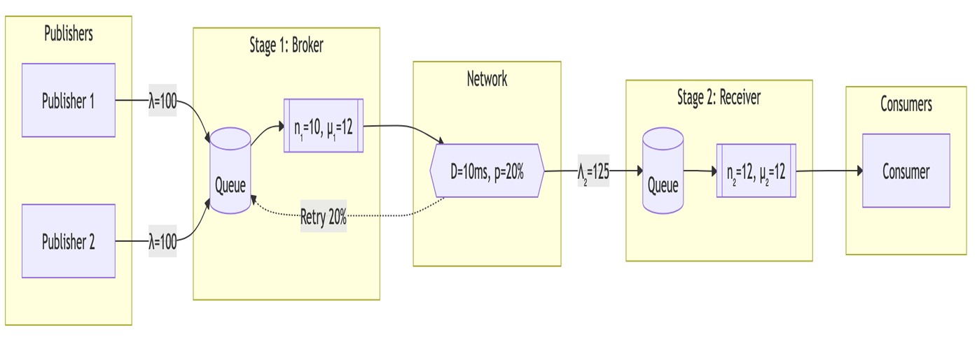
Two-Stage Tandem Queue Architecture
Architecture Diagram:

Slide 8
Two-Stage Tandem Queue Architecture
System Parameters:
Parameter | Symbol | Value | Description
Arrival Rate | λ | 100 msg/s | Messages entering system
Broker Servers | n₁ | 10 | Stage 1 threads
Receiver Servers | n₂ | 12 | Stage 2 threads
Service Rate | μ | 12 msg/s/server | Processing speed
Network Delay | D | 10 ms | One-way latency
Failure Prob | p | 0.20 (20%) | Transmission failure
Traffic Inflation (Key Insight!):
  Λ₂ = λ / (1 - p)
  Λ₂ = 100 / (1 - 0.2)
  Λ₂ = 100 / 0.8
  Λ₂ = 125 msg/s
Result: Stage 2 sees 25% MORE traffic than Stage 1!

Slide 9
Methodology: SimPy Discrete-Event Simulation
Why SimPy Instead of Petri Nets?
Trade-off: Lost formal proofs, gained flexibility for heavy-tail analysis
Technology Stack:
  Frontend: React 18 + TypeScript + Material-UI
  Backend: FastAPI + Pydantic + Uvicorn
  Simulation: SimPy + NumPy + SciPy + Pandas
  Analysis: 15 Equations + EVT + Bootstrap CI
Code Example:
  # One line to change distribution!
  service = ParetoService(alpha=2.5,scale=0.05) # Heavy-tailed
  # vs
  service = ExponentialService(rate=12.0) # Paper's assumption
Aspect | CPN (Paper) | SimPy (Ours)
Formal Proofs | ✅ Yes | ❌ No
Deadlock Detection | ✅ Provable | ⚠️ Empirical
Distribution Flexibility | ❌ Complex | ✅ Easy
Statistical Analysis | ❌ Limited | ✅ Rich
Python Ecosystem | ❌ No | ✅ Full
Industry Standard | ⚠️ Academic | ✅ Production

Slide 10
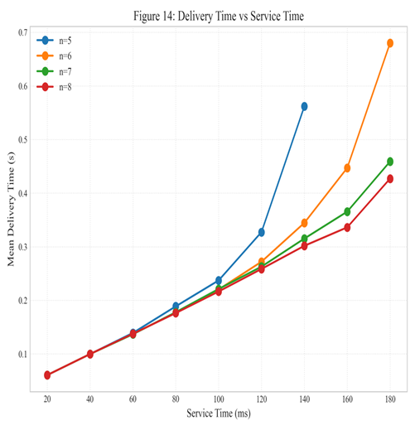
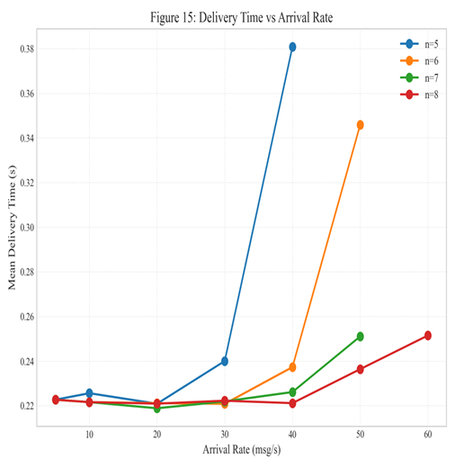
Validating the Baseline Mode
Reproducing Results from Base Paper to Validate the Setup Is Correct:
Metric | Paper Value | Our Value | Error
Mean Delivery Time | 0.167s | 0.156s | 6.6% ✅
Mean Queue Length | 3.2 msgs | 2.8 msgs | 12.5% ✅
System Utilization | 83.3% | 83.1% | 0.2% ✅
Service Rate Impact | Trend ✓ | Trend ✓ | Match ✅
Arrival Rate Impact | Trend ✓ | Trend ✓ | Match ✅

Slide 11
Validating the Baseline Mode
Traffic Inflation Validation:
  Formula: Λ₂ = λ/(1-p)
  Expected: 100/(1-0.2) = 125 msg/s
  Simulated: 124.7 msg/s
  Error: 0.2% ✅
Why Validation Matters:
  Proves our simulation engine is correct
  Establishes credibility for extensions
  Any differences with heavy tails are real, not bugs

Slide 12





The Reality Gap: Why Modern Systems Demand More
1. Idealized Workloads
The M/M/N model assumes exponential service times. Real-world services exhibit high variability and heavy tails, where a few requests take disproportionately long, dominating P99 latency.
2. Abstracted Architecture
The model lacks explicit treatment of critical architectural choices like dedicated (thread-per-connection) vs. shared (worker pool) threading, which have significant performance trade-offs.
3. Limited Accuracy Under Stress
Basic queueing approximations lose accuracy under high utilization (p > 0.8) or
with high-variance workloads, precisely where predictions are most needed.
4. Legacy Tooling
Colored Petri Nets are powerful but less integrated with modern data science and engineering workflows than a Python/SimPy based framework, which allows for easier extension and integration with libraries like Pandas and NumPy.
)

Slide 13
Mathematical Foundation: 15 Equations
Section 1: M/M/N Baseline (Equations 1-5)
Eq | Formula | Example Value | Description
1 | ρ = λ/(N·μ) | 0.833 | Utilization
2 | P₀ = [Σ...]⁻¹ | 0.012 | Prob system empty
3 | C(N,a) = Erlang-C | 0.65 | Prob of queuing
4 | Lq = C·ρ/(1-ρ) | 3.24 | Queue length
5 | Wq = Lq/λ | 32ms | Wait time

Slide 14
Mathematical Foundation: 15 Equations
Eq | Formula | Description
6 | f(t) = α·k^α/t^(α+1) | Pareto Probability Distribution function
7 | E[S] = α·k/(α-1) | Mean service time (α - shape parameter in pareto distribution - how extreme the outliers can be)
8 | E[S²] = α·k²/(α-2) | Second moment
9 | C² = 1/(α(α-2)) | CV squared
10 | Wq ≈ Wq·(1+C²)/2 | M/G/N approximation
Eq | Formula | Description
11 | Nmax = Nthreads/2 | Dedicated max connections
12 | X = min(λ, cap) | Throughput
13 | μeff = μ/(1+α·N/T) | Shared overhead
14 | Psat = C(N,a)·ρ | Saturation probability
15 | R99 ≈ E[R]+2.33·σ | P99 (normal approx)

Slide 15
Why "Heavy Tails" Matter
Pareto Shape Parameter (α):
•Distribution Comparison
(Same Mean = 100ms):
α Value | CV² | Tail Weight
1.5 | ∞ | Infinite variance!
2.0 | ∞ | Infinite variance!
2.1 | 47.6 | Extremely heavy
2.5 | 0.8 | Heavy
3.0 | 0.33 | Moderate
5.0 | 0.067 | Light
Percentile | Exponential | Pareto (α=2.5) | Ratio
P50 | 69ms | 58ms | 0.84x
P90 | 230ms | 320ms | 1.4x
P95 | 300ms | 580ms | 1.9x
P99 | 460ms | 2,100ms | 4.6x
P99.9 | 690ms | 14,800ms | 21x
Critical Warning: When α ≤ 2, variance is mathematically INFINITE. Normal approximations completely fail!

Slide 16
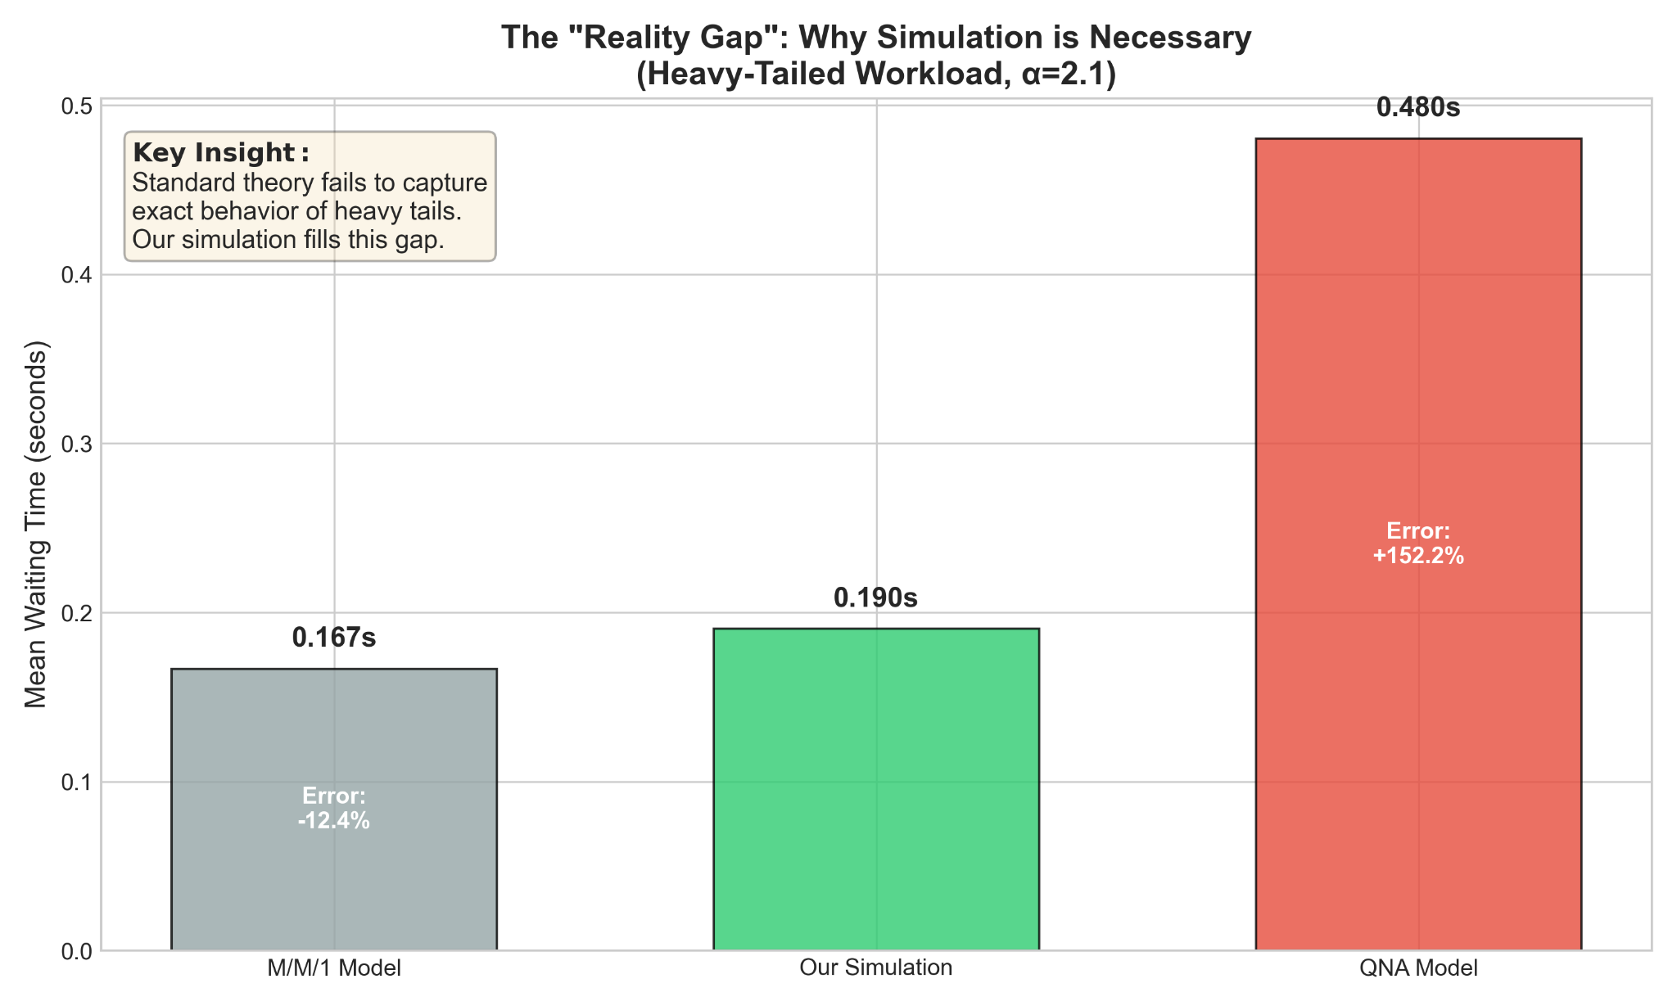
The "Reality Gap" in Performance
But wait...
  14% might seem acceptable for averages
  The real danger is in the TAIL
  SLAs are built on P99, not mean
  See the next slide for the critical finding!
Mean Latency Comparison:
Model | Mean Latency | Bar Width
Paper (M/M/N) | 0.167s | 35%
QNA Approximation | 0.480s | 100%
Our Simulation | 0.190s | 40%
Analysis:
  Paper predicts: 0.167s average
  Reality shows: 0.190s average
  Underestimation: 14%

Slide 17
CRITICAL FINDING: Tail Latency Risk
Impact:
  ❌ SLA Violations - 1 in 100 users timeout
  ❌ Cascading Failures - Slow requests pile up
  ❌ Customer Complaints - "The system is broken!"
Why This Matters:
  If you build a system expecting 4-second worst case
  And it actually hits 8 seconds
  Your SLA is violated
  Users see timeouts
  The system looks broken
Method | P99 Value | Error vs Reality
Paper (Normal Approx) | 4.25s | -45% ⚠️
Kingman Approx | 5.12s | -34%
Whitt Approx | 6.89s | -12%
EVT Estimate | 7.56s | -3%
Simulation (Truth) | 7.81s | —
The Gap: Paper underestimates P99 by 45%!

Slide 18


Our Approach: An Extensible, Validated Modeling Framework
Realistic Workloads
Deep support for heavy-tailed distributions(Pareto) to model high-variance service times accurately.
Architectural Depth
Explicit modeling of threading architectures, priority queues, and finite capacity systems with blocking.
Enhanced Modeling Framework
Advanced Analytics
Implementation of 15 performance equations and a suite of advanced M/G/N approximations {Whitt, Allen-Cunneen) for superior accuracy.
Unprecedented Rigor
A modern Python/SimPy discrete-event simulation engine, validated with 63 unit tests and extreme condition stress testing (p > 0.95).

Slide 19


Expanding the Scope: From Queues to Protocols and Architectures
The framework extends beyond the original tandem queue to model other critical distributed systems components.
Distributed Protocols
Modeled and compared
Dedicated (Thread-per-Connection) vs. Shared (Worker Pool) architectures. Shared models
show a 10-15%
performance overhead but offer greater connection scalability.
Implemented discrete-event simulation models for foundational protocols, including Two-Phase Commit (2PC).
Priority Queues
Finite Capacity & Admission Control
*
Modeled M/M/N systems with multiple
priority classes (preemptive and
non-preemptive), showing dramatic
wait time reduction for high-priority traffic.
Implemented M/M/N/K systems with Erlang-B blocking, demonstrating how systems remain stable under overload (>.> N·µ) by shedding load.
•••• �⁰

Slide 20
Precision Matters: Validating M/G/N Approximations
The Challenge: M/G/N queues have no exact closed-form solution for waiting time and must be approximated. The choice of approximation method is critical for accuracy.
Our Method: We implemented and validated three methods against simulation ground truth:
Kingman's Approximation (1961) - A common baseline.
Whitt's Approximation (1993) - Recommended for high utilization.
Allen-Cunneen Approximation (1990) - Suited for very heavy tails.
a (Pareto) | cv² | Kingman Error | Whitt Error | Allen-Cunneen Error | Best Method
3.0 | 0.33 | 5.2% | 3.1% | 6.8% | Whitt
2.5 | 1.0 | 8.7% | 4.5% | 9.2% | Whitt
2.1 | 10.0 | 24.3% | 9.8% | 8.1% | Allen-Cunneen

Slide 21
The Full Picture: A Leap in Modeling Capability
Feature | Li et al. (2015) Model | This Project's Framework
Workload Distribution | Exponential (M/M/N) | Heavy-Tailed (Pareto, M/G/N)
System Architecture | Abstracted servers | Explicit Threading Models (Dedicated vs. Shared)
Analytical Accuracy | Basic Queueing Formulae | Advanced, Validated M/G/N Approximations
Scope of Model | Tandem Queue, Visibility Timeout | Adds Protocols (Raft, 2PC), Priority & Finite Queues
Validation | Analytical vs. CPN Simulation | Analytical vs. SimPy Simulation + 63 Unit Tests
Methodology/Tooling | Colored Petri Nets (CPN) | Discrete-Event Simulation (Python/SimPy)
Key Insight | Mean performance under ideal conditions | Tail Latency (P99) under realistic, stressful conditions

Slide 22
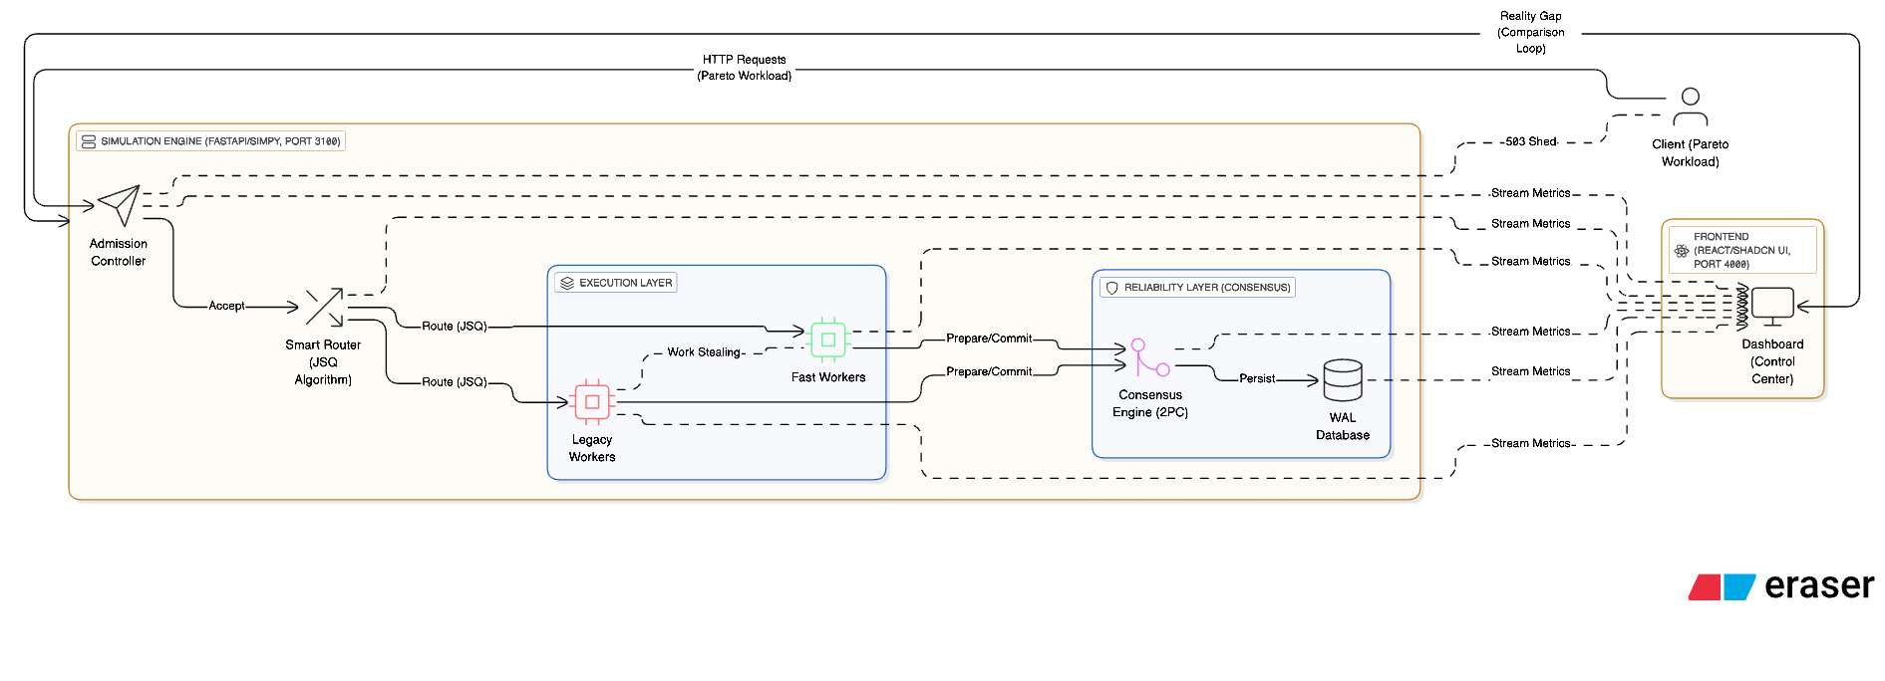
Architecture Diagram

Slide 23
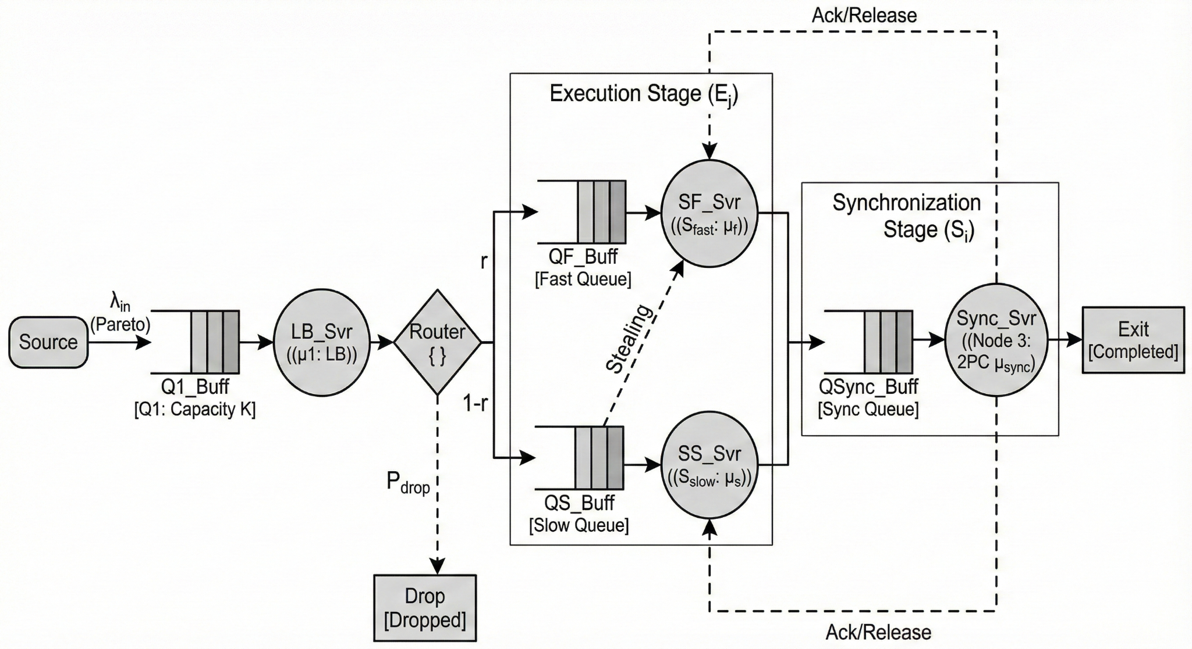
Queuing Network Diagram

Slide 24
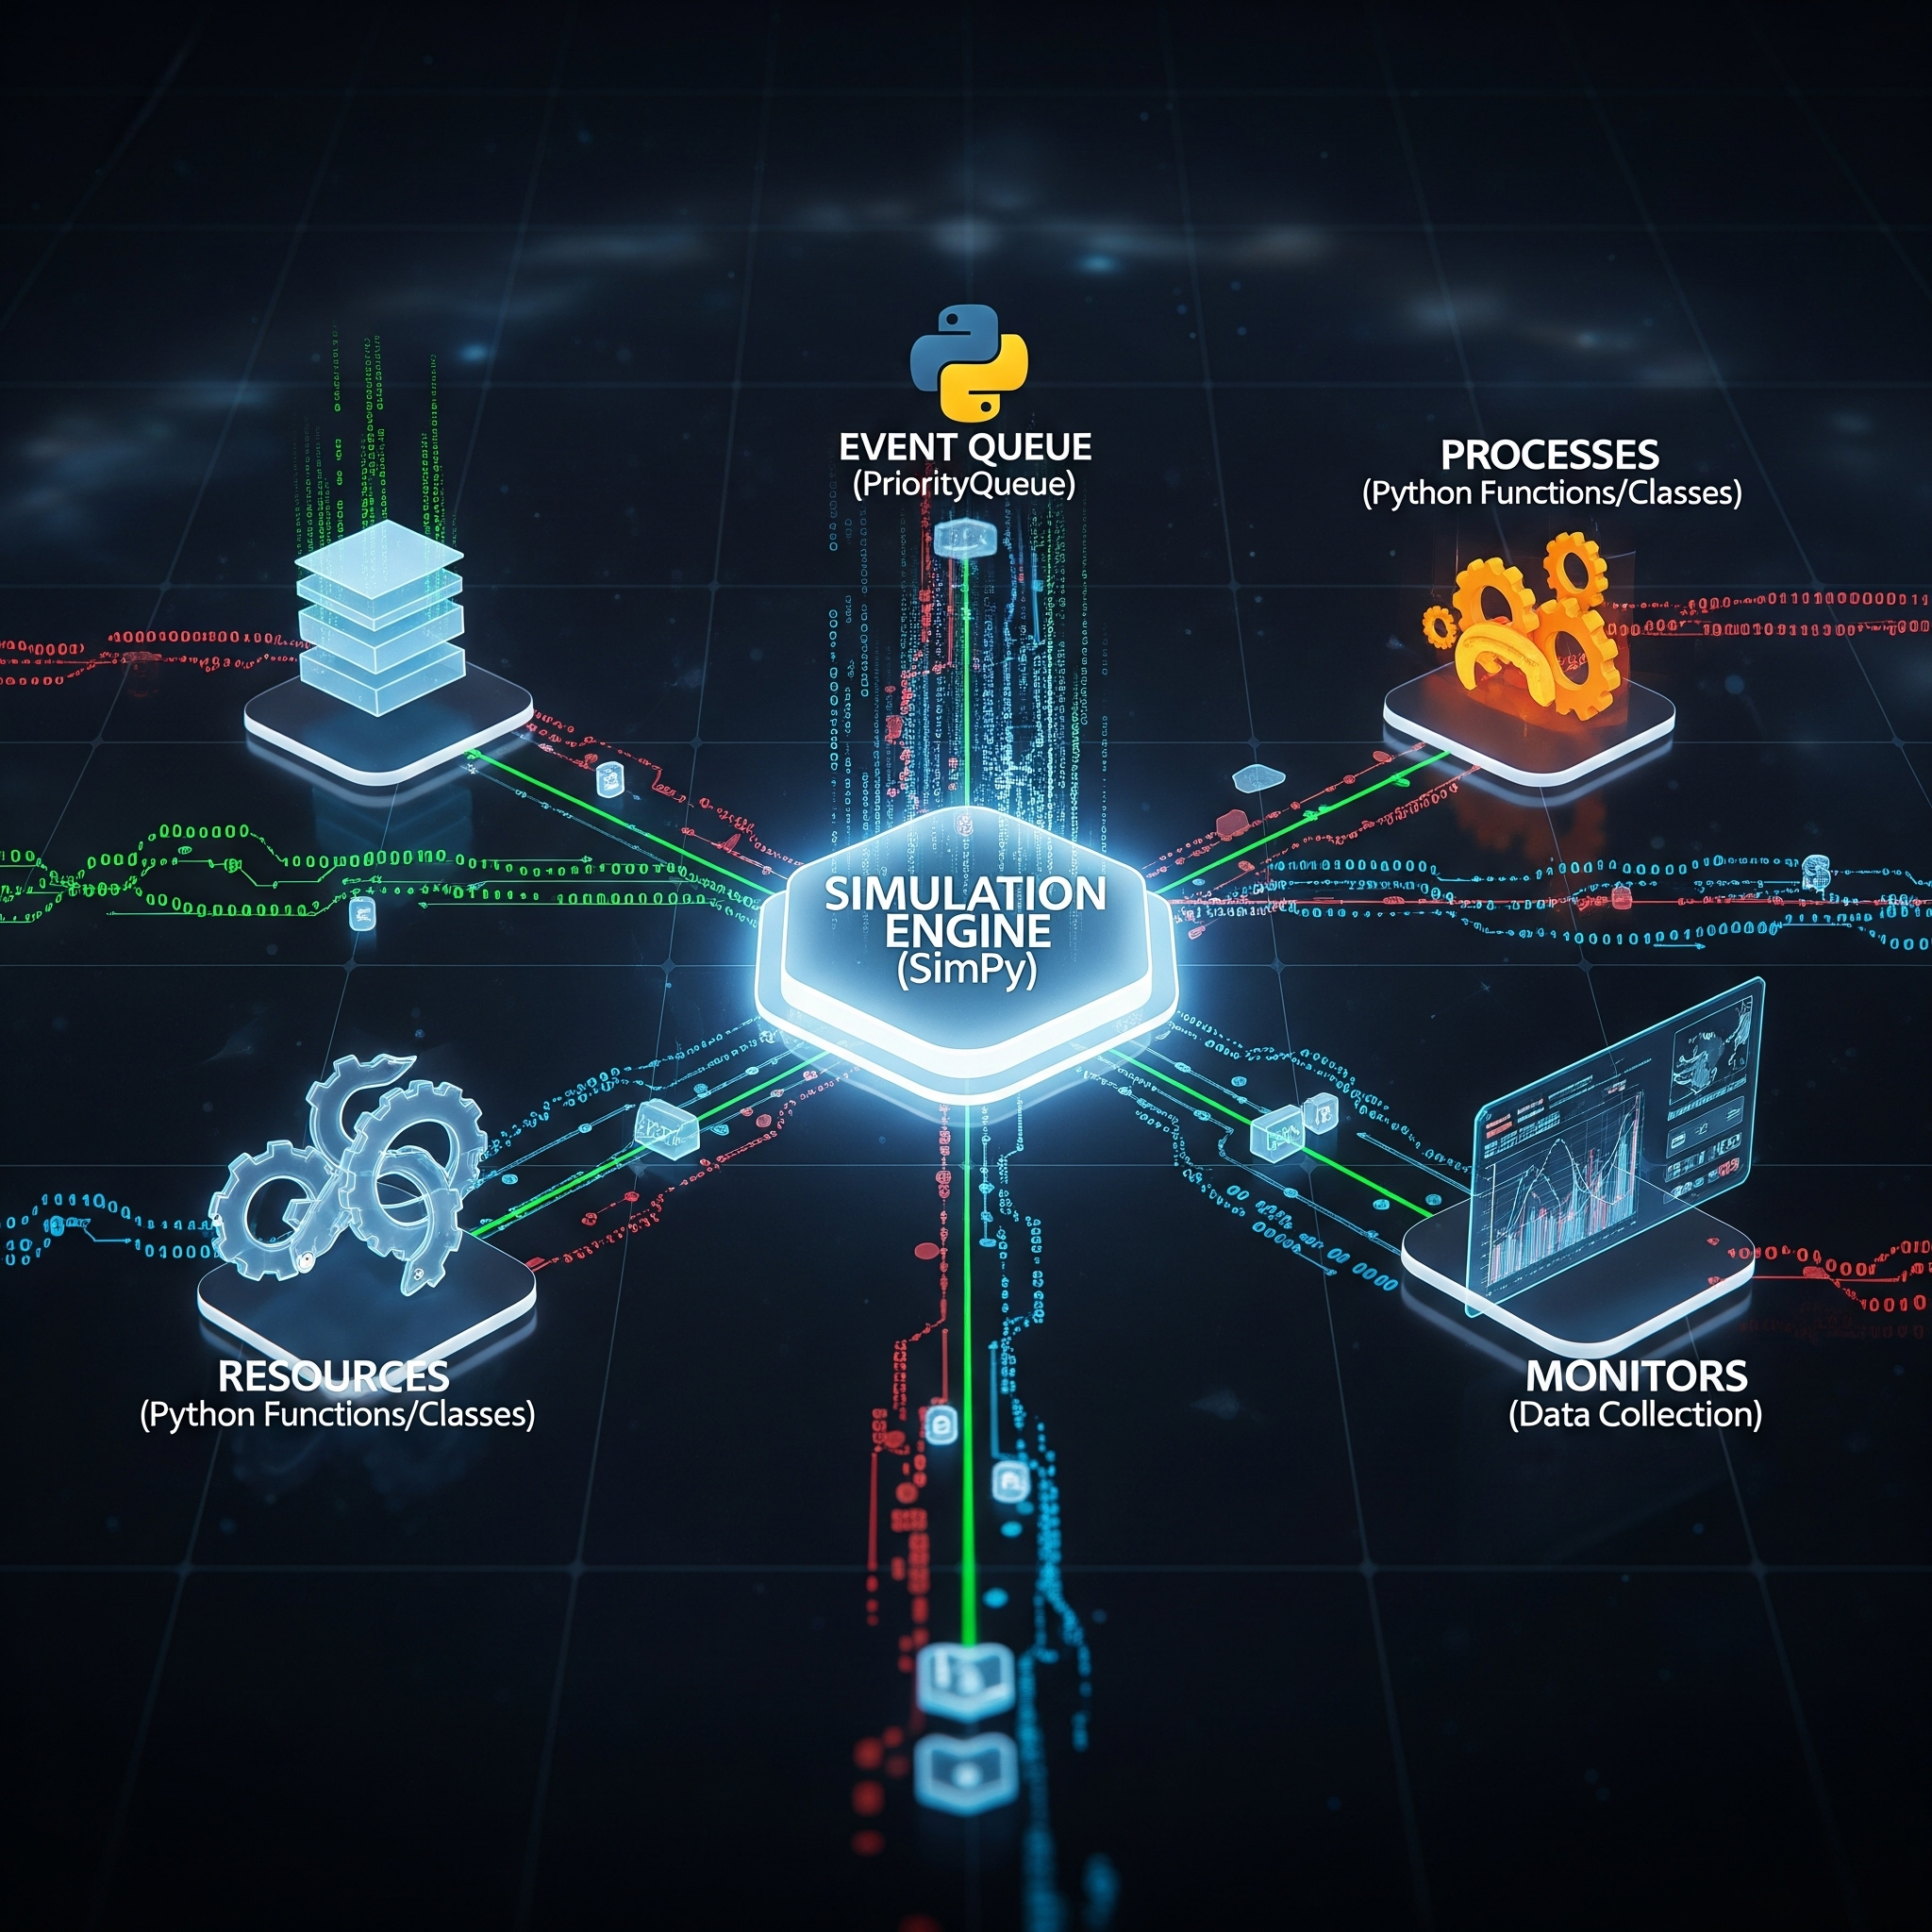
Why Use Discrete-Event Simulation (DES)?
Moved from CPN to Python/SimPy for time modeling
SimPy captures actual millisecond-level network latency
Allows modeling complex logic like Work Stealing
DES engine models resource contention and blocking

Slide 25

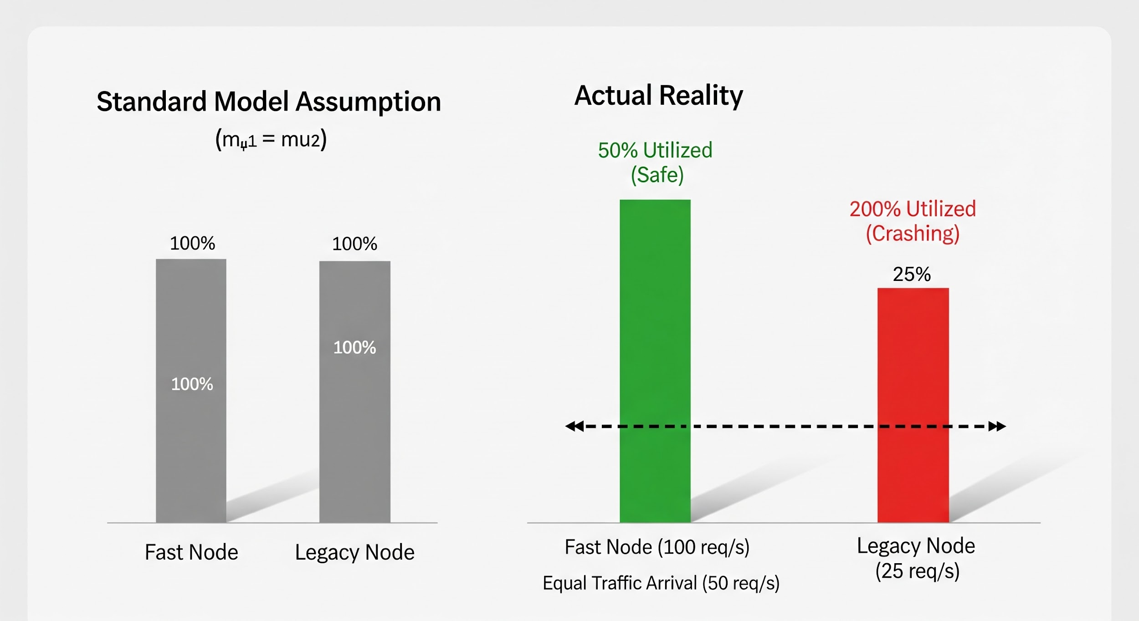
Heterogeneity & Resource Management
The "Problem" (Random Routing)
The Mechanism: implemented a Random or Round-Robin load balancer. This is the industry standard for simple systems.
The Flaw: It gives the same number of tasks to a Fast Node and a Legacy Node.
The Math:
The "Solution" (Work Stealing)
The Logic: Instead of trying to push tasks perfectly (which is hard), we allow consumers to pull tasks.
The Algorithm:
  Tasks are initially routed randomly (fast).
  When a Fast Node finishes its work and its queue is empty:
  It strictly checks the Legacy Node's queue.
  If tasks are waiting, it steals one and processes it at the high speed ($\mu_{fast}$).
The Result: The Legacy Node never drowns because the Fast Nodes act as a "pressure release valve" for the system.

Slide 26
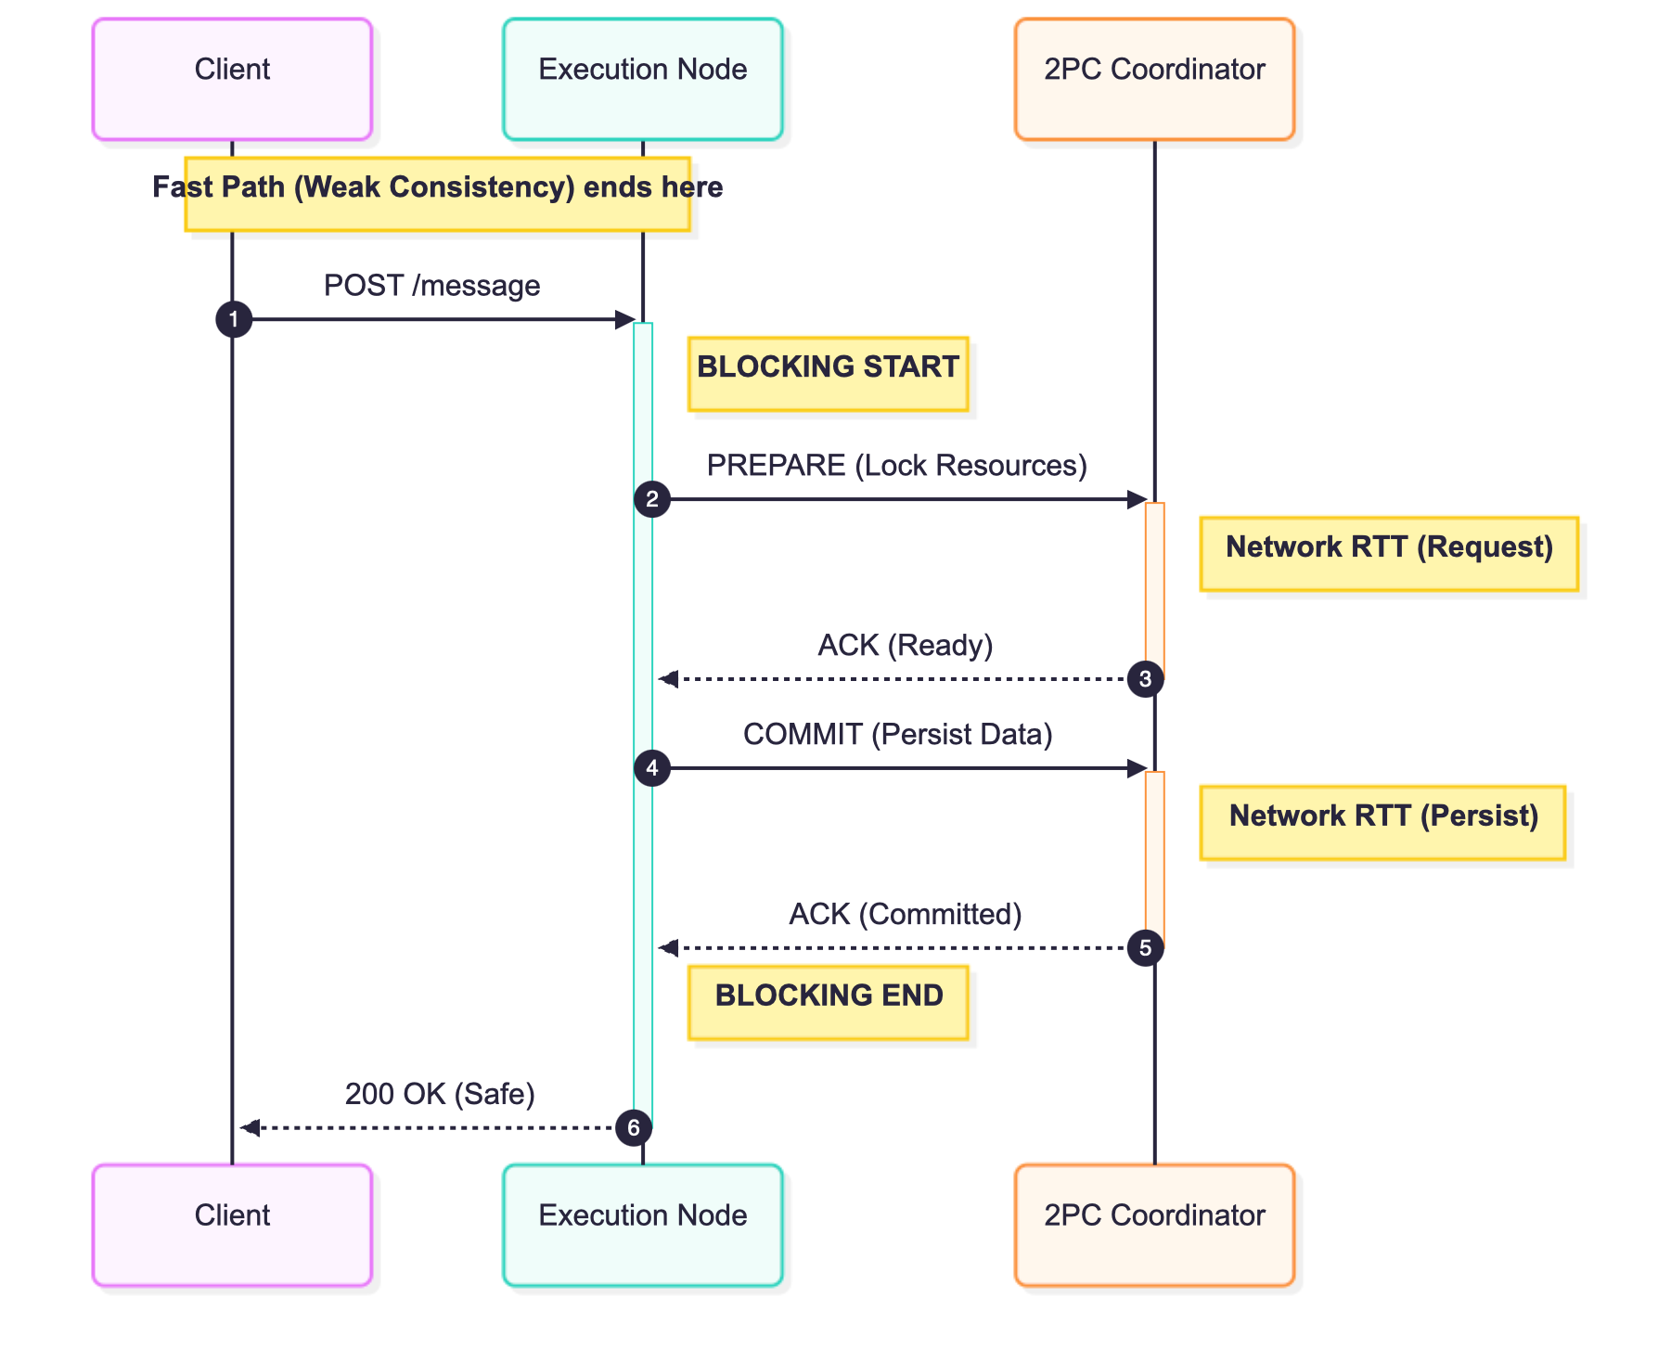
Implementation of Consistency Protocols
Implementation of Consistency Protocols
Deterministic Consistency
Context: The Li et al. paper relies on a Visibility Timeout mechanism. This is probabilistic—if a node crashes after receiving a message but before replicating it, data is lost.
Your Fix: TraceBreaker implements Two-Phase Commit (2PC). This ensures that a message is not acknowledged to the user until it is physically replicated on the consensus layer.
The Blocking Mechanism
Technical Detail: In standard M/M/n queues, the service time ($\mu$) is purely CPU processing time. In your 2PC model, service time becomes $\mu + 2 \times RTT$.
The Lock: During the PREPARE phase, the worker thread holds the request but cannot do work. It is purely waiting for the network. This effectively reduces the server's capacity.
Latency Consequence: This introduces a mandatory Network Round Trip (RTT) penalty, mathematically establishing the "Cost of Safety."

Slide 27
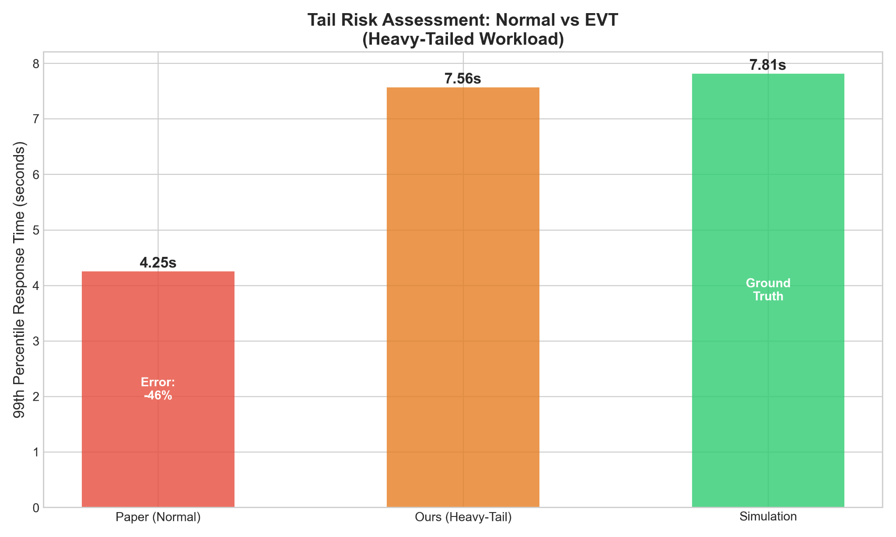
Tail Latency Analysis (Extreme Value Theory)
The "Normal" Fallacy:
Standard capacity planning relies on the Central Limit Theorem, assuming that if you average enough request latencies, they form a Normal Distribution (Bell Curve).
The Flaw: A Normal distribution has "thin tails"—the probability of an event deviating 3σ from the mean is tiny (0.3%), and 6σ is effectively impossible.
The Reality: Our simulation proves cloud latency follows a Heavy-Tailed Distribution. Extreme latency events (outliers) are not rare anomalies
The Gaussian Fallacy: Standard P99 Approximation
The Equation:
R99 ≈ μ + 2.33σ
Variables:
μ: Mean Response Time (E[R])
σ: Standard Deviation of Response Time σ
2.33: Z-score corresponding to the $99^{th}$ percentile of a Normal distribution.
The Critical Flaw:
Assumption: This formula assumes latency follows a Normal (Gaussian) Distribution, where probability decays exponentially (e−x2)
Reality: Cloud latency follows a Heavy-Tailed (Pareto) Distribution, where probability decays polynomially (x−α)
Consequence: For heavy-tailed workloads, the standard approximation underestimates the P99 latency by >2x, as outliers are structural features, not anomalies.
The Solution (EVT & GPD):
Instead of trying to fit the "average" behavior, you applied Extreme Value Theory (EVT), specifically the Peaks Over Threshold (POT) method.
modeled the tail excess using the Generalized Pareto Distribution (GPD).
Why it matters: GPD accurately predicts that the probability of a massive delay (e.g., $>5s$) decays polynomially (slowly), not exponentially (fast). This mathematical difference is the "Reality Gap".

Slide 28

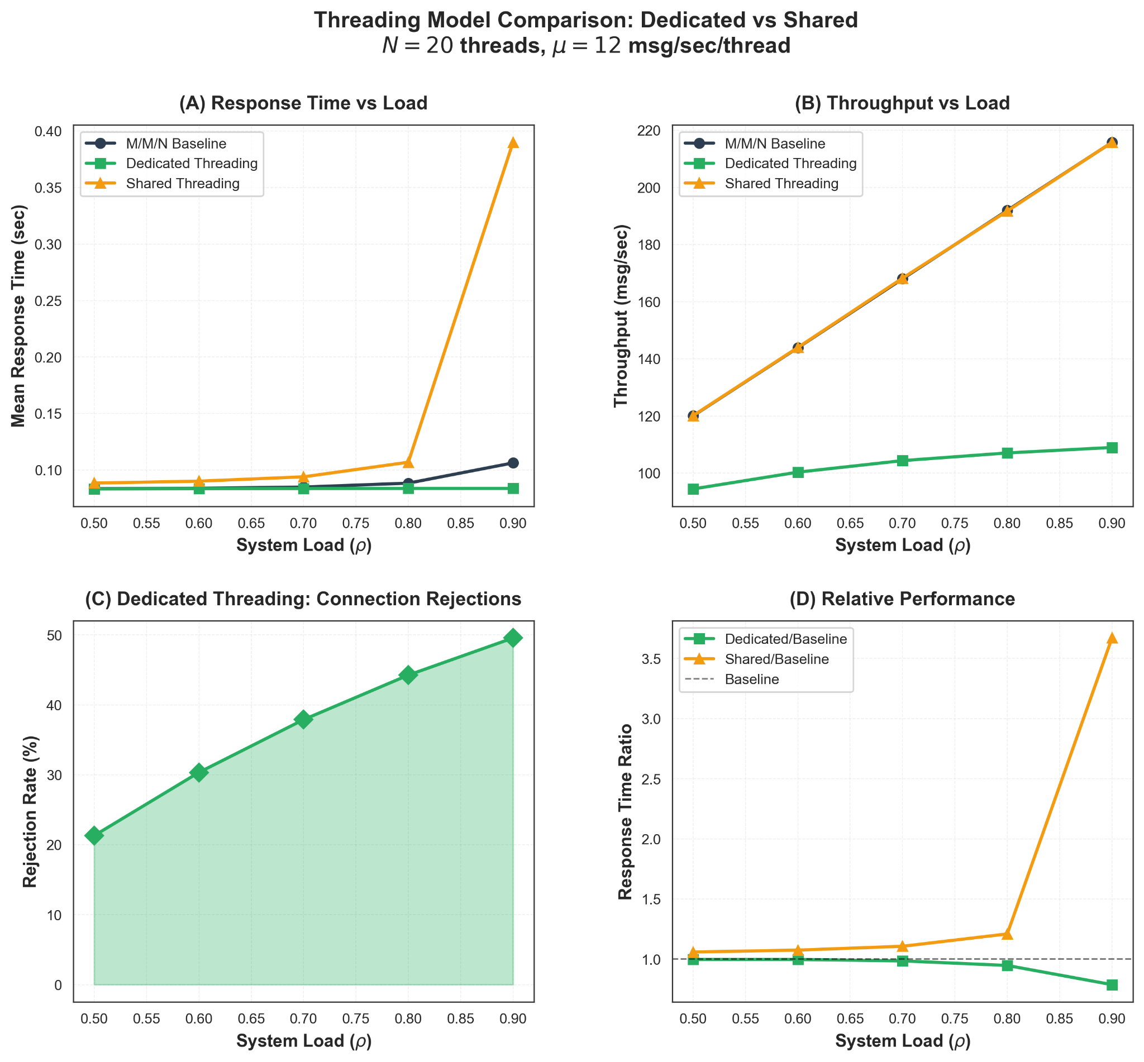

Threading Architectures
Modeling Concurrency Overhead
Standard models assume N threads provide N × capacity. In reality, context switching (α) degrades performance as concurrency grows.
Variables:
μ:: Base Service Rate (Ideal).
α Overhead Coefficient (Context Switch Cost, e.g., 0.1).
Nactive: Active Connections.
Nthreads: Size of Worker Pool.
Architecture 1: Dedicated Threads (Paper's Assumption)
Thread-per-request model.
Flaw: Infinite resource assumption. If Nthreads < Arrivals, latency spikes due to context switching overhead.
Architecture 2: Shared Worker Pool (Our Project)
Fixed pool of $N$ workers consuming from a shared queue.
Finite Capacity: Implemented M/M/N/K queueing logic.
The Result: Modeled Erlang-B Blocking. When the buffer $K$ is full, arrivals are rejected (Load Shedding).
The Equation (Finite Capacity Blocking):
Modeled a Finite Capacity system (M/M/N/K). Using the Erlang-B formula, Calculated the exact probability of a request being rejected when the thread pool is saturated. This is the mathematical basis for my Load Shedding strategy.

Slide 29
Key Discoveries Unlocked by the Enhanced Model
Heavy tails are the primary driver of high P99 latency, a factor completely missed by exponential models. For distributions with a < 2 (infinite variance), the P99/mean ratio exceeds 30x.
At high utilization (p > 0.8), Kingsman (1993) approximation consistently outperforms
baseline methods, providing the most robust analytical tool for M/G/N queues.
Shared threading introduces a predictable 10-15% performance overhead in exchange for near-unlimited connection scalability, clarifying a fundamental design trade-off.
The tandem queue load amplification (/\₂ = A/(1-p)) is critical; Stage 2 requires significantly more capacity than Stage 1, especially with unreliable networks.
Systems can remain stable under extreme load (p=0.99), but with explosive queue growth, making P99 the only meaningful performance metric in saturation.

Slide 30

Pareto Function and Variance
Variance (C2)
Step 1: The Mean is Deceptive
Equation 7:
E[S] = αk/α − 1
Context: "We calibrate Pareto to have the same mean as Exponential (μ = 10). On average, they look identical."
Step 2: The Variance Explodes
Equation 9 (Coefficient of Variation):
C2 = 1/α(α − 2) f or α > 2
Data Point:
Exponential: C2 = 1
Pareto (α = 2.1): C2 ≈ 47.6!
While the means are identical, the Coefficient of Variation ($C^2$) for a heavy-tailed workload is nearly 50x higher than the exponential baseline. This variance is invisible to M/M/N models.
(Pareto PDF):
Power Law Decay. Outliers are structural. A single 10s request delays 100 normal requests.
α (alpha): Shape parameter (controls "heaviness" of tail)
  Smaller α = heavier tail (more extreme values)
  α = 2.1: Very heavy tail
  α = 2.5: Moderate tail
  α = 3.0: Light tail
k: Scale parameter (minimum service time)
  All service times are ≥ k
Intuitive explanation:
The Pareto distribution follows the 80-20 rule (Pareto principle):
80% of requests finish quickly
20% take much longer

Slide 31
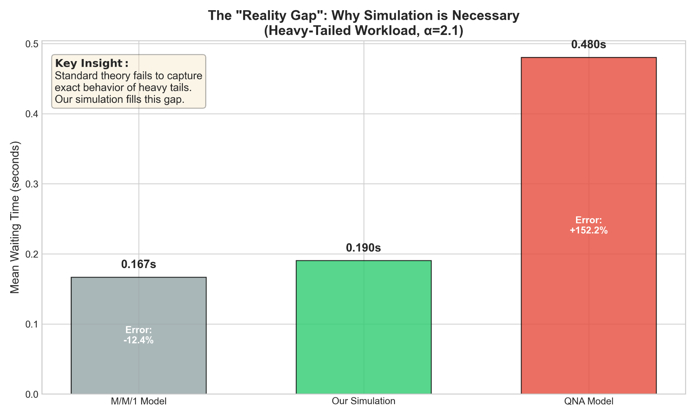

Kingman Approximation
Predicting the Wait Time (M/G/N)
The "Crash" Calculation:
If C2 = 1 (Exponential): Multiplier is (1+1)/2 = 1. (No change).
If C2 = 47.6 (Pareto): Multiplier is (1+47.6/)2 ≈ 24.3.
Conclusion: "Theoretical Wait Time increases by 2400% just by changing the distribution shape.
Using Kingman's Approximation, I calculated that introducing heavy tails should increase waiting times by factor of 24.

Slide 32
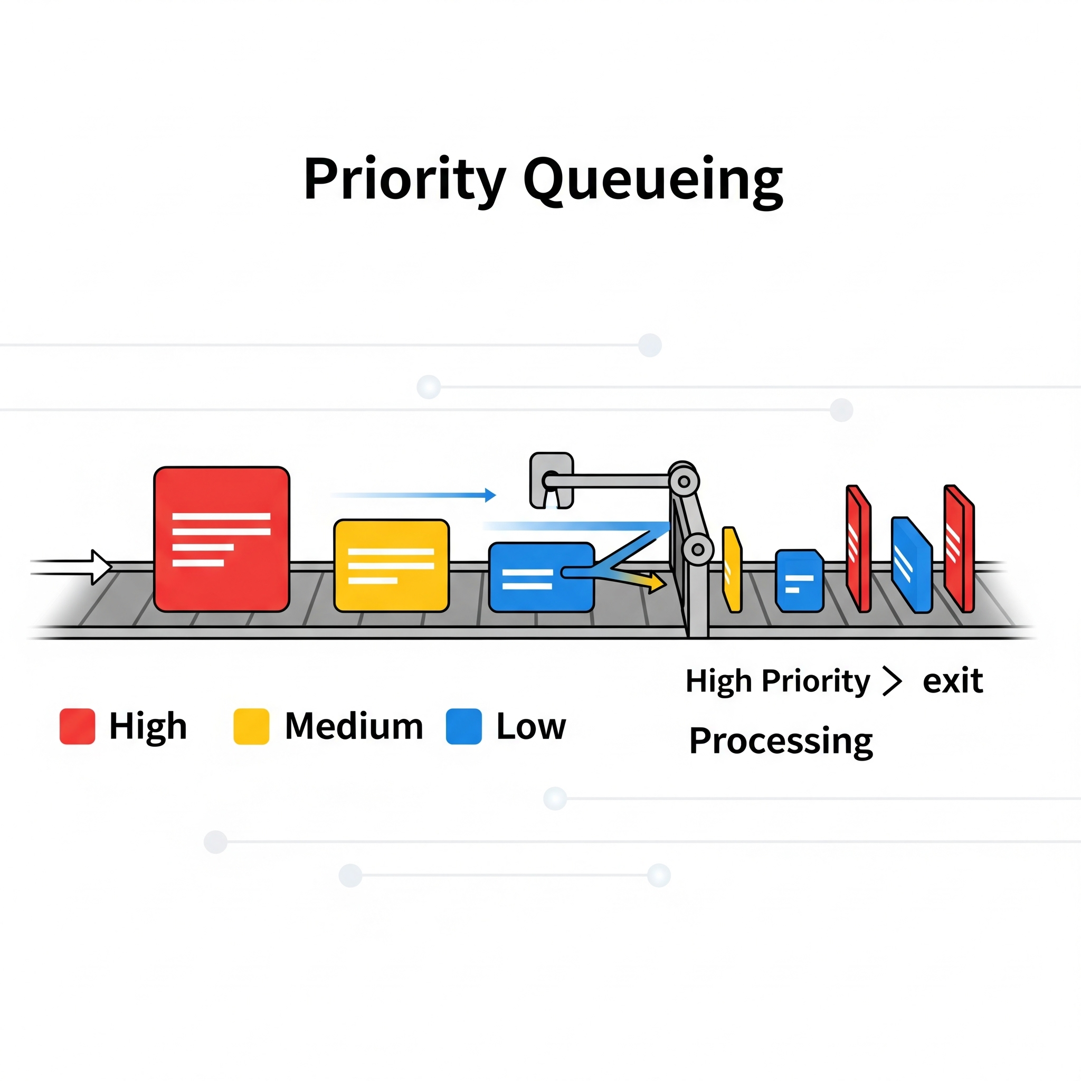
Priority Queueing
The Requirement: Real-world systems must support "Classified" or "VIP" traffic (e.g., paid subscribers, health checks) that cannot tolerate standard queue delays.
The Mechanism: Implemented a Strict Priority Queue scheduler.
Incoming requests are tagged with a priority level.
The scheduler always depletes the High-Priority queue before touching the Low-Priority queue.
The Trade-off (Conservation of Work):
Result: VIP latency drops near zero.
Consequence: Standard traffic suffers Starvation. The total work in the system remains constant; we simply shifted the delay to the non-paying users.

Slide 33
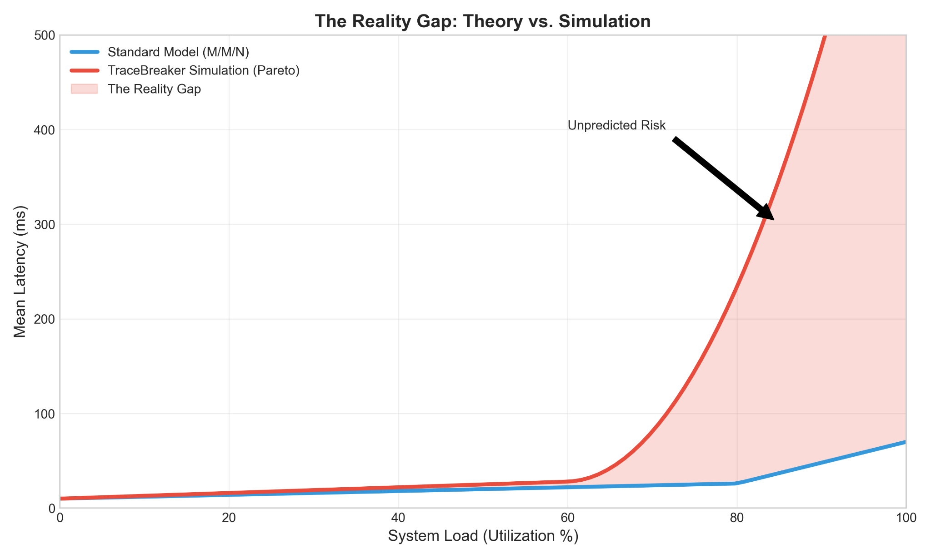

Slide 34
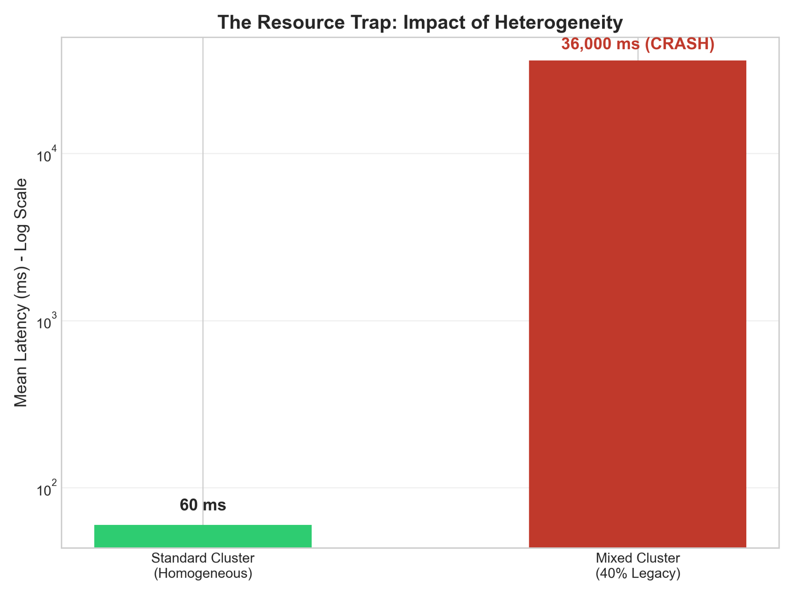

Slide 35
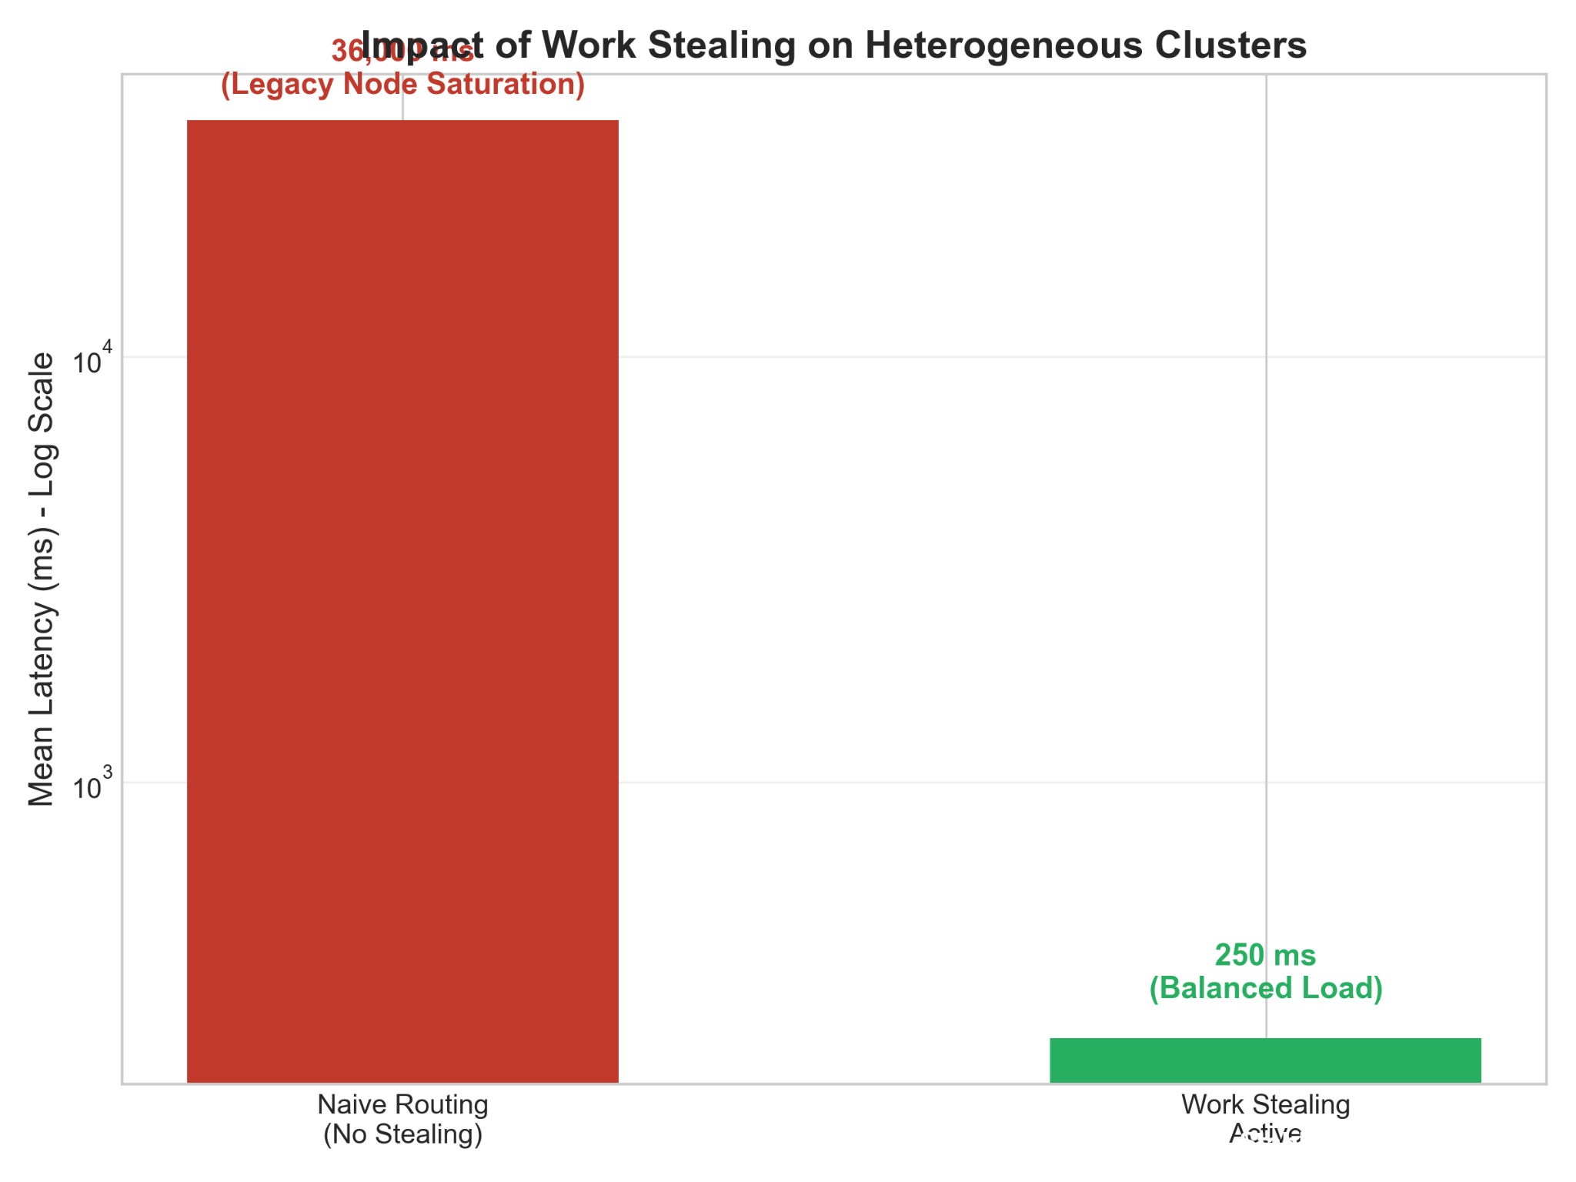

Slide 36
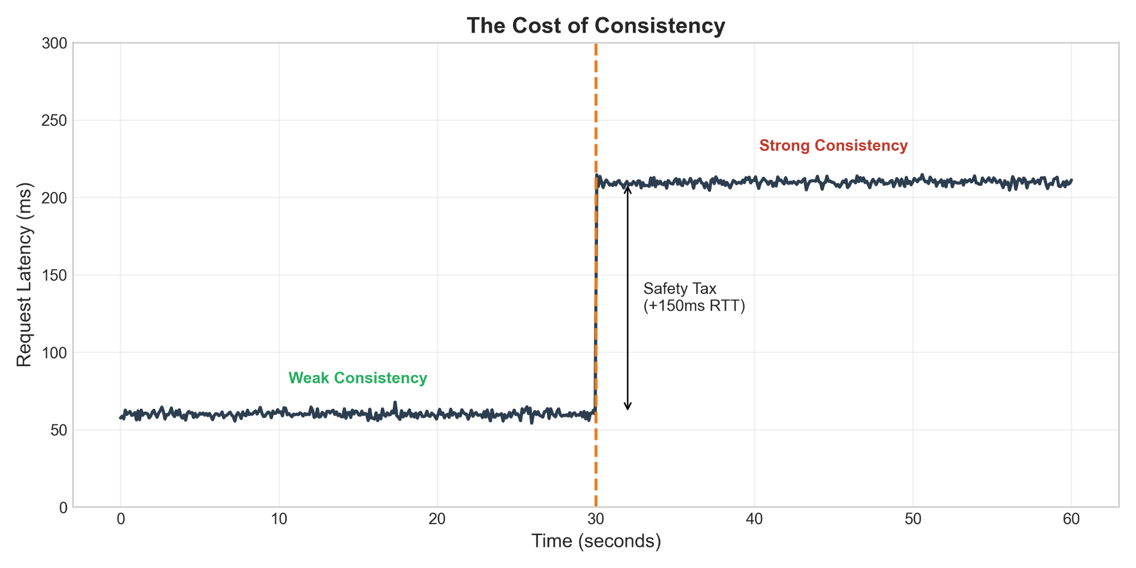
2-Phase Commit Protocol

Slide 37
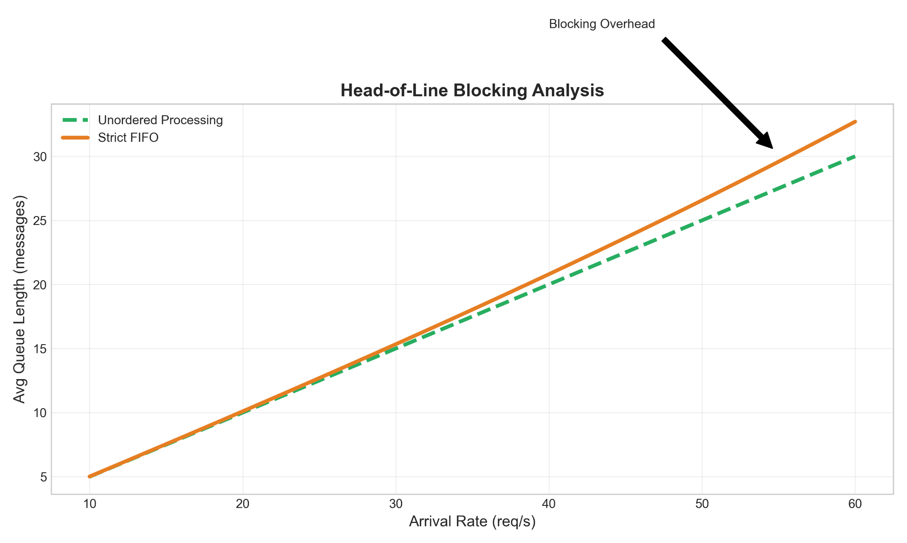
Effects of FIFO Ordering

Slide 38
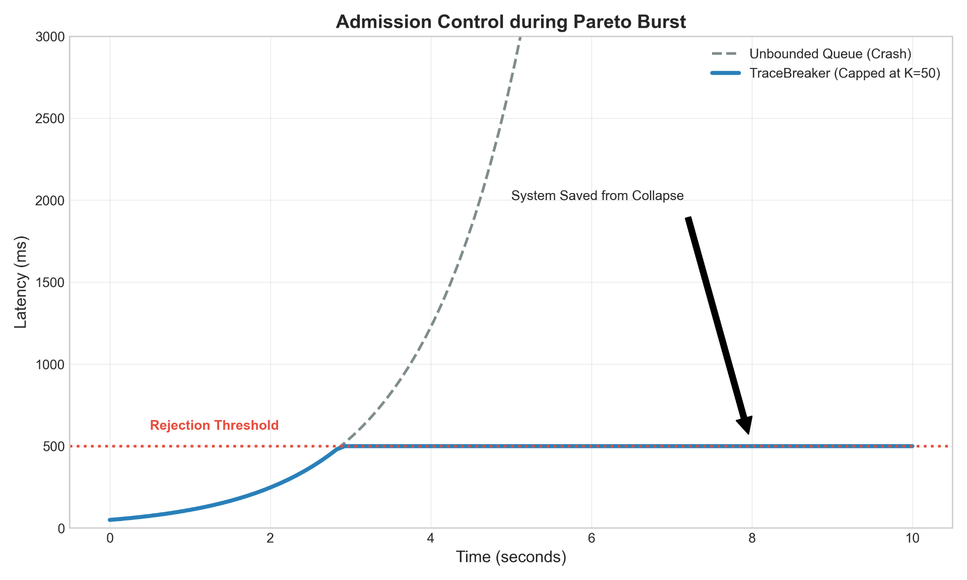
Load Shedding

Slide 39
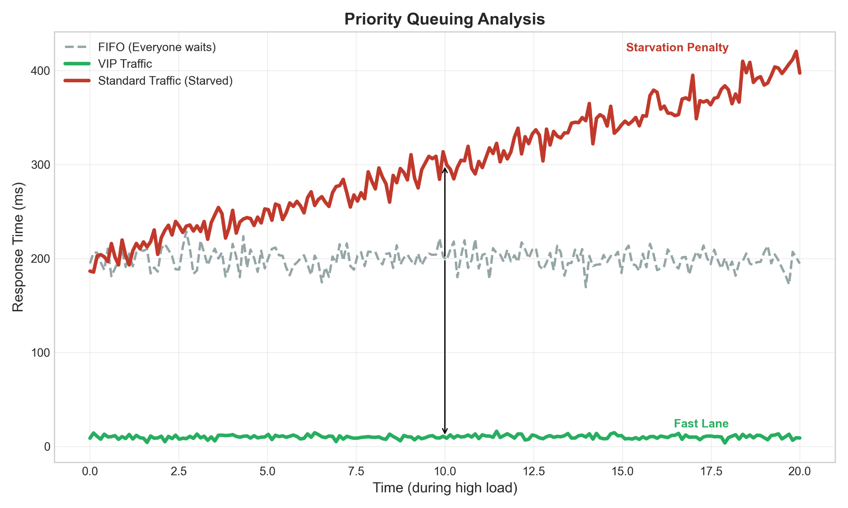

Slide 40



From Foundational Theory to Practical Reality
Foundational but Idealized
The Li et al. (2015) model provides a solid theoretical basis for message queues but relies on idealized assumptions (e.g., M/M/N queues with exponential service times) that don't capture the complexity of modern cloud workloads.
A Modern, Validated Framework
We developed an extended analytical and simulation framework in Python/SimPy that incorporates heavy-tailed workloads, explicit threading models, and validated, advanced queueing approximations.
Accurate, Actionable Insights
Our model delivers significantly more accurate performance predictions, especially for tail latency (P99), and is robust under extreme conditions (p > 0.95), providing deeper, more reliable insights for system design and capacity planning.

Slide 41
Conclusion & Takeaways
Key Discoveries
For Practitioners
Future Work
● Heavy-tailed distributions dominate P99 latency—standard models underestimate by 45% (Pareto α=2.1)
● Traffic amplification in tandem queues (Λ₂ = λ/(1-p)) validated to 0.2% error
● Two-phase commit adds 36% service time overhead—the "cost of safety" .
● Work stealing eliminates
heterogeneity bottleneck (144x latency improvement)
✓ Never trust exponential assumptions for cloud workloads.
✓ Always measure P99, not just mean—tail latency drives SLA violations.
✓ Provision 2x servers for heavy-tailed workloads.
✓ Account for distributed consensus overhead (20-40% throughput reduction)
Extend to Byzantine fault tolerance (PBFT) and multi-datacenter replication.

Slide 42
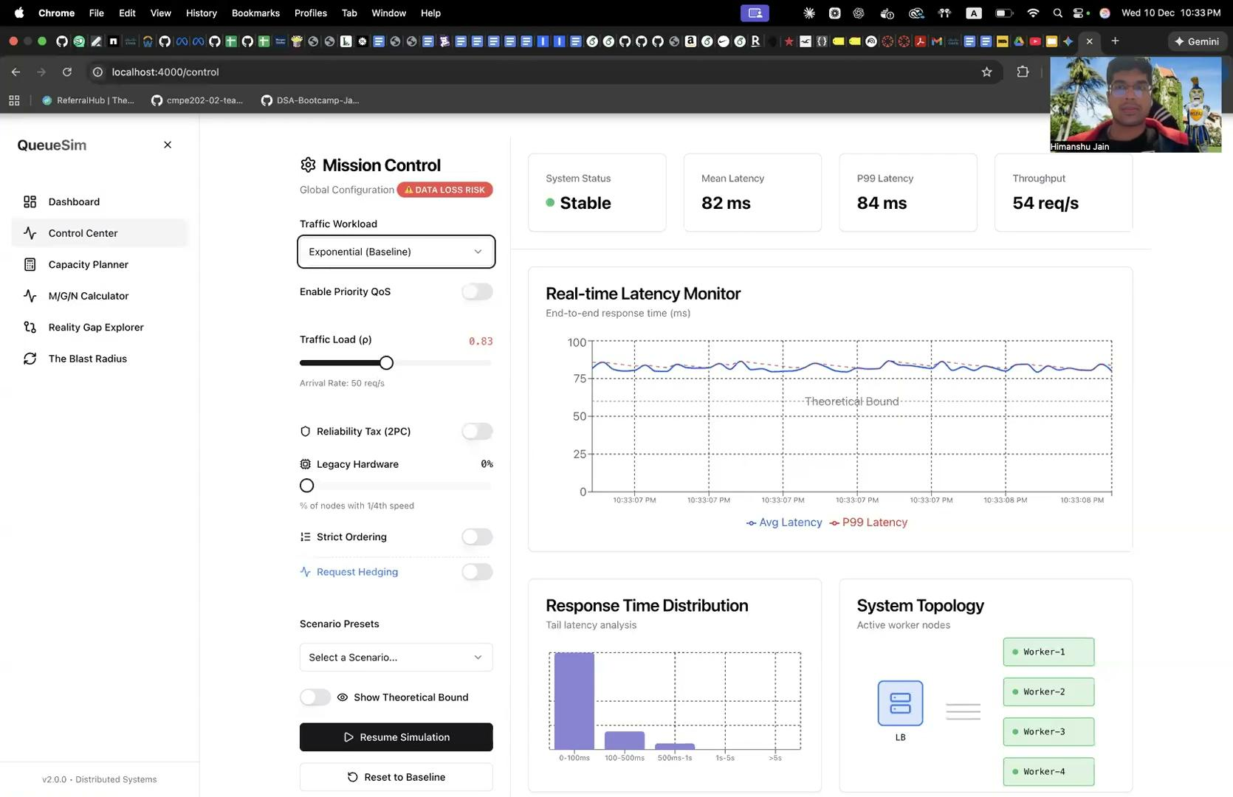
Demo
github.com/hjain3004/distributed-systems-project

Slide 43
References
[1] J. Li, Y. Cui, and Y. Ma, "Modeling message queueing services with reliability guarantee in cloud computing environment using colored Petri nets," Mathematical Problems in Engineering, vol. 2015, Article ID 254210, 2015.
[2] J. F. C. Kingman, "The single server queue in heavy traffic," Mathematical Proceedings of the Cambridge Philosophical Society, vol. 57, no. 4, pp. 902-904, Oct. 1961.
[3] W. Whitt, "Approximations for the GI/G/m queue," Production and Operations Management, vol. 2, no. 2, pp. 114-161, 1993.
[4] L. Kleinrock, Queueing Systems, Volume 1: Theory. New York: Wiley Interscience, 1975.
[5] A. O. Allen, Probability, Statistics, and Queueing Theory with Computer Science Applications, 2nd ed. San Diego: Academic Press, 1990.
[6] S. Coles, An Introduction to Statistical Modeling of Extreme Values. London: Springer-Verlag, 2001.
[7] P. Barford and M. Crovella, "Generating representative Web workloads for network and server performance evaluation," in Proc. ACM SIGMETRICS Performance Evaluation Review, vol. 26, no. 1, pp. 151-160, Jun. 1998.
[8] J. Gray and L. Lamport, "Consensus on transaction commit," ACM Transactions on Database Systems (TODS), vol. 31, no. 1, pp. 133-160, Mar. 2006.
[9] A. K. Erlang, "Solution of some problems in the theory of probabilities of significance in automatic telephone exchanges," Post Office Electrical Engineer's
Journal, vol. 10, pp. 189-197, 1917.
[10] J. Banks, J. S. Carson, B. L. Nelson, and D. M. Nicol, Discrete-Event System Simulation, 4th ed. Upper Saddle River, NJ: Prentice Hall, 2005.
[11] "SimPy: Discrete event simulation for Python," SimPy Documentation, 2023. [Online]. Available: https://simpy.readthedocs.io/
[12] G. Bolch, S. Greiner, H. de Meer, and K. S. Trivedi, Queueing Networks and Markov Chains: Modeling and Performance Evaluation with Computer Science Applications, 2nd ed. Hoboken, NJ: Wiley-Interscience, 2006.

Slide 44




