Slide 1
小
大
E_{g}
屈折率n
p-GaAs 200nm C: 1×10¹⁹
3 周期
In_{0.255}Ga_{0.745}As 15nm : well
GaAs 12nm : barrier
p-Al_{x}GaAs x:0.55→0.20 200nm C: 1×10¹⁸
Active layer
2.0 um
p-Al_{x}GaAs x:0.55 1000nm C: 1×10¹⁸
(1)
p-Al_{x}GaAs x:0.55 400nm C: 4×10¹⁷
well
p-Al_{x}GaAs x:0.20→0.55 200nm C: 2×10¹⁷
barrier
p-GaAs 50nm C : 2×10¹⁷
well
barrier
p-In_{x}GaP x:0.485 100nm Zn : 2×10¹⁷
well
nonGaAs 120nm (SCH)
(2)
10 周期
In_{0.255}Ga_{0.745}As 15nm : well
GaAs_{0.71}P_{0.29} 10nm : barrier
Active layer
non-GaAs 100nm (SCH)
well
n-Al_{x}GaAs x:0.55→0.20 200nm Si : → 1×10¹⁷
barrier
・・・
・・・
n-Al_{x}GaAs x:0.55 1400nm Si : 1×10¹⁸
n-Al_{x}GaAs x:0.20→0.55 100nm Si : → 1×10¹⁸
n-GaAs 200nm Si :1-2×10¹⁸(Buffer)
n-GaAs (Substrate)

Slide 2
3 periods
In_{0.255}Ga_{0.745}As 15nm : well
GaAs 12nm : barrier
well
barrier
well
barrier
well

Slide 3
10 periods
In_{0.255}Ga_{0.745}As 15nm : well
GaAs_{0.71}P_{0.29} 10nm : barrier
・・・

Slide 4
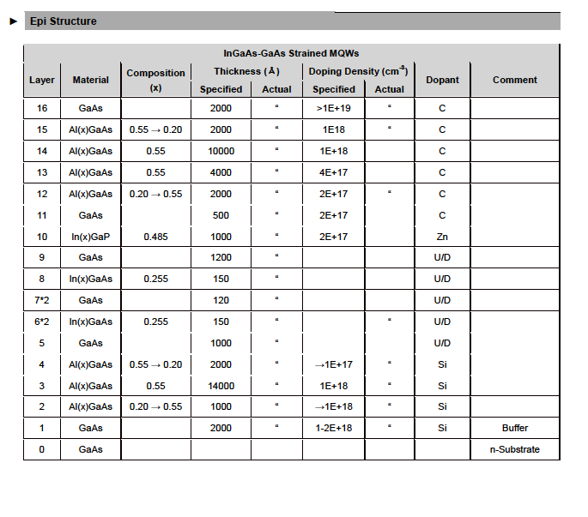
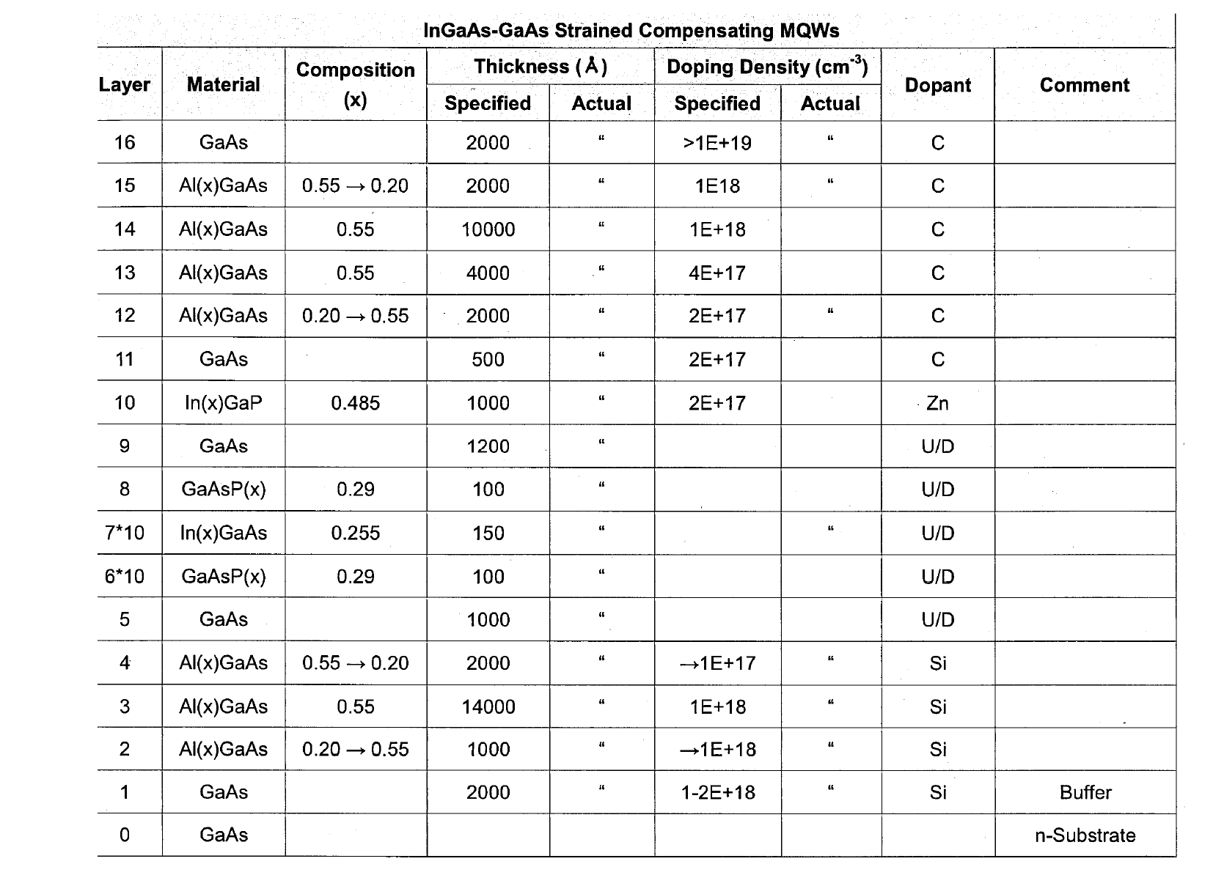
3QW
電極(AuZn)
10QW
10 periods
InGaAs:well
GaAsP :barrier

