Slide 1
Gain switching for ~100-ps pulse (CAN LD and DBR-LD from Thorlabs)
Akiyama Lab meeting (2018/08/09 Tao)

Slide 2
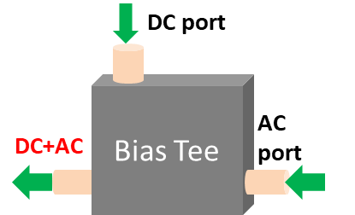
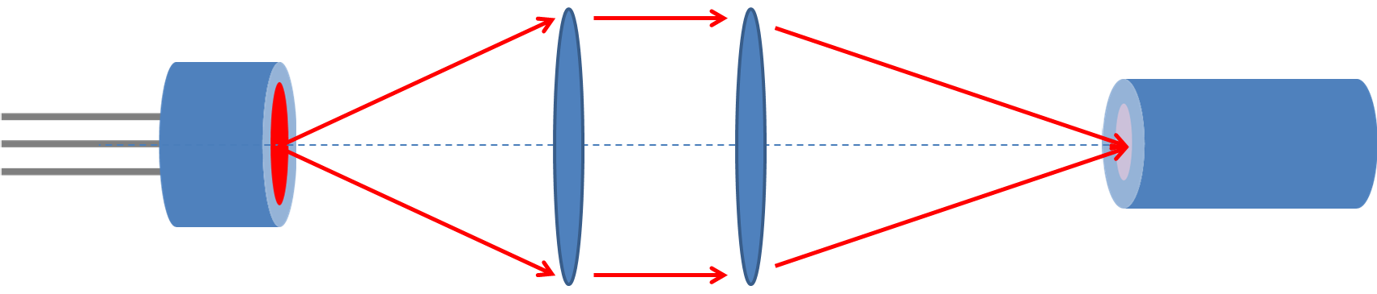
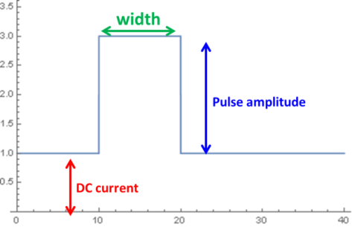
Akiyama Lab meeting (2018/08/09 Tao)
Setup
Amp
ATT
PG
CAN
LD
Fiber
Spectrometer
ATT
HS-Osc. Scope
Bias-T used
No impedance matching parts
Maximum pump amplitude after Amp.: ~37V
Focusing on single GS peak from LD

Slide 3
Akiyama Lab meeting (2018/08/09 Tao)
CAN-LD: cw off, high pump amplitude, width variation

Slide 4
Akiyama Lab meeting (2018/08/09 Tao)

Slide 5
Akiyama Lab meeting (2018/08/01 Tao)
CAN-LD: cw variation, high pump amplitude, width 0.5ns

Slide 6
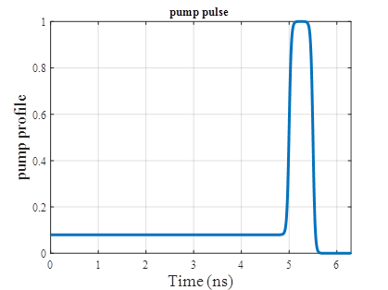
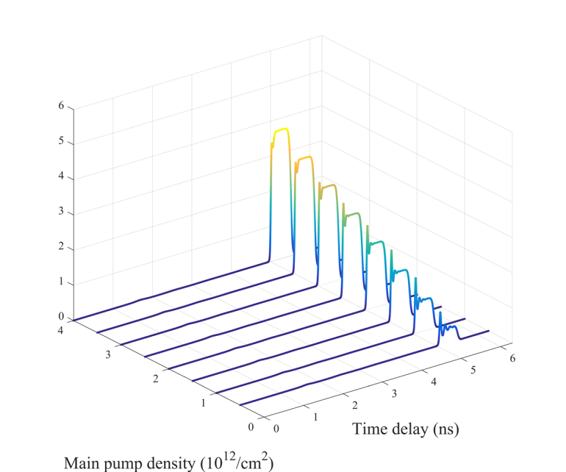
Akiyama Lab meeting (2018/08/09 Tao)
CAN-LD: cw @threshold, high pump amplitude, width 0.5ns
Hints for sub-ns pulse generation (vs simulation)?
Main pump

Slide 7
DBR-Pigtailed LD
Akiyama Lab meeting (2018/08/09 Tao)

Slide 8
Akiyama Lab meeting (2018/08/09 Tao)
DBR-LD: cw off, pump ampl. variation, width 2.5ns

Slide 9
Akiyama Lab meeting (2018/08/09 Tao)
DBR-LD: cw off, pump ampl. max, width variation

Slide 10
Akiyama Lab meeting (2018/08/09 Tao)
DBR-LD: cw low, pump ampl. max, width 0.5ns

Slide 11
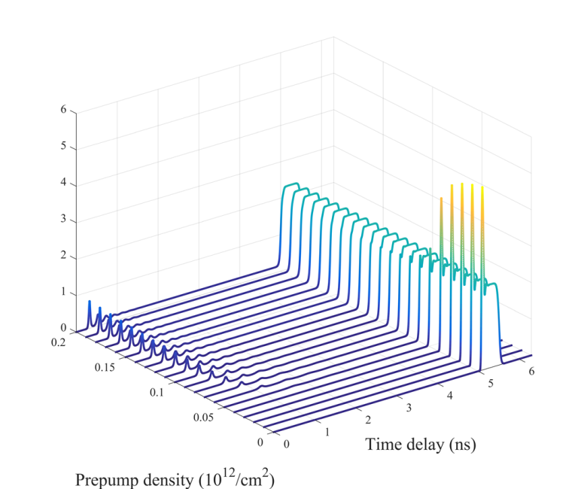
Akiyama Lab meeting (2018/08/01 Tao)
DBR-LD: cw high, pump ampl. max, width 0.5ns
Hints for sub-ns pulse generation (vs simulation)?
Main pump
Pre-pump

Slide 12
FP-Pigtailed LD
Akiyama Lab meeting (2018/08/09 Tao)

Slide 13
Akiyama Lab meeting (2018/08/09 Tao)

Slide 14
Akiyama Lab meeting (2018/08/09 Tao)

Slide 15
Akiyama Lab meeting (2018/08/09 Tao)

Slide 16
Akiyama Lab meeting (2018/08/09 Tao)

Slide 17
Data of the QD LD
Akiyama Lab meeting (2018/08/09 Tao)

Slide 18
Akiyama Lab meeting (2018/08/09 Tao)

Slide 19
Akiyama Lab meeting (2018/08/09 Tao)

