Slide 1
PLASMOL · JOBS / FINAL
01 / 13
DISSERTATION CAMPAIGN
Nanoparticle and CAP effects
on a double core hole
A sudden double vacancy on one core orbital, next to a nanoparticle. The molecule and the sphere are not chosen. Each later run turns one piece on and leaves the rest fixed.
SERIES
PAIR
STATUS
Sudden single-site DCH
Not chosen · two pairs still open
Step 1 done · 2–8 are placeholders
Notes:
Open with the comparison, not a chosen dye. The molecule and the nanoparticle are unset. Step 1, the literature and the valence screen, is done. Steps 2–7 have inputs whose molecule and nanoparticle fields are still placeholders. Do not launch a file that contains PLACEHOLDER_.

Slide 2
THE QUESTION
02 / 13
One switch at a time, or the causes mix.
01
02
03
The nanoparticle
The CAP
Then two checks
The local field, and, when back-propagation is on, the field the molecule itself radiates into the cell.
The Lopata non-Hermitian term on the Fock matrix. It sets lifetimes and peak widths, instead of a coherent oscillation that does not decay.
Step 7 moves the gap on the resonant pair. Step 8 repeats the key runs where the plasmon misses the bright root.
DYNAMICS
SPECTRA
Hole occupations on the neutral MO basis. The sudden double hole is already non-stationary, so the hole moves with no external field.
A δ-kick on the isolated molecule, and a hybrid cross section under a Gaussian centered on that molecule’s bright root.
NOT A SPECTRUM
A field-free hybrid job has no incident field. The cross section divides by that field, so the denominator is ~0. Those runs are occupations, the local field, and the induced dipole.
Notes:
The published result is a difference. DCH plus nanoparticle plus CAP plus a pulse mixes four causes. Dynamics are mo_occ.csv. Spectra are cross_section. If there is no incident source, do not divide.

Slide 3
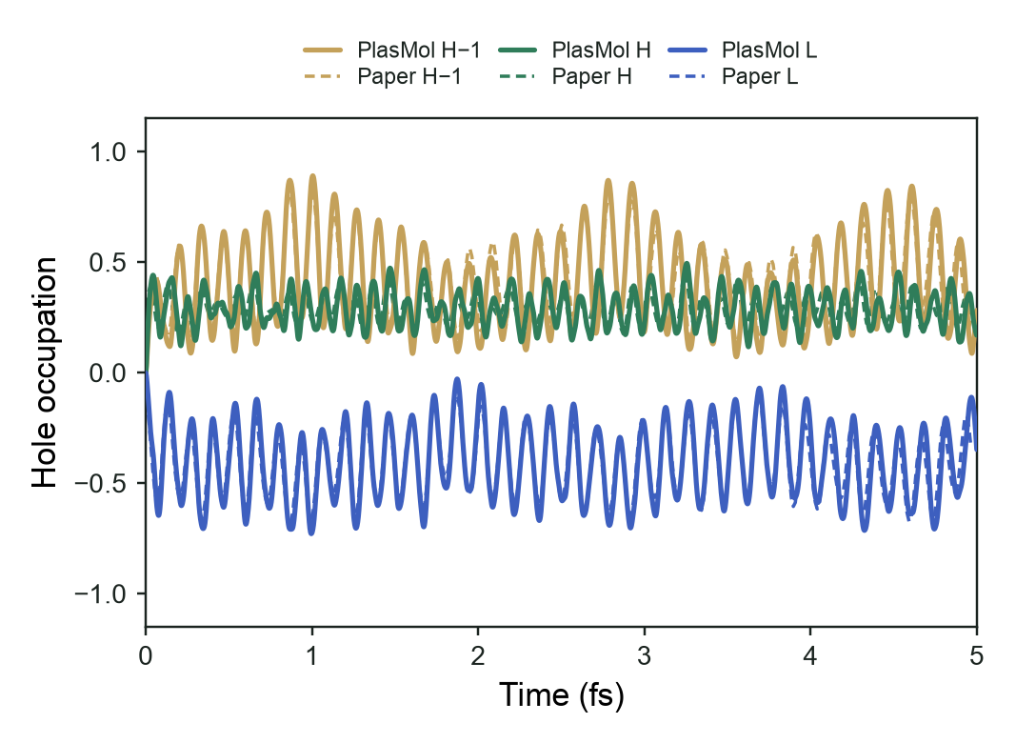
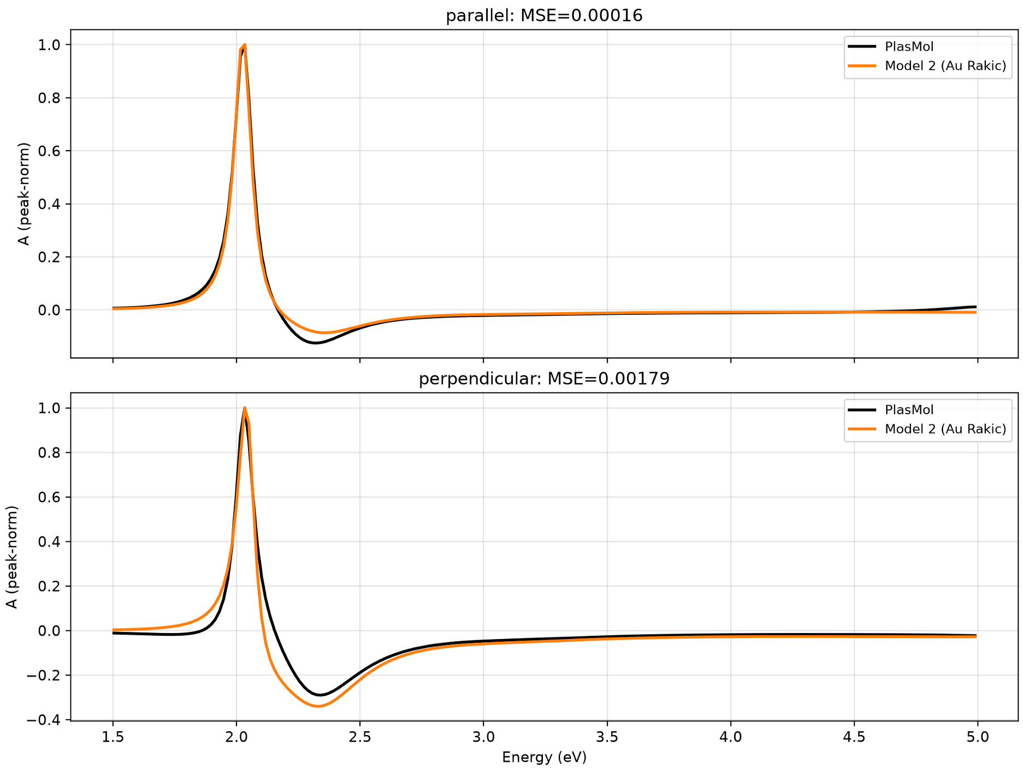
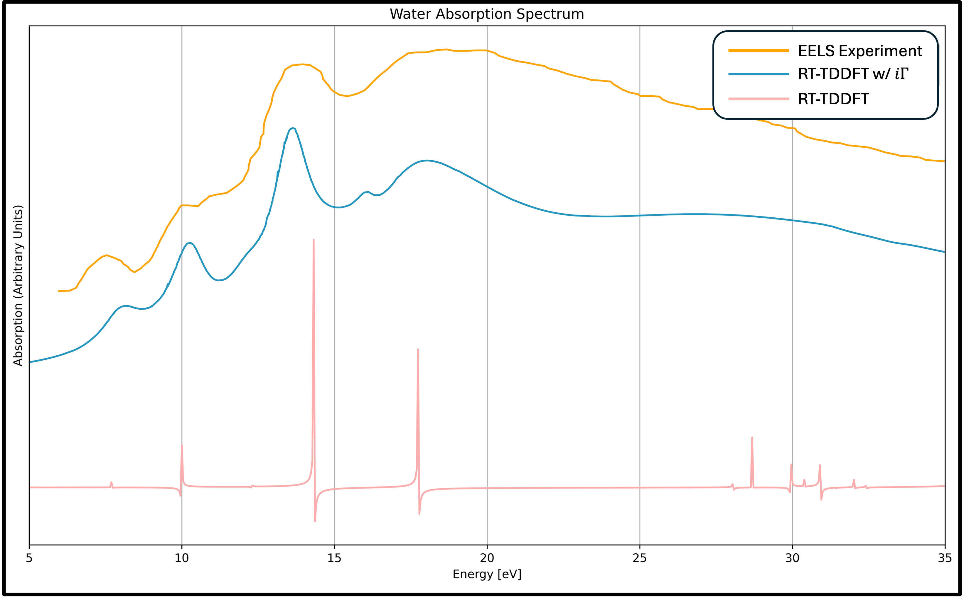
ALREADY CHECKED · NOT PART OF JOBS / FINAL
03 / 13
The methods line up with the references.
01 SUDDEN DCH
02 THE CAP
03 HYBRID LOOP
3-pentanone holes. Solid: PlasMol. Dashed: Nascimento, Fig. 8a.
Water with the CAP, set against Lopata and Govind, JCTC 2013.
Sodium beside gold. PlasMol against the Gersten–Nitzan model.
None of these is the molecule in Steps 2–8. MOs 21, 23, and 24 are the pentanone frontier, not the production one. This campaign does not reuse the sodium line or that gold sphere.
Notes:
Do not rerun these checks instead of Steps 2–8, and do not overlay their traces on the new jobs. The DCH panel is the Cartesian PySCF sweep against the digitized Nascimento Fig. 8a. Inputs that say driver dch are retired.

Slide 4
THE RUN LIST
04 / 13
Eight steps. Only the screen has been run.
1
Literature and screen
Bright valence lines near a metallic plasmon.
Done
2
Core survey
Which MO is the core on the resonant molecule.
Placeholder
3
Field-free DCH
The sudden hole, one factor at a time. D1–D6.
Placeholder
4
δ-kick spectra
Isolated absorption, ± DCH, ± CAP. K1–K4.
Placeholder
5
Gaussian hybrid
Cross section, ± DCH, ± NP, ± CAP. G1–G8.
Placeholder
6
Two controls on G4
Perpendicular, and back-propagation off.
Placeholder
7
Distance
Resonant pair at three other surface gaps.
Placeholder
8
Detuned pair
Key runs where the resonances do not overlap.
Placeholder
Notes:
There is no separate step for choosing the pair. Choose it, then fill the placeholders, then launch. Steps 2–7 are the resonant pair. Step 7 changes only the gap. Step 8 is the pair whose resonances do not overlap, still at 0.015 μm.

Slide 5
STEP 1 · DONE
05 / 13
The literature molecules miss both plasmons. One candidate does not.
417 nm
418.5 nm
None
trans-thioindigo, screen μ
35 nm silver, not selected
of the DCH-literature set
LC-ωPBE at μ = 0.34272, f = 0.29. That μ is not the production value. The root moves if μ changes.
Mie peak of Meep Ag in water. This pair is resonant with itself. It is not written into the JSON.
No bright line in that screen sits on the silver plasmon near 418 nm or the gold plasmon near 540 nm.
What Step 1 actually is
A reading list of double-core-hole papers, plus a valence-absorption screen of those molecules and of trans-thioindigo. Thioindigo is not in that literature. The production initial condition, from Step 3 on, is the pentanone one: a sudden double vacancy on one core MO, neutral orbitals kept. It is not a two-site free-electron-laser spectrum. The thioindigo μ tune has not been run.
Notes:
If thioindigo is later selected, match the calculated root at 417 nm, not the benzene maximum. The 418.5 nm number is the Rakic Ag dielectric, not Ag_visible. Meep marks that Palik fit unstable.

Slide 6
FROM STEP 2 ON
06 / 13
The form is fixed. μ and ε₀ are not.
HELD FIXED
STILL A PLACEHOLDER
Functional
Geometry
LC-ωPBE on every run. Not PBE0. The value of μ is open
Resonant file in Steps 2–7. A separate file in Step 8
Basis
Core and frontier
6-311G*, Cartesian. Charge 0, singlet. Nuclei stay at PBE0
One core index, and three watch indices
CAP shape
Nanoparticle
Static. γ₀ = 1, ξ = 0.5, clamp 100. ε₀ is open
Meep material and radius. Baseline x is radius + 0.015 μm
Time
Gaussian wavelength
Molecule-only: dt 0.05 au. Hybrid: dt 0.1 au to 10,000 au
The molecule’s bright root, in μm
Cell
μ
Water, n = 1.33. Baseline gap 0.015 μm. Step 7 is the scan
One number on every file for that molecule, CAP on or off
Gaussian width
ε₀
fwidth 2.0. The wavelength itself is still open
CAP threshold in Ha, tuned at that μ. CAP files only
Notes:
μ and ε₀ are tuned for the chosen molecule. The pentanone pair, 0.34272 and 0.003028 Ha, is not pasted in. A CAP-off job must use the same μ as its CAP-on partner. ε₀ appears only in the CAP block. Do not launch until every PLACEHOLDER_ token in that file is a real value.

Slide 7
STEP 2 · PLACEHOLDER
07 / 13
Name the core before any hole is made.
survey.json builds the neutral molecule, writes which atoms contribute to MOs 0 through 5, and exits. It does not remove electrons and it does not propagate. The production hole is two electrons from one of those MOs, so the propagation stays closed-shell.
THIOINDIGO TRIAL
Not the production assignment.
Print, don’t ionize
MO 0, 1
The 0–5 list is what the survey reports. It is not the production hole.
Sulfur 1s
MO 2, 3
Oxygen 1s
One MO
A second index would open the shell. Single core holes are out of this plan.
MO 4, 5
Carbon 1s
Equivalent atoms
The two oxygen 1s orbitals are a mix of both carbonyls. Do not copy these indices unless thioindigo is the molecule you select.
A canonical MO can be a combination of two sites, not a hole on one of them.
Notes:
Do not launch Step 3 until the resonant survey has been run and the core index is written into the DCH files. The trial lives in Step_2/thioindigo_trial.

Slide 8
STEP 3 · FIELD-FREE
08 / 13
The drive is the sudden hole, not a laser.
Run
CAP
Sphere
Radiates
What the difference is
D1
off
no
—
The free hole. Stock geometry. Can checkpoint.
D2
on
no
—
D2 − D1 is the CAP on that free hole.
D3
off
yes
on
D3 − D1 is the sphere when the molecule radiates.
D4
off
yes
off
If D4 matches D1, the effect is the radiated field coming back.
D5
on
yes
on
D5 − D3 is the CAP on the radiating case.
D6
on
yes
off
D6 − D4 is the CAP when the molecule does not source the cell.
After D1, paste the rotation that puts the core-hole dipole on +x into D3–D6 only. Compare occupations on the first 400 au. The hybrid step is 0.1 au, not 0.05.
Notes:
D3–D6 have no Meep source and cannot checkpoint. Do not treat them as cross sections. Neutral field-free dynamics are not in the matrix: with no hole and no field the density does not move.

Slide 9
STEP 4 · δ-KICK
09 / 13
The real-time spectrum of the molecule alone.
Absorption driver, polarization full, so x, y, and z are averaged. Kick 0.001 au. Propagate 4000 au. The Fourier window γ = 0.01 is about 0.27 eV half-width. It is not a substitute for the CAP. The plotted window is 1.5–15 eV unless the bright root sits above that.
K1
Neutral, no CAP
K2
Neutral, CAP on
The ordinary spectrum. A rotation would not change the averaged curve.
K2 − K1 is the CAP on the closed shell.
K3
DCH, no CAP
K4
DCH, CAP on
K3 − K1 is the sudden hole.
K4 − K3 is the CAP on the hole.
Step 1’s linear response is the check on the same neutral molecule. It is not a substitute for K1. K1’s three dipole files are a valence axis, not the rotation used for D3–D6.
Notes:
These jobs can checkpoint. A core hole writes mo_occ.csv under x_dir, y_dir, and z_dir. Lower gamma before treating the 4000 au trace as higher resolution. The dipole is already small by a few hundred au.

Slide 10
STEP 5 · GAUSSIAN HYBRID
10 / 13
The same pulse, with and without the sphere.
The Gaussian is centered on the molecule’s bright root, fwidth 2.0. Parallel puts the field along the nanoparticle–molecule axis. Single is the empty cell. Back-propagation is on. The published curve is cross_section. No checkpoints.
G1
G2
G3
G4
neutral · no sphere
DCH · no sphere
neutral · sphere
DCH · sphere
no CAP
no CAP
no CAP
no CAP
G5
G6
G7
G8
neutral · no sphere
DCH · no sphere
neutral · sphere
DCH · sphere
CAP
CAP
CAP
CAP
Run G1–G4 first. G4 − G2 is the sphere at fixed DCH. G2 − G1 is the hole with no sphere. G8 − G4 is the CAP on the production hybrid. The empty cell is not a substitute for Step 4.
Notes:
Do not reuse a vacuum reference computed with a different source or a different dt. The plot window is a placeholder until the bright root is known. gamma is 0 on these jobs.

Slide 11
AFTER G4 MOVES
11 / 13
Two controls at 0.015 μm, then the gap.
STEP 6
STEP 7
Only after resonant G4 moves.
Same pair. Three other gaps.
G4 perpendicular
Polarization perpendicular instead of parallel.
0.005, 0.030, and 0.060 μm. The 0.015 μm baseline is not repeated. Each gap is D3, D4, and G4 only.
G4, no back-propagation
The molecule feels the cell and does not source it.
Compare D3 − D1 and G4 − G2 with the baseline. If the gap changes D3 and G4 but not D4, the distance dependence is the field coming back.
One of each is enough. Do not repeat them across CAP, DCH, or the Step 7 gaps until this G4 has moved.
Molecule x is the radius plus that gap, not the baseline x. Widen the cell if the farther gap no longer fits.
Notes:
Step 7 does not repeat molecule-only jobs. D1 and G2 have no nanoparticle. No CAP and no perpendicular run. The detuned pair stays at 0.015 μm so distance and resonance are not changed together.

Slide 12
STEP 8 · OFF RESONANCE
12 / 13
The same question, where the plasmon misses the root.
The Gaussian stays on the molecule’s bright root. The gap stays 0.015 μm. This comparison is resonance, not distance.
Survey
D1, D3, D4
The core index belongs to this molecule.
Free hole, then the sphere with and without radiation.
K1, K3
G1–G4
Where the bright root is, before and after the sudden hole.
Cross section, ± DCH, ± nanoparticle, no CAP.
Read D3 − D1 and G4 − G2 against the resonant pair. If the nanoparticle effect shrinks here, it was the shared resonance. The detuned tokens are a separate set.
Notes:
K1 is what makes detuned a measurement. Do not repeat the CAP rows, the Step 6 controls, or the Step 7 gaps. If only the nanoparticle changes, reuse D1, K1, K3, G1, and G2.

Slide 13
STILL OPEN
13 / 13
Nothing from Step 2 on should be launched yet.
01
Choose both pairs
02
Survey, then the index
A resonant pair, plasmon on the bright root. A detuned pair, plasmon off that root. Then replace every placeholder.
Write the core MO and the three frontier indices into the resonant DCH files. Do not reuse the thioindigo trial unless that molecule is selected.
03
D1, then the rotation
04
G1–G4 before the rest
Paste the orientation that puts the moving core-hole dipole on +x into D3–D6 only. Leave D1 and D2 on the stock frame.
The CAP rows, the G4 controls, and the gap scan wait on that 2×2. Step 8 waits until the resonant comparison is in hand.
A file that still contains PLACEHOLDER_ is not an input. The Step 7 x tokens are radius plus that gap. Detuned tokens are only in Step 8.
Notes:
Step 7 runs only if resonant G4 − G2 is nonzero. Step 8 stays at 0.015 μm. Hybrid jobs cannot checkpoint. Publish peak-normalized curves when the claim is that a peak moved or broadened.

