Slide 1
branch
PCSrc
1
0
<<2
CONCAT
ADD
0
1
<<2
W
W
JUMP
W
M
M
E
Control
Hi
MUX
ADD
MULT
LOW
4
RegWrite
zero
RN1
RD1
PC
ADDR
RD
RN2
Register File
ALU
Instruction memory
WN
ALUSrc
RD2
0
1
MemRead
WD
ADDR
Data
Memory
RD
MemToReg
EXTND
ALU
control
WD
0
1
immed
ALUOp
RegDst
MemWrite
0
1
IF/ID
ID/EX
EX/MEM
MEM/WD

Slide 2
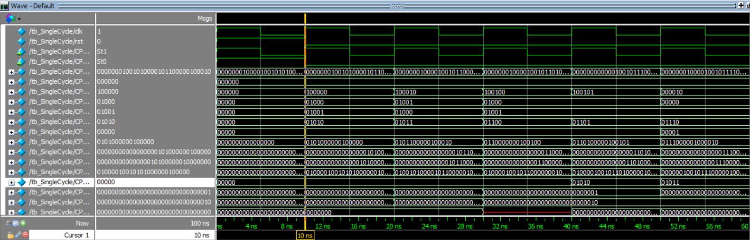

Slide 3
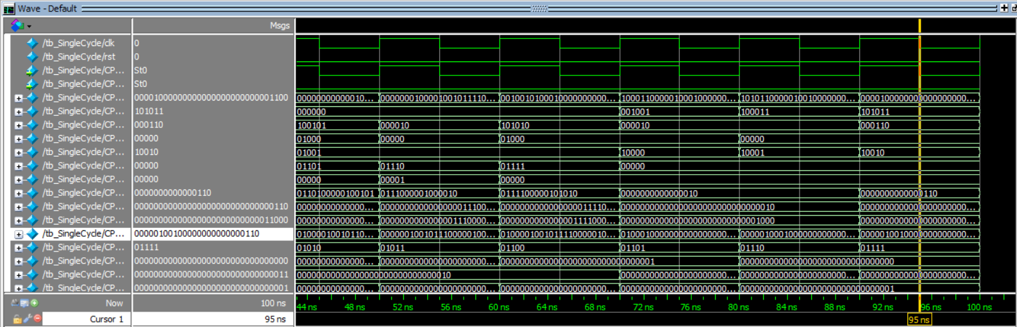

Slide 4
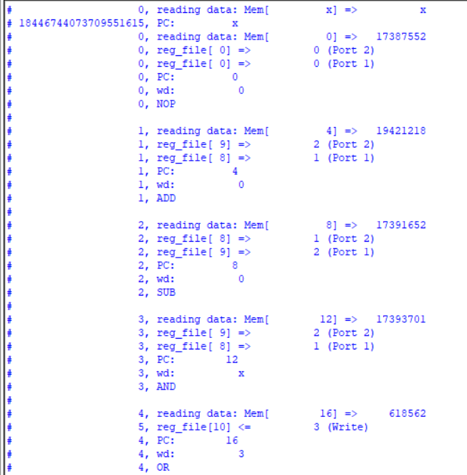

Slide 5
