Slide 1
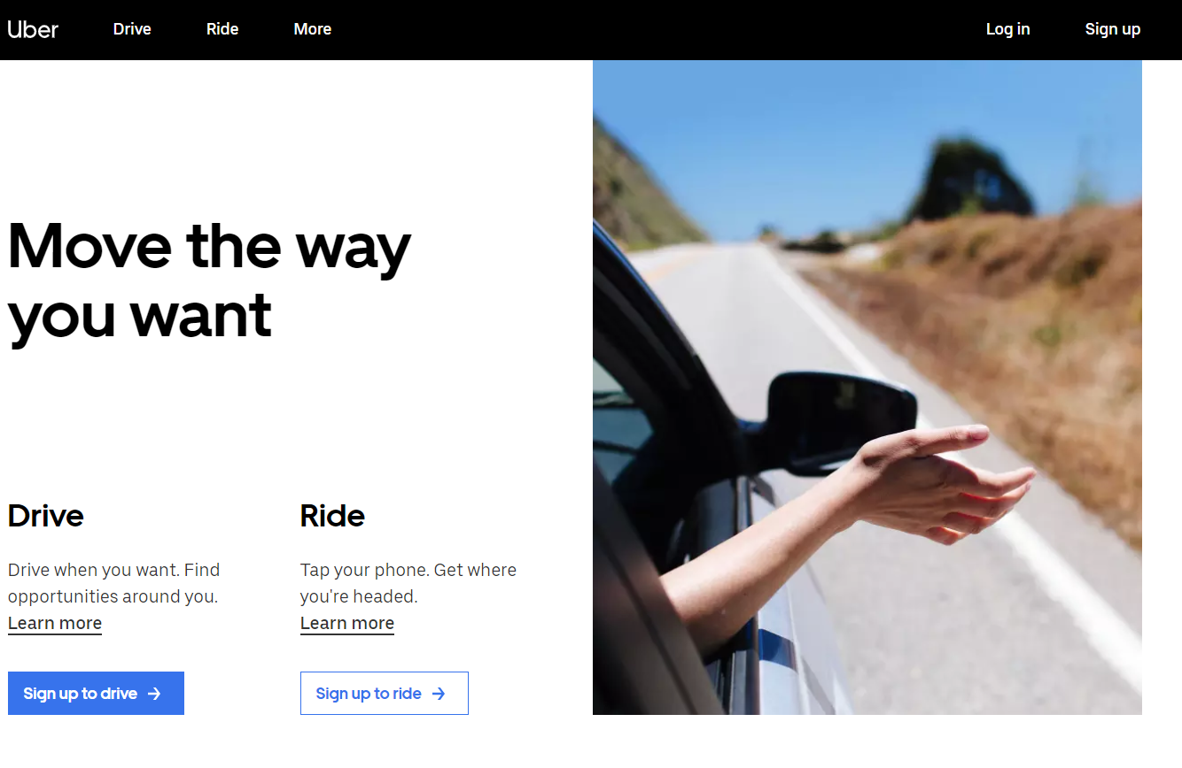

Home Page
Uber
Hoster
Biliq

Slide 2
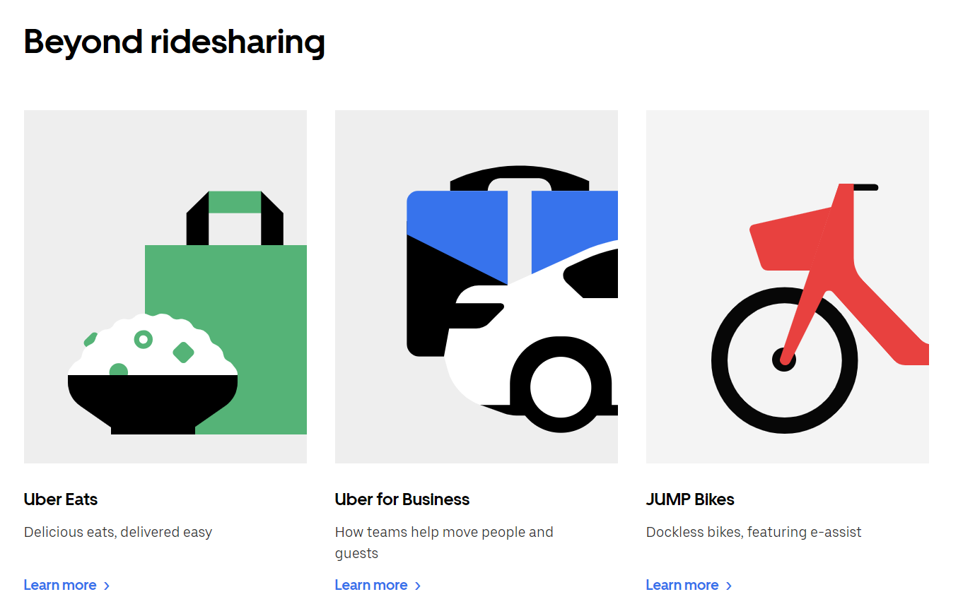

Property Certificates
Uber
Property Certificates
Biliq

