Slide 1


New Study Program in Space Systems and Communications Engineering
SPACECOM
Kick-off meeting
Tashkent University of Information Technologies named after Muhammad Al-Khwarizmi
04/03/2020

Slide 2
24.10.1945 - founded the State Polytechnic
today the Technical University of Sofia is the largest technical higher educational and research establishment in Bulgaria
over 20 000 students
total number of personnel: 2400
over 1800 full-time academic staff
11 main faculties, 3 divisions for foreign education programmes, 3 branches in Plovdiv and Sliven

Slide 3
Faculty of Electronic Engineering and Technology
Department of Electronic Engineering
Department of Power Electronics
Department of Microelectronics
Department of Chemistry

Slide 4
Microcooling project: 3D packaging for avionics applications
Stacked 3D module
Clamping system
I/O PCB
Interconnections
Substrate
Layer 1
Layer 2
Integrated
heat pipe
Layer 3
Thermal path
Casing
Customized Routing PCB

Slide 5

Sintered powder heat pipe for 3D packaging
Heat sources
Heat source
Condensers
Heat enters the HP
Heat pipe
Vapour
Convective cooling
(external for the HP)
Vapour condenses
Liquid evaporates
Sintered powder wick

Slide 6

TeLearn Laboratory 29 Projects
Last 5 years co-ordinator of projects:
Tempus (2013–2017), 543861-TEMPUS-1-2013-BG-TEMPUS-JPCR “Education in Nanotechnologies”
Erasmus+, Knowledge Alliance (2016 – 2018), 562206-EPP-1-2015-1-BG-EPPKA2-KA “MicroElectronics Cloud Alliance”
Erasmus+, Capacity Building in Higher Education (2016 – 2020) 573828-EPP-1-2016-1-BG-EPPKA2-CBHE-JP, Internationalised Master Degree Education in Nanoelectronics in Asian Universities, NanoEl
Erasmus+, Capacity Building in Higher Education 585336-EPP-1-2017-1-BG-EPPKA2-CBHE-JP (2017 – 2020) Euro-Mongolian Cooperation for Modernisation of Engineering Education, EUMong

Slide 7
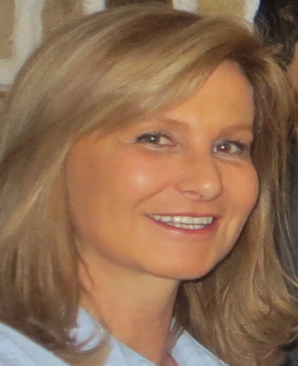
Slavka Tzanova
Dipl. Eng. in Automation and Telemechanics from TUS
M.Sc. in Educational Technology from University of Twente, the Netherlands
Ph.D. in Microelectronics from TUS
D.Sc. in Educational Sciences
Professor in the Department of Microelectronics and in the French Department of Electrical Engineering
Head of the TeLearn Laboratory
Invited professor at INP Grenoble 2001-2006
Thermal management of multichip modules (MCM) and microsystems
Design of Si and GaAs integrated circuits
Instructional design and evaluation of eLearning materials
Languages: French, Russian, English, Italian, Spanish

Slide 8
Tasks of TU-Sofia in SPACECOM
TUS leads the WP1 Need analysis/review the current curricula and learning outcomes definition
Support to universities from Uzbekistan in the new curriculum design;
Development of syllabus and materials of two courses in micro- nanoelectronics (Advanced microelectronics and CAD)
Dissemination of project results to other CBHE consortiums; publication of project results on conferences and forums on higher education.
Meeting in Sofia for the staff from C-Offices.

Slide 9
SPACECOM Project
This project has been funded with support from the European Commission. This publication reflects the views only of the author, and the Commission cannot be held responsible for any use which may be made of the information contained therein

