Slide 1




NEW STUDY PROGRAM IN SPACE SYSTEMS AND COMMUNICATIONS ENGINEERING (SPACECOM)
Khabibullo Nosirov – Project Coordinator

Slide 2














The Consortium:
Tashkent University of Information Technologies,
Technical University of Berlin,
University of Sorbonna,
Artesis-Plantijn University of Applied Sciences,
Technical University of Sofia,
EXOLAUNCH,
Coursento,
National University of Uzbekistan,
Tashkent State Technical University,
Turin Polytechnic Institute in Tashkent,
Karshi branch of TUIT,
Ferghana Polytechnic Institute,
Branch center of retraining and professional development of pedagogical staff under TUIT,
Astronomical Institute of the Uzbek Academy of Sciences.
|

Slide 3
The main objectives of the project are:
Development and modernization of the existing master's program in satellite technology, space technology and communication systems, as well as the use of satellite communications in accordance with the recommendations of the Bologna process.
Period: 2019-2022 years
Budget of the project: 998997 euro

Slide 4
Expected Project Results:
- opening new master program in space engineering and technology;
- modernization of the existing and development of new courses related to Space and Communication Engineering;
- organizing new educational-scientific research laboratory for space engineering and technology;
- re-training personal of TUIT and its branches;
- developing new handbook and educational-methodological manuals.

Slide 5
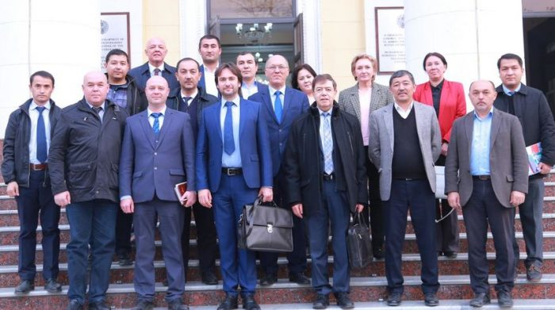
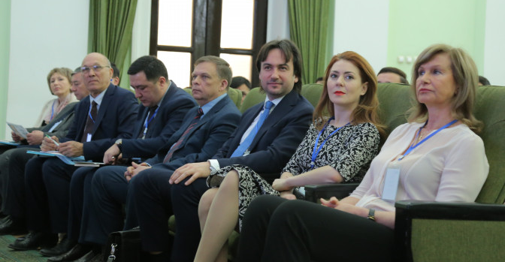
The First Year Activities
Preparation meeting was held in TUIT in November 2019 in Tashkent, Uzbekistan
Participation in Grant Holders meeting 2020 in Brussels, Belgium
Project management related challenges discussion meeting in Berlin, Germany
A kick-off meeting of the project was held in TUIT
Project web site has been developed
Preventive Monitoring of the project by NEO UZ was held in ZOOM

Slide 6
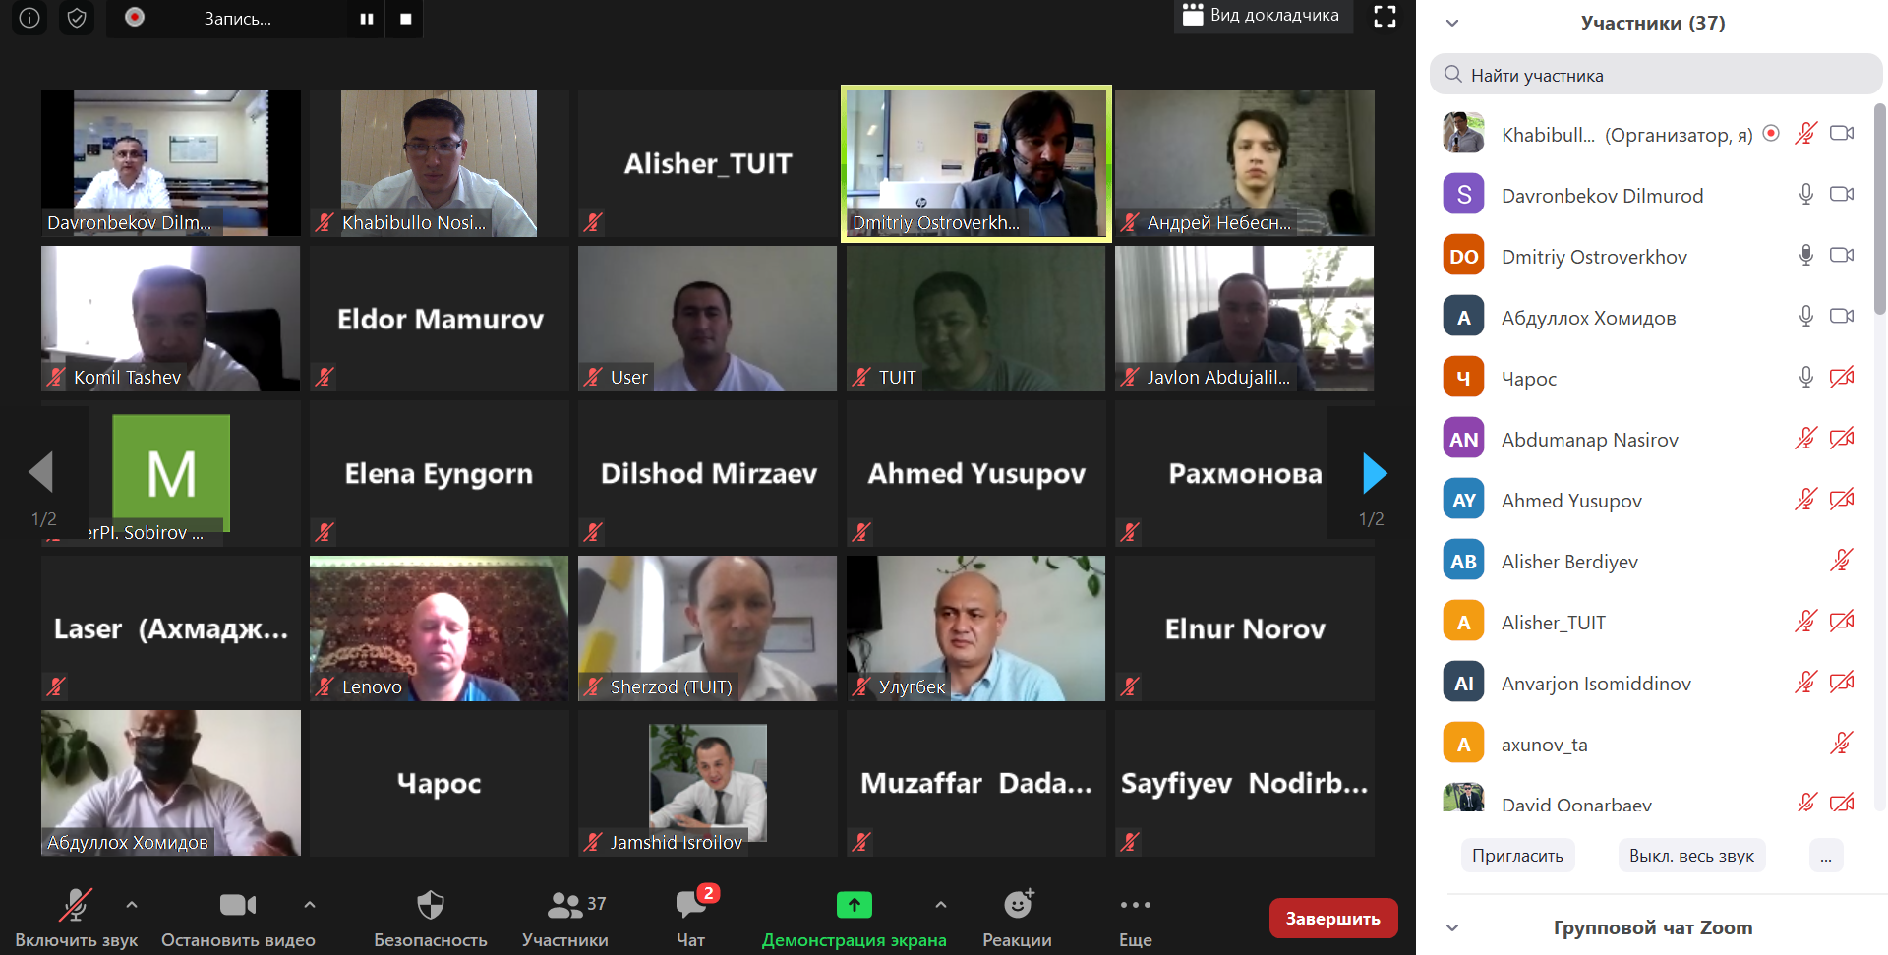
The First Year Activities (2)
Several meetings on project implementation were held in Zoom
Meetings devoted to the forming the list of needed equipment were held and by the decision of the consortium tendering procedure are started

Slide 7
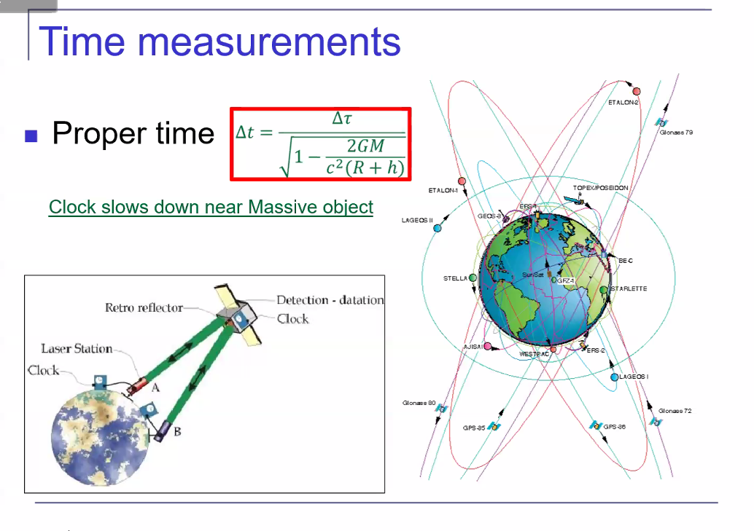
The First Year Activities (3)
New master program in Satellite Communications (“Sun’iy yo‘ldoshli aloqa”) has been opened and 4 students have been enrolled to the program
Syllabuses for the new program have been prepared by local staff with advices from EU partners
Organized the Master-class of the scientists from Ulugh Bek Astronomical Institute in Zoom platform for the students of partner universities
No. | Subjects, blocks and types of activities | Student’s study hours |  |  |  |  |  |  |  |  |  | Yearly, semester, weekly hours
 |  | Volume of overall hours and ECTS |  |  | Auditoria works (in hours) |  |  |  |  |  | Self-Study | 1st year |  |  |  | 2nd year
 |  |  |  |  | Overall | Lecture | Practice | Laboratory | Seminar | Course work (project) |  | Weeks in the year
 |  |  |  |  |  |  |  |  |  |  |  | 30 |  |  |  | 24
 |  |  |  |  |  |  |  |  |  |  |  | Semesters
 |  |  |  |  |  |  |  |  |  |  |  | 1 |  | 2 |  | 3 |  | 4
 |  |  |  |  |  |  |  |  |  |  |  | Weeks number in semester
 |  | hours | % | ECTS |  |  |  |  |  |  |  | 15 |  | 15 |  | 15 |  | 9
1 | 2 | 3 | 4 | 5 | 6 | 7 | 8 | 9 | 10 | 11 | 12 | 13 |  | 14 |  | 15 |  | 16
1.00 | General Methodological Subjects | 300 | 21 | 10 | 150 | 150 | 0 | 0 | 0 | 0 | 150 |  | 4 |  | 4 |  | 2 | 0
1.01 | Research methodology | 60 |  | 2 | 30 | 30 |  |  |  |  | 30 |  | 2
1.02 | Innovation and project management | 60 |  | 2 | 30 | 30 |  |  |  |  | 30 |  |  |  | 2
1.03 | Search and extract of information | 60 |  | 2 | 30 | 30 |  |  |  |  | 30 |  | 2
1.04 | Artificial Intelligence and Neural Networks | 60 |  | 2 | 30 | 30 |  |  |  |  | 30 |  |  |  |  |  | 2
1.05 | Algorithm design and analysis | 60 |  | 2 | 30 | 30 |  |  |  |  | 30 |  |  |  | 2
2.00 | Specialty subjects IICS | 690 | 48 | 23 | 240 | 150 | 75 | 15 | 0 | 0 | 450 |  | 6 |  | 3 |  | 7 | 0
2.01 | Engineering Mathematics, Statistics and Data Analysis | 120 |  | 4 | 45 | 30 | 15 |  |  |  | 75 |  | 3
2.02 | Flow control, modeling and simulation | 120 |  | 4 | 45 | 30 | 15 |  |  |  | 75 |  |  |  | 3
2.03 | Intelligent information and communication systems | 180 |  | 6 | 60 | 30 | 15 | 15 |  |  | 120 |  |  |  |  |  | 4
2.04 | Geoinformation Systems | 120 |  | 4 | 45 | 30 | 15 |  |  |  | 75 |  |  |  |  |  | 3
2.05 | Structural and object-oriented programs using MATLAB and PYTHON | 150 |  | 5 | 45 | 30 | 15 |  |  |  | 105 |  | 3
3.00 | Specialty selective subjects of the IICS | 450 | 31 | 15 | 150 | 90 | 45 | 15 | 0 | 0 | 300 |  | 0 |  | 7 |  | 3 | 0
3.01 | Specialty selective subjects | 180 |  | 6 | 60 | 30 | 15 | 15 |  |  | 120 |  |  |  | 4
3.02 | Specialty selective subjects | 150 |  | 5 | 45 | 30 | 15 |  |  |  | 105 |  |  |  | 3
3.03 | Specialty selective subjects | 120 |  | 4 | 45 | 30 | 15 |  |  |  | 75 |  |  |  |  |  | 3
 | Overall | 1440 | 100 | 48 | 540 | 390 | 120 | 30 | 0 | 0 | 900 |  | 10 |  | 14 |  | 12 | 0
4.00 | Science activities | 2160 |  | 72 |  |  |  |  |  |  |  |  | 8 |  | 8 |  | 8 | 20
4.01 | Preparation and defending the master thesis | 1560 |  | 52 |  |  |  |  |  |  |  |  | 7 | 7 |  | 6 |  | 10
4.02 | Scientific pedagogical work | 240 |  | 8 |  |  |  |  |  |  |  |  | 1 | 1 |  | 2
4.03 | Internship | 360 |  | 12 |  |  |  |  |  |  |  |  |  |  |  |  |  | 10
 | Overall | 3600 |  | 120 | 540 | 390 | 120 | 30 | 0 | 0 | 900 |  | 18 | 22 |  | 20 |  | 20

Slide 8

Thank You!
Khabibullo Nosirov, PhD
Project coordinator, Head of the Department
Tashkent University of Information Technologies named after Muhammad al-Khwarizmi
Radio and Mobile Communications Faculty
Amir Temur 108, 100084
Tashkent, Uzbekistan
n.khabibullo1990@gmail.com
+998 99 811 57 62 (WhatsApp)
+998 90 911 57 62 (Telegram)
www.tuit.uz www.spacecom.uz

Slide 9









