Slide 1
Air Pollution: Community Service Project in Gudipallipadu
COMMUNITY SERVICE PROJECT · FULL PROJECT REPORT
01-06-2026 to 26-07-2026
Sree Venkateswara College of Engineering · Guide: Ms. Ch. Vanaja
Notes:
Greet the audience and introduce the project and the presenters.

Slide 2
Project at a glance
8 weeks
6 + 2
01-06-2026 to 26-07-2026
Main project plus mini project
Gudipallipadu
Air pollution
The community we served
Awareness and mitigation theme
Notes:
The project ran from 1 June to 26 July 2026 in Gudipallipadu under the guidance of Ms. Ch. Vanaja, Department of CSE. Six weeks of main project, then a two-week mini project.

Slide 3
Why air pollution matters
Main sources
Effects
Vehicle emissions
Industrial activity
Farming and livestock
Waste burning
Dust, wildfires, volcanoes
Respiratory problems
Heart disease and stroke
Cancer risk
Climate change
Damage to ecosystems
Notes:
Air pollution is the release of harmful substances into the air. Left: where it comes from. Right: what it does to health and the environment.

Slide 4
What we did in the community
1
Awareness campaigns
2
School outreach
Brochures and informational materials handed out to residents
Workshops with local students on health and environment
3
Community events
4
Business outreach
Fairs, meetings and clean air workshops for residents
Meetings with local businesses on sustainable practices
Notes:
Four types of activity. Next: how these activities unfolded week by week and what they achieved.

Slide 5
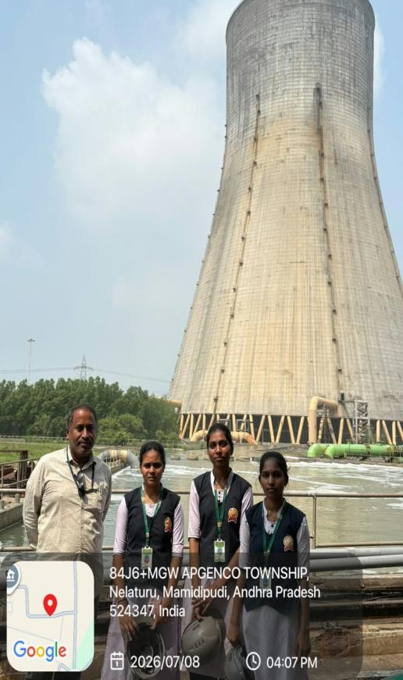
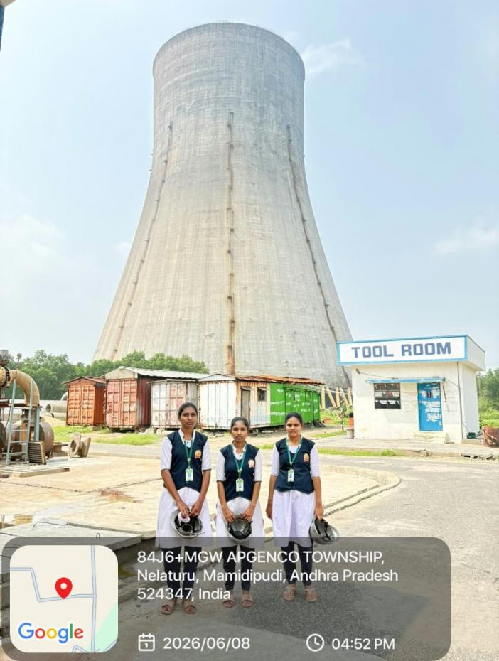
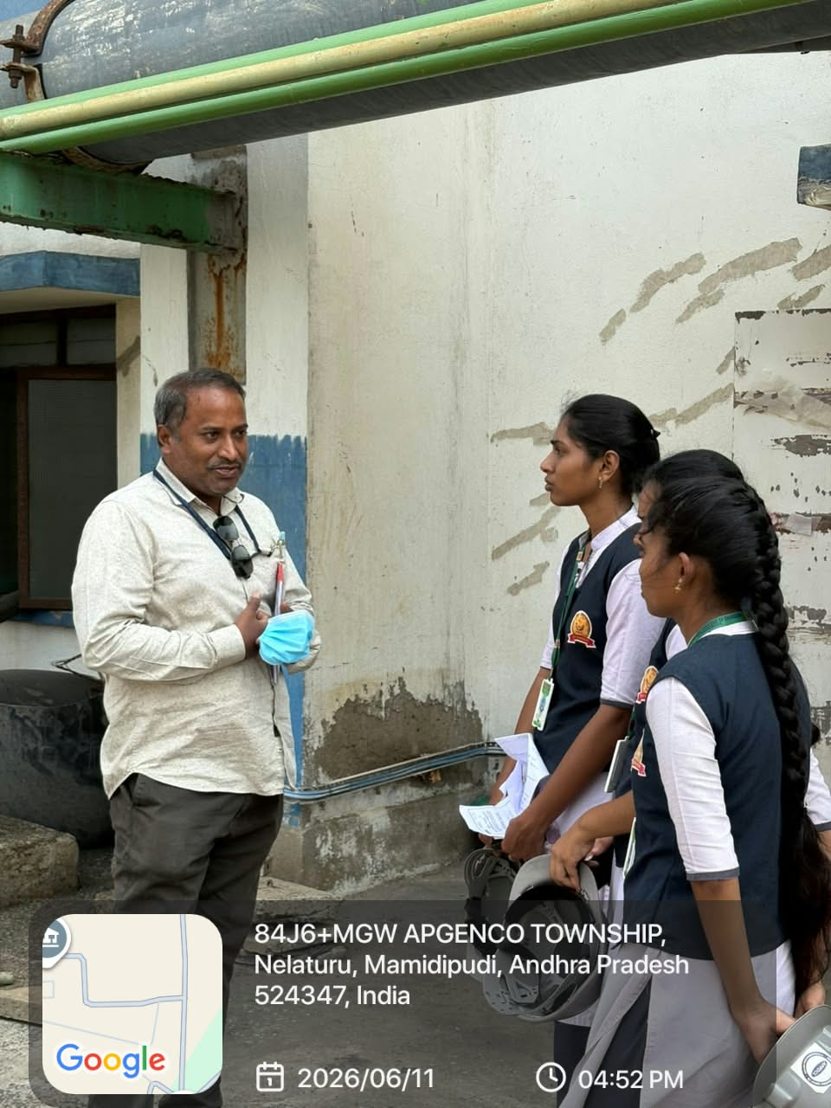
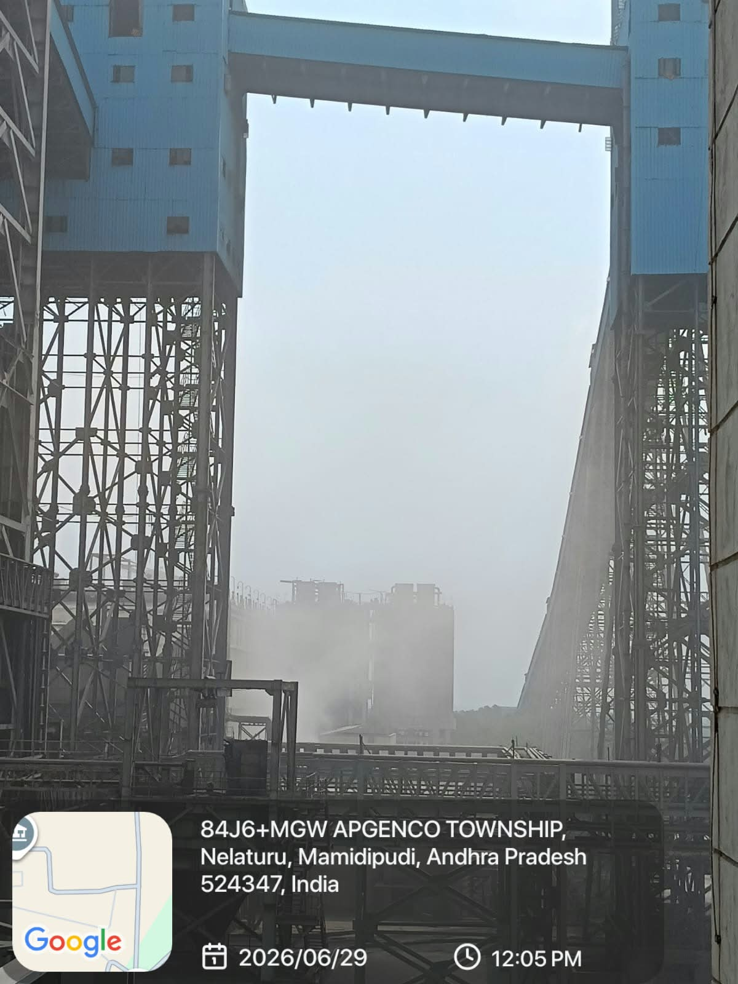
Field visits
Site visits near the APGENCO township, Nelaturu, June to July 2026 (geotagged photos)
08 July 2026
08 June 2026
11 June 2026
29 June 2026
Notes:
Photos from our field visits in June and July 2026. Describe what you observed at the site and how it connects to air pollution.

Slide 6
Main project, week by week
1
Week 1: Awareness drive
2
Week 2: Community fair
3
Week 3: Scaling up
Brochures to 500 residents, student workshop, community meeting
Fair, workshop for 75 students, 5 businesses met
7 businesses, 400 brochures, workshop for 100 students
4
Week 4: Fair and workshops
5
Week 5: Feedback
6
Week 6: Sharing results
125 students, 10 businesses, 500 brochures
Resident feedback meeting, report finalised, wrap-up
Follow-up meeting, final leaflets, report completed
Notes:
Walk through the six weeks. Outreach grew each week: more students, more businesses, more residents. Week 6 closed the main project and the mini project began.

Slide 7
Impact in numbers
1,700
resident handouts across the brochure drives
25
businesses met
over four weeks
Totals are summed from the weekly activity logs.
Notes:
Workshop attendance doubled and then some, from 50 students in week 1 to 125 in week 4. Brochure handouts add up to 1,700 residents and 25 businesses were met (3, 5, 7 and 10).

Slide 8
What we learned
1
Empathy
2
Communication
3
Problem solving
Understood the challenges residents face
Spoke with residents, students and businesses
Found practical ways to cut pollution
4
Leadership
5
Technical skills
Organised events and led campaigns
Research, data analysis and project management
Notes:
Five areas of growth: empathy, communication, problem solving, leadership and technical skills. Then move on to the mini project.

Slide 9
Mini project overview
Objectives
Week 7 (13 to 19 July)
1
Assess awareness among residents
Chose the topic, prepared the questionnaire and surveyed 100 residents door to door
2
Identify reported health effects
Week 8 (20 to 26 July)
3
Suggest ways to reduce air pollution
Tabulated and analysed responses, wrote the report and reviewed it with the guide
Notes:
The mini project asked: how aware are residents, and how does air pollution affect their health? We surveyed 100 residents using a questionnaire on awareness, health, income and economic loss.

Slide 10
Survey results
75%
know the causes and effects
40%
report respiratory problems
20%
report economic losses
Notes:
Awareness is high at 75%, yet 40% report respiratory problems and 20% report economic losses. Agriculture (50%) and daily wage labour (30%) are the main incomes.

Slide 11
Action plan
Short term (0 to 6 months)
Long term (6 to 24 months)
Expand awareness campaigns
Hold community meetings
Run school programmes
Partner with local businesses
Promote clean energy
Better waste management
More green spaces
Air quality monitoring
For authorities: air quality policies, clean energy investment, public transport, waste rules and monitoring.
Notes:
Short-term steps can start now. Long-term steps need investment. We also recommend that concerned authorities set air quality policies and monitor air quality.

Slide 12
Conclusion
Conclusion
Limitations
Future scope
Awareness is high, but air pollution still affects health and livelihoods in Gudipallipadu.
One village, 100 residents, self-reported answers.
Study specific health outcomes and test awareness programmes.
Thank you. Questions?
Notes:
Close with the conclusion, limitations and future scope. Take questions.

