Slide 1
ASC Student challenge

Slide 2
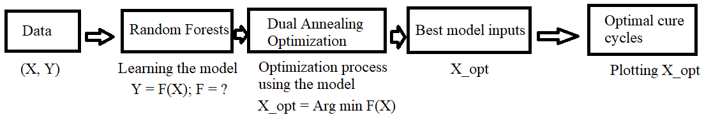
Objectives (SG)

Slide 3
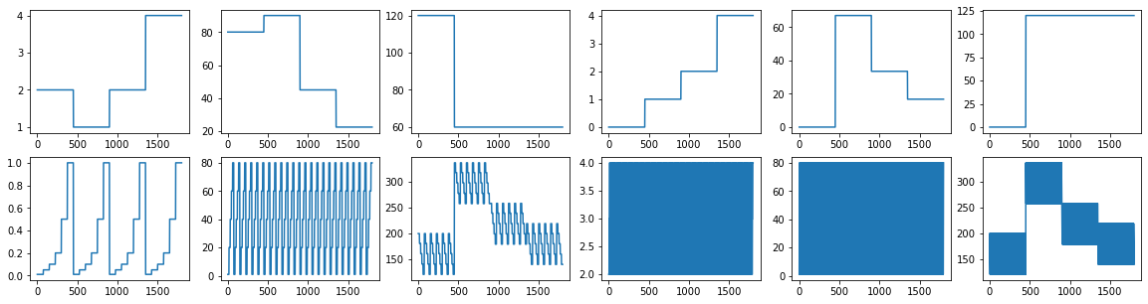
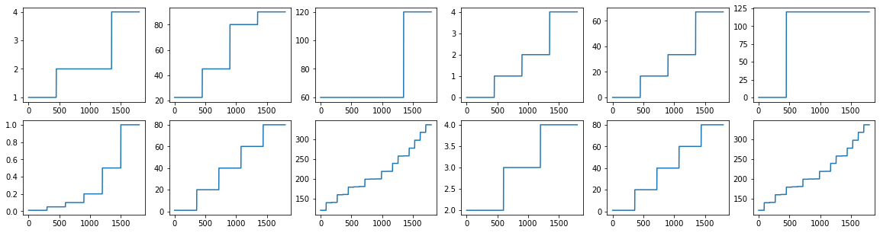
Understanding the ASC dataset
Learning the model
12 inputs (X_data) , 7 outputs (Y_data). 1800 samples.
Raw input distribution hints discrete input space. Sorting the input values validates this.
Each input (feature) has a fixed (discrete) number of values that it takes.
X1:3, X2:4, X3:2, X4:4, X5:4, X6:2, X7:6, X8:5, X9:20, X10:3, X11:5, X12:20
A total of ~138 million possible cases, out of which 1800 are available.
Decision trees generate decision boundaries to make accurate regression based prediction on discrete inputs.
Decision trees are one of the most interpretable ML models.
Random forests are an ensemble of decision trees that reduce overfitting.
Random forests are used to learn the relationship between inputs and outputs of the dataset.
Raw input values over 1800 cases (12 plots)
← Sorted Input Values
Notes:
Intro to how the data is spread, why R forests,

Slide 4
Dual annealing based optimization.
Optimization to find best inputs to the model
Using random forests, for any input vector, the output can be predicted.
So, a constrained optimization can be designed to find the ideal input vector that can produce desired outputs.
The constraints of optimizations:
1. How can discrete space optimization be executed in a continuous space?
Search in a continuous space, evaluate loss in a discrete space.
2. What is the optimal nature of outputs?
Maximum Fiber Volume Fraction (%) (Y4) needs to be maximized and all the other outputs need to be minimized. (Y1, Y2, Y3, Y5, Y7). (Note that Y6 is constant for all inputs)
3. How can global optima be guaranteed?
Dual annealing based optimization is used that ensures a globally optimal solution.
4. Bonus: The total cure cycle time can be obtained from the inputs corresponding to the temperature, autoclave pressure and vacuum pressure values. The value from these three input sources has to be constant. How can this be enforced?
The loss function is set to return infinite when the difference in either of three times is more than 3 minutes. This disregards any solution in the input space that does not follow the 4rd constraint.
Dual Annealing (SciPy) = Fast Simulated Annealing (FSA) + Tsallis Statistics
Notes:
why dual annealing?
It is a type of stochastic hill climbing where a candidate solution is modified in a random way and the modified solutions are accepted to replace the current candidate solution probabilistically. This means that it is possible for worse solutions to replace the current candidate solution. The probability of this type of replacement is high at the beginning of the search and decreases with each iteration, controlled by the “temperature” hyperparameter.
It combines the annealing schedule (rate at which the temperature decreases over algorithm iterations) from “fast simulated annealing” (FSA) and the probabilistic acceptance of an alternate statistical procedure “Tsallis statistics” named for the author.

Slide 5
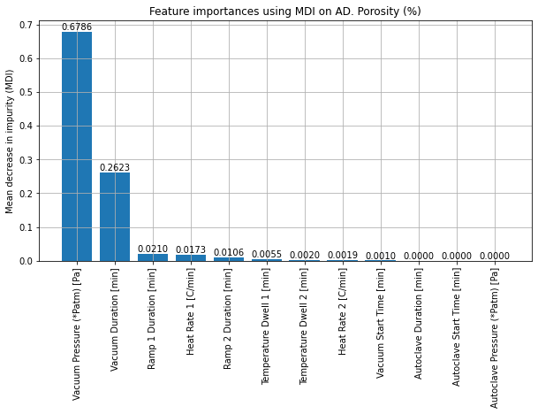
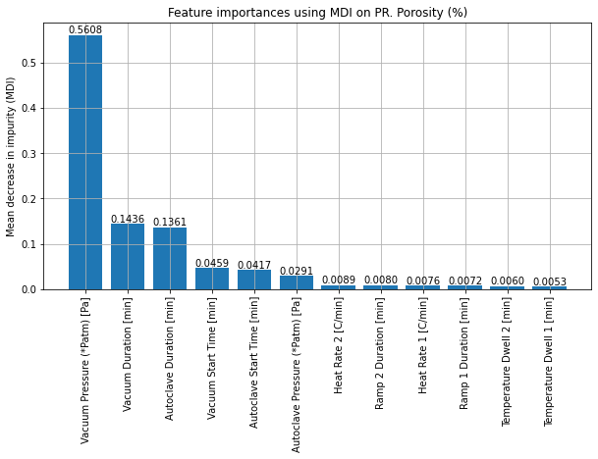
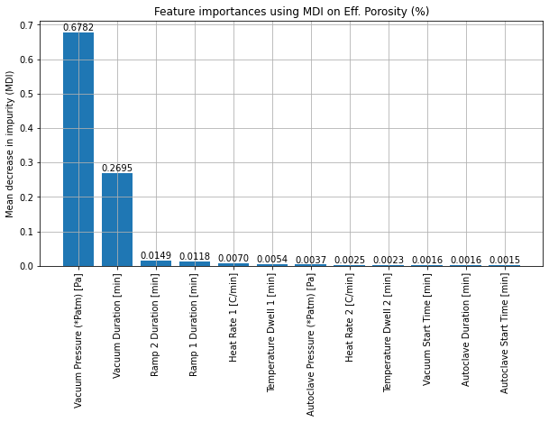
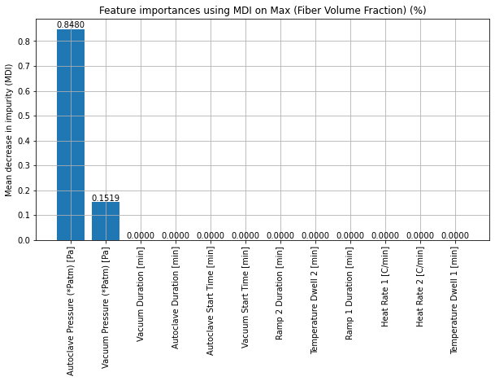
Best features #1

Slide 6
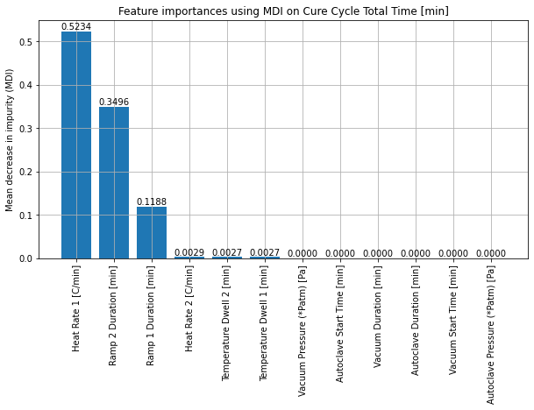
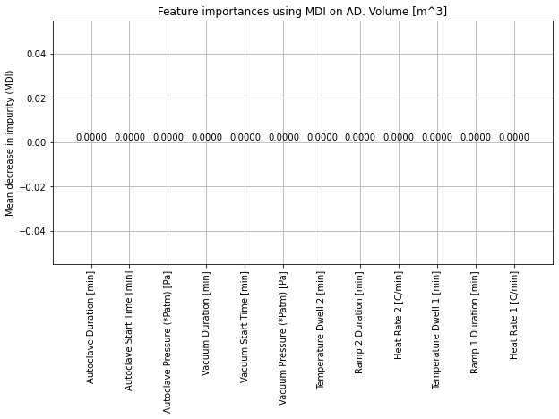
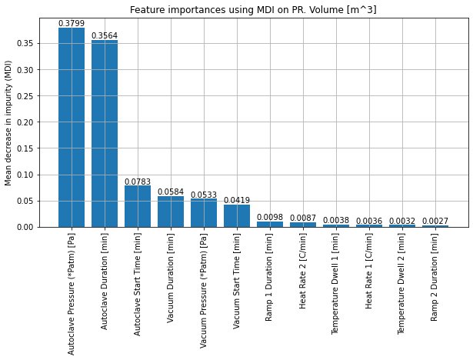
Best features #2

Slide 7
Interactions b/w involved physics.

Slide 8

Design/ validation of ML models
How are the model learning (Random Forests) and optimization (dual annealing) methods verified?
Validating Random forests:
The data set containing 1800 samples is randomly shuffled and then split into 1530 samples for training and 270 samples for testing. (15% split)
The coefficient of determination (R) is used to evaluate the training and testing accuracies of the prediction.
R = 1- (u/v), where u = ((y_true – y_pred)^2).sum(); v = ((y_true – y_true.mean())**2).sum() . R $∈$ [0,1]
Dual annealing finds optimizes the hyper parameters implicitly to guarantee global optima within the prescribed number of epochs (1000). The optimization residual wrt the final optimal x can be used as a measure to judge the quality of optimization. This residual will be referred to as $ε$.
By looking at the R (testing) and $ε$values for the model and optimization, the results concerning any case can be validated.
Cycle -1: Ideal cure cycle that optimizes y1, y2, y3, y4, y5, y6, y7 : (R: 0.98 , $ε$: 4e-2 )
Cycle -2: Ideal cure cycle that optimizes y3, y4, y5 : (R: 0.999 , $ε$: 1.3e-3 )
Cycle -3: Ideal cure cycle that optimizes y3, y4 : (R: 0.998 , $ε$: 5.1e-4 )
Cycle -4: Ideal cure cycle that optimizes y4, y5 : (R: 0.999 , $ε$: 1.2e-3)
Cycle -5: Ideal cure cycle that optimizes y1, y2 : (R: 0.968 , $ε$: 4.8e-6)
Cycle -6: Ideal cure cycle that optimizes y3, y4, y7 : (R: 0.991, $ε$: 5.1e-4)
Cycle -7: Ideal cure cycle that optimizes y1, y2, y3, y4, y5, y6 : (R: 0.989 , $ε$: 3.8e-3)
Notes:
Show testing and validation results for various processes.
Optimization results.
Coeffcient of determination = 1- residual sum of squares / total sum of squares

Slide 9
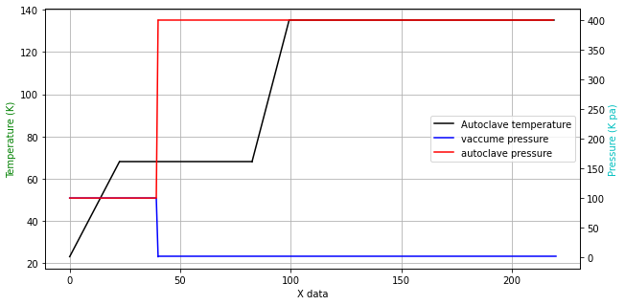
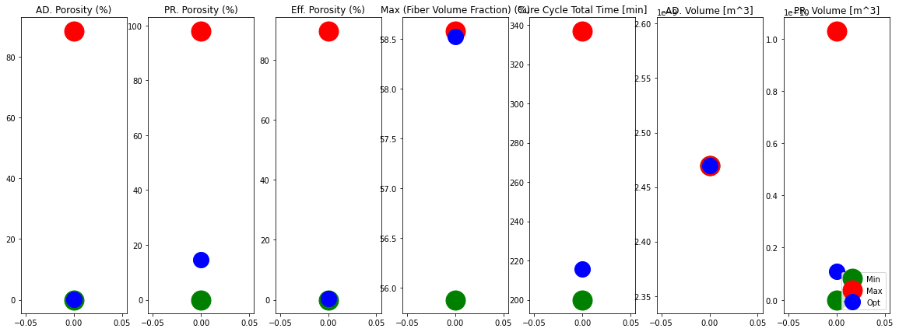
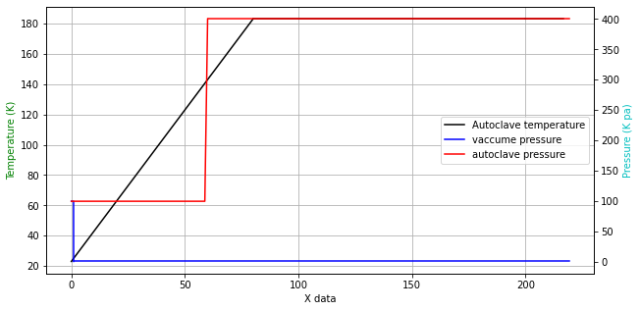
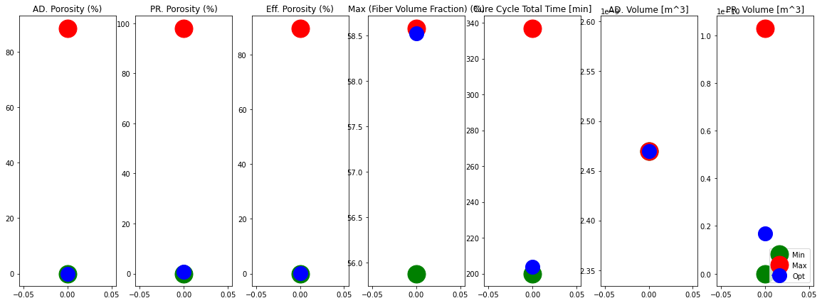
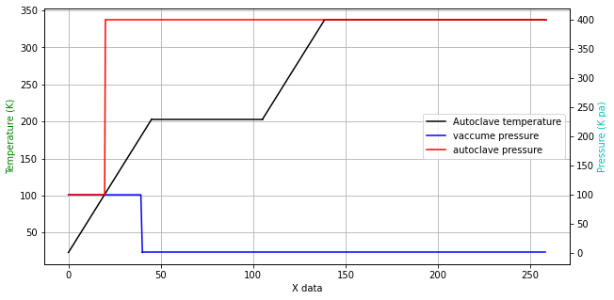
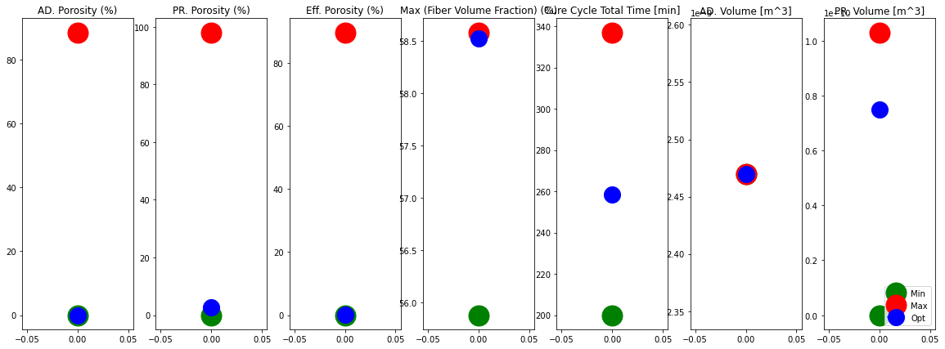
Optimal Cure cycles #1

Slide 10
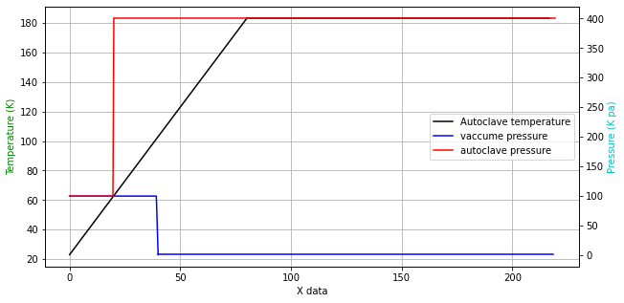
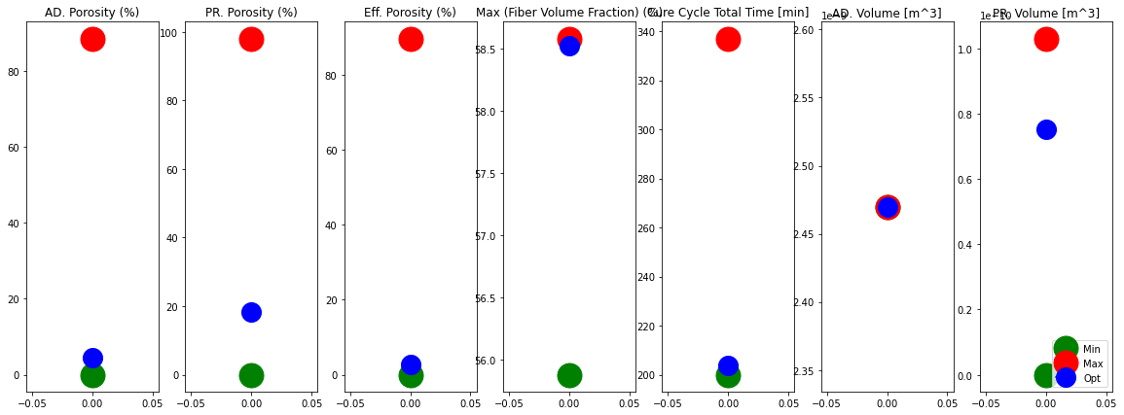
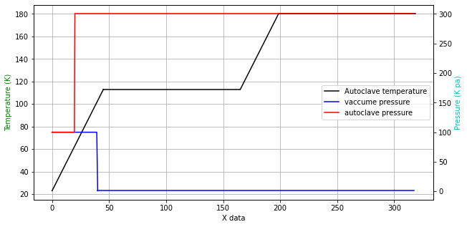
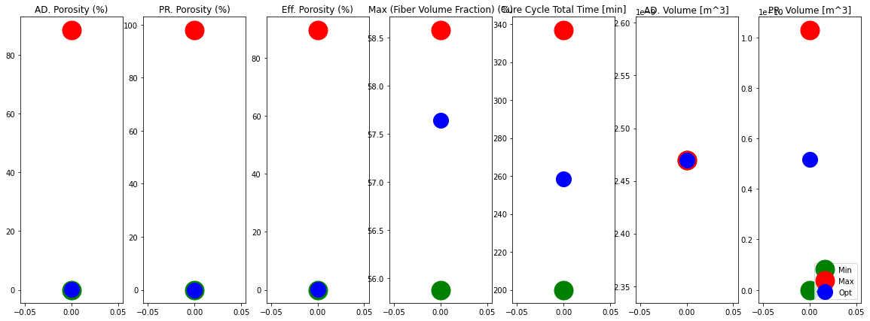
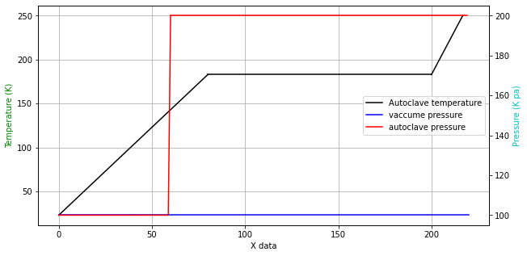
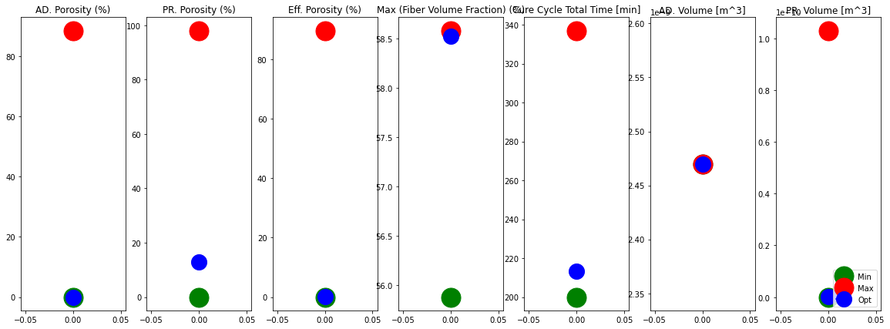
Optimal Cure cycles #2

Slide 11
Conclusions

Slide 12
Thank you!

