Slide 1
Optimization of co-curing process of sandwich composites using machine learning techniques
Shiva Goutham Pattapu
Sahil Kommalapati

Slide 2

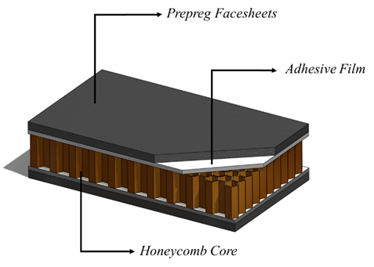
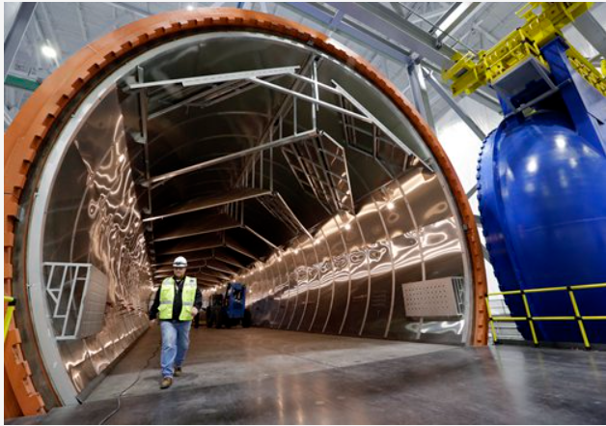
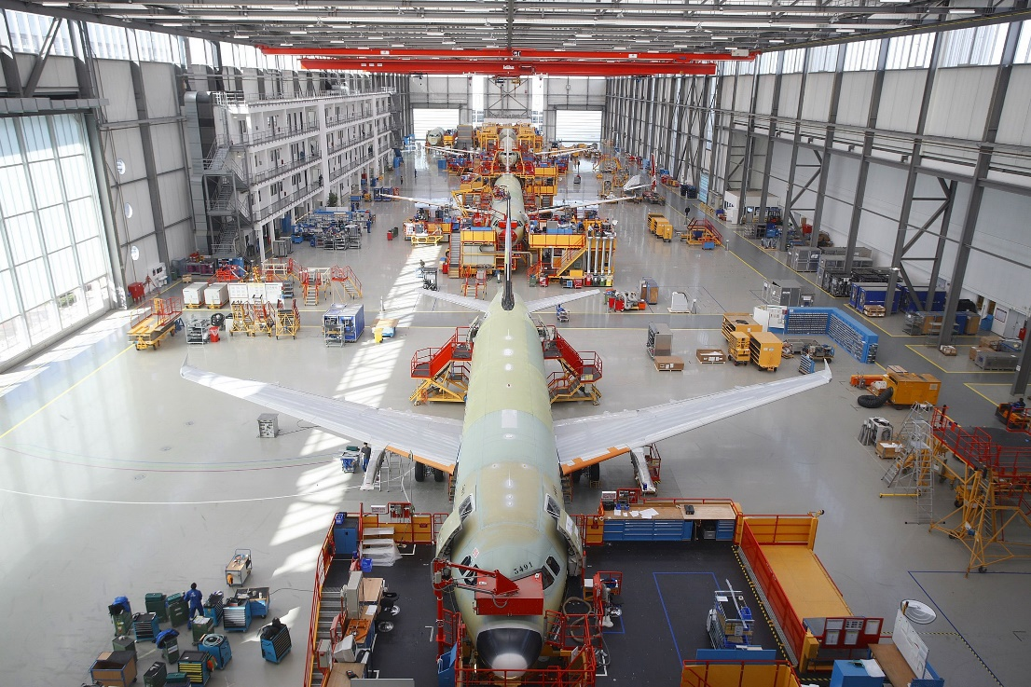
Introduction :
Sandwich composites are commonly used in aerospace applications. These structures can be manufactured using co-curing, where the facesheet consolidation and the bonding occur simultaneously in a single operation under a prescribed co-cure cycle.
Fig 1: Sandwich composite
Fig 2: Autoclave facility, USA
Fig 3: A320 final assembly line, USA
Co-cure advantages:
Cost and time effective- can be done in single step.
Eliminate fitment issues.
Enabling production of complex geometries.
Co-cure challenges:
Complex interactions between constituents.
Material compatibility is required to cure prepreg and adhesive at the same time.
1

Slide 3
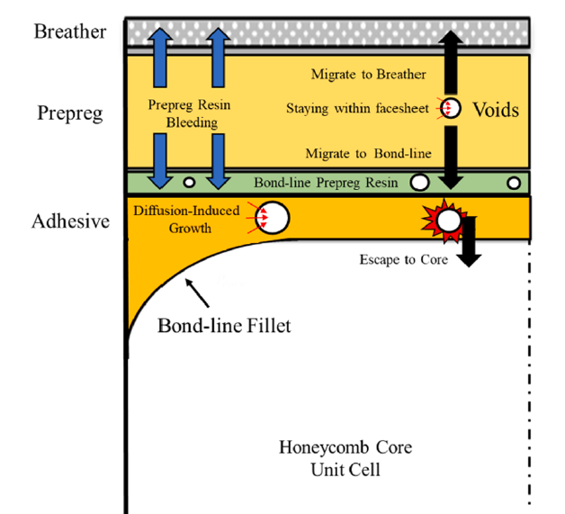
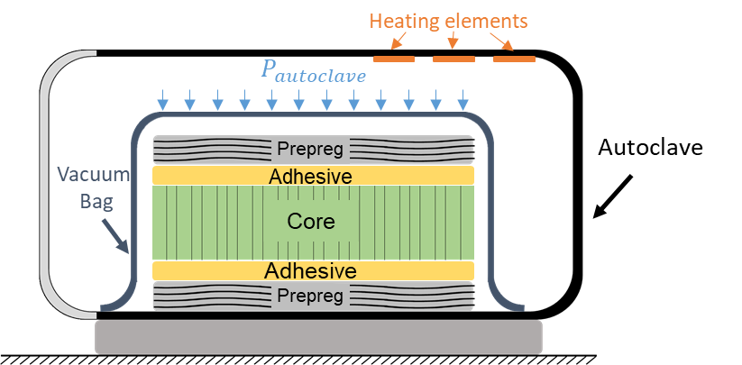
Interactions of constituents in co-cure process:
Fig 4: co-curing of sandwich composite in autoclave
Fig 5: Showing different physical phenomena in the co-cure process [1]
ML model:
Relationship of different physical phenomena in the co-cure process
Build new cure cycles.
Optimized cure cycles for given objective function
Inputs (12):
Temperature cycle (Heat rates, dwell times)
Autoclave pressure and time
Vacuum pressure and time
Outputs (7):
Porosities (Pr, Ad & bondline)
Max fibre vol fraction.
Cure cycle total time.
Ref 1: Navid Niknafs Kermani, et al., “A bond-line porosity model that integrates fillet shape and prepreg facesheet consolidation during equilibrated co-cure of sandwich composite structures”, Composites Part A 139 (2020) 106071
2

Slide 4
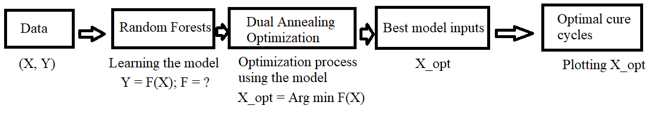
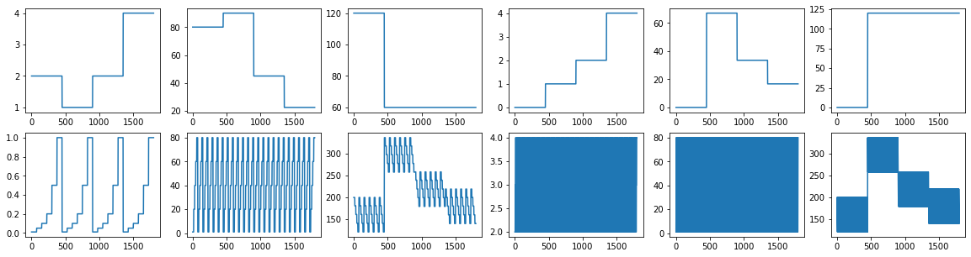
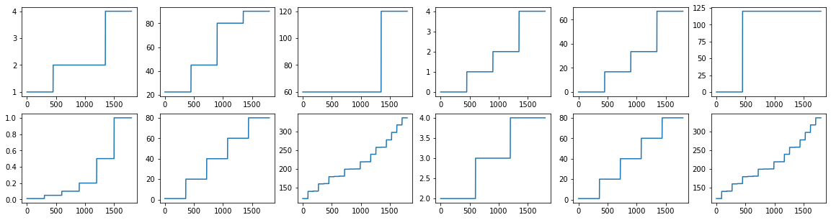
Machine Leaning model approach:
12 inputs (X_data) , 7 outputs (Y_data). 1800 samples.
Raw input distribution hints discrete input space. Sorting the input values validates this.
Each input (feature) has a fixed (discrete) number of values that it takes.
X1:3, X2:4, X3:2, X4:4, X5:4, X6:2, X7:6, X8:5, X9:20, X10:3, X11:5, X12:20
A total of ~138 million possible cases, out of which 1800 are available.
Decision trees generate decision boundaries to make accurate regression-based prediction on discrete inputs.
Decision trees are one of the most interpretable ML models.
Random forests are an ensemble of decision trees that reduce overfitting.
Random forests are used to learn the relationship between inputs and outputs of the dataset.
Fig 6: workflow for identifying optimal cure cycles for the provided data
Fig 7- Raw input values over 1800 cases (12 plots)
Fig 8- Sorted Input Values
4

Slide 5
ML- Optimization- Dual annealing based optimization:
Using random forests, for any input vector, the output can be predicted.
So, a constrained optimization can be designed to find the ideal input vector that can produce desired outputs.
The constraints of optimizations:
1. How can discrete space optimization be executed in a continuous space?
Search in a continuous space, evaluate loss in a discrete space.
2. What is the optimal nature of outputs?
Maximum Fiber Volume Fraction (%) (Y4) needs to be maximized and all the other outputs need to be minimized. (Y1, Y2, Y3, Y5, Y7). (Note that
Y6 is constant for all inputs)
3. How can global optima be guaranteed?
Dual annealing based optimization is used that ensures a globally optimal solution.
4. Bonus: The total cure cycle time can be obtained from the inputs corresponding to the temperature, autoclave pressure and vacuum pressure values.
The value from these three input sources has to be constant. How can this be enforced?
The loss function is set to return infinite when the difference in either of three times is more than 3 minutes. This disregards any solution in the input space that does not follow the 4rd constraint.
5

Slide 6
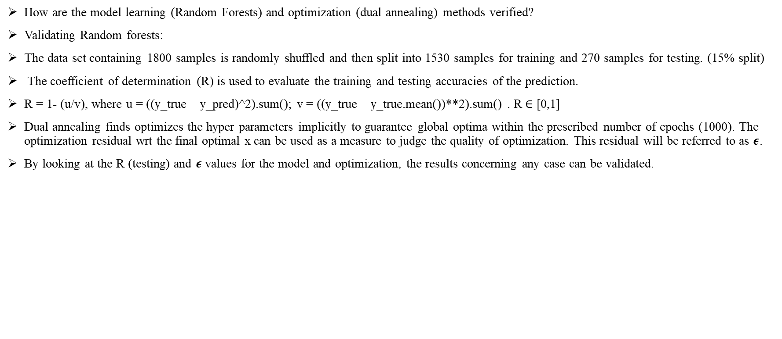
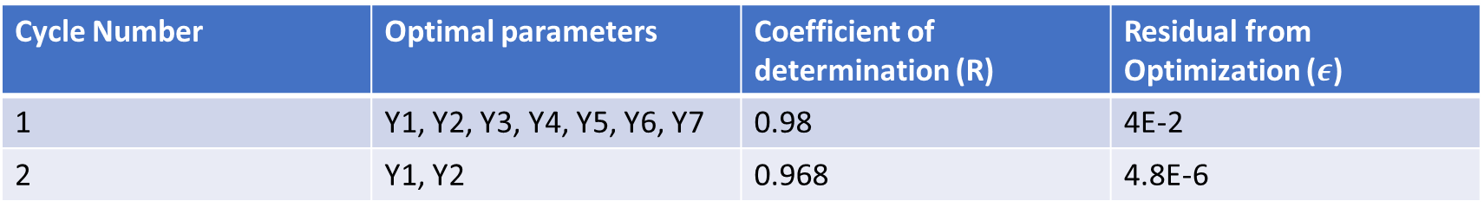
Design and validation of ML tool:
How are the model learning (Random Forests) and optimization (dual annealing) methods verified?
Validating Random forests:
The data set containing 1800 samples is randomly shuffled and then split into 1530 samples for training and 270 samples for testing. (15% split)
The coefficient of determination (R) is used to evaluate the training and testing accuracies of the prediction.
R = 1- (u/v), where u = ((y_true – y_pred)^2).sum(); v = ((y_true – y_true.mean())**2).sum() . R $∈$ [0,1]
Dual annealing finds optimizes the hyper parameters implicitly to guarantee global optima within the prescribed number of epochs (1000). The optimization residual wrt the final optimal x can be used as a measure to judge the quality of optimization. This residual will be referred to as $ε$.
By looking at the R (testing) and $ε$values for the model and optimization, the results concerning any case can be validated.
Cycle Number | Optimal parameters | Coefficient of determination (R) | Residual from Optimization ($ε$)
1 | Y1, Y2, Y3, Y4, Y5, Y6, Y7 | 0.98 | 4E-2
2 | Y1, Y2 | 0.968 | 4.8E-6
6

Slide 7
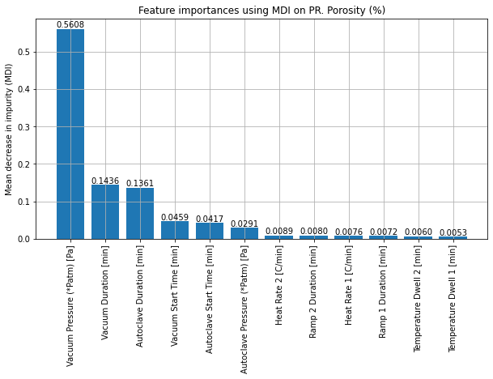
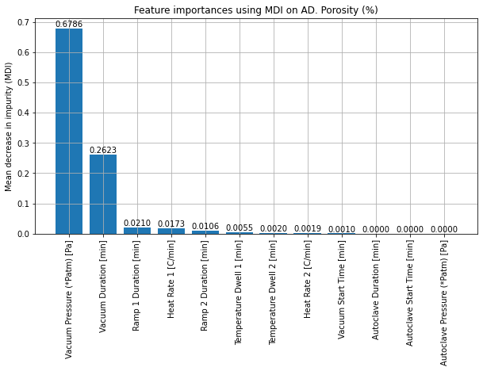
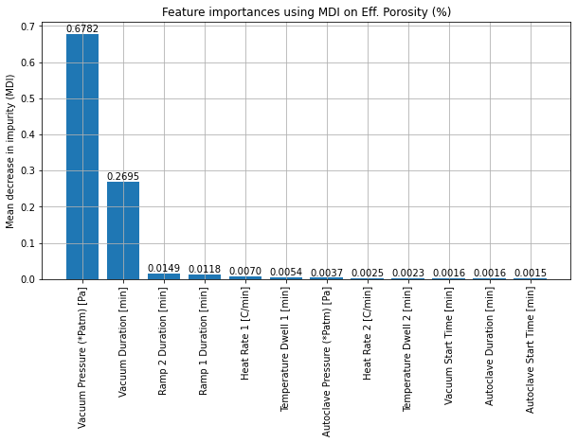
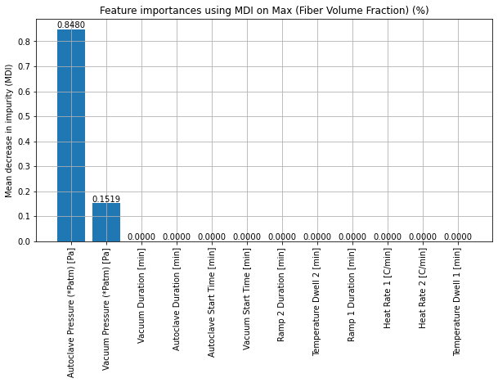
Results- Governing process parameters for each output in the dataset:
7

Slide 8
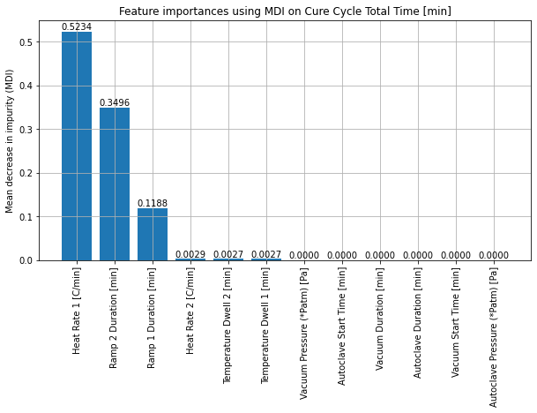
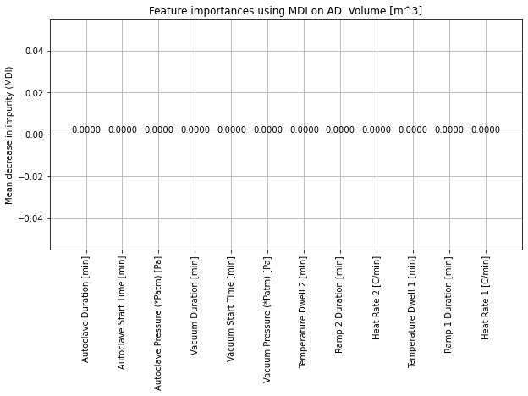
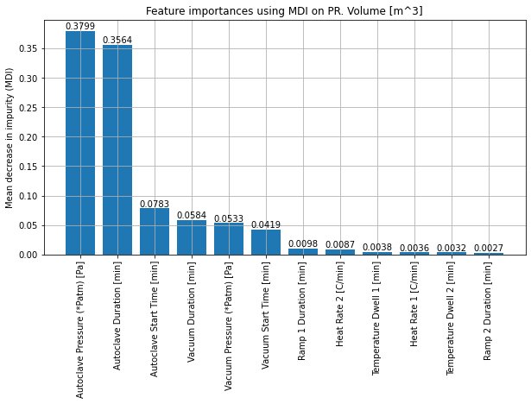
Results- Governing process parameters for each output in the dataset :
8

Slide 9
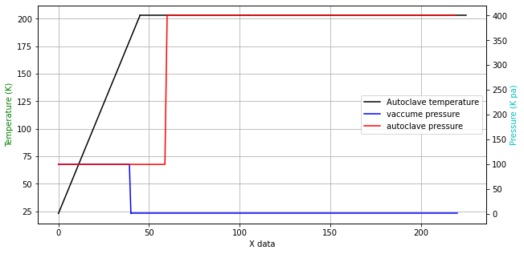
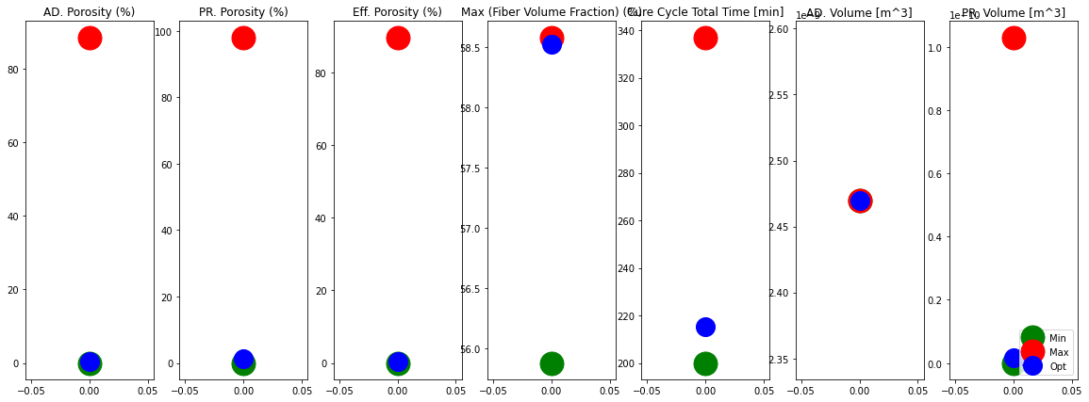
Results- Determination of optimal cure cycle:
Objective function “a”: 1. Minimum prepreg porosity
2. Minimum adhesive porosity
3. Minimum Effective or bondline porosity
4. Maximum fibre volume fraction
5. Lower cure cycle total time
6. Minimum squeezed out prepreg resin volume
0.28
0.135
Time (min)
Fig 7: Optimal cure cycle for the objective function “a”
Fig 8: Output plots for the optimal cure cycle for objective “a”
9

Slide 10
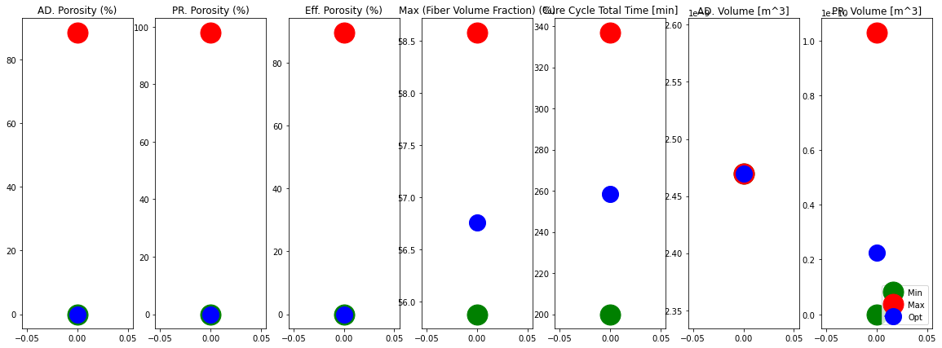
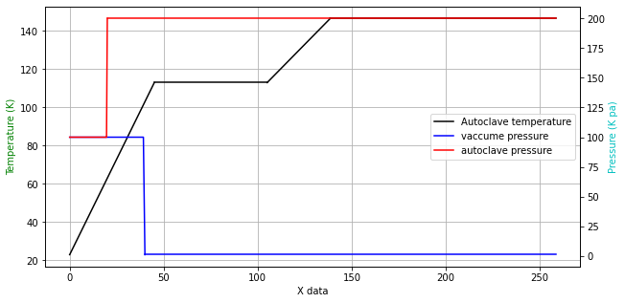
Results- Determination of optimal cure cycle:
Objective function “b”: 1. Minimum prepreg porosity
2. Minimum adhesive porosity
0
Time (min)
Fig 9: Optimal cure cycle for the objective function “b”
Fig 10: Output plots for the optimal cure cycle for objective “b”
10

Slide 11
Conclusions:
A Machine Learning model was developed which can be used to find out facesheet consolidation, porosities and squeezed out prepreg resin for a given cure cycles. This helps to design new cure cycles for co-cure process of sandwich composites.
Random forests were utilized to learn the relationship between inputs and the outputs. They are extremely interpretable and give a detailed outlook on the sensitivity of input fluctuations on the output regression using mean decrease in the gini impurity value.
The developed ML model provides optimal cure cycles for a given objective functions and data set.
A global optimization tool known as Dual Annealing was utilized. This approach is a hybrid between the random search and hill climbing and grantees a globally optimal solution.
Two new cure cycle designs were obtained as a result of the overall optimization framework.
It would be interesting to explore the experimental validity of these results in the future.
10

Slide 12
Thank You! Questions, comments?

