Slide 1
Vortex Identification Algorithms – Graftieaux et al. (2001)
Critical review for Lab Meeting – 27.5.2020

Slide 2

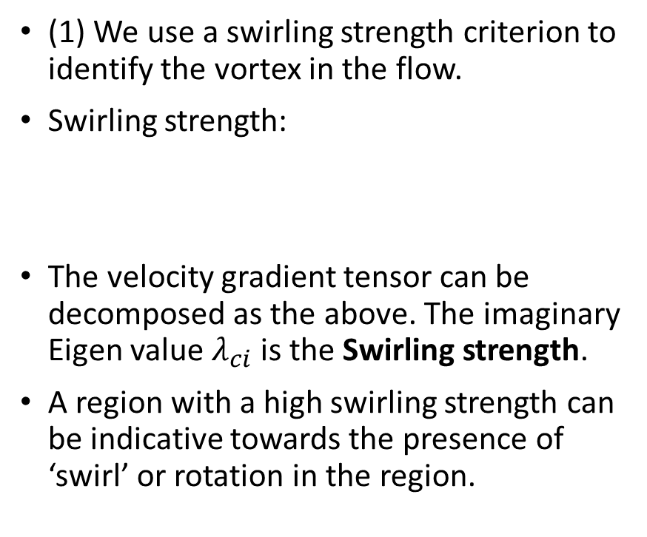
Updates on MCMC – Recap : Goals
Goal 1 : Identify a vortex in a turbulent flow.
Goal 2 : Identify the information about the properties of the vortex: Circulation strength, Inner Core Radius, X,Y positions of the center of the core and the Convective Velocity.
(1) We use a swirling strength criterion to identify the vortex in the flow.
Swirling strength:
The velocity gradient tensor can be decomposed as the above. The imaginary Eigen value $λ_{ci}$is the Swirling strength.
A region with a high swirling strength can be indicative towards the presence of ‘swirl’ or rotation in the region.

Slide 3
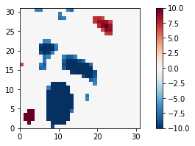
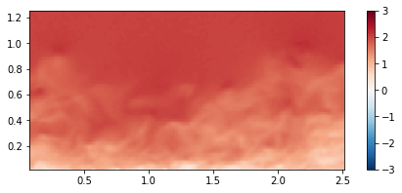
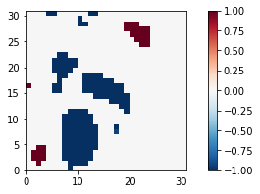
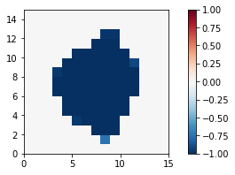
Vortex Identification
Swirling strength profile
at that particular region
Velocity field of the flow
Utilizing the geometric center of the cleaned swirling strength blob to identify the vortex.
Swirling Strength Profile – Normalized, De-noised

Slide 4
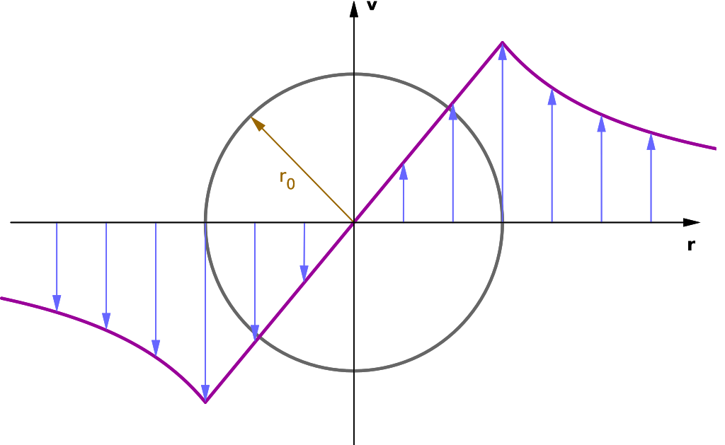

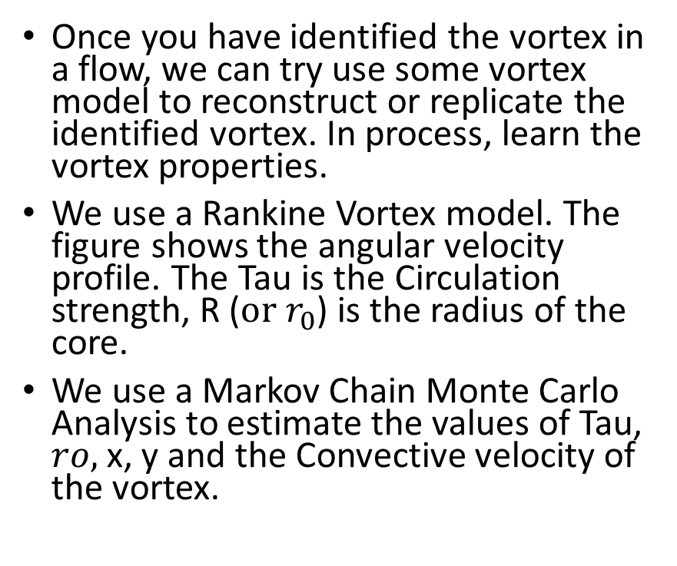
Vortex Analysis
Once you have identified the vortex in a flow, we can try use some vortex model to reconstruct or replicate the identified vortex. In process, learn the vortex properties.
We use a Rankine Vortex model. The figure shows the angular velocity profile. The Tau is the Circulation strength, R ($or r_{0}$) is the radius of the core.
We use a Markov Chain Monte Carlo Analysis to estimate the values of Tau, $ro,$x, y and the Convective velocity of the vortex.

Slide 5
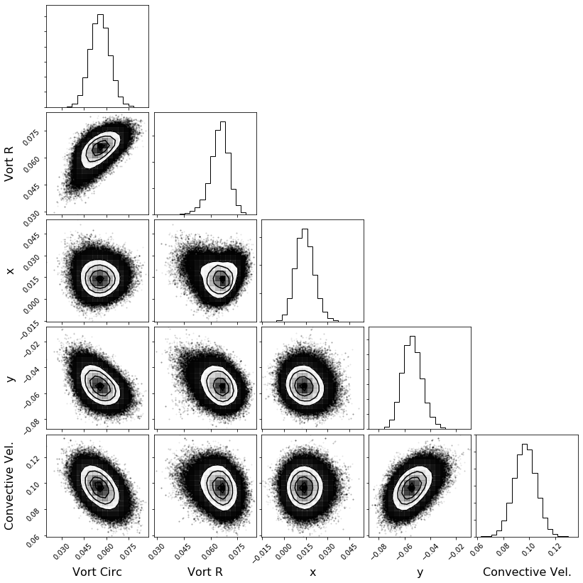
Vortex Analysis
Circulation Strength PDF
Figure on the left shows a MCMC analysis for one vortex. It is a corner plot.
It shows 5 probability distribution functions (PDFs) for all the 5 parameters of the vortex which we wanted to learn.
The mean of the PDF is the most likely value of the parameter! Clear peaks in x, y show that we did a good job at identifying the vortices.
The figure on the left would be the ideal case which we hope to get for every vortex, with clear peaks and convergence. However, there are many different kinds of failures..
Core Radius PDF
Center x – position PDF
Center y – position PDF
Convective Velocity PDF

Slide 6
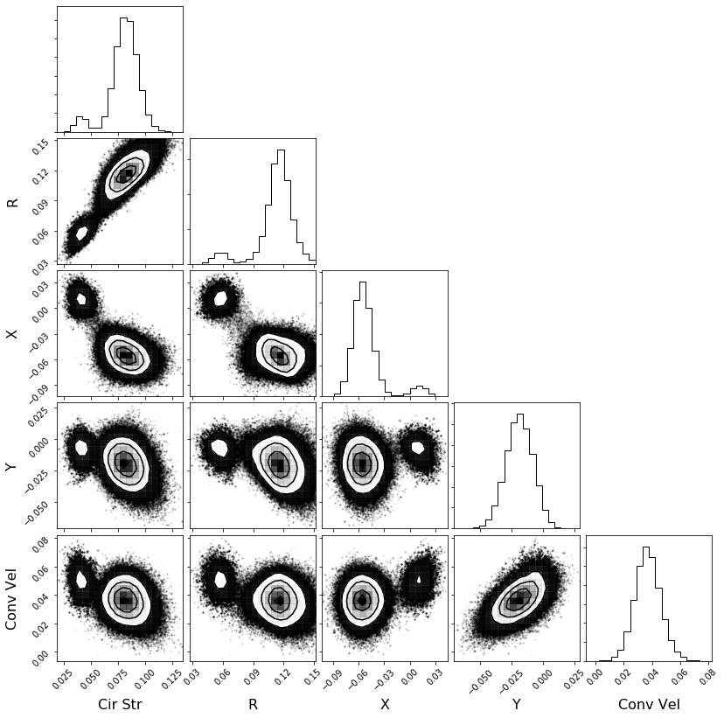
Updates on MCMC - Types of Failures
We have classified the failures into 3 major types. They are referred as F1, F2 and F3.
F1 – At least one of the pdfs in the MCMC analysis has multiple peaks (right image)

Slide 7
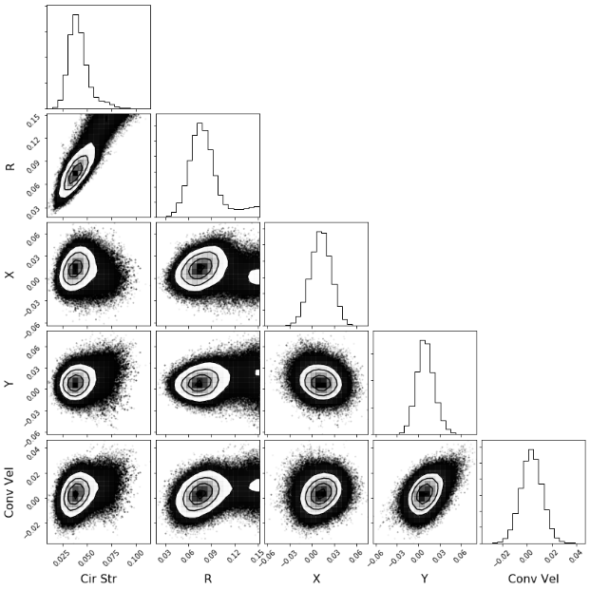
Updates on MCMC - Types of Failures
F2 – In at least one of the pdfs in the MCMC analysis, the total convergence is not contained within the bounds which we have set.

Slide 8
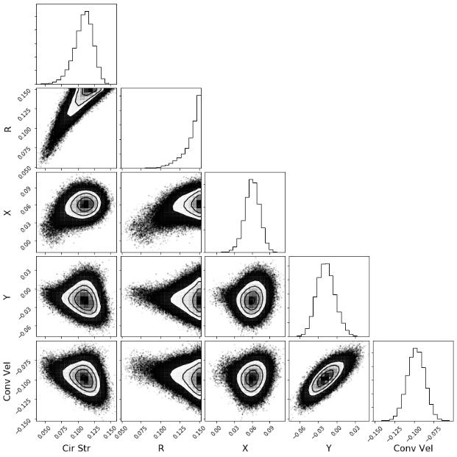
Updates on MCMC - Types of Failures
A stricter F2!
F3 - In at least one of the pdfs in the MCMC analysis, there is divergence.
All F3 are also F2 failures.
So, how can we rectify these?

Slide 9
Motivation for using Graftieaux.
The most crucial part of our entire model is based on accurately identifying the vortices from the flow and localizing them using a bounding box.
We currently take the geometric center of the (cleaned) swirling strength blob as the center of the vortex core.
Most of the failures seem to happen due to improper identification of the vortex center and the bounds.
So we need better estimates of them.

Slide 10
Combining PIV, POD and vortex identification algorithms for the study of unsteady turbulent swirling flows
Graftieaux et al (2001)
*all figures in the upcoming slides are taken from this work.
Ϯ Graph-Thi-o

Slide 11
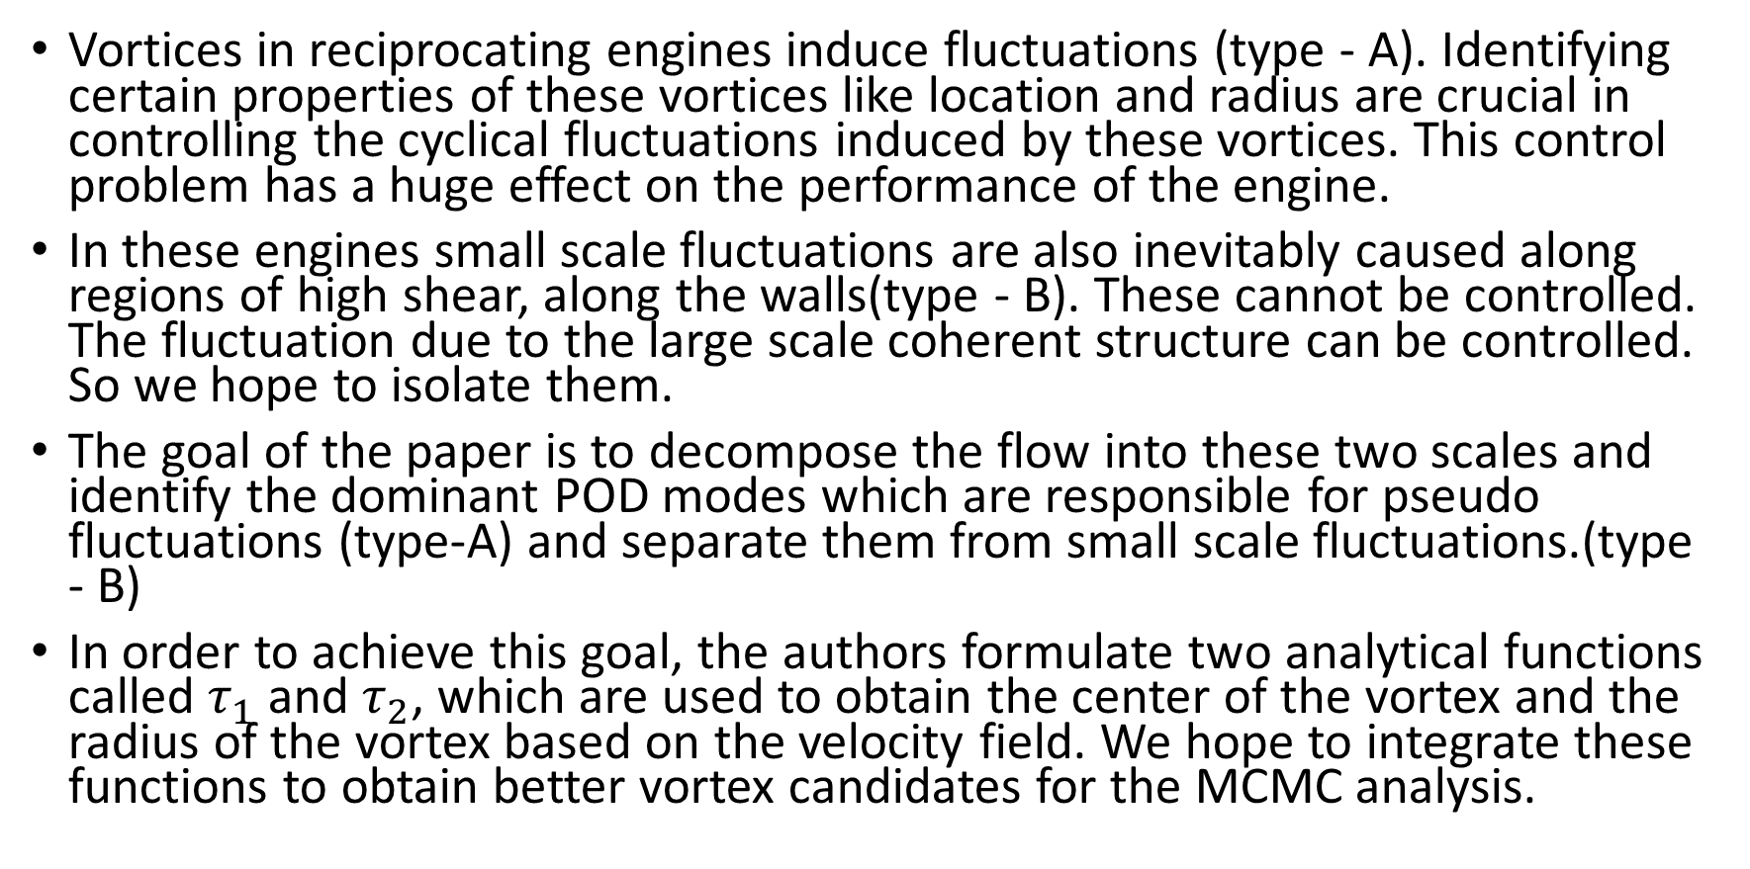
Paper – goals and intro
Vortices in reciprocating engines induce fluctuations (type - A). Identifying certain properties of these vortices like location and radius are crucial in controlling the cyclical fluctuations induced by these vortices. This control problem has a huge effect on the performance of the engine.
In these engines small scale fluctuations are also inevitably caused along regions of high shear, along the walls(type - B). These cannot be controlled. The fluctuation due to the large scale coherent structure can be controlled. So we hope to isolate them.
The goal of the paper is to decompose the flow into these two scales and identify the dominant POD modes which are responsible for pseudo fluctuations (type-A) and separate them from small scale fluctuations.(type - B)
In order to achieve this goal, the authors formulate two analytical functions called $τ_{1}$ and $τ_{2}$, which are used to obtain the center of the vortex and the radius of the vortex based on the velocity field. We hope to integrate these functions to obtain better vortex candidates for the MCMC analysis.

Slide 12
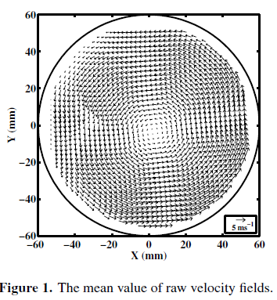
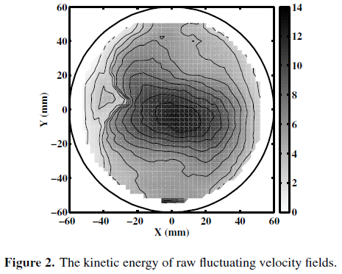
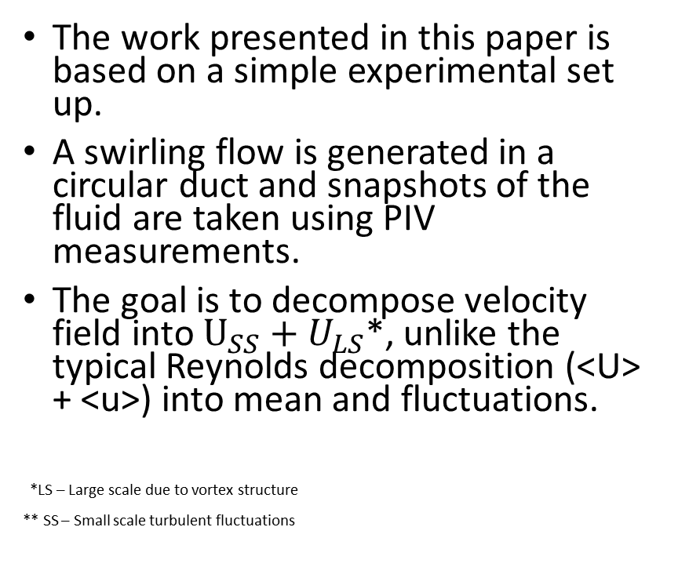
Paper – Setup
Setup
Analytical Methods
POD results
The work presented in this paper is based on a simple experimental set up.
A swirling flow is generated in a circular duct and snapshots of the fluid are taken using PIV measurements.
The goal is to decompose velocity field into $U_{SS}+U_{LS}$*, unlike the typical Reynolds decomposition (<U> + <u>) into mean and fluctuations.
*LS – Large scale due to vortex structure
** SS – Small scale turbulent fluctuations

Slide 13
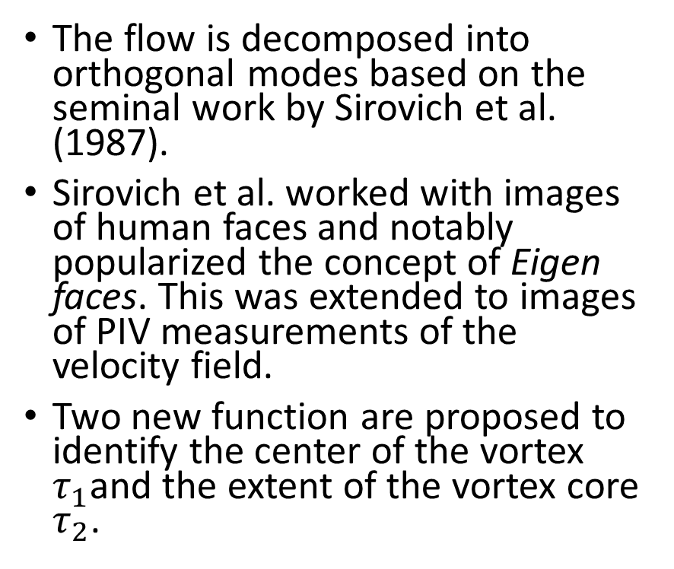
Algorithms to Identify Vortices
Setup
Analytical Methods
POD results
The flow is decomposed into orthogonal modes based on the seminal work by Sirovich et al. (1987).
Sirovich et al. worked with images of human faces and notably popularized the concept of Eigen faces. This was extended to images of PIV measurements of the velocity field.
Two new function are proposed to identify the center of the vortex $τ_{1}$and the extent of the vortex core $τ_{2}$.
POD decomposes the modes based on their contribution to the total energy.
Since the fluctuations due to large scale coherent structures correspond to higher KE, this decomposition works really well.

Slide 14
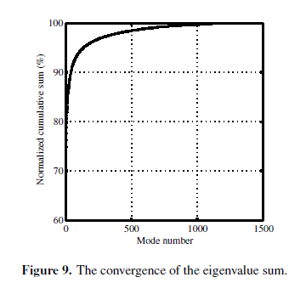





POD
Equations to get POD modes
U – snapshots of PIV data. K – correlation matrix. $φ$ is the POD mode. $a_{ij}$ is the coefficient of the modes, helpful in reconstruction. (Contribution)

Slide 15
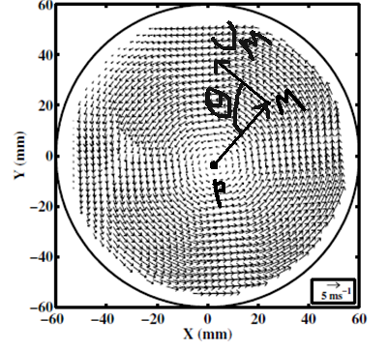
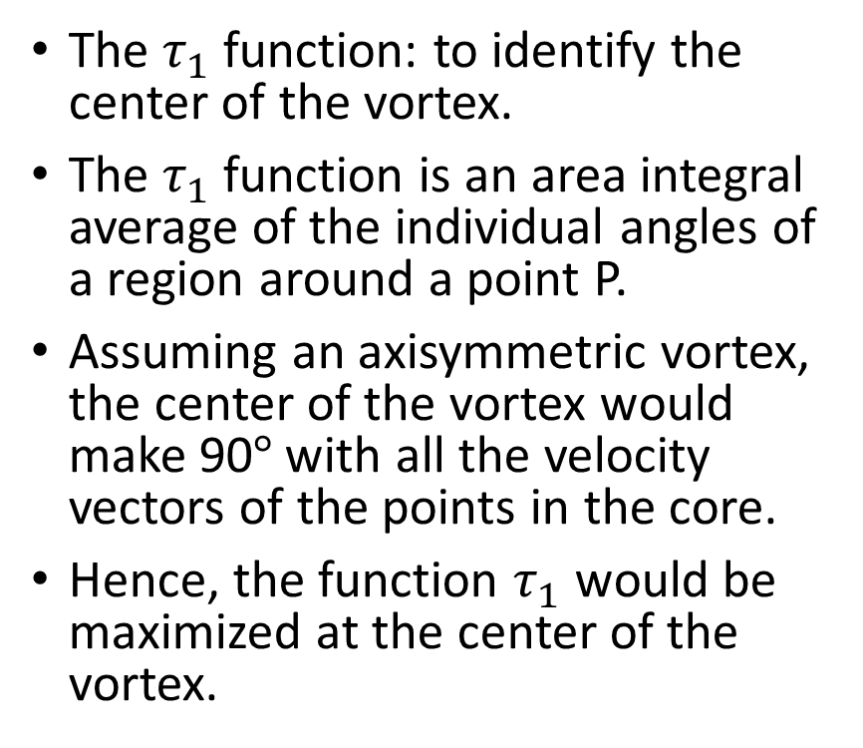
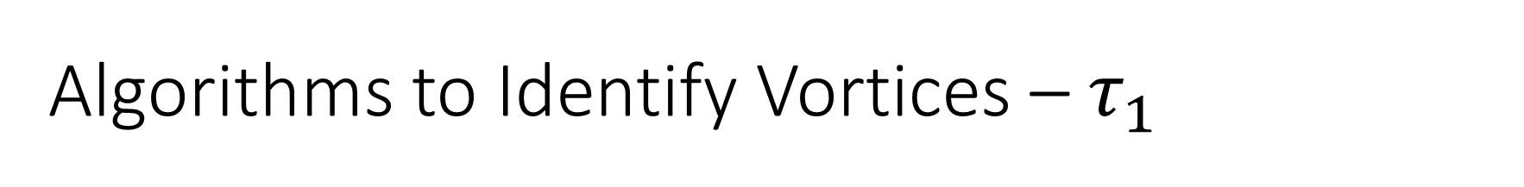
Algorithms to Identify Vortices – $τ_{1}$
Setup
Analytical Methods
POD results
The $τ_{1}$ function: to identify the center of the vortex.
The $τ_{1}$ function is an area integral average of the individual angles of a region around a point P.
Assuming an axisymmetric vortex, the center of the vortex would make 90$°$with all the velocity vectors of the points in the core.
Hence, the function $τ_{1}$ would be maximized at the center of the vortex.
Velocity Field

Slide 16




Algorithms to Identify Vortices – $τ_{1}$
Hence $τ_{1}$ can be written as:
Which can be expresses in terms of an outer product as :
A discretized version of $τ_{1}$ for PIV data:
Velocity Field

Slide 17

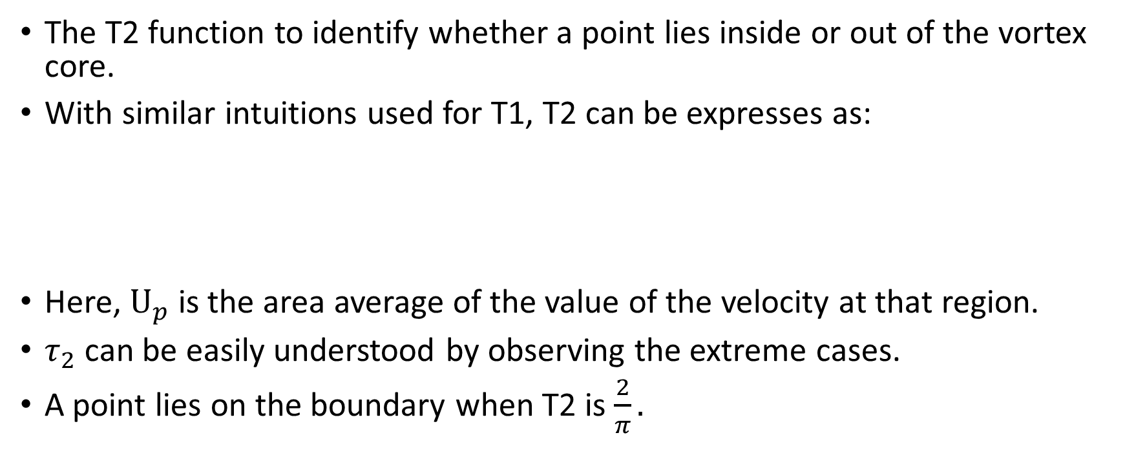
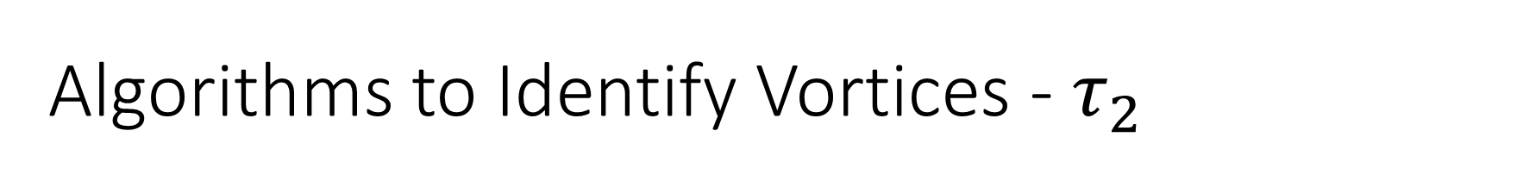
Algorithms to Identify Vortices - $τ_{2}$
Setup
Analytical Methods
POD results
The T2 function to identify whether a point lies inside or out of the vortex core.
With similar intuitions used for T1, T2 can be expresses as:
Here, $U_{p}$is the area average of the value of the velocity at that region.
$τ_{2}$ can be easily understood by observing the extreme cases.
A point lies on the boundary when T2 is $\frac{2}{π}.$

Slide 18

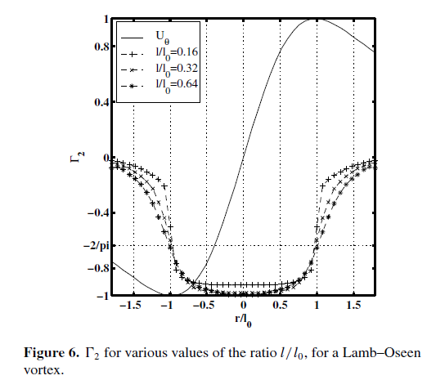
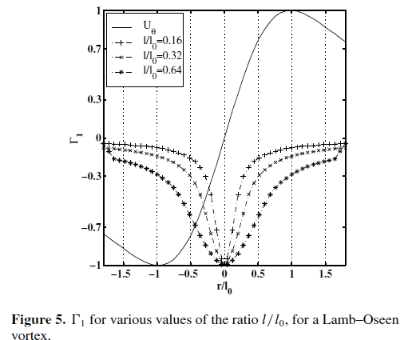
Results – Applying T1, T2 to Lamb-Oseen Vortex model
Setup
Analytical Methods
POD results
Left: The T1 function identifies the center at r = 0
Right: the points between –r and +r are identified to be within the vortex core
Note: the Lamb-Oseen model’s azimuth angle can be observed in the plots, which is governed by the equation show above.

Slide 19
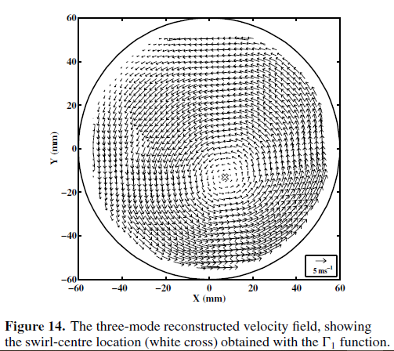
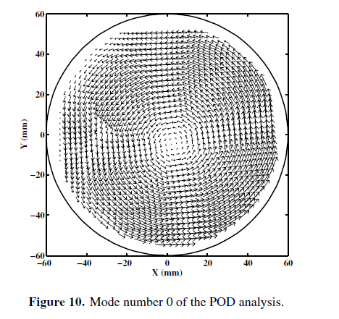
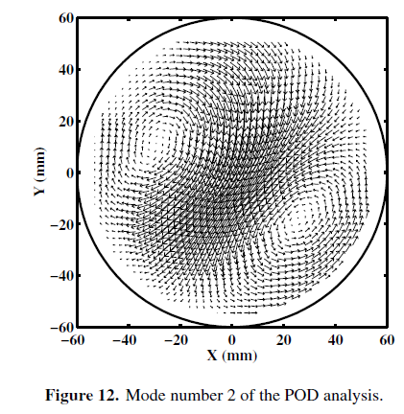
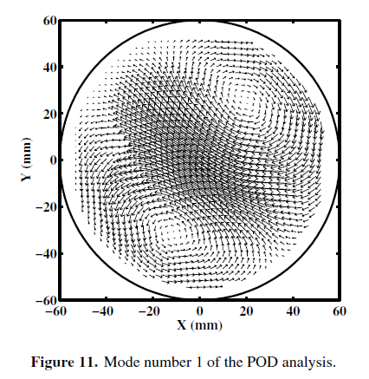
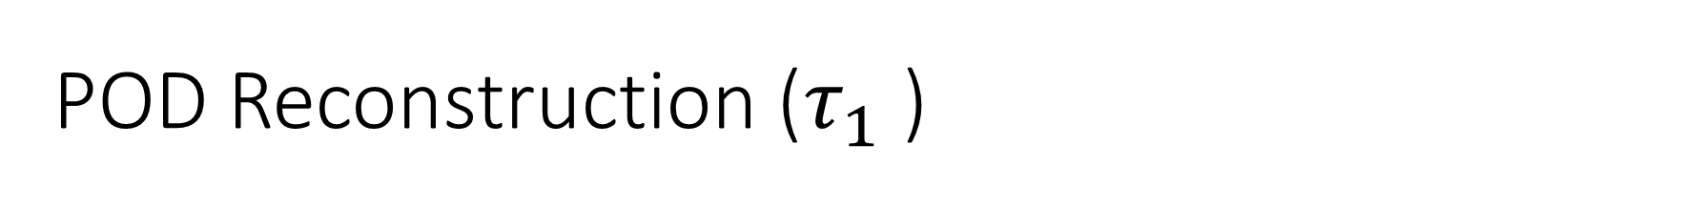
POD Reconstruction ($τ_{1}$)
+
=
+
The first three modes of the flow contain 90% of the energy.
Identifying the center using the first three modes, using T1 function.

Slide 20
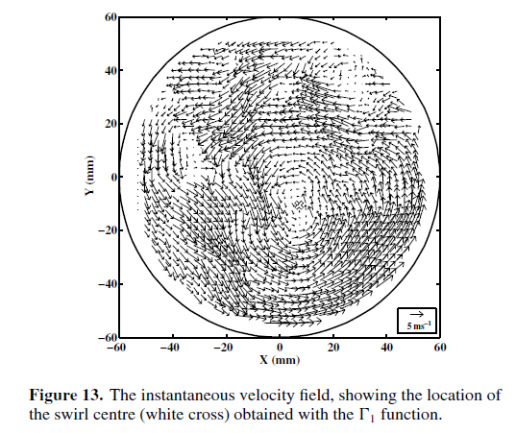
POD Reconstruction
The Center matches with original flow data!

Slide 21
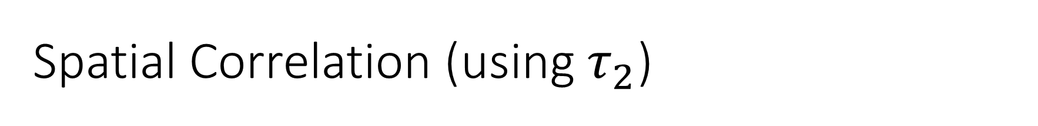
Spatial Correlation (using$τ_{2}$)
To establish the correlation between the first three modes and the large scale velocity fluctuations, the variance of T2 is plotted. First, on the entire flow data and next using the first three modes.
The goal is to show prove that we have successfully identified the large scale velocity fluctuation by the POD modes.
Then we can claim that they are directly induced by the fluctuation on the vortex boundary, which cause the pseudo-fluctuations.
Notes:
Basically show that the large scale fluctuations are due to the vortex and due to the first modes (high energy)

Slide 22
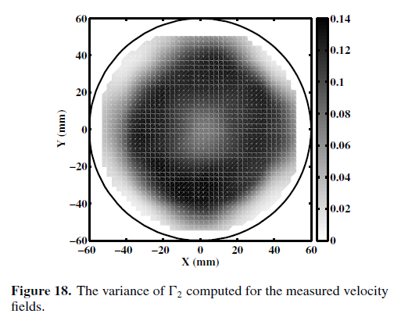
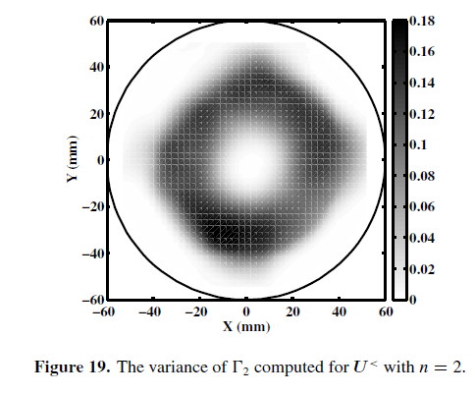
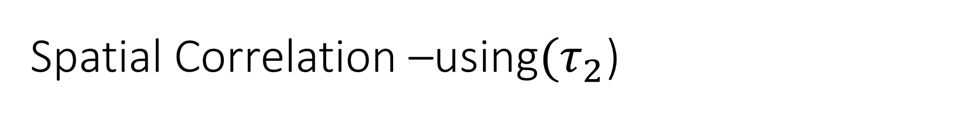
Spatial Correlation –using$(τ_{2}$)
The same crown structure of high variance is observed in both figures, and our claims hold true.

Slide 23
Thanks!
Questions..?

