Slide 1
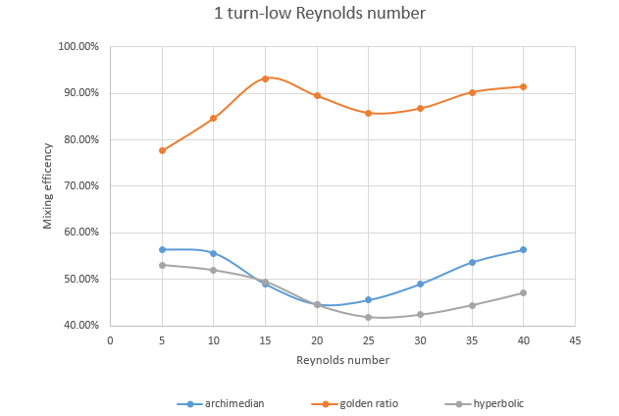
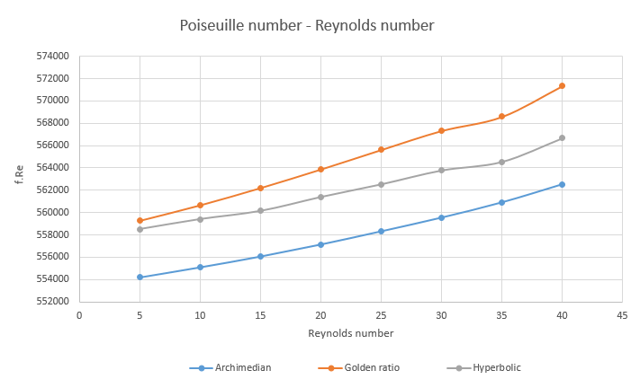
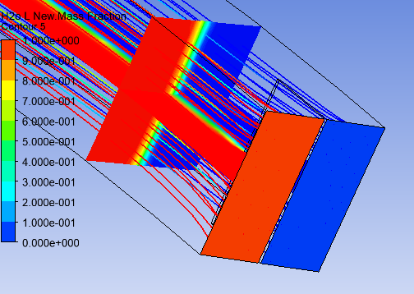
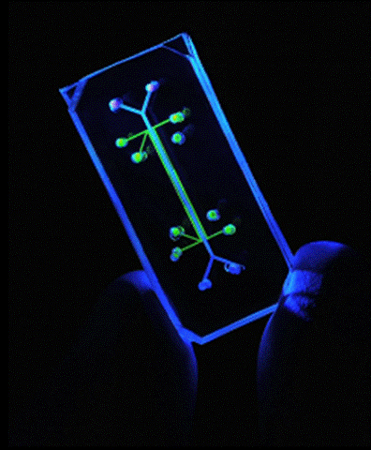
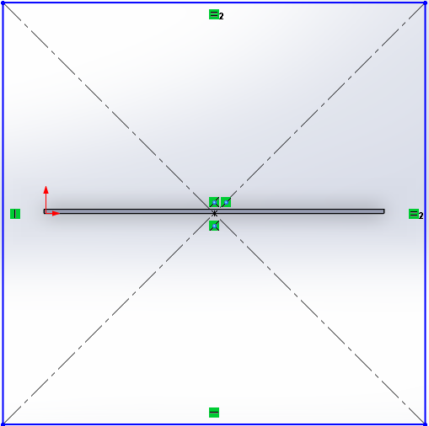

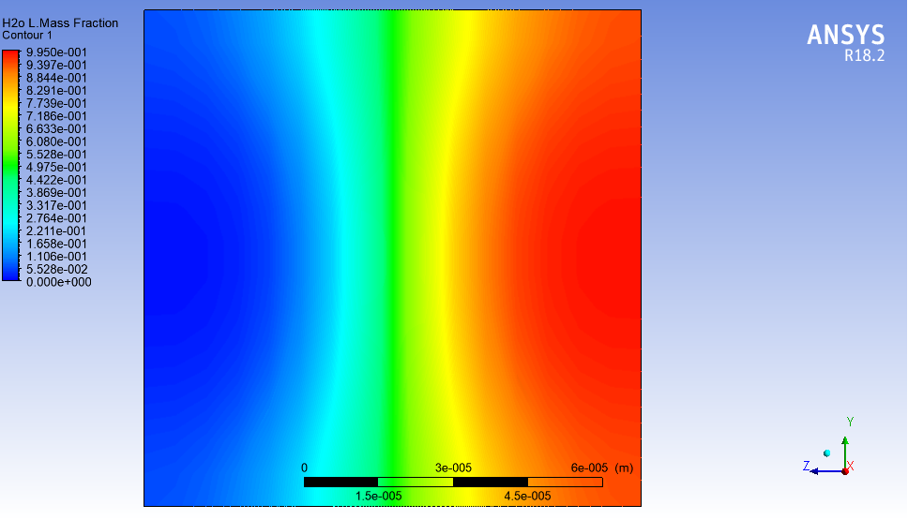
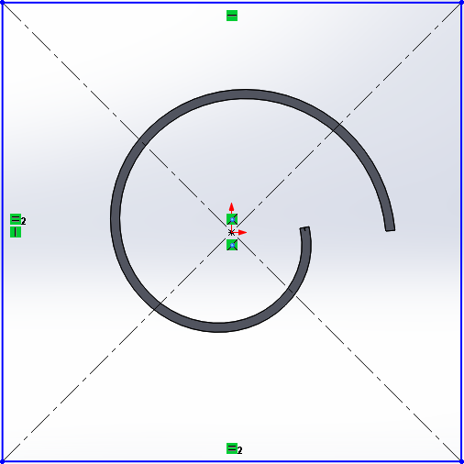
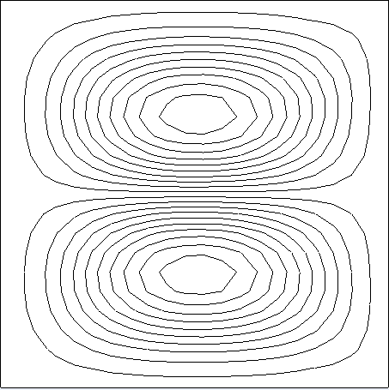
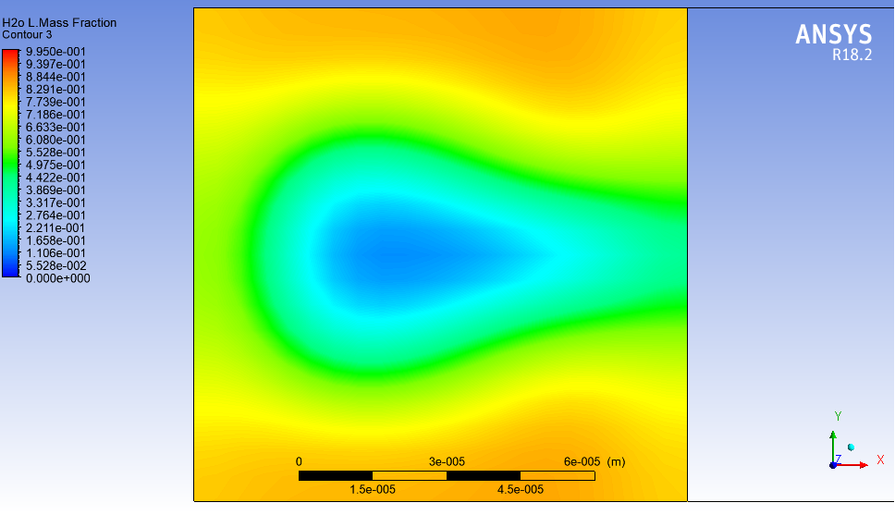
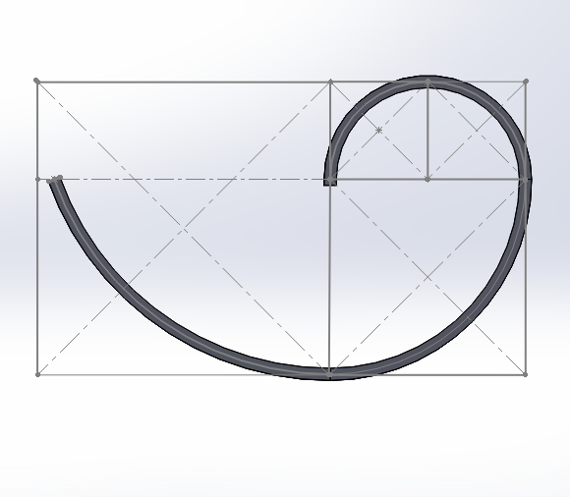
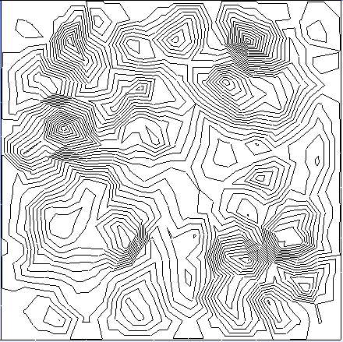
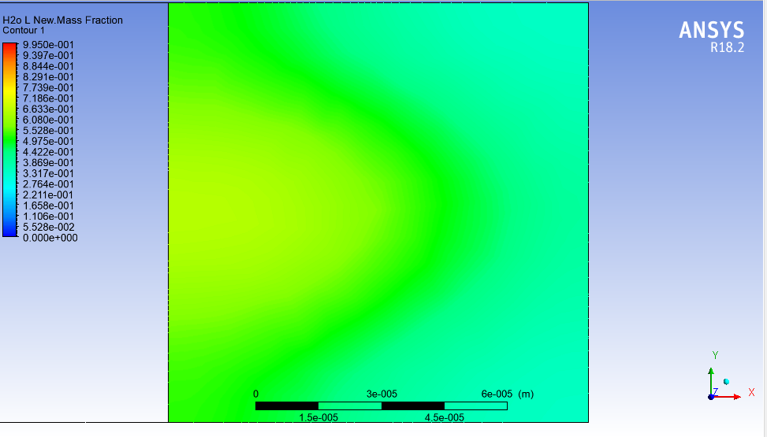
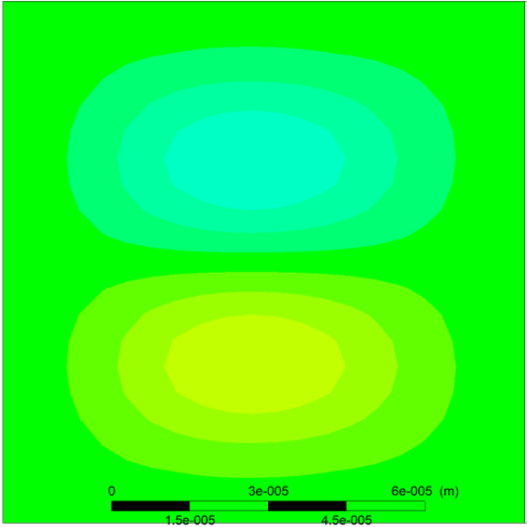
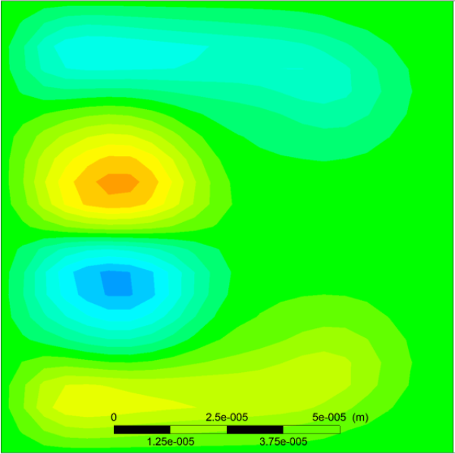

Enhancing miscible fluid mixing using
Golden ratio spiral Microchannel
Kommalapati Sahil¹, Amit Agrawal²
Introduction:
Results:
Mixing of fluids has numerous applications.
It is crucial in maintaining a homogenous environment for chemical and biological experimentation.
Particularly with micro channels, it is used in lab-on-a-chip applications.^{[2]}
Every chemical reaction among various components on the chip are governed by understanding the physics behind mixing.
Mixing of miscible fluids using a T-shaped microchannel has been a standard^{[1].}
W.R. Dean’s works on the fluid behavior in curved channels has revolutionized mixing^{[2]}.
The anomalous behavior of the golden ratio^{[4]} spiral microchannel and the physics behind it is analyzed.
Figure 5. Mixing efficiency over
Reynolds number^{[6]}
Figure 6. Poiseuille number over
Reynolds number^{[6]}
Geometry | Velocity helicity at the outlet | Mass-fraction at the outlet
Figure 1. Mixing at the inlet position^{[6]}
Figure 2. Lungs on chip ^{[5]}
Literature:
The effect of miniaturization of dimension to a micrometer scale increases the ratio of surface area relative to fluid volume. This enhances mixing as well as the heat transfer between the fluids^{[2]}.
The inertial forces enable the inter and intra molecular diffusion, which upon formulation results in the species transport equation^{[1][3]}.
The introduction of curvature in the microchannel path leads to the generation of a net shear force along the axial plane^{[1][2][3]}.
Balancing this force, keeping the conservation of mass in mind results in the formation of vortices knows as Dean’s vortices in the fluid.
These vortices enhance the mixing properties, by introducing a localized swirling motion. This was previously absent in the straight microchannel.
Table 1. Comparison among straight, Archimedean
and Golden ratio spiral microchannels^{[6]}
All contours above are plotted at Re=10. Red and blue dyed liquids (water) are passed through inlets in a vertical configuration. The formation of Green dye indicates complete mixing.
Conclusions:
The anomalous behavior of the golden ratio spiral can be attributed to the sudden change in the radius of curvature of the spiral (for every quarter turn).
A sudden change in the dean’s number (α 1/R) is observed.
A dispersion of the dean’s vortices is observed, which also lead to an increase in the swirling strength.
The golden ratio^{[4]} spiral gives us an insight on how fluid mixing can be enhanced through a crude approximation of the growth rate as the golden ratio.
Figure 3. Primary dean vortices^{[6]}
(Archimedean spiral, Re : 40)
Figure 4. Secondary dean vortices^{[6]}
(Archimedean spiral, Re : 1000)
Methods:
Important References:
In order to obtain a comparative on the various curved microchannel geometries, a study was done on various spiral geometries.
Archimedean, Hyperbolic and golden ratio spirals were utilized.
The governing equations along with the STE were solved in FLUENT.
A grid Independence test was carried ensure the accuracy of the solutions.
The contours and data exportation was done from POST. MATLAB was utilized to calculate the mixing efficiency.
[1] V. S. Duryodhan, R. Chatterjee, S. G. Singh and A. Agrawal , "Mixing of Planar Spiral Microchannel," Experimental Thermal Fluid Science, vol. 89, pp. 119-127, 2017
[2] Di D Carlo, Inertial Microfluidics, Lab on a chip (9) 2009, 3038.
[3] A. Alam, K.Y. Kim, Analysis of mixing in curved microchannel with rectangular
grooves, Chem. Eng. J. 181–182 (2012) 708.
[4] Omotehinwa T, Ramon S.O Fibonacci Numbers and Golden Ratio in Mathematics and science,
International Journal of Computer and Information Technology (ISSN: 2279-- 0764)
[5] openwetware.org/wiki/Sythetic_Organs_on_a_Chip,_by_Manuel_Escanciano_and_Chris_Lowe
[6] Kommalapati Sahil, Amit Agrawal A comparative study on different spiral geometries for enhanced miscible fluid mixing.
sahil15105@mechyd.ac.in
amit.agrawal@iitb.ac.in
Research carried at
Microfluidics Laboratory, IIT Bombay

