Slide 1

Title :Eco Awarness for Sustainable Living
Student Name : K.Harini
Student ID: 2520040011
Cluster : 4
Section: sec-15
Under the Guidance
of
Supervisor Name : TSP Madhuri
Assistant Professor
Department of CSE

Slide 2
Abstract
The project focuses on creating awareness about the importance of protecting the environment and adopting sustainable living practices.
It highlights major environmental issues such as pollution, climate change, and the excessive use of natural resources.
The project promotes eco-friendly habits like reducing plastic usage, recycling waste, saving water, and conserving energy.
A website is developed using HTML, CSS, and JavaScript to provide information, tips, and resources related to sustainable living.
The platform encourages people, especially students and communities, to participate in environmental protection activities.
The main goal of the project is to inspire individuals to adopt green lifestyles and contribute to a cleaner, healthier, and more sustainable planet. 🌱🌍

Slide 3
Existing System
Environmental awareness is mainly spread through traditional methods such as campaigns, seminars, and printed materials.
Information about sustainable living is scattered across different websites and platforms, making it difficult for users to access it in one place.
Many existing platforms provide only general information and lack interactive features to engage users.
There is limited digital support that encourages individuals to actively participate in eco-friendly activities.
Most systems do not provide a simple and user-friendly platform specifically focused on sustainable living awareness.
As a result, people may not fully understand how their daily habits affect the environment or how to adopt sustainable practices effectively. 🌱

Slide 4
Proposed System
Develop a website platform to promote eco awareness and sustainable living.
Provide complete environmental information in one place for easy access.
Include a login page for users to access the website.
Create sections such as About, Services, Projects, Donate, and Posts.
Display eco-friendly images and educational content about the environment.
Share tips for sustainable living like recycling, saving water, and reducing plastic use.
Encourage users to participate in environmental protection activities.
Provide simple and user-friendly navigation for better user experience.
Spread awareness about conserving natural resources and reducing pollution.
Motivate people to adopt eco-friendly habits for a sustainable future. 🌱🌍

Slide 5
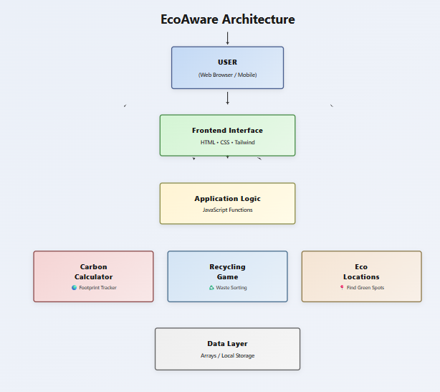
System Architecture
User Layer –Users interact with the application through a web browser to enter environment related information.
Frontend Layer –Provides responsive interface design and seamless user experience .Structures dashboard layout across all devices.
Application Logic Layer -Processes user inputs and performs calculations. Manages carbon footprint analysis and waste tracking
Feature Modules – The system includes modules like Carbon Calculator , Recycling Game ,and Eco Modules to manage different environment condition.
Data Layer –Stores carbon scores, recycling points, and user preferences .Displays real-time data and user achievements dynamically.

Slide 6
Project Modules
Login / Authentication Module – Allows users to securely sign up and log in to the website using a username and password to access eco-related content.
Navigation Module – Manages the menu or navigation bar that helps users switch between different sections such as Home, About, Services, Projects, Donate, and Posts.
Home Module – Displays the main introduction of the website, eco-awareness message, and images related to sustainable living.
About Module – Provides information about the importance of eco awareness, sustainable living practices, and environmental protection.

Slide 7
Project Modules
Services Module – Shows the eco-friendly services or initiatives such as recycling awareness, tree plantation, waste management, and energy conservation.
Projects Module – Displays environmental projects or activities that promote sustainability and green living.
Posts / Blog Module – Shares articles, tips, and updates related to eco-friendly lifestyles, environmental issues, and sustainability practices.
Donation Module – Allows users to support environmental causes by donating to eco-friendly initiatives or campaigns.

Slide 8
Objectives
To create awareness about environmental protection and sustainable living.
To educate people about eco-friendly practices such as recycling, reducing plastic use, and conserving energy.
To develop a user-friendly website that provides information about eco awareness.
To encourage individuals and communities to participate in environmental activities.
To promote the importance of protecting natural resources for future generations.
Future Enhancements
Adding interactive features such as quizzes and challenges on eco awareness.
Integrating real-time environmental data like air quality or pollution levels.
Developing a mobile-friendly application for better accessibility.
Adding a community discussion forum where users can share ideas and eco tips.
Implementing user activity tracking for eco-friendly habits.

Slide 9
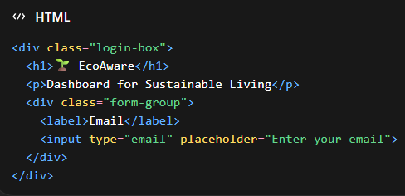
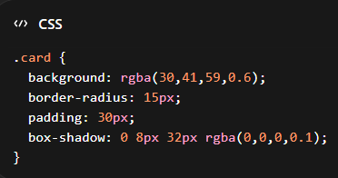
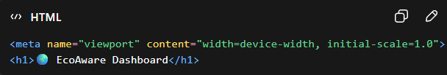
Co’s Attainments - FWD
CO1 – HTML Structure, Internet Concepts, Basic CSS
This CO teaches how to structure web pages, include resources, and apply CSS for visual appeal and layout.
HTML Structure: All the dashboard pages (login Page, dashboard, home, calculator, game, etc.)
Internet Concepts: Using <meta>, <link> (if external CSS or fonts), and <script> for JavaScript.
Basic CSS: Styling login page, dashboard sidebar, buttons, and cards.

Slide 10
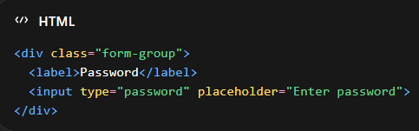
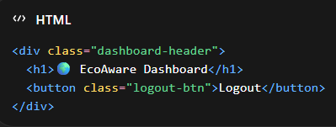
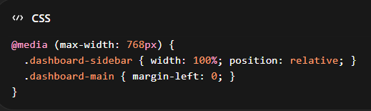
Co’s Attainments - FWD
CO2: Forms, Semantic HTML, Responsive CSS Layout
CO2 focuses on gathering user input through forms, using semantic tags for accessibility, and making the site mobile-friendly.
Forms: Login form (email, password) and Carbon Footprint Calculator form (inputs for transport, electricity, water, plastic).
Semantic HTML: <header>, <main>, <section>, <h1>-<h4>, <label>, <button>.
Responsive CSS: Media queries for mobile view of sidebar and dashboard.
.

Slide 11
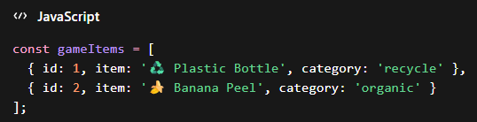
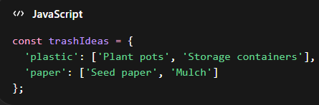
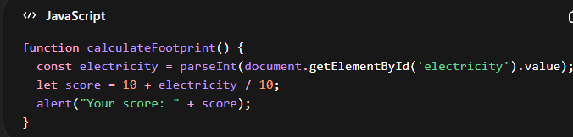
Co’s Attainments - FWD
CO3– Implement JavaScript for Functionality:
CO3 focuses on writing logic, using arrays/objects to store data, and creating dynamic functionality.
JavaScript Functions: calculate Footprint(), initialize Game(), generate Ideas().
Arrays & Objects: waste Items, trash Ideas, contacts, locations.

Slide 12
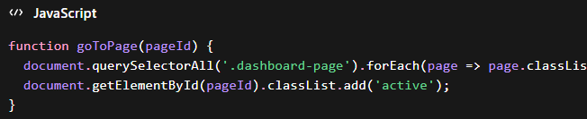
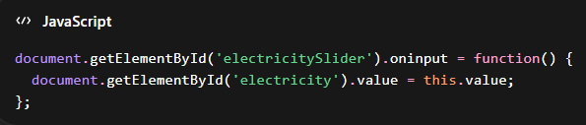
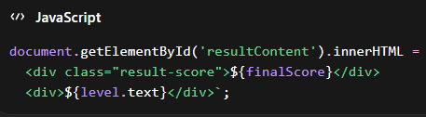
Co’s Attainments - FWD
CO4: DOM Manipulation, Events, Fetch/API usage
CO4 emphasizes interactivity, real-time updates, and connecting user actions to visible changes.
DOM Manipulation: Displaying results (resultContent.innerHTML), updating game items (renderGameItems()), locations and contacts lists.
Events: onclick, onchange, ondragstart, ondrop.
Fetch/API (if added later): You can fetch environmental data from external APIs for locations or carbon info.

Slide 13
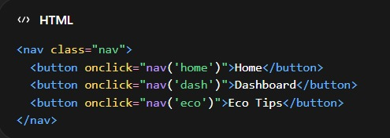
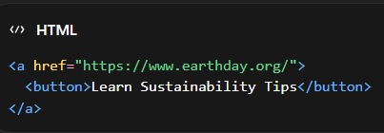

Co’s Attainments - FWD
CO5 – : Develop a Complete Mini Web
Application Integrated HTML, CSS, and JavaScript to develop a complete Eco Awareness for Sustainable Living web application.
In this project we used main web application concepts such as Login/Registration page, Dashboard interface, Eco Tips & Sustainable Practices module, Waste Management & Recycling Guide, and Environmental Resources / Emergency environmental contacts page to organize the platform features.

Slide 14
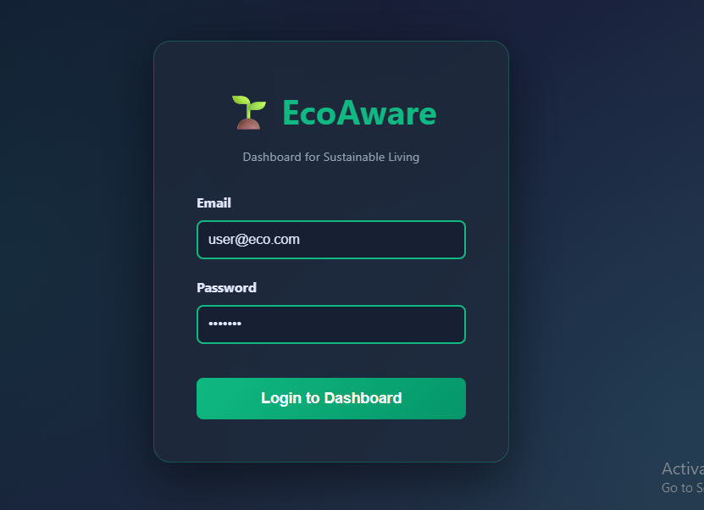
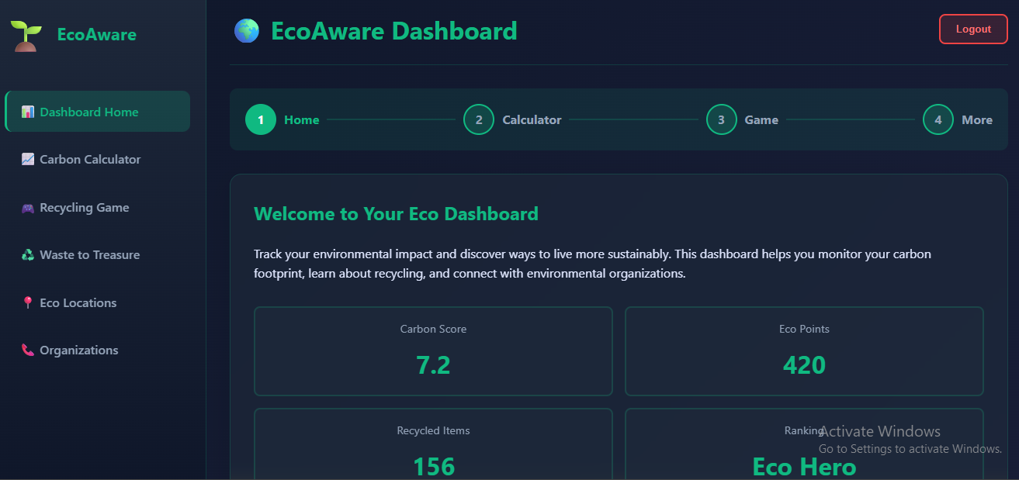
Screenshots-FWD

Slide 15
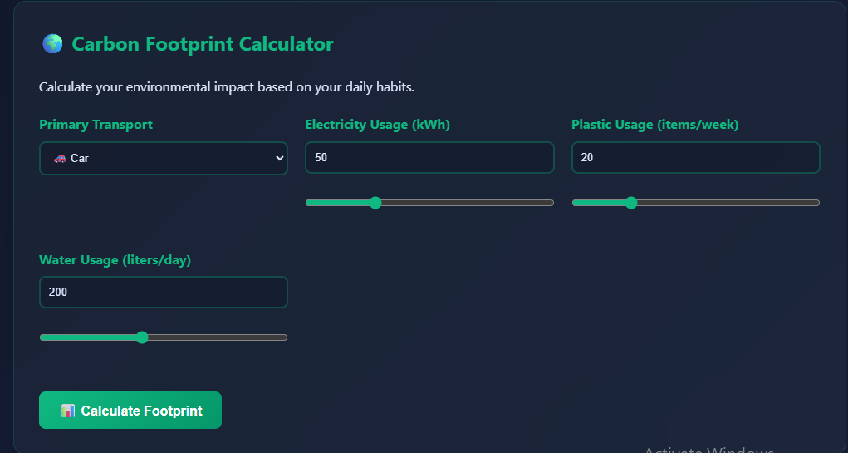
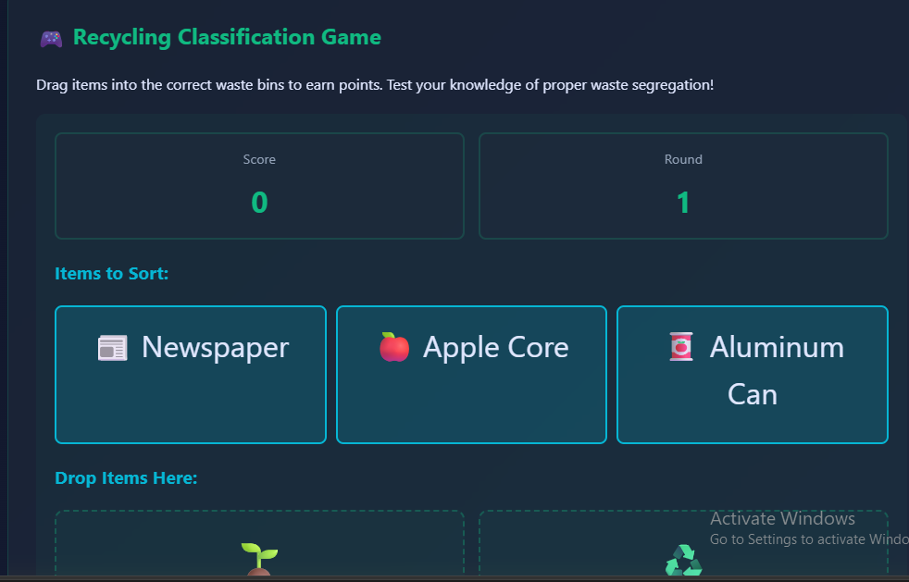

Slide 16
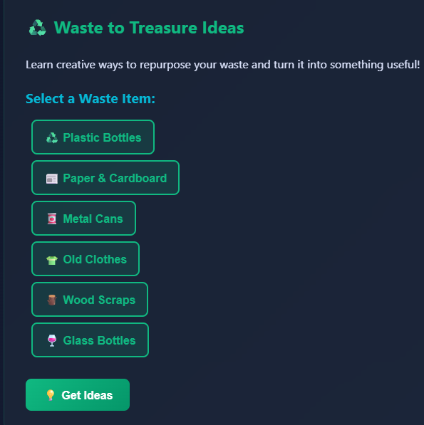
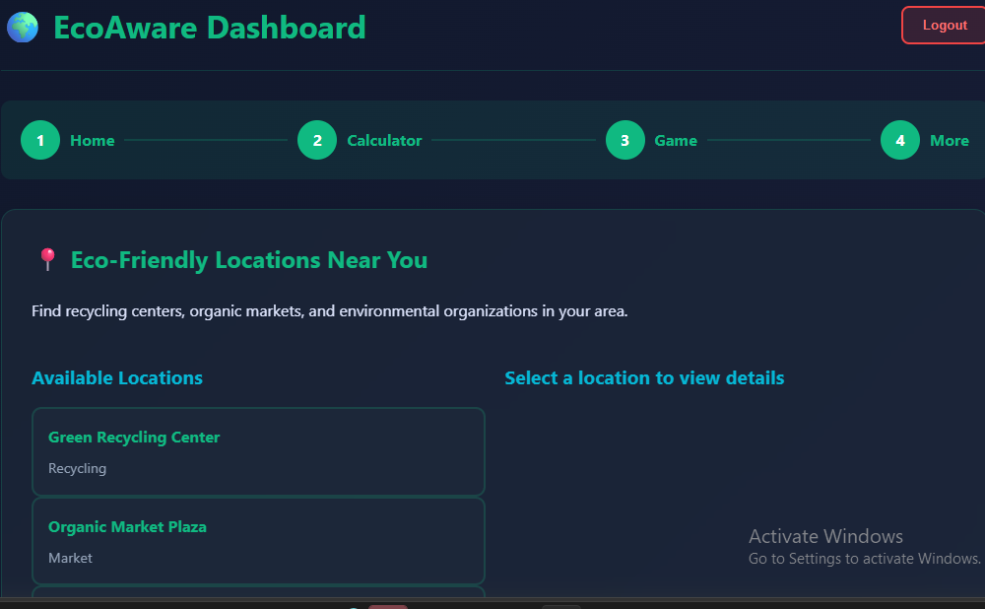
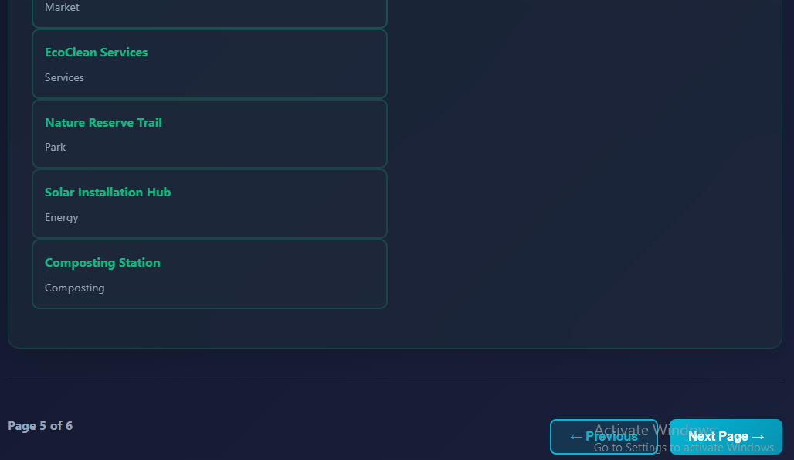

Slide 17
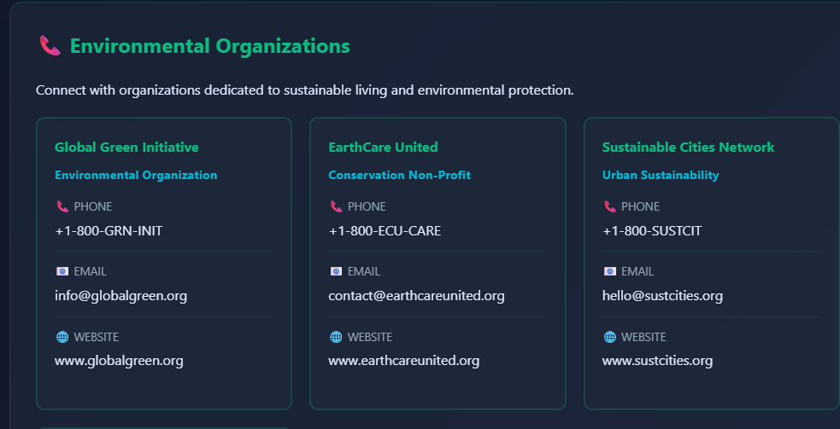
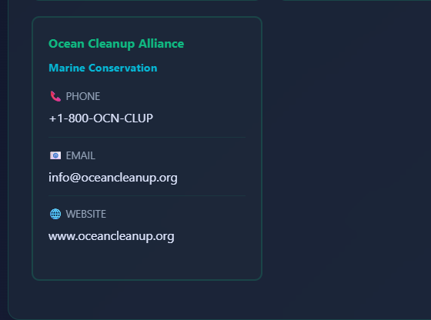

Slide 18
Conclusion
The Eco Awareness for Sustainable Living website was successfully developed using HTML, CSS, and JavaScript to create an interactive and user-friendly platform.
The project helps users learn about sustainable practices, eco-friendly alternatives, and ways to reduce environmental impact in daily life.
JavaScript functions were used to implement dynamic features such as interactive tips, eco-quiz results, and tracking sustainable actions.
HTML was used to structure the web pages, while CSS and Tailwind CSS were used to design a responsive and visually appealing interface.
The application demonstrates the integration of front-end technologies to build an informative and engaging environmental awareness platform.
Charts, visuals, and interactive elements were used to provide clear insights into sustainable practices, improving the overall user experience.
This project helped in understanding web development concepts such as DOM manipulation, event handling, and dynamic content updates.
In the future, the application can be enhanced by adding user login systems, personalized eco-goals, and database storage for tracking environmental impact over time.

Slide 19
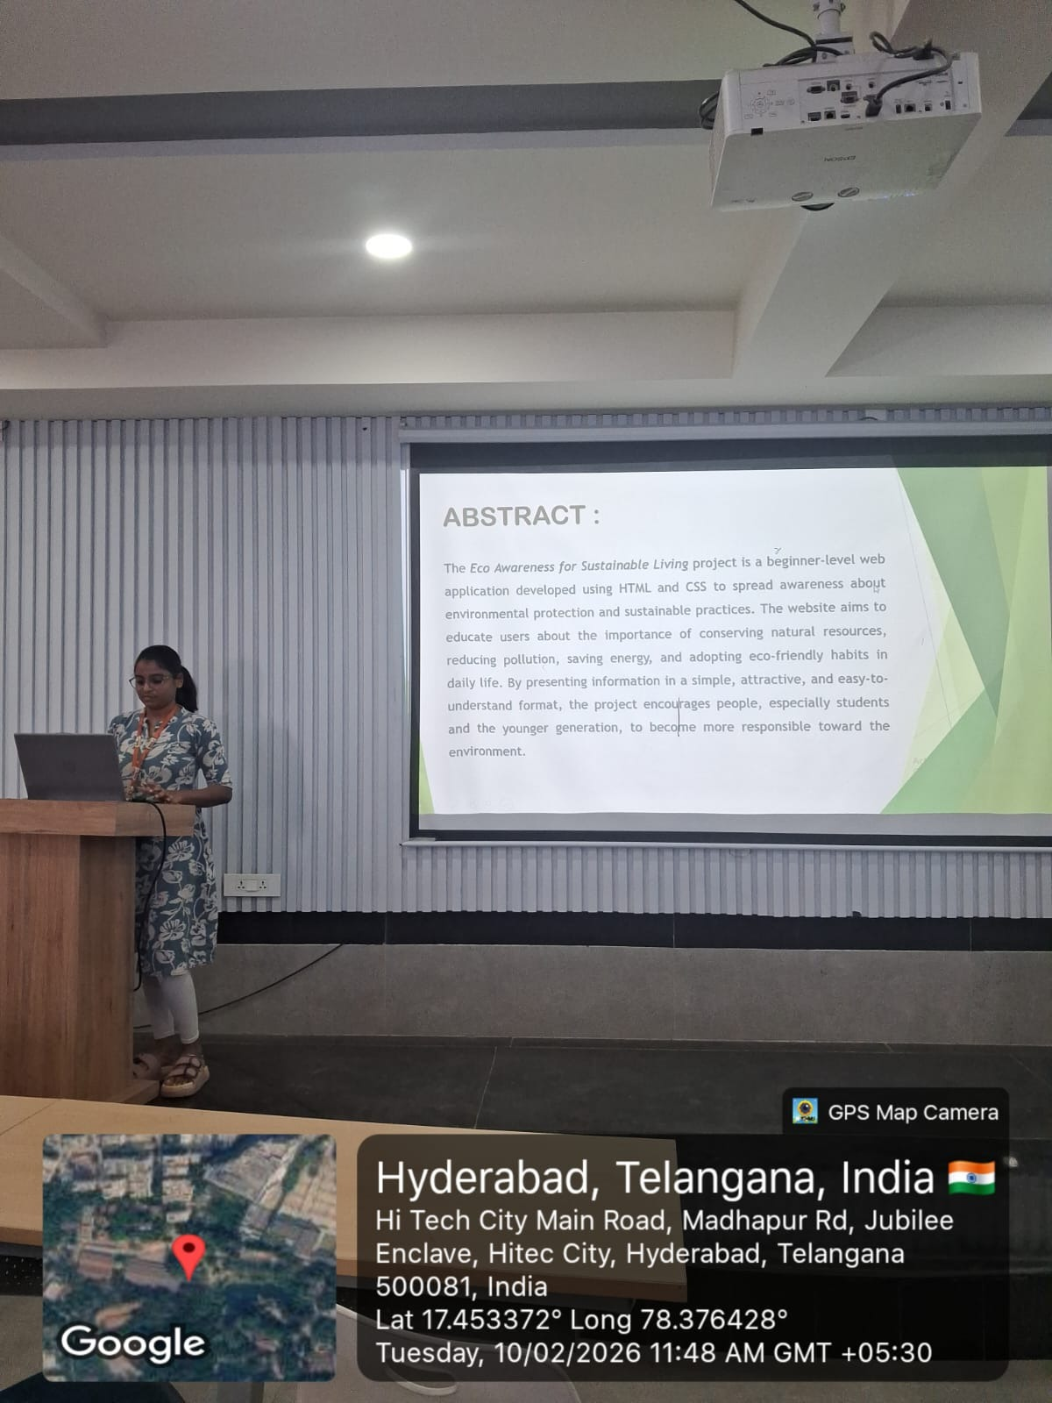
Geo- Tag Photos

Slide 20
THANK YOU

