Slide 1
Intelligent Movie Search: Goals
CS 410 – Team DJTV
Team Members
Danh Nguyen NetID: danhn2@illinois.edu
Justin Quach NetID: jmquach2@illinois.edu
Tik On (Johnson) Lui NetID: tlui2@illinois.edu
Vamshidhar Kommineni NetID: komminen@illinois.edu
Goals
Learn about and use the algorithms and techniques from CS 410 in a simple real-world application
Build an application that can be extended easily by other students in future semesters
Find some additional areas of learning both in information retrieval and general CS

Slide 2
Intelligent Movie Search: Approach
CS 410 – Team DJTV
Choose a rich data set: Stanford Movie Reviews Large Dataset + IMDB Metadata
Design the use cases, data needed, etc.
Search Engine (Names and Metadata)
Review Sentiment
Similar Movies
Data Collection and transformation: Fetch, schematize and store for later steps
Experiment with the algorithms/methods, evaluation and produce the data/modules for the application:
Choice of three rankers for search engine (BM25, Jelinek-Mercer, Dirichlet Prior)
Pre-computed sentiment analysis (Vader)
Choice of methods for similar movies (BERT, Word2Vec, TF-IDF)
Build a simple web application as a front-end for the Information retrieval techniques
Stretch: Host web application for easy use/grading/experimentation – Hosted on Azure and pythonanywhere

Slide 3
Intelligent Movie Search: Architecture
CS 410 – Team DJTV
Pre-computation phase
Data Collector (IMDB)
Similar Movies Algorithms (Jupyter Notebook)
4
Precomputed Similar Movies JSON
1
3
Transform data to JSON files
Large Movie Review Dataset (Stanford)
2
5
Sentiment Analysis Algorithm (Jupyter NB)
Precomputed Sentiment JSON
6
2
Hosted Web application
5
Web App - Search Engine
3
Search Results
1
4
Web App – Details
Metadata, Sentiment, Similar Movies

Slide 4
Intelligent Movie Search: Installation
CS 410 – Team DJTV
Installation for usage: None. Visit one of these two websites:
http://cs410djtv.azurewebsites.net
http://komminen.pythonanywhere.com
Note: Both websites are identical. First few uses/clicks after a while can be slow because of container reloads, warming up data, etc. on the hosting platform.
Installation for extension (not needed for peer grading): Fully documented in the report
Git clone https://github.com/komminen/CS410_DJTV.git
Setup anaconda, python3.5, pip install --r requirements.txt
Run with “python main.py” and open up the browser to localhost

Slide 5
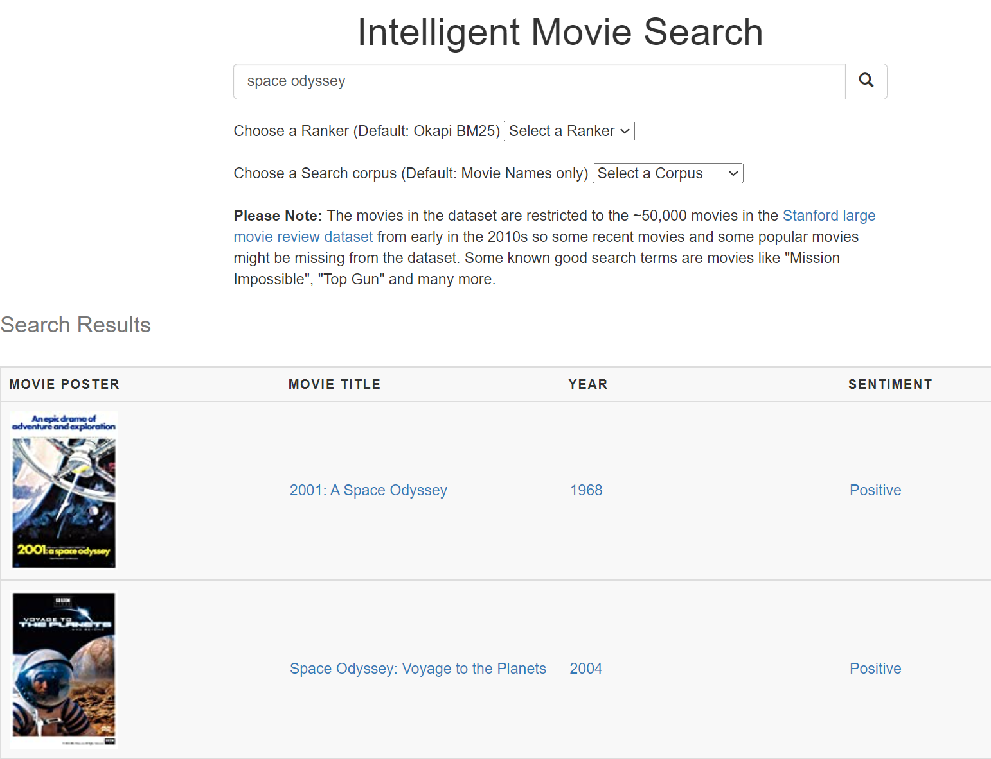
Intelligent Movie Search: Demo/Testcases
CS 410 – Team DJTV
Search Engine test case: Default ranker, default corpus (movie names)
Try a movie like “Space Odyssey” in the search box
Search Engine test case: Choose a ranker or search corpus from the drop down and re-run the search
E.g. Try “Meryl Streep” with default corpus and there are no results.
With “All movie metadata” for corpus, you see movies that she acted in
Note: The movie list matches the ~50K movies in the Stanford movie dataset so it isn’t exhaustive

Slide 6
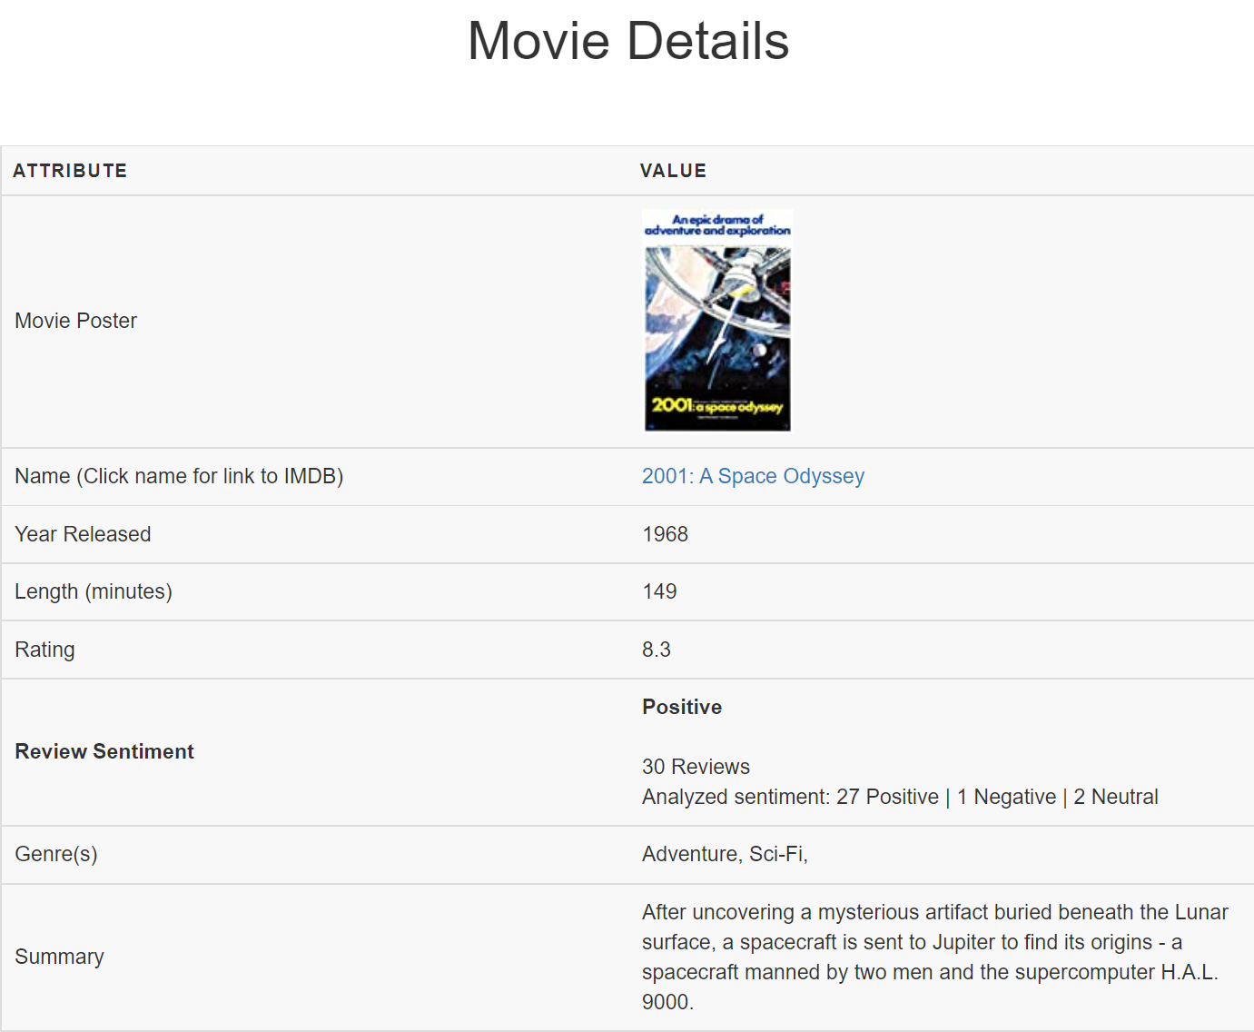
Intelligent Movie Search: Demo/Testcases
CS 410 – Team DJTV
Test case for metadata, sentiment, similar movies
Click on the first result from the search for “space odyssey” to see details about the movie http://cs410djtv.azurewebsites.net/detail/0062622/
Metadata: Metadata fetched from IMDB is shown including a link to IMDB to learn more about the movie
Sentiment: There were 30 reviews in the movie review research dataset, with 27 classified as positive by the Vader algorithm
Similar Movies: Scroll down to see similar movies all with a space theme using BERT. You can change to Word2Vec or TF-IDF and update to see completely different sets of similar movies

