Slide 1
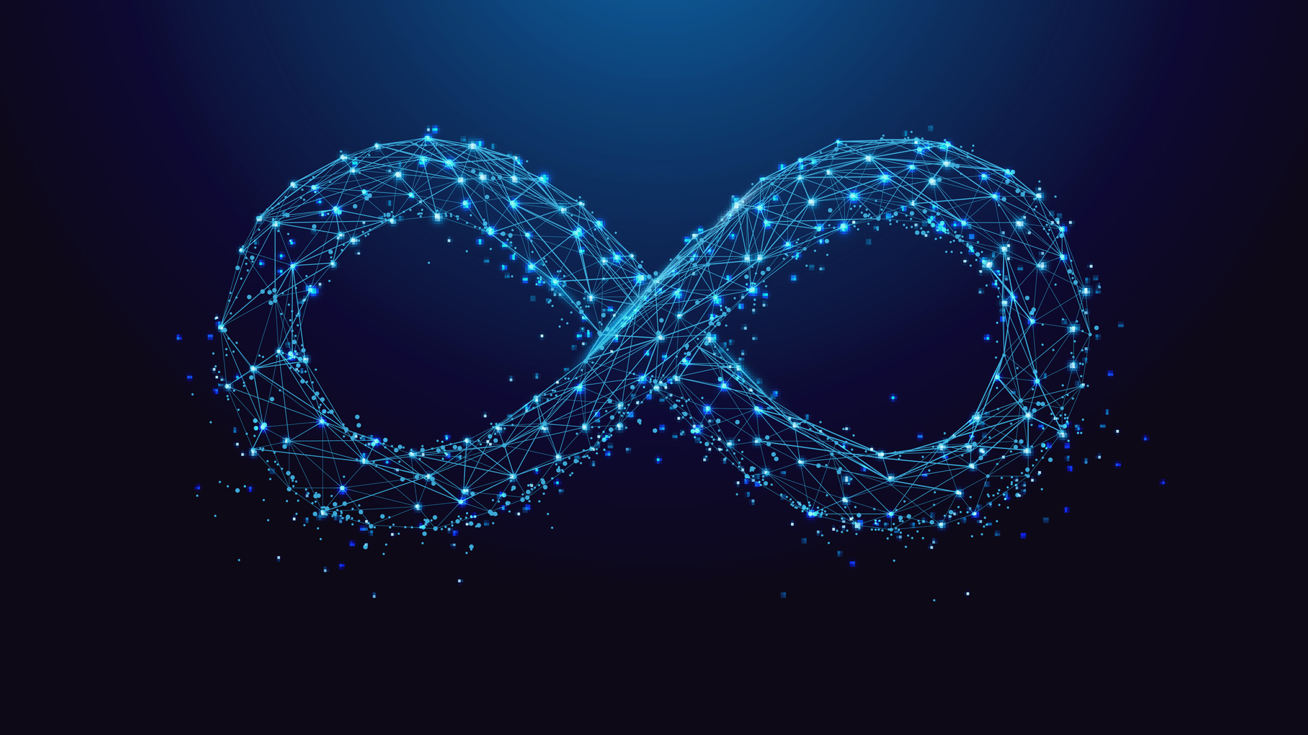
DevOps

Slide 2
DevOps
Development Team + Operational Team -----> DevOps.
Main aim is to shorten the systems development life cycle and provide continuous delivery with high software quality.
DevOps on Cloud.
Example

Slide 3
Waterfall Model
Software Development Life Cycle(SDLC) is a process used to develop software products.
It is a traditional way of software development.
SDLC follows 6 stages
Planning
Defining
Designing
Building
Testing
Deployment

Slide 4
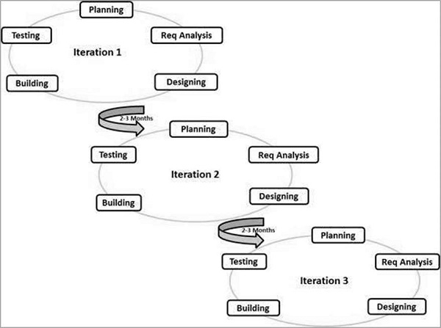
AGILE MODEL
Agile model is a combination of iterative and incremental process models with focus on process adaptability and customer satisfaction by rapid delivery of working software product.
Agile Methods break the product into small incremental builds. These builds are provided in iterations.
Each iteration has following stages
Planning and Requirements analysis
Designing
Building
Testing

Slide 5
DevOps
DevOps solves the problems of Agile and Waterfall Model
It improves the collaboration and productivity by
Automating Infrastructure
Automating workflows
Continuously monitors application performance.
And all this can be done by set of tools.

Slide 6
Benefits of DevOps
Reliable
Faster Delivery
Faster Updates
High Quality
Lower Cost
Lesser Defects

Slide 7
DevOps Life Cycle
Plan
Code
Build
Test
Release
Deploy
Operate
Monitor

Slide 8
DevOps Building Blocks
Version control System
Continuous Integration
Continuous Testing
Continuous Deployment
Continuous Monitoring
Using set of tools.

Slide 9
Tools
GIT
Bitbucket
Subversion
Code Commit
Docker
Apache Ant
Maven
Selenium
JUnit
QUnit

Slide 10
Some More Tools
Kubernetes
Puppet
Chef
AWS
Nagios
Data Dog
Splunk

Slide 11
GIT
Git acts as Version Control system
File with 1st
unmodified 10 lines of code
10 lines of code
Code Updated
Modified 2 lines among that 10 lines
Unmodified file
Updated file
Modified 10 lies code
But only update file is seen by the user.
Changes reverted
Unmodified 10 lines code

Slide 12
GitHub
Git also helps in collaboration.
Remote Location (GITHUB)
CODE (developers work on)
Interact
Interact
Interact
Local (GIT)
Dev 1
Local (GIT)
Dev 2
Local (GIT)
Dev 3

Slide 13
GIT Stages
Three stages of GIT
Working Directory
Staging Area
Committed Area
File 1
File 1
File 1
File 1.1
add
Commit
File 2
File 2
revert
reset

Slide 14
Basic GIT commands
git Status
git add Application name [ Git add app.py]
git commit
git log
git log --oneline
git show (log id)
git remote add origin address_of_repo
git push origin master
git clone repo_address
git checkout file_name
git reset file_name
git revert commit_id

Slide 15
Jenkins
Jenkins is simply like a personal assistant.
Example
Jenkins is called as an Orchestrator.
Java code
Compile
Test
Review
Deploy

Slide 16
Jenkins Pipeline
It is a sequence of task executed automatically.
It can have n number of tasks
Pipelines has two parts CI(Continuous Integration) and CD (Continuous Deployment).
Java code
Compile
Test
Review
Deploy

Slide 17
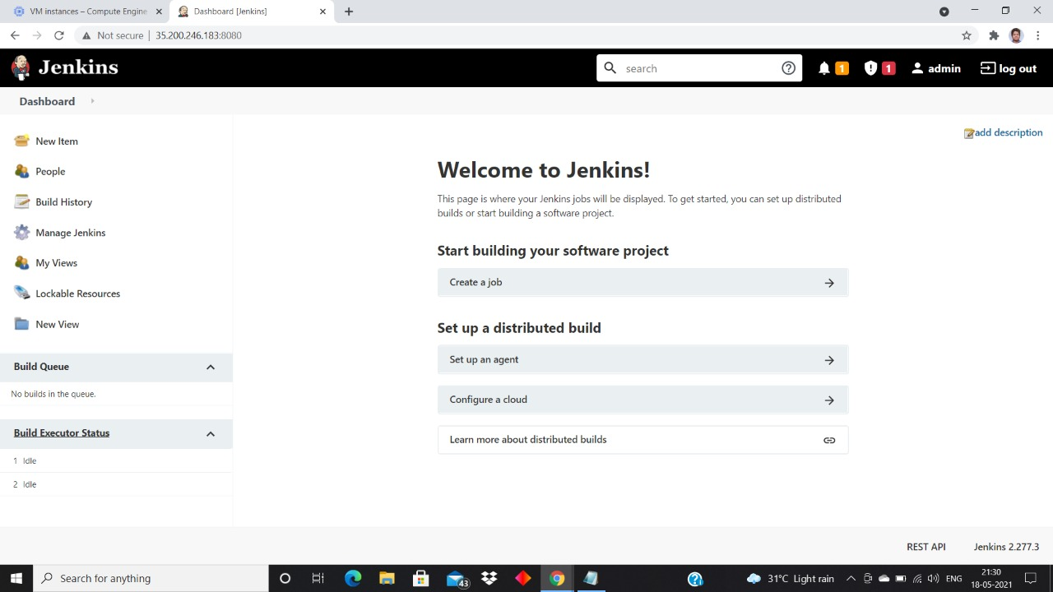
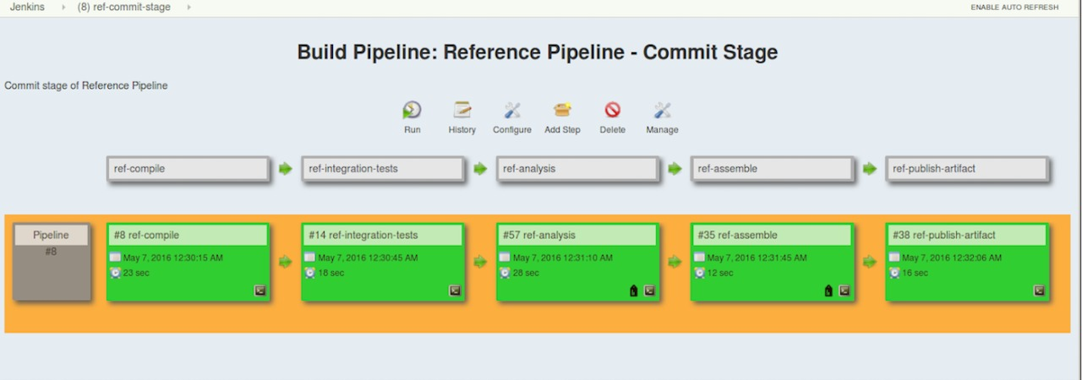
Jenkins GUI

Slide 18
Docker
Docker is called as a Container Engine.
It solves the problem between Dev team and Ops Team.
Dev team developed application using
Python 3.6
Numpy
Pandas
Ops team try to run the application using
Python 2.7
Numpy
forwarded to
Sends back

Slide 19
Containerization & Image
Docker forms a container along with application dependencies.
Docker Image can be generated from the containers.
This Docker Images can be used to deploy the application in any number of systems and the application works exactly same in all the systems.
Python 3.7
Numpy
pandas
Python 3.7
Numpy
pandas
FORWARDED TO
Ops team
Python 2.7
Dev Team

Slide 20
Basic Docker Commands
docker –version
docker ps
docker ps –a
docker pull image_name
docker images
docker run arguments image_name [docker run –itd centos]
docker stop container_name
docker rm container_name
docker commit container_image_name
Docker tag old_image_name new_image_name

Slide 21
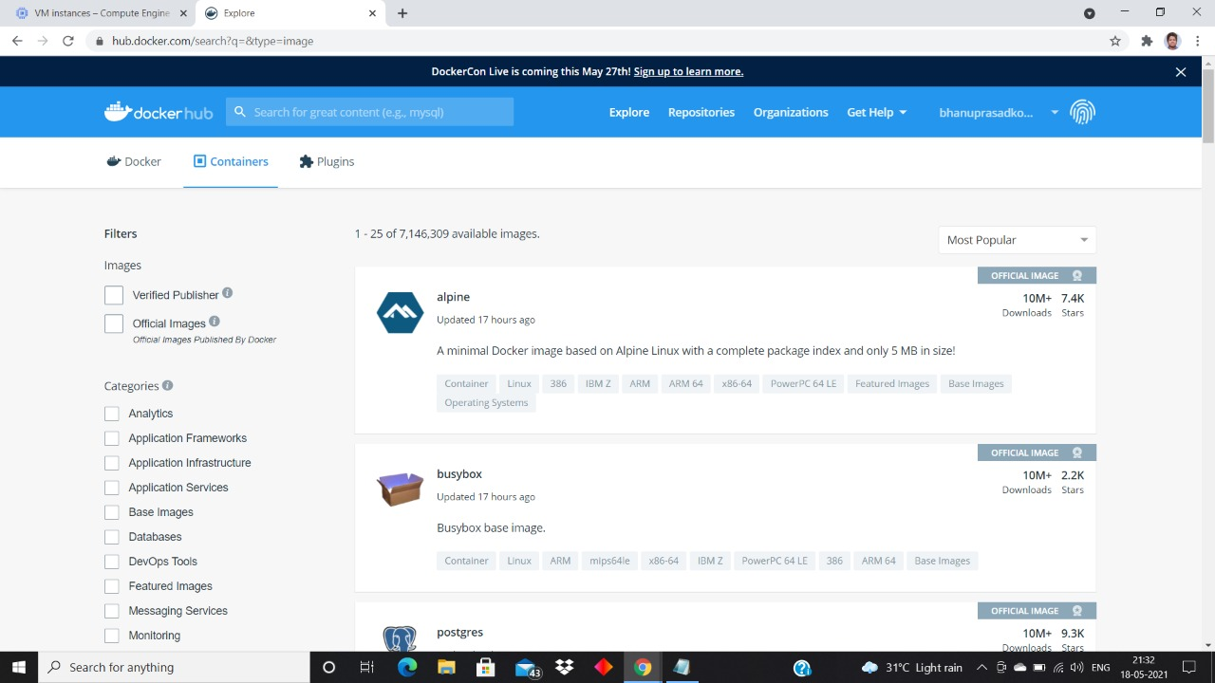
Docker Hub GUI
You can pull images from Docker Hub
You can push images to Docker Hub and make it available it for users.

Slide 22
THANK YOU
BY
BHANU PRASAD KOMMULA
17D41A05A9
CSE-B

