Slide 1

Deep Face RECOGNITION
BDM 3035 - Big Data Capstone Project

Slide 2

GROUP H
Marzieh Mohammadi Kokaneh (C089839)
Saurabh Laltaprasad Gangwar (C0894380)
Brayan Leonardo Gil Guevara (C0902422)
Rohit Kumar (C0895100)
Eduardo Williams Cascante (C0896405)
(VentureBeat, 2024)

Slide 3

agenda
Introduction
Data Collection and Preparation
Methodology
Analysis and Results
Discussion
Conclusion
References
(Carson Group, 2023)

Slide 4
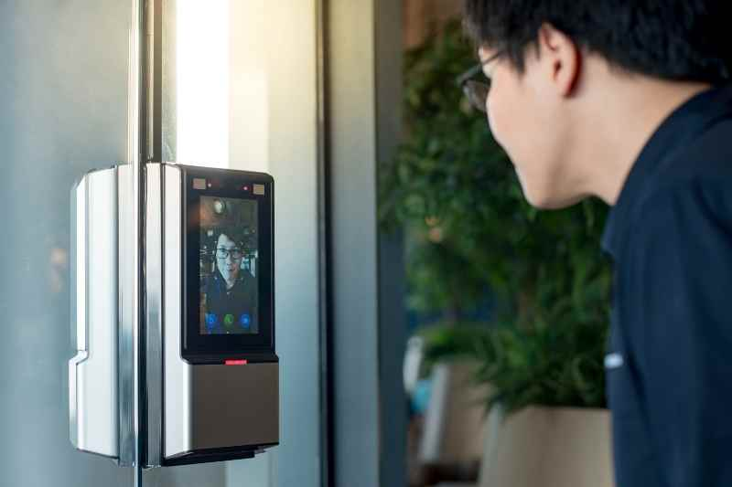
introduction
This project explores the use of deep learning techniques for facial recognition, useful for understanding how Convolutional Neural Networks works
This project can be applied in several fields such as:
Biometric control and access
Video surveillance solutions
Lost people searching, and so on
The original idea comes from creating a local dataset having different photos of our team’s members and training the model to detect the identity of each person. However, due some resources limitations (time, processing capacity, etc.) we reduced the scope to just two group’s members.
(Cline, 2024)

Slide 5
Data Collection and Preparation
Data collection
Each person took 150 pictures from its smartphone and fixed them to 480 x 480 pixels
Data splitting
Training dataset → 100 pictures
Validation dataset → 20 pictures
Test dataset → 30 pictures

Slide 6
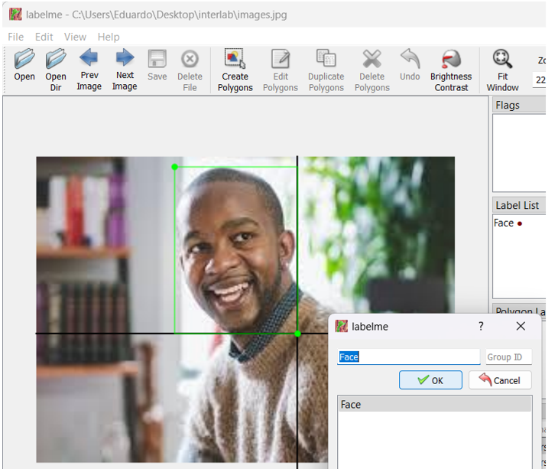
Data Collection and Preparation
Data annotation
LabelMe is a free graphical annotation tool for image and video data
LabelMe allows to label different objects over the same picture
LabelMe saves labels and coordinates in a Json file (for each picture)

Slide 7
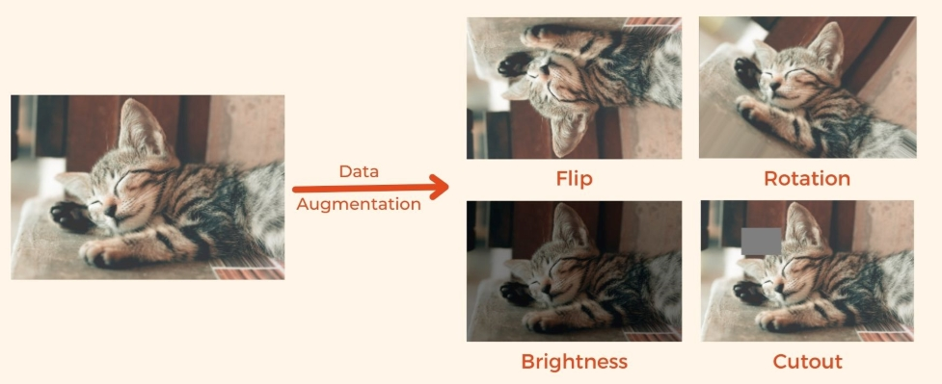
Data Collection and Preparation
Data augmentation
Since 150 pictures are not enough for this process, we had to multiply them
Albumentations is a fast and flexible image augmentation library
Albumentations not only multiplied pictures but also applied some transformations on their position, heights, widths, and number of color channels, in order for training process to learn about different faces conditions
(Panchuang, 2021)

Slide 8
Methodology
We created a CNN (Convolutional Neural Network), by using Tensorflow, Keras, GlobalMaxPooling2D, VGG16, among others
Input layer shape (120,120,3) → (height, width, RGB)
VGG16 layer
GlobalMaxPooling2D layer for Classification → 2048 units
GlobalMaxPooling2D layer for Regression → 2048 units
Output layer for Classification → Classes
Output layer for Regression → Coordinates

Slide 9
Methodology
TensorFlow
It is an open-source machine learning framework developed by Google.
It's widely used for building and deploying machine learning models, particularly deep learning models.
Keras
It is a high-level neural networks API, written in Python and capable of running on top of TensorFlow.

Slide 10
Methodology
VGG16
It is a convolutional neural network (CNN) architecture that was proposed by the Visual Geometry Group (VGG) at the University of Oxford.
It is one of the most well-known deep learning models for image classification.
GlobalMaxPooling2D
It is a pooling operation commonly used in convolutional neural networks.
It reduces the spatial dimensions (height and width) of the input while retaining the most important features.

Slide 11
Methodology
For compiling the model, we used the following settings:
Optimizer → Adam
Classification loss → SparseCategoricalCrossentropy
For training process, we used the following callbacks:
TensorBoard → Just for logging (not for visualizations)
EarlyStopping → It stops epochs if metrics no longer get better
ModelCheckpoint → For tracking and saving the best weights and metrics

Slide 12
Analysis and Results
(VentureBeat. 2024)

Slide 13
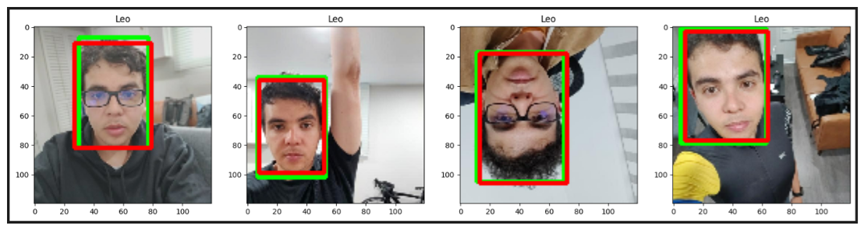
Analysis and Results
To evaluate regression predictions (coordinates) we used Intersection Over Union metric
Intersection over Union (IoU) is used to measure the accuracy of object detection by comparing the ground-truth bounding box (green) to the predicted bounding box (red)
We got 89.94% of precision for this metric

Slide 14
Discussion
Regarding to classification predictions, we got 100% of accuracy in train and validation datasets, however we also got 96.53% in test dataset which is good and demonstrate that our model is not overfitted.
As for regression predictions, we used Intersection Over Union metric in test dataset, and we got 89.94%. Let's consider that any value greater than 0.5 on IoU is typically a good score.

Slide 15
Discussion
We got 78% of classification accuracy on an unseen dataset, it means the accuracy decreased.
However, we understand this could be due to factors such as: unseen pictures was taken with other phone model, some faces were not exactly in front of the camera, people appeared pulling faces in some pictures or faces covered just a little percentage of the picture, unlike training dataset where faces covered at least 30% of pictures.
As a learning, we must select pictures from different sources and different conditions, such as: positions, light exposition, etc., to improve the robustness of the model.

Slide 16
Conclusion
Our project aimed to develop a robust face recognition model using deep learning techniques, specifically Convolutional Neural Networks (CNNs).
Through a series of meticulously planned steps, from data collection and preprocessing to model training and evaluation, we achieved significant milestones.
Comprehensive data preprocessing and augmentation, which enhanced the model's ability to generalize.
Our project successfully developed a deep learning-based face recognition model with high accuracy. The use of CNNs and transfer learning significantly contributed to the model's performance by reduced training time and improved performance.

Slide 17
Final steps
DEMO
QUESTIONS

Slide 18
References
Carson Group. (2023, October 3). Four reasons we believe stocks won’t crash in October. https://www.carsongroup.com/insights/blog/four-reasons-we-believe-stocks-wont-crash-in-october/
Cline, R. (2024, March 18). Biometric access control systems: Your complete guide. ButterflyMX® - Video Intercoms & Access Control Systems. https://butterflymx.com/blog/biometric-access-control/
CS231n: Convolutional neural networks for visual recognition. (n.d.). Retrieved June 11, 2024, from https://cs231n.github.io/
Géron, A. (2019). Hands-on machine learning with scikit-learn, Keras, and TensorFlow: Concepts, tools, and techniques to build intelligent systems. O’Reilly Media.
Ng, A. (n.d.). Deep learning. Coursera. Retrieved June 11, 2024, from https://www.coursera.org/specializations/deep-learning
Panchuang. (2021, July 12). Image augmentation in deep learning. Panchuang Blog. https://panchuang.net/2021/07/12/%E6%B7%B1%E5%BA%A6%E5%AD%A6%E4%B9%A0%E4%B8%AD%E7%9A%84%E5%9B%BE%E5%83%8F%E5%A2%9E%E5%BC%BA%E7%AE%80%E4%BB%8B/
Scikit-Learn. (2024). Official Documentation. Retrieved June 11, 2024, from https://scikitlearn.org/stable/
tensorflow.org. (n.d.). Get started with TensorBoard. TensorFlow. Retrieved from https://www.tensorflow.org/tensorboard/get_started
VentureBeat. (2024, August 9). The art and science of SaaS pricing: True usage-based pricing. https://venturebeat.com/business/the-art-and-science-of-saas-pricing-true-usage-based-pricing/

Slide 19

Thanks!

