Slide 1
G2M insight for Cab Investment firm
Anirudh Kompella Date: 10-10-2021

Slide 2
Description:
XYZ is a private equity firm in US. Due to remarkable growth in the Cab Industry in last few years and multiple key players in the market, it is planning for an investment in Cab industry.
Provide actionable insights to help XYZ firm in identifying the right company for making investment.
Cab Companies:
Yellow Cab
Pink Cab
The Analysis include :
Data Understanding,
Data Visualization,
Creating multiple hypothesis,
Building models and finding the best fit model based on Accuracy.

Slide 3
Data Preparation:
There are 4 datasets:
Cab_Data.csv – this file includes details of transaction for 2 cab companies.
Customer_ID.csv – this is a mapping table that contains a unique identifier which links the customer’s demographic details.
Transaction_ID.csv – this is a mapping table that contains transaction to customer mapping and payment mode.
City.csv – this file contains list of US cities, their population and number of cab users.

Slide 4
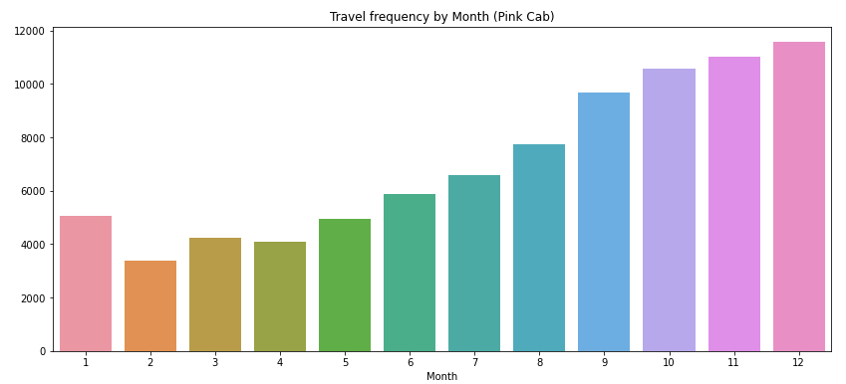
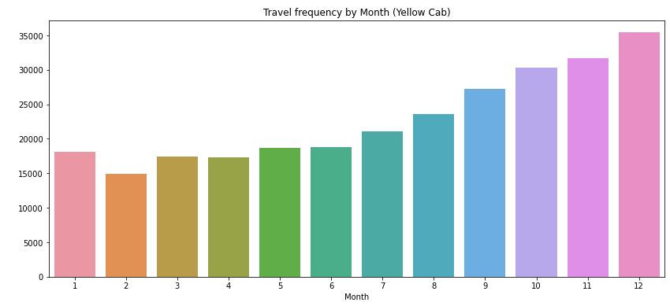
Travel Frequency per Month:
Yellow Cab has higher travels (35000) in the month of December which is the holiday season compared to Pink Cab (11000).

Slide 5
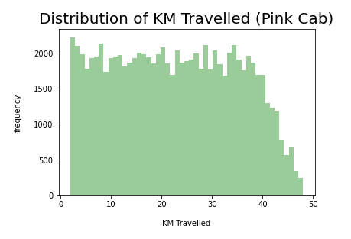
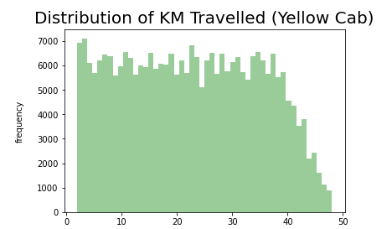
Distribution of KM Travelled for both Cabs:
From the above graphs, we can see that for both Pink and Yellow Cab most of the rides are in the range of approximately 2 to 48 KM.

Slide 6
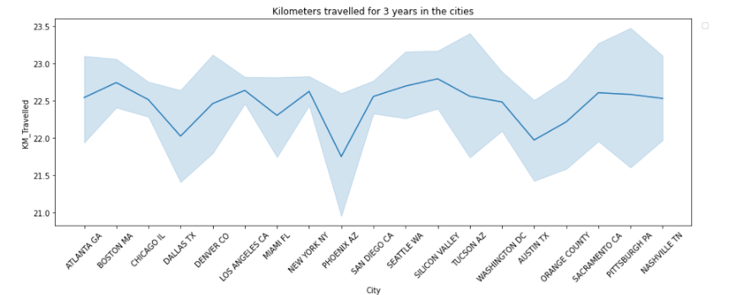
Kilometers travelled for 3 years in the cities with both the cabs

Slide 7
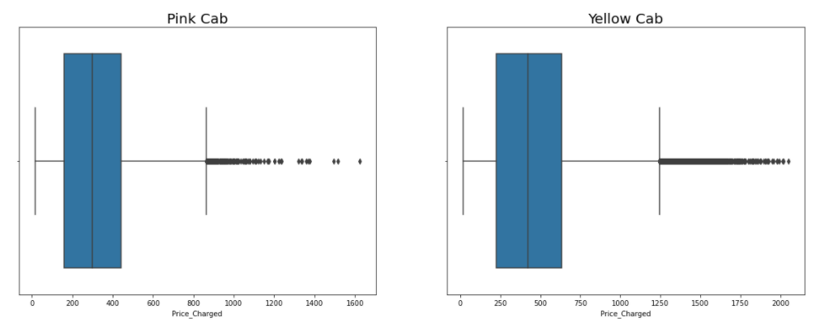
Distribution of Price Charged for both Cabs:
The Price Charge range for Yellow cab is more than the Pink cab.
The outliers are due to use of high-end cars.

Slide 8
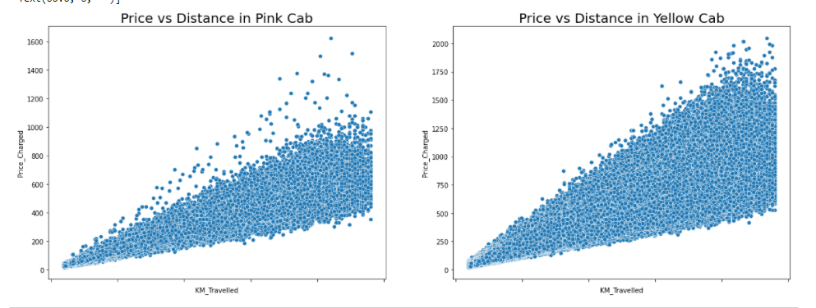
Pink Cab: Price Charged per KM per City
All the cities have the same increase in price charge with increase in distance

Slide 9
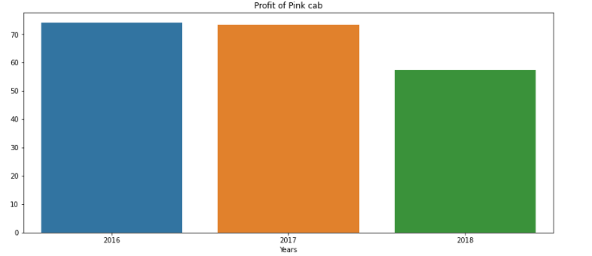
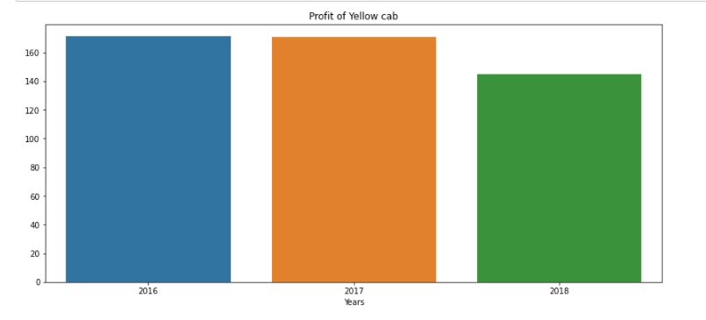
Profit of cabs compared with both companies wrt years

Slide 10
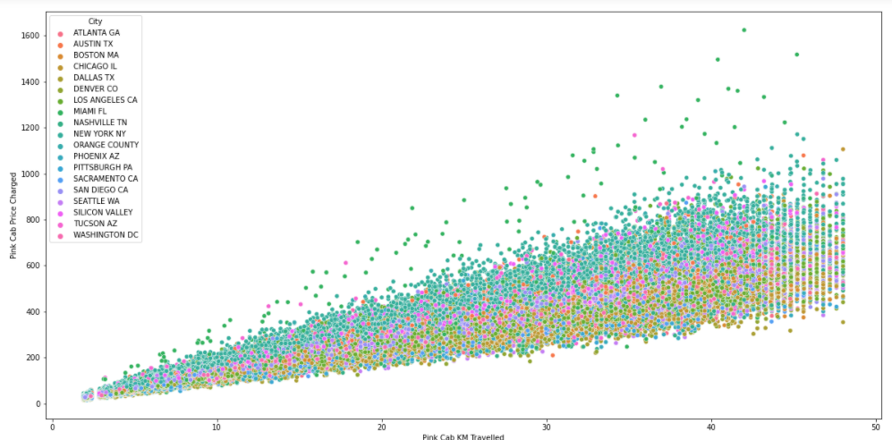
Pink Cab: Price Charged per KM per City
For Pink cab all the cities have the same increase in price charge with increase in distance

Slide 11
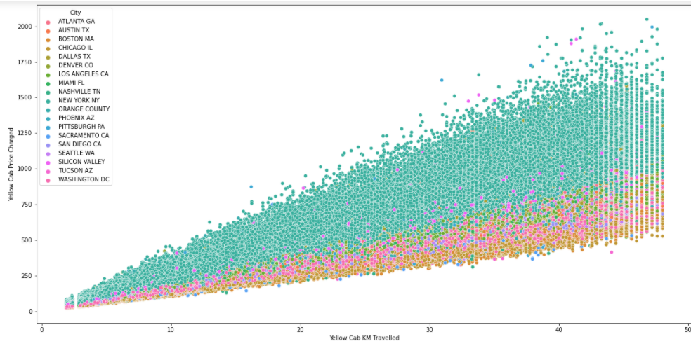
Yellow Cab: Price Charged per KM per City
In New York City the Price charged for Yellow Cab is more in comparison to the other cities

Slide 12
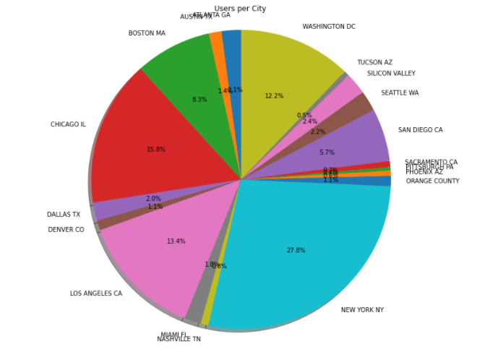
User per city
New York City has the highest Cab users with 28% followed by Chicago with 16% and Los Angeles with 13%

Slide 13
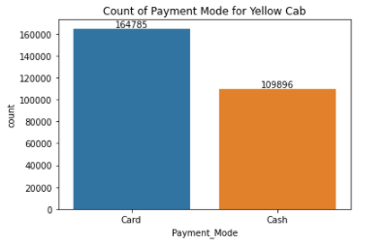
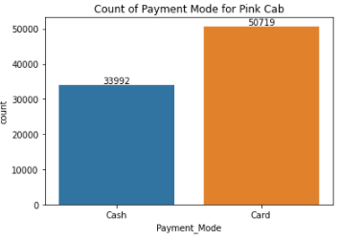
Count of payment mode for both the companies

Slide 14
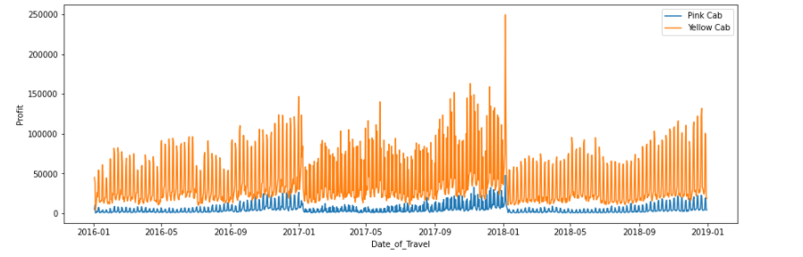
Profit wrt to date of travel of both companies
Yellow cab company have more profit

Slide 15
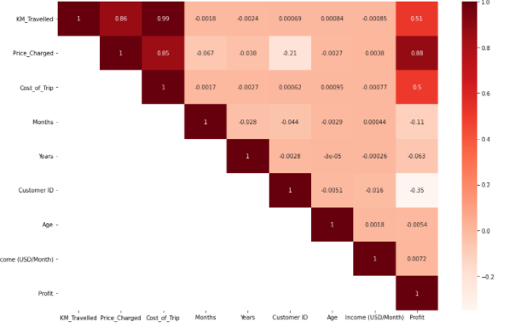
Yellow company correlation
Positive correlation between profit and KM Travelled

Slide 16
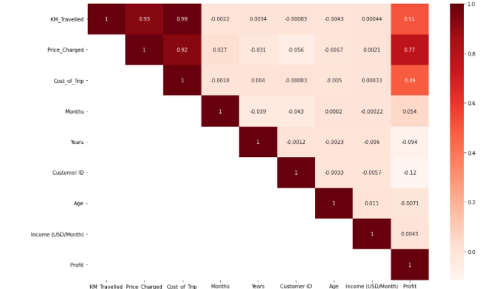
Pink company correation
Positive correlation between profit and KM Travelled

Slide 17
Recommendation
Margin per Gender: For Yellow Cab there is difference in Margin between Male and Female Customers due to which Female Customer percentage is higher in Yellow Cab in comparison to Pink Cab.
Profit Margin: For Yellow Cab the Profit Margin is higher per year from 2016 to 2018 in comparison to Pink Cab.
Transaction per year: For Yellow Cab Transaction per year from 2016 to 2018 is almost double than Pink Cab.
On the basis of the above points, Yellow Cab is recommended for investment

