Slide 1
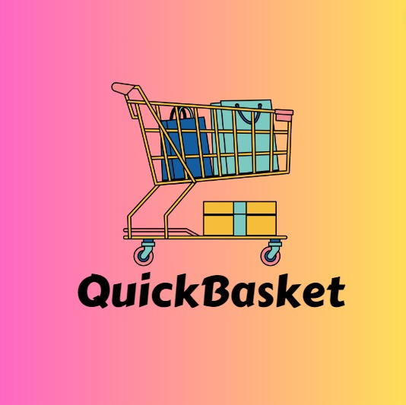
Fresh Choices, Fresh Living….

Slide 2

INTRODUCTION
QuickBasket is a fast and convenient online grocery store website. Users can shop for groceries from the comfort of their home, with only a few clicks on our user-friendly interface, they can explore and add products to their cart easily. QuickBasket offers an extensive range of products to
suit everyone's everyday needs, from pantry necessities to fresh food. QuickBasket is an extremely time-saving website that reduces the time spent driving to the grocery shop and standing in queue for billing.We prioritize user's security and convenience so we offer very secured payment options. For Modern problems, QuickBasket is a modern solution, built with an attractive user friendly interface and a highly secured back-end technology.

Slide 3
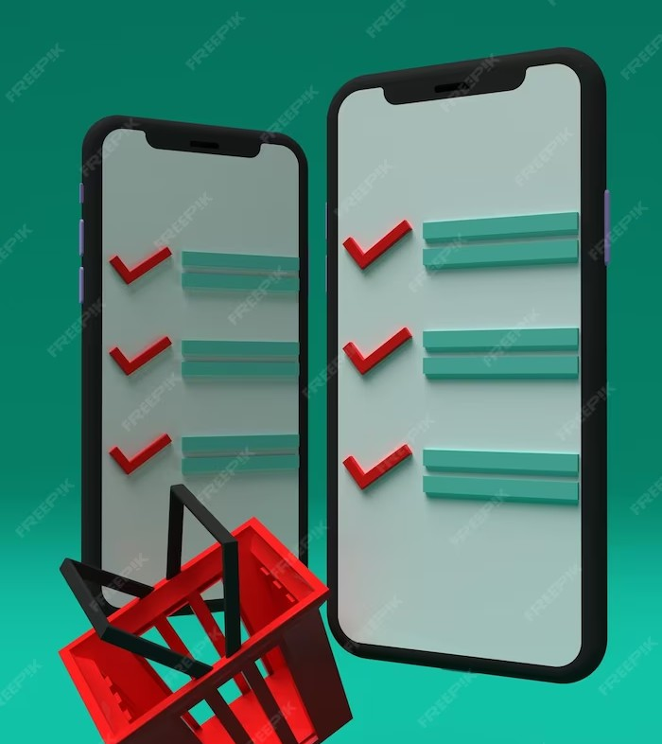
EASY TO USE
QuickBasket is designed with
in mind. Our intuitive interface allows you to
. No more searching through crowded aisles or getting lost in a maze of products. With QuickBasket,
grocery shopping has never been easier!

Slide 4

FAST DELIVERY
Say goodbye to long waits for grocery deliveries. QuickBasket offers
right to your doorstep. We understand the importance of
, so we prioritize speed and reliability. With QuickBasket, you'll never
have to worry about running out of essentials again.

Slide 5

WIDE SELECTION
QuickBasket offers a to
suit every need. From fresh produce to pantry staples, we've got you covered. Our partnerships with local suppliers ensure that you get the
items. With
QuickBasket, you can easily find all your favorite brands and discover new ones too!

Slide 6

PERSONALIZED RECOMMENDATIONS
QuickBasket goes beyond just being a grocery store. Our advanced algorithms analyze your shopping habits and preferences to provide. Discover new products that match your taste and receive tailored offers just for you. QuickBasket is your
personal shopping assistant!

Slide 7
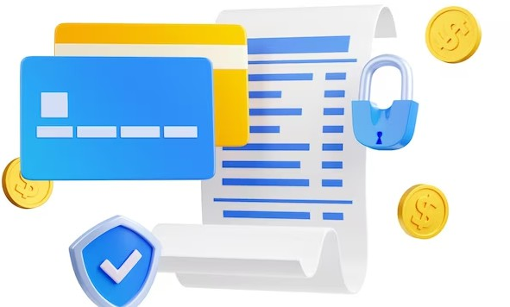
SECURE AND CONVENIENT PAYMENT
QuickBasket prioritizes your security and convenience. We offer a variety of
to ensure a hassle-free checkout experience. Whether you prefer credit
cards, digital wallets, or cash on delivery,
QuickBasket has got you covered. Shop with peace of mind knowing that your payment
information is always protected.

Slide 8

24/7 CUSTOMER SUPPORT
At QuickBasket, we value your satisfaction.
That's why we provide
to assist you with any queries or concerns. Our dedicated team is always ready to help, whether it's tracking your
order, resolving issues, or providing product
recommendations. With QuickBasket, you're never alone on your grocery shopping journey.

Slide 9
CONCLUSION
Thank you for joining us today to learn about QuickBasket, the fast and convenient grocery store website. With QuickBasket, you can enjoy the Say goodbye to long lines and heavy bags, and say hello to a stress-free shopping experience.
Start using QuickBasket today and discover a whole new way to shop for groceries!

Slide 10

Thanks!
Connect us on:
Quickbasket123@gmail.com
Ph No: 0123456789

