Slide 1
Designing for Down Syndrome
IDIA 640 | Byron Buckley

Slide 2
What is it?
Down syndrome (DS) is a disorder that manifests itself in disabilities that affect all three major types of capabilities:
  cognitive,
  motor, and
  perceptual

Slide 3
Target User
Down syndrome sufferers with moderate to mild mental retardation (IQ: 40-70 range).
Individuals able to effectively use the equipment as is with no modifications to the keyboard or mouse or other assistive technology or modifications
Individuals able to observe the various visual cues in applications and the OS.

Slide 4
Target Users
Persons able to undertake/understand abstract tasks (such as CAPTCHAs etc)
Individuals who had taken formal computer classes, at some point in their lives, anywhere from elementary school to post-secondary and continuing education.

Slide 5
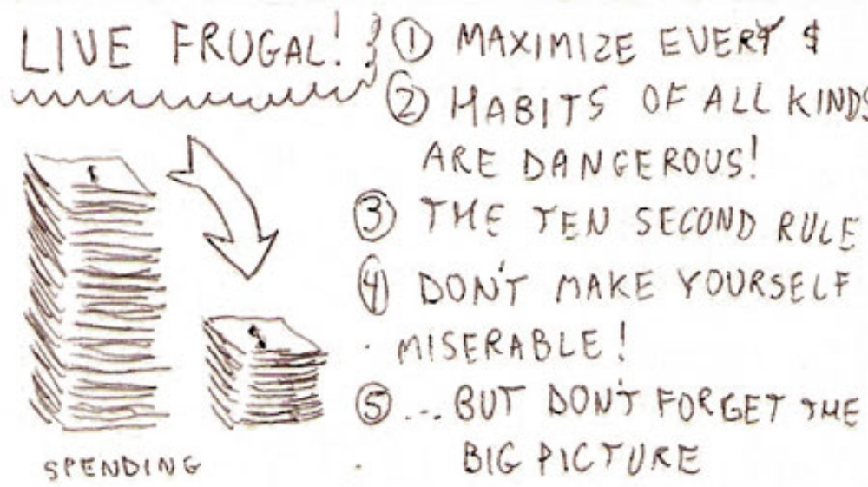
Budgeting

Slide 6
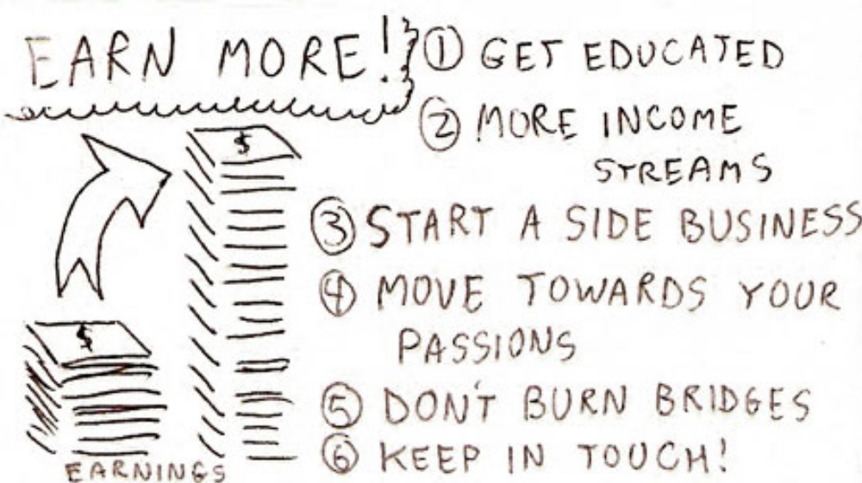
Budgeting

Slide 7
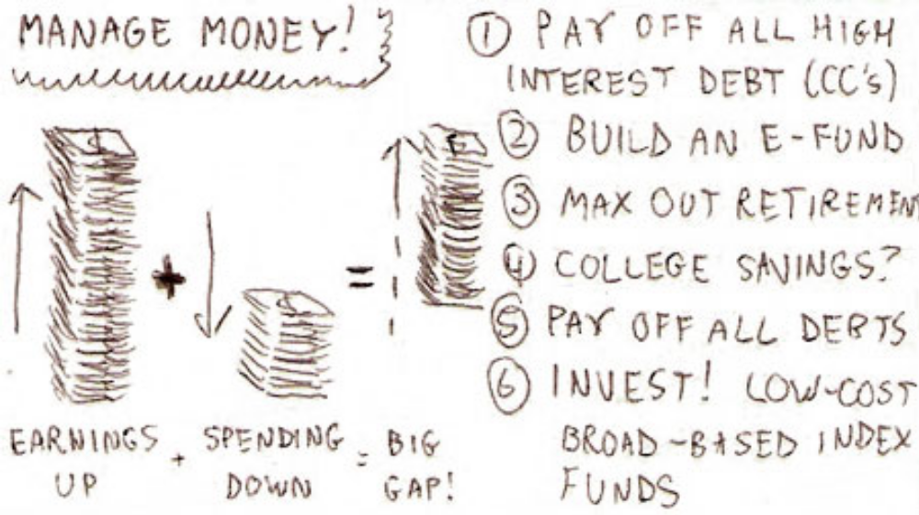
Budgeting

Slide 8
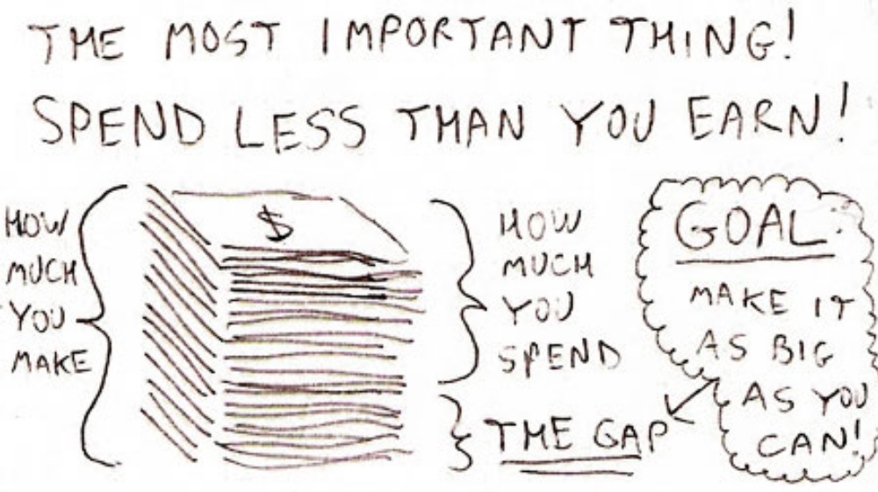
Budgeting

Slide 9

Personas
Backstory
Brian has multiple tasks at the supermarket. Over the past year he has put groceries in bags for customers, he also assists customers at the self-checkout line. He has Down syndrome, and has difficulty with abstract concepts, reading, and doing mathematical calculations.
Motivations
Mr. Clay usually buys his own groceries at the supermarket he works at since its familiar. His difficulty with abstract concepts causes Brian to prefer the familiar.
Frustrations
Brian finds it difficult to keep track of how much he is spending daily. He often conducts multiple transactions at the supermarket and spends money for transport and various activities.
Ideal Experience
Consistent navigation, plain language for interface copy and instructions. Accelerators to aid in selecting UI elements along with word prediction for form fields would also be effective. Word prediction would also bring up previously entered budget items.
Brian Clay, age 30
Single
Philadelphia, PA
Supermarket Attendant

Slide 10

Personas
Backstory
Michael is a data entry clerk at a manufacturing firm. He enters and maintains customer information in the company’s system. Sorting mail is also a part of his tasks.
Motivations
Michael is interested in living independently like his neurotypical peers. His parents have stated that he must demonstrate the ability to manage his income properly before they allow this. He has been using the computer since elementary school and is pretty comfortable using one. His parents think the computer is a good medium to aid him with income management.
Frustrations
While Michael has many skills in his favor as a person with Down Syndrome, his challenges with math, and by extension his budgeting issues is a sore point for him since he really wants to self actualize by living on his own.
Ideal Experience
Consistent navigation, plain language for interface copy and instructions. Accelerators to aid in selecting UI elements along with word prediction for form fields would also be effective.
Michael Lazar, age 25
Single
Rochester, NY
Data Entry Clerk

Slide 11
Application Demo
View Demo @ http://komplexb.github.io/easy-budget

Slide 12
Design Approach
Aid with Distinguishing and Understanding
  Easy-to-read text (Plain Language) for copy text
  Avoiding popups and unnecessary animations
  Progressive Disclosure
  Reduced Interface

Slide 13
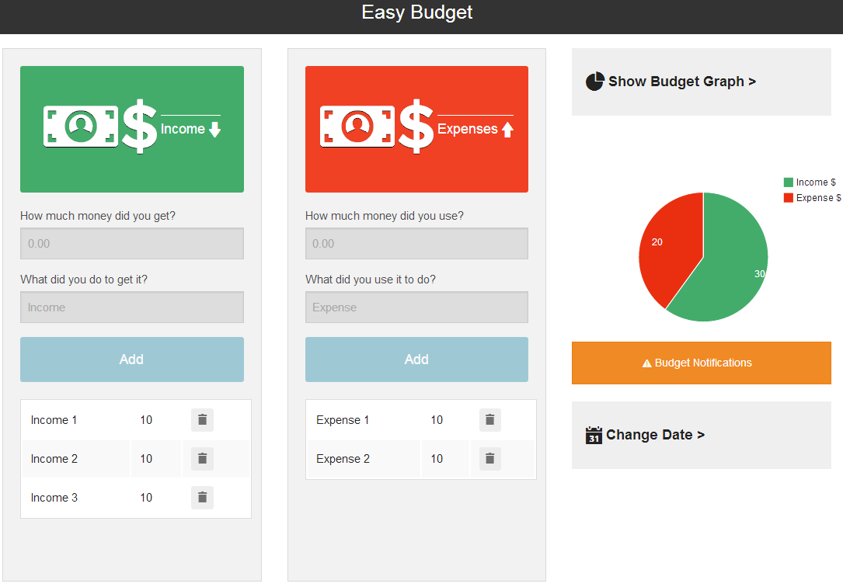
Design Approach
  Progressive Disclosure
  Reduced Interface

Slide 14
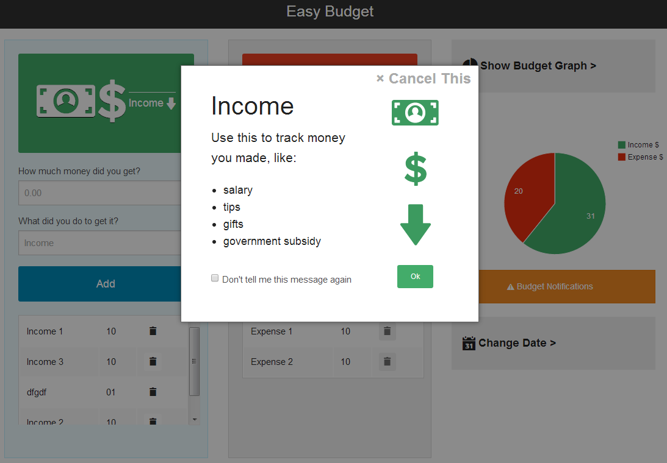
Design Approach
  Avoiding popups and unnecessary animations

Slide 15
Design Approach
Aiding with User Interaction
  Accelerators
  Spelling and Grammar Tools

Slide 16
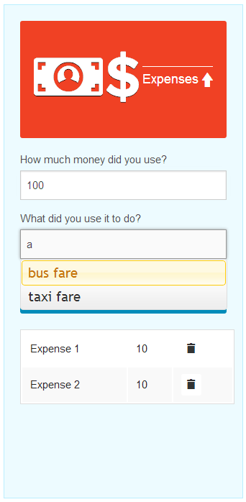
Design Approach
  Autocomplete as an accelerator.

Slide 17
Design Approach
Aid with navigation and finding content
  Consistency and predictability
  Helpful error and success messages
  Multiple navigation mechanisms

Slide 18
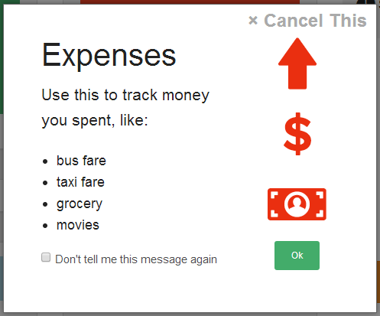
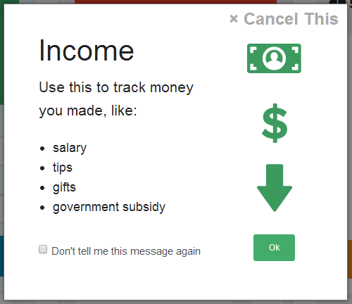
Design Approach
  Consistent colors and icon/images used

Slide 19
Design Approach
  Provide clear guidance, feedback and rewards.
  Don't underestimate the impact of images.
  Remember that everything means something.

Slide 20
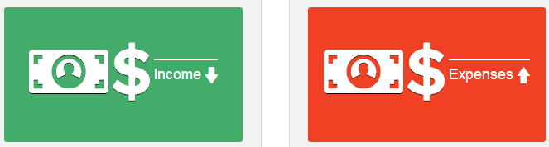
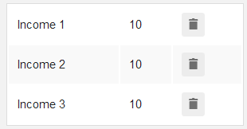
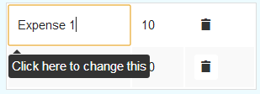
Design Approach
  Use of images via icons
  Tooltips provided for elements with low affordance

Slide 21
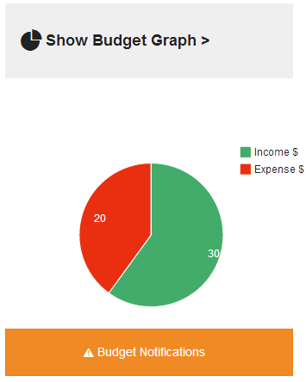
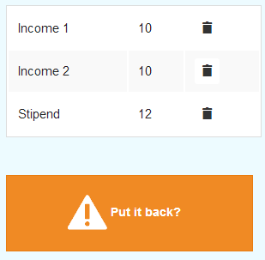
Design Approach
  Feedback

Slide 22
Sources
Kirijian, A., Myers, M., & Charland, S. (2001). Web Fun Central: Online learning tools for individuals with Down syndrome. Retrieved from Interaction Design: Beyond human-computer interaction: http://www.id-book.com/secondedition/downloads/casestudy_10point1.pdf
Kumin, L., Lazar, J., & Feng, J. H. (2012, 06). Expanding Job Options: Potential Computer-Related Employment for Adults with Down Syndrome. Retrieved from The ACM Digital Library: acm.org
"Mr. Sands, Supermarket assistant with Down syndrome." Stories of Web Users How People with Disabilities Use the Web. N.p., n.d. Web. 27 Nov. 2013. &lt;http://www.w3.org/WAI/intro/people-use-web/stories#supermarketassistant
Hamm, Trent. "Everything You Ever Really Needed to Know About Personal Finance On Just One Page" . N.p., n.d. Web. 28 Nov. 2013. &lt;http://www.thesimpledollar.com/onepage/&gt;.

Slide 23
Thanks!

