Slide 1
cs332 project : Distributed Sorting
20190263 신재욱
20220615 고민석
20220170 하동은

Slide 2
Review of weekly progress
 | Weekly Progress and Plan
Week1 | Define commit conventions, coding style, meeting schedule, and milestones
Week2 | Study the project scope, draft a simple design, and explore how to effectively use ChatGPT
Week3 | Develop a detailed design and gain a deeper understanding of gRPC
Week4 | Write gRPC example code, define message protocols, and generate input data
Week5 | Set up virtual machines, begin implementation, and conduct unit testing
Week6 | Continue implementation and prepare for a progress presentation (planned)
Week7 | Conduct comprehensive testing and focus on performance optimization (planned)
Week8 | Final testing and deliver the final presentation (planned)

Slide 3



Logisitic
We communicated with…
Kakao Talk Zoom Face-to-Face
We decided to do…
고민석
신재욱
하동은
Master & Worker
Overall Design
Configuration
gRPC unit test
Partition & Sort
Message Setup
Sampling & Merge

Slide 4
Configuration
Language
JDK | 11.0.0.2
SDK | 2.13.15
SBT | 1.8.3
Libraries
File I/O | java.io, scala.io, java.nio
Network | scalapb, io.grpc.grpc-netty
Concurrent Programming | CountDownLatch, AtomicInteger, synchronized
 | Future(scala.concurrent, scala.util.{Failure, Success})
Logging | com.typesafe.scalalogging.LazyLogging (SLF4j)
additional | Cats Effect, ZIO, Monix, Quasar, FS2, scala-parallel-collections

Slide 5
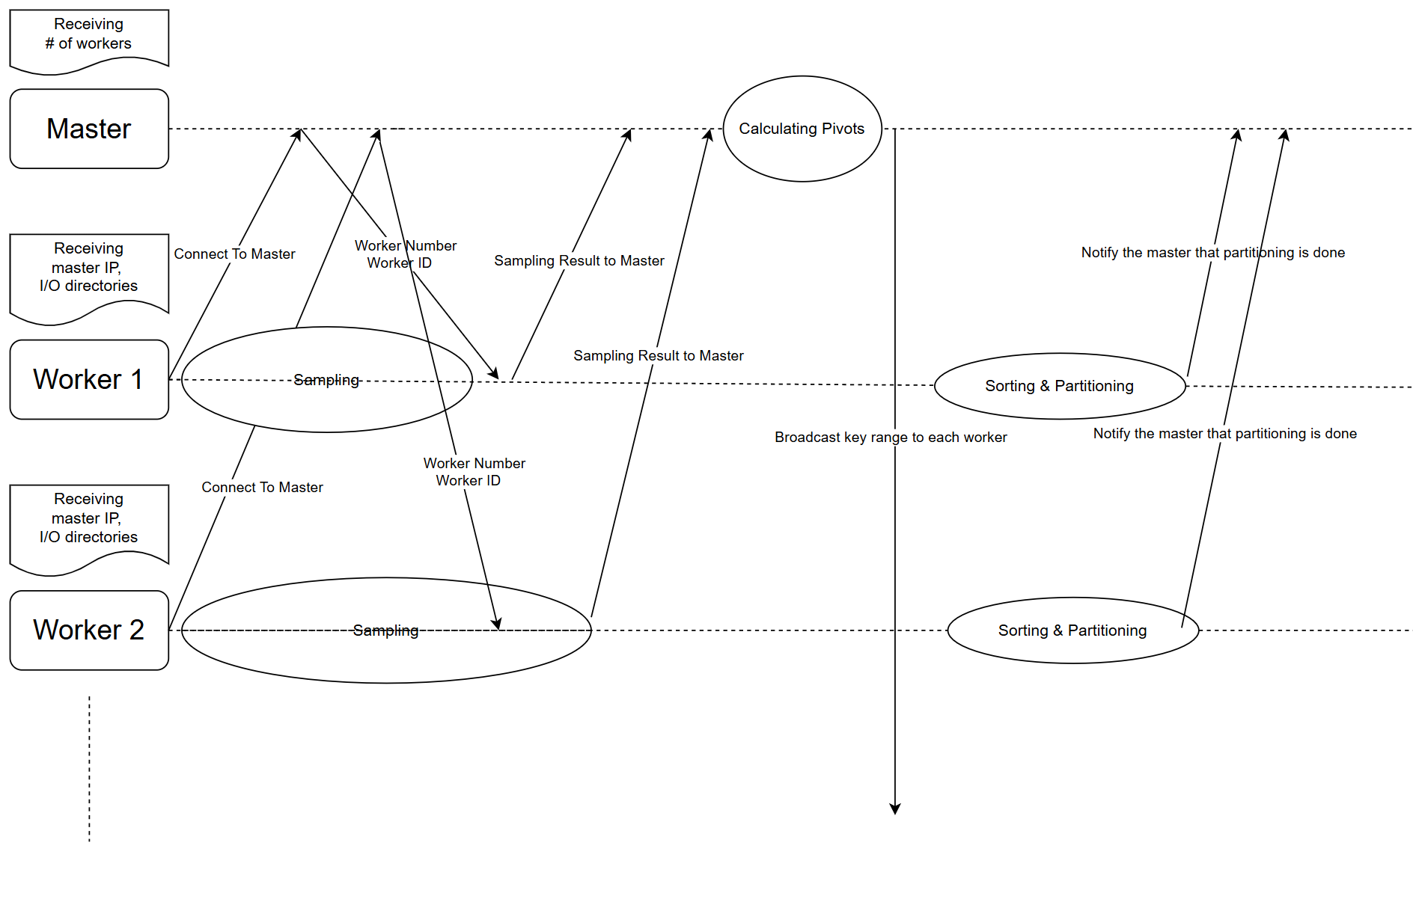
Flow chart

Slide 6
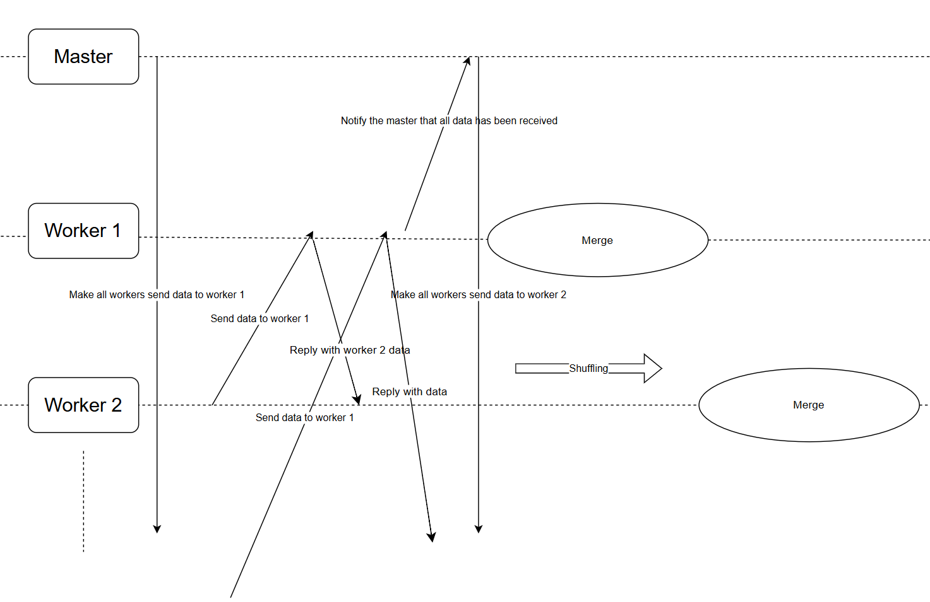
Flow chart

Slide 7
Message Setting
Message Name | Content (Worker → Master) | Content (Master → Worker)
registerWorker | worker IP address | worker ID number of worker
calculatePivots | worker ID, Sampled Data | map { worker ID -> worker IP } map { workerID -> key range }
partitionEndMsg | worker ID | -
startShuffling | receiver ID | -
mergeEndMsg | worker ID | -

Slide 8
Message Setting
Message Name | Content | Content
sendDataToWorker | data, source | data, source
shuffleAck | workerID | -

Slide 9
Registration
Worker1
Worker1
Worker2
Worker2
Master
.
.
.
RegisterWorkerRequest
RegisterWorkerReply
.
.
.
Worker10
Assign Worker ID
(registerWorker)
Worker10
get Worker IP
(IPUtils.scala)

Slide 10
Sampling & Pivot Calculation
Worker1
Worker1
Distribute the pivot points
evenly across the workers
Worker2
Worker2
Master
.
.
.
CalculatePivotRequest
CalculatePivotReply
.
.
.
Worker10
Calculates the pivot
(calculatePivots)
Worker10
Sends sample data
Send the partitioning range & IP List

Slide 11

Sorting & Partitioning (SortAndPartition.scala)
Input Files
Data Chunk
(100MB)
.
.
.
Sorted Data Chunk (100MB)
get data via streaming
Sort and save data blocks
.
.
.
.
.
.
Sorted Data Chunk (100MB)
A
B
C
D
E
F
PhaseCompleteNotification
Partition data based on sampling range (File Partitioning)
Notify master that partitioning is done
(Worker.scala)

Slide 12
Shuffling & Merging
(1) Send the partition : range [A]
A1
A2
Worker2
Worker1
A2
B2
A2
.
.
.
.
.
.
B1
C2
A3
C1
B3
Worker3
.
.
.
(2) Send the partition : range [B]
C3
[After shuffling for Worker1]
A1
(Merged)
Worker1
B3
Worker3
Start shuffling for Worker2
C3
B2
.
.
.
C1
Worker2
B1
.
.
.
B1
C2

Slide 13
Milestone, implementation
Milestone#0 | Define Commit Convention and Coding Style | O
Milestone#1 | Generate Input Data Using Gensort | O
Milestone #2 | Familiarize with gRPC by Writing Example Code | O
Milestone #3 | Define gRPC Messages and Fields | O
Milestone #4 | Select Libraries | O
Milestone #5 | Implement Master and Worker(communication, command execution) | O
Milestone #6 | Implement Phase 1 - Sampling | X
Milestone #7 | Implement Phase 2 - Sorting and Partitioning | O
Milestone #8 | Implement Phase 3 - Shuffling | X
Milestone #9 | Implement Phase 4 - Merging | O
Milestone #9 | Implement Testing and Validation | X

Slide 14
Unit Test
gRPC : Hello World | Sending Hello World message between server and client in local environment
gRPC : File transfer | Transferring txt files between server and client in local environment
IO : get File | Receive files via streaming and save them.
IO : sort & partition | Divide files into partitions and store them according to their range.

Slide 15
Q&A

