Slide 1
Write detail explanation for the following Advanced Database System
A. Data Warehousing
B. Online transaction processing (OLTP)
C. Data mining techniques

Slide 2
A. Data Warehousing
Data warehouses serve as a central repository for storing and analysing information to make better informed decisions.
An organization's data warehouse receives data from a variety of sources, typically on a regular basis, including transactional systems, relational databases, and other sources.
A data warehouse is a centralized storage system that allows for the storing, analysing, and interpreting of data in order to facilitate better decision-making.
Data warehouses are primarily designed to facilitate searches and analyses and usually contain large amounts of historical data.

Slide 3
Key Characteristics of Data Warehouse
Subject-Oriented
A data warehouse is subject-oriented since it provides topic-wise information rather than the overall processes of a business.
Integrated
A data warehouse is developed by integrating data from varied sources into a consistent format.
The data must be stored in the warehouse in a consistent and universally acceptable manner in terms of naming, format, and coding.

Slide 4
Non-Volatile
Data once entered into a data warehouse must remain unchanged. All data is read-only. Previous data is not erased when current data is entered.
Time-Variant
The data stored in a data warehouse is documented with an element of time, either explicitly or implicitly.

Slide 5
Operational Database vs. Data Warehouse
Operational Database
Operational systems are designed to support high-volume transaction processing.
Operational systems are usually concerned with current data.
Data within operational systems are mainly updated regularly according to need.
They support thousands of concurrent clients.
Operational systems are widely process-oriented.
Data In
Less Number of data accessed.

Slide 6
Data Warehouse
Data warehousing systems are typically designed to support high-volume analytical processing (i.e., OLAP).
Data warehousing systems are usually concerned with historical data.
Non-volatile, new data may be added regularly. Once Added rarely changed.
Loaded with consistent, valid information, requires no real-time validation.
It supports a few concurrent clients relative to OLTP.
Data warehousing systems are widely subject-oriented
Data Out
Large Number of data accessed.

Slide 7
B. Online transaction processing (OLTP)
OLTP System handle with operational data.
Operational data are those data contained in the operation of a particular system.
Example, ATM transactions and Bank transactions, etc.
OLTP is basically focused on query processing, maintaining data integrity in multi-access environments as well as effectiveness that is measured by the total number of transactions per second.
It administers the day-to-day transaction of an organization.
Typically, a web, mobile, or enterprise application tracks all those interactions or transactions with customers, suppliers, or partners and updates them in the OLTP database.

Slide 8
Feature | OLTP
Characteristic | It is a system which is used to manage operational Data.
Users | Clerks, clients, and information technology professionals.
Data contents | OLTP system manages current data that too detailed and are used for decision making.
Database Size | 100 MB-GB
Database design | OLTP system usually uses an entity-relationship (ER) data model and application-oriented database design.
Volume of data | Not very large
Access patterns | The access patterns of an OLTP system subsist mainly of short, atomic transactions. Such a system requires concurrency control and recovery techniques.
Access mode | Read/write
Insert and Updates | Short and fast inserts and updates proposed by end-users.
Normalization | Fully Normalized
Processing Speed | Very Fast

Slide 9
Characteristics of OLTP
OLTP uses transactions that include small amounts of data and It supports complex data models and tables.
Indexed data in the database can be accessed easily.
OLTP has a large number of users and It has fast response times.
Databases are directly accessible to end-users and The response time of OLTP system is short.
OLTP uses a fully normalized schema for database consistency.
It strictly performs only the predefined operations on a small number of records and OLTP stores the records of the last few days or a week.

Slide 10
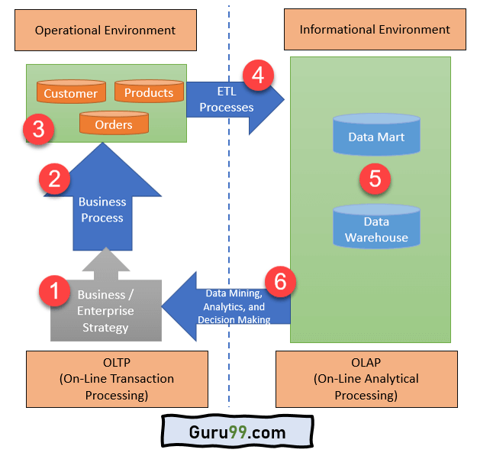
Architecture of OLTP
Here is the architecture of OLTP:
OLTP Architecture

Slide 11
OLTP Architecture
Business / Enterprise Strategy: Enterprise strategy deals with the issues that affect the organization as a whole. In OLTP, it is typically developed at a high level within the firm, by the board of directors or the top management
Business Process: OLTP business process is a set of activities and tasks that, once completed, will accomplish an organizational goal.
Customers, Orders, and Products: OLTP database store information about products, orders (transactions), customers (buyers), suppliers (sellers), and employees.
ETL Processes: It separates the data from various RDBMS source systems, then transforms the data (like applying concatenations, calculations, etc.) and loads the processed data into the Data Warehouse system.
Data Mart and Data warehouse: A Data Mart is a structure/access pattern specific to data warehouse environments. It is used by OLAP to store processed data.
Data Mining, Analytics, and Decision Making: Data stored in the data mart and data warehouse can be used for data mining, analytics, and decision making. This data helps you to discover data patterns, analyse raw data, and make analytical decisions for your organization’s growth.

Slide 12
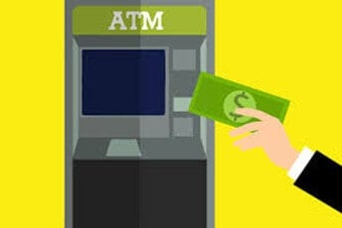
Example of OLTP Transaction
An example of the OLTP system is the ATM center. Assume that a couple has a joint account with a bank. One day both simultaneously reach different ATM centre’s at precisely the same time and want to withdraw the total amount present in their bank account.
OLTP for ATM image

Slide 13
However, the person that completes the authentication process first will be able to get money. In this case, the OLTP system makes sure that the withdrawn amount will be never more than the amount present in the bank. The key to note here is that OLTP systems are optimized for transactional superiority instead of data analysis.
Other examples of OLTP system are:
Online banking nnn | Online airline ticket booking
Sending a text message | Order entry

Slide 14
OLTP vs. OLAP(Online Analytical Processing)
Here is the important difference between OLTP and OLAP:
OLTP | OLAP
OLTP is an online transactional system. | OLAP is an online analysis and data retrieving process.
It is characterized by large numbers of short online transactions. | It is characterized by a large volume of data.
OLTP is an online database modifying system. | OLAP is an online database query management system.
OLTP uses traditional DBMS. | OLAP uses the data warehouse.
Insert, Update, and Delete information from the database. | Mostly select operations
OLTP and its transactions are the sources of data. | Different OLTP databases become the source of data for OLAP.
OLTP database must maintain data integrity constraints. | OLAP database does not get frequently modified. Hence, data integrity is not an issue.
It’s response time is in a millisecond. | Response time in seconds to minutes.
The data in the OLTP database is always detailed and organized. | The data in the OLAP process might not be organized.
Allow read/write operations. | Only read and rarely write.
It is a market-orientated process. | It is a customer orientated process.
Queries in this process are standardized and simple. | Complex queries involving aggregations.
Complete backup of the data combined with incremental backups. | OLAP only need a backup from time to time. Backup is not important compared to OLTP

Slide 15
Advantages of OLTP
OLTP offers accurate forecast for revenue and expense.
OLTP makes transactions much easier on behalf of the customers.
OLTP provides support for bigger databases.
Partition of data for data manipulation is easy.
Partition of data for data manipulation is easy.
We need OLTP to use the tasks which are frequently performed by the system.
When we need only a small number of records.
The tasks that include insertion, updation, or deletion of data.

Slide 16
Disadvantages of OLTP
If the OLTP system faces hardware failures, then online transactions get severely affected.
OLTP systems allow multiple users to access and change the same data at the same time, which many times created an unprecedented situation.
If the server hangs for seconds, it can affect to a large number of transactions.
OLTP required a lot of staff working in groups in order to maintain inventory.
Online Transaction Processing Systems do not have proper methods of transferring products to buyers by themselves.
OLTP makes the database much more susceptible to hackers and intruders.
Server failure may lead to wiping out large amounts of data from the database.
You can perform a limited number of queries and updates.

Slide 17
Challenges of an OLTP System
It allows more than one user to access and change the same data simultaneously.
Therefore, it requires concurrency control and recovery technique in order to avoid any unprecedented situations
OLTP system data are not suitable for decision making. You have to use data of OLAP systems for “what if” analysis or the decision making.

Slide 18
C. Data mining techniques
Data Mining
Data mining is the process of searching and analyzing a large batch of raw data in order to identify patterns and extract useful information.
Companies use data mining software to learn more about their customers. It can help them to develop more effective marketing strategies, increase sales, and decrease costs. Data mining relies on effective data collection, warehousing, and computer processing.
Data mining is the process of analyzing a large batch of information to discern trends and patterns.
Data mining can be used by corporations for everything from learning about what customers are interested in or want to buy to fraud detection and spam filtering.
Data mining programs break down patterns and connections in data based on what information users request or provide.
Social media companies use data mining techniques to commodify their users in order to generate profit.
This use of data mining has come under criticism as users are often unaware of the data mining happening with their personal information, especially when it is used to influence preferences.

Slide 19
Data Mining Techniques
Data mining uses algorithms and various other techniques to convert large collections of data into useful output. The most popular types of data mining techniques include:- association rules, classification, clustering, decision trees, K-Nearest Neighbor, neural networks, and predictive analysis.
Association rules, also referred to as market basket analysis, search for relationships between variables.
Classification uses predefined classes to assign to objects. These classes describe the characteristics of items or represent what the data points have in common with each other.
Clustering is similar to classification. However, clustering identifies similarities between objects, then groups those items based on what makes them different from other items.
Decision trees are used to classify or predict an outcome based on a set list of criteria or decisions.
K-Nearest Neighbour (KNN) is an algorithm that classifies data based on its proximity to other data.
Neural networks process data through the use of nodes. These nodes are comprised of inputs, weights, and an output.
Predictive analysis strives to leverage historical information to build graphical or mathematical models to forecast future outcomes.

Slide 20
The Data Mining Process
To be most effective, data analysts generally follow a certain flow of tasks along the data mining process
The data mining process is usually broken into the following steps.
Step 1: Understand the Business
Before any data is touched, extracted, cleaned, or analysed, it is important to understand the underlying entity and the project at hand
Step 2: Understand the Data: Once the business problem has been clearly defined, it's time to start thinking about data
Step 3: Prepare the Data
Data is gathered, uploaded, extracted, or calculated. It is then cleaned, standardized, scrubbed for outliers, assessed for mistakes, and checked for reasonableness.
Step 4: Build the Model: With a clean data set in hand, it's time to crunch the numbers.
Step 5: Evaluate the Results
The data-centered aspect of data mining concludes by assessing the findings of the data model or models.
Step 6: Implement Change and Monitor
The data mining process concludes with management taking steps in response to the findings of the analysis.

Slide 21
Applications of Data Mining
In today's age of information, almost any department, industry, sector, or company can make use of data mining.
Sales
Marketing
Manufacturing
Fraud Detection
Human Resources
Customer Service

Slide 22
Advantages and Disadvantages of Data Mining
Pros of Data Mining
It drives profitability and efficiency
It can be applied to any type of data and business problem
It can reveal hidden information and trends
Cons of Data Mining
It is complex
Results and benefits are not guaranteed
It can be expensive

