Slide 1

Photoshop for Writing
d/acc for how we write, speak and think
LIVE ON IOS AND WEB · OPEN SOURCE · BUILT ON BASE
Notes:
My name is Konrad, this is Argo, and the title of this talk is the same one I am taking to Devcon in Mumbai. Photoshop for writing.

Slide 2

Your ability to think, speak, and write is about to decide everything.
Notes:
For most of history you could get by on what you knew. That era is closing. When everyone has the same models and the same answers on tap, the only differences left are the quality of your ideas and your ability to express them. That is not a soft skill any more, that is the whole game, and almost nobody is training for it.

Slide 3
Your success in life will be determined largely by your ability to speak, your ability to write, and the quality of your ideas. In that order.
▶
Winston clip, 15 seconds
assets/winston-how-to-speak-first60.mp4
trimmed 0:38 to 0:53
Patrick Winston, MIT
Patrick H. Winston, “How to Speak”, MIT OpenCourseWare. CC BY-NC-SA.
Notes:
Play the fifteen second clip, then: Winston ran the MIT Artificial Intelligence Laboratory. He spent his life on machine intelligence and this is what he told his students mattered most. Speak, write, ideas, in that order. In the age of AI he is more right, because those three are the only things that do not come out of the box. STILL MISSING: Winston clip trimmed to 0:38-0:53 and level matched.

Slide 4
D/ACC, ONE YEAR LATER
Rung two is tighter and tighter feedback between AI and humans.
TODAY
TOMORROW
OVER TIME
AI as tools, not highly autonomous agents
Tighter and tighter feedback between AI and humans
A tightly coupled combination of machines and us
The mechanisms he named for rung two: virtual reality, myoelectrics, brain computer interfaces. All hardware. All years out.
Notes:
This is the middle rung of d/acc. The variable being optimised is not model capability, it is loop tightness. Same model, different number of turns. One shot prompt and generate is the replacement pattern. Real time collaboration is the augmentation pattern. Look at the mechanisms he named. All hardware, all years out, all measured in milliseconds of latency.

Slide 5
THE UNCLAIMED HALF
He made the Photoshop argument about images. Nobody carried it to language.
IMAGES
LANGUAGE
Artist and AI trade drafts in real time. The artefact is the point.
The artefact is a by product. The compression of thought is the cognition.
Claimed. Shipping.
Open. This is where Argo is built.
Delegate the drawing and you lose a picture you did not make. Delegate the writing and you skip the step that was doing the thinking.
Notes:
He made the Photoshop argument about images and never carried it to language. That is the gap I am building in. A daily writing loop is a feedback loop between a human and an AI that exists now, needs no implant, and runs on the interfaces everybody already has, text and voice. And language is the harder case, because with an image the artefact is the point, while with writing the artefact is a by product. The compression of thought is the cognition. Delegate the drawing and you lose a picture you did not make. Delegate the writing and you skip the step that was doing the thinking.

Slide 6
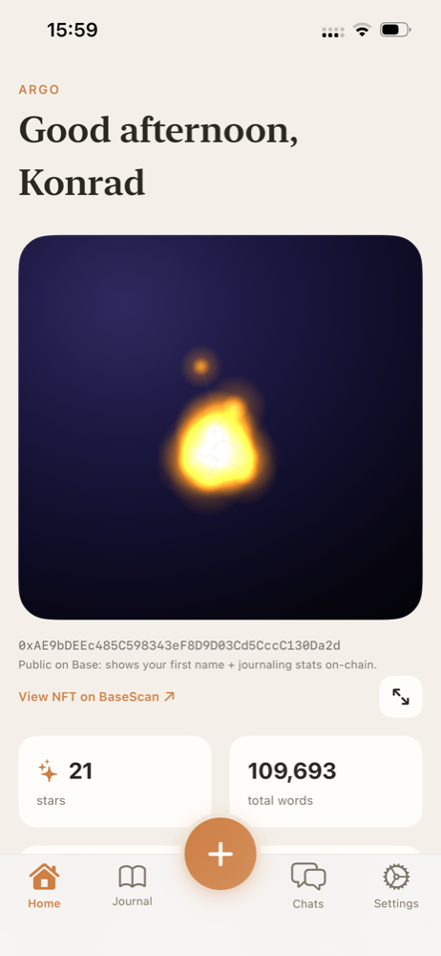
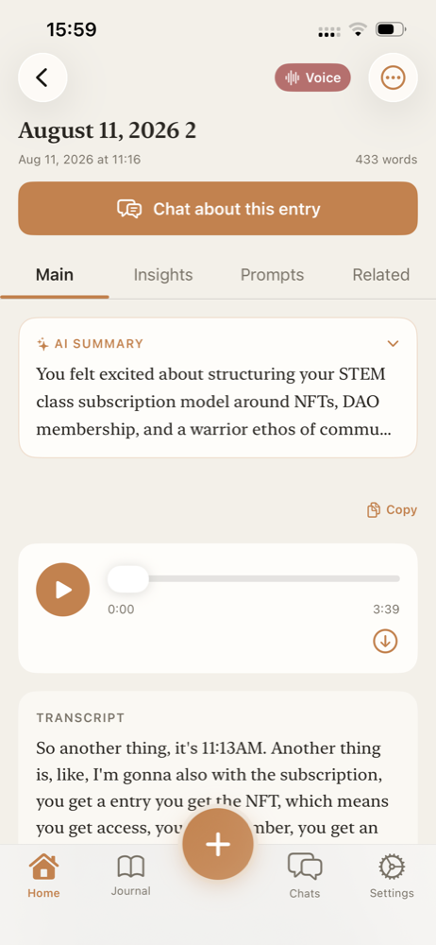
THE PRODUCT
A private journaling AI that never writes for you.
Write it or say it. A companion that has read every entry you have ever made reads it back: a summary, the insights, the questions to ask yourself, and the entry from eight months ago you forgot you wrote.
They all kept a notebook. None of them had one that remembered.
Notes:
You write or you just talk, and an AI companion that has read every entry you have ever made reads it back to you. A summary, the insights, the questions you should be asking yourself, and the connection to the thing you wrote eight months ago and forgot. They all kept a notebook. None of them had one that remembered.

Slide 7
▶
Launch film, 30 seconds, full bleed, sound up
Placeholder. The ten thirty-second spots are scripted and storyboarded in final-demo-day/launch-ad/, but no cut film exists yet.
Notes:
Say nothing during the film. After it, one line: that launched on August 7th. STILL MISSING: The 30 second launch film. Scripted in launch-ad/, not yet shot or cut.

Slide 8
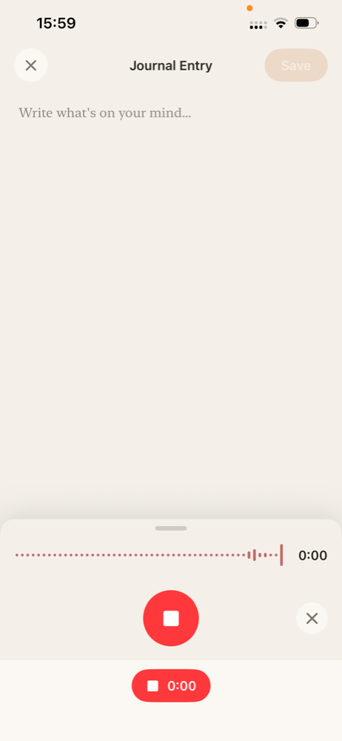
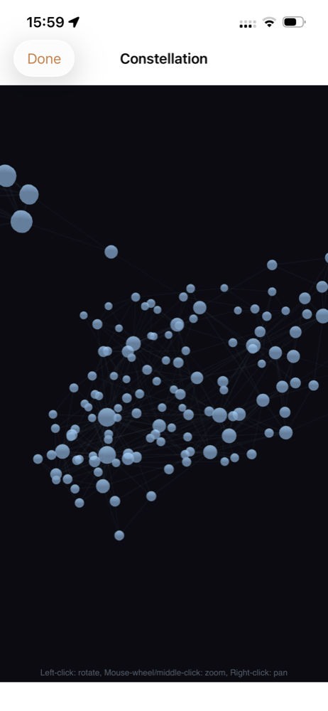
LIVE ON THE DEVICE
Three moves. No menus.
ONE
TWO
THREE
Talk. It captures and transcribes.
It reads you back, and surfaces what you forgot.
The day becomes a star in your Soul.
Notes:
Three moves only, narrated while doing them. One, I talk, no blank page and no typing, and the word count climbs to seven hundred and fifty. Two, it comes back with what I actually said, tightened, plus the questions I should be asking myself, and it surfaces an entry from months ago on the same theme that I had genuinely forgotten writing. Three, every completed day adds a star, placed by the meaning of my words. That is my Soul. STILL MISSING: Live device mirror. These stills are the fallback if the phone fails.

Slide 9
PRIVACY IS ARCHITECTURE, NOT POLICY
Nobody can read it. Not even us.
Zero knowledge
Open source
Confidential inference
Encrypted on your device with a key that only exists there. Our servers hold ciphertext.
You do not have to take my word for any of it. You can read it.
The journal AI runs on Morpheus, inside a trusted execution environment.
Stated plainly on stage: voice latency currently routes through a separate provider. Moving it back is on the roadmap. Do not extend the confidential inference claim to voice.
Notes:
You are about to put the most honest thing you have ever written into an app, so the privacy cannot be a policy, it has to be architecture. Encrypted on your device with a key that only exists on your device. Our servers hold ciphertext. The whole thing is open source so you can read it rather than trust me. The journal AI runs confidential inference on Morpheus. Voice latency currently routes through a separate provider and moving it back is on the roadmap, and I would rather say that here than be asked it later.

Slide 10
A CREDENTIAL YOU OWN. ON BASE.
The Soul is the ledger of the loop.
One star per completed day, placed by the meaning of your words. Soulbound on Base mainnet: it cannot be bought, sold, or transferred. Not a bolt on identity feature, the receipt for having run the loop for a year.
Bots can fake a profile. They cannot fake a year of your thinking.
Notes:
Every day you complete the human side of the loop, one star records it. It is soulbound on Base mainnet, so it cannot be bought, sold, or transferred. That makes it the thing the internet is short of right now, proof of a human who actually showed up over time. It is not a bolt on identity feature. It is the receipt for having run the d/acc loop for a year. Bots can fake a profile. They cannot fake a year of your thinking.

Slide 11
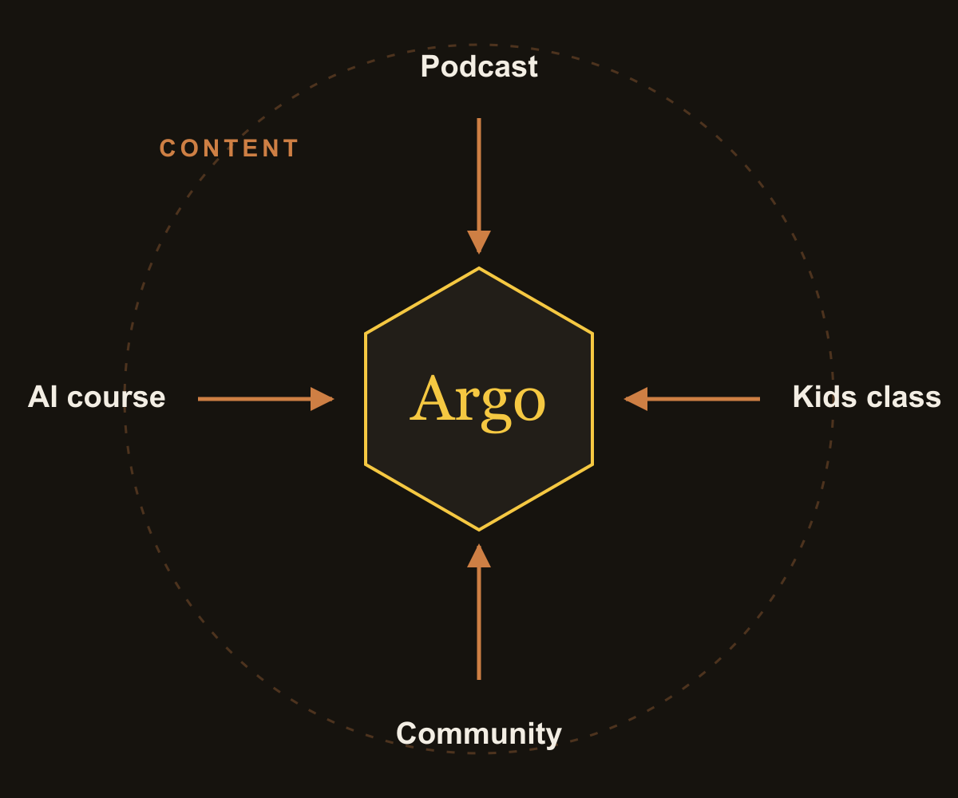
GO TO MARKET
I am not buying users. I built a machine that feeds the app.
You do not get momentum from one big push. You get it from pushing the same wheel in the same direction until it turns itself. Every part of my life is a spoke on it.
Jim Collins, Good to Great
Notes:
Here is the part I actually want to be judged on. Jim Collins wrote about the flywheel in Good to Great. You do not get momentum from one big push, you get it from pushing the same wheel in the same direction until it turns itself. I am not buying users. I built a flywheel and every part of my life is a spoke on it.

Slide 12
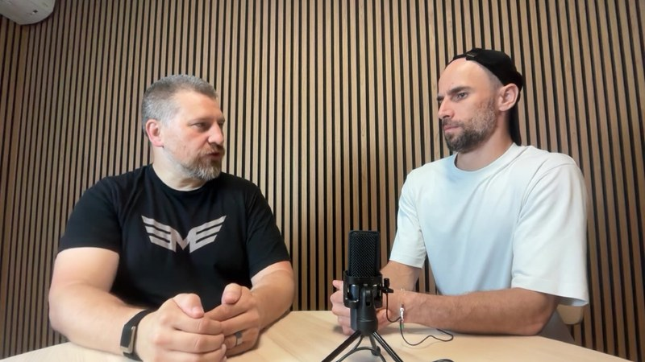

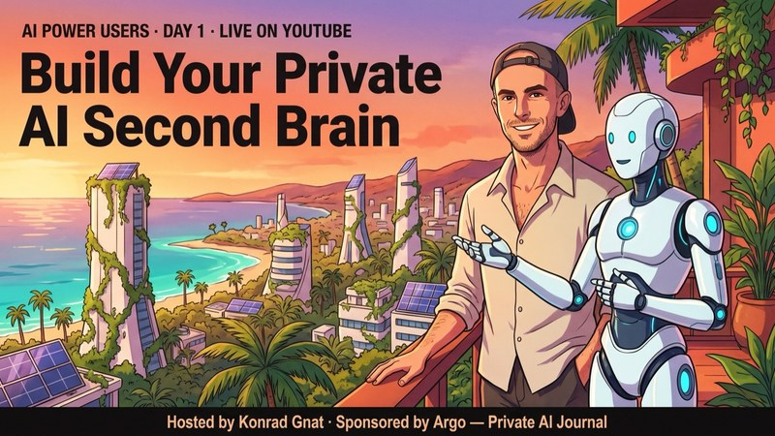
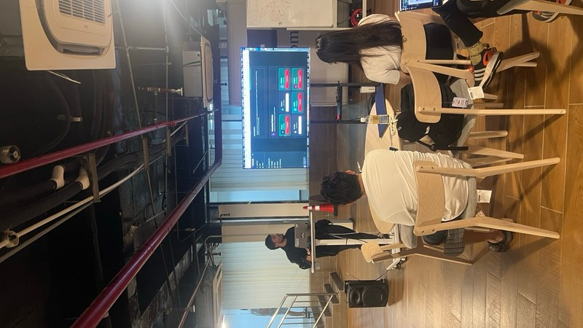
THE FOUR SPOKES
Every one of them ends with the app.
The podcast
The kids class
The AI course
The community
Creativity, technology, spirituality. Every episode describes the app and asks the guest what they think.
Holistic creativity and STEM. Draw, journal, teach each other a concept. Every family gets a subscription.
Free online fills the funnel, paid in person. Singapore, and now Cambodia.
A subscription is not an app, it is a membership. And all of it becomes content.
Notes:
One, the podcast, on creativity, technology, and spirituality, and in every single episode I describe the app and ask the guest what they think of it. Two, a holistic creativity and STEM class for kids where we draw, journal, and teach each other a concept, and every family in the class gets a subscription. Three, an AI power users course for adults, free online to fill the funnel and paid in person, run in Singapore and now Cambodia, where people who just spent two hours learning to work with AI are exactly the people who understand why a private one matters. Four, the community, because a subscription is not an app, it is a membership. And all four turn into content, which feeds all four again.

Slide 13
IS IT TURNING
The numbers, and none of them bought.
—
—
—
—
—
Views across channels
App downloads since 7 Aug
Views on the launch ad
Community events hosted
Paying subscribers
platform dashboards
App Store Connect
per platform
3 at MyBW, confirm full count
confirm current figure
Placeholders on purpose. Say only what you can defend in Q and A.
Notes:
So is it turning. Read the five numbers off the slide, one sentence each, and say only what you can defend in question time. Every one of these came from the wheel and not from ad spend. STILL MISSING: Every figure on this slide. Pull from the platform dashboards and App Store Connect.

Slide 14
ON THE RECORD
Every episode is a channel and a testimonial at once.
“Training for keeping your mind sharp.”
“Private AI you can actually trust is the thing I have been waiting for.”
“My kid loves it.”
Quote to collect
Parent, kids class
AI course student
Reported repeatedly. Get one on the record in writing.
Not yet collected. Ask at the end of the next in person class.
Podcast guest
Paraphrase. Pull the verbatim line from the recording.
Podcast guest
Paraphrase. Confirm name, title, and permission.
Notes:
These are on the record. One guest called it training for keeping your mind sharp. Another said private AI you can actually trust is the thing they had been waiting for. The parents keep telling me the same thing, which is that their kids love it. Every episode is a distribution channel and a testimonial at the same time. STILL MISSING: Verbatim quotes, guest names and exact titles, and permission to show them.

Slide 15
WHY IT IS BUILT THIS WAY
By involving human feedback at each step of decision-making, we reduce the incentive to offload high-level planning responsibility to the AI itself.
Vitalik Buterin, My Techno-Optimism
An AI that never writes for you keeps the human in every loop by construction, so the incentive never forms. This is the loop, shipping today.
Notes:
Vitalik argues the augmentation path is not just the nicer option, it is the safer one, and the mechanism is economic rather than technical. Keeping a human in every loop removes the incentive to hand over the planning. An AI that never writes for you keeps you in every loop by construction, so that incentive never forms. That is the whole argument, and it is why the app is built the way it is.

Slide 16
Not a prototype, not a roadmap. You can use it tonight.
LIVE ON IOS AND WEB · OPEN SOURCE · BUILT ON BASE · DEVCON MUMBAI
THE ASK
One specific sentence. The raise and what it buys, the introductions you want, or the pilot you want run.
Notes:
Argo is live on iOS, there is a web portal, it is open source, the encryption is real, the journal AI is confidential, and the Soul is on Base mainnet today. Not a prototype. You can use it tonight. The reason I am confident is not the app, it is that I built a machine that feeds it and it is already turning. Then the ask, as one specific sentence, then stop talking. STILL MISSING: THE ASK. One specific sentence. The single most important missing line in the deck.

