Slide 1
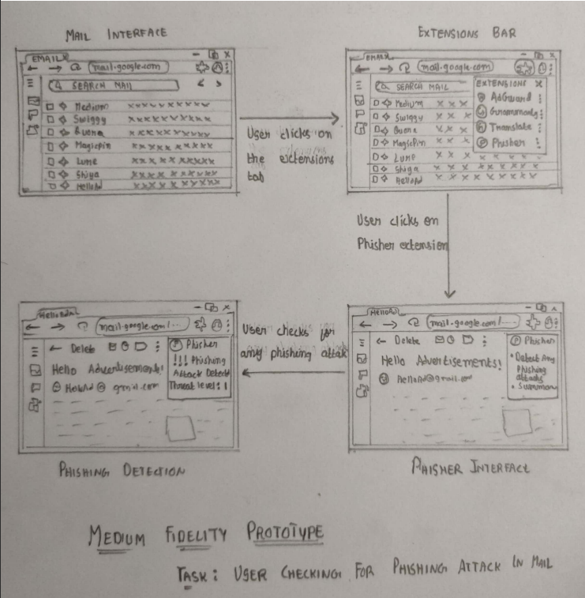
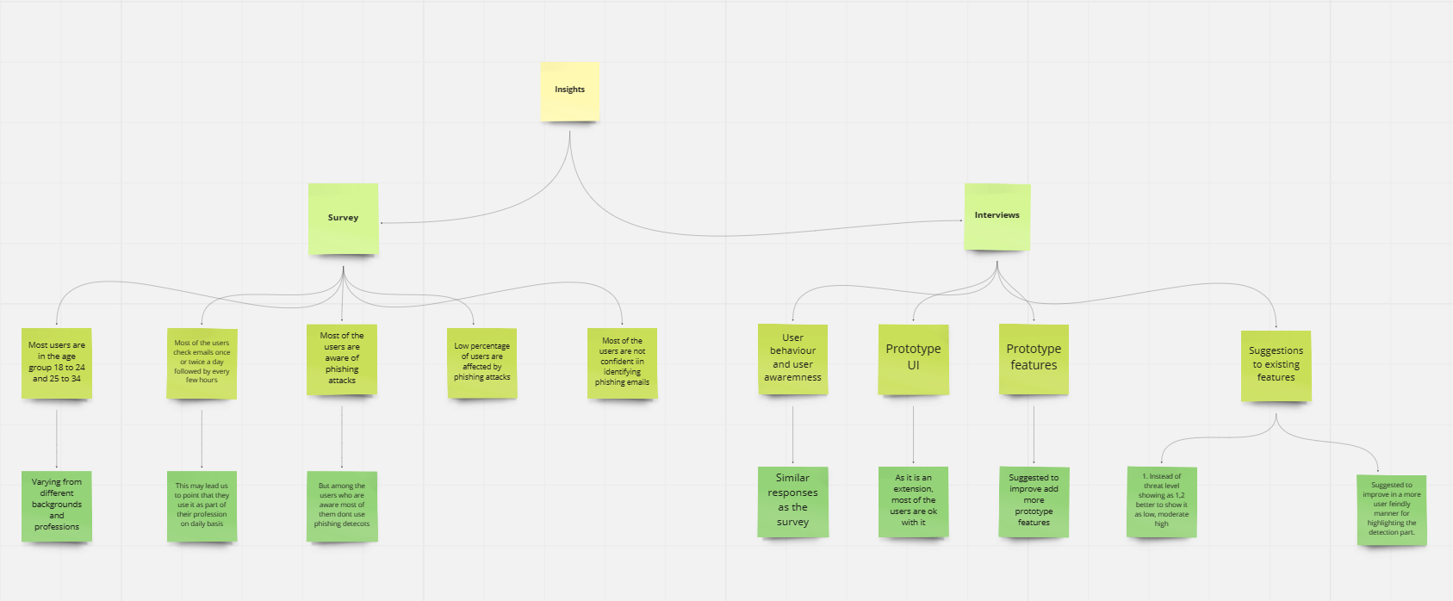
Phisher: A phishing detector
Konam Akhil Vamshi Donthireddy Manoj Reddy
Indraprastha Institute Of Information Technology Delhi
Introduction
Low Fidelity Prototype
Findings from surveys
Phishing attacks are a growing threat to internet users worldwide. These attacks use fraudulent emails, websites, and other forms of communication to trick users into revealing sensitive information such as login credentials, credit card numbers, and personal data. As a result, phishing attacks can lead to identity theft, financial loss, and other serious consequences.
Most users are in the age group 18 to 24 and 25 to 34
Most of the users check emails once or twice a day followed by every few hours
Most of the users are aware of phishing attacks
Low percentage of users are affected by phishing attacks
Most of the users are not confident in identifying phishing emails,
Scope
Phisher is software that helps identify and prevent phishing attacks. It does this by analyzing and detecting signs that a message or website might be a phishing attempt, such as the presence of a suspicious URL, mismatched domains, or the use of known phishing tactics, and also with the integration of human intuition from the user feedback. This also gives updates about the latest phishing attacks and creates awareness among the
people.
Findings from contextual Interviews
As it is an extension, most of the users are ok with it
Instead of the threat level showing as 1,2 better to show it as low, moderate-high
Suggested to improve in a more user friendly manner for highlighting the detection part.
Miro Maps
Materials and Methods
The literature review analyzed various research papers, articles, blogs, etc. In addition to readings, a comparative analysis was conducted between some of the available phishing tools.
Usability studies were conducted in the form of surveys, and contextual interviews where general and broad questions related to the project and the usability of Low-fi and Hi-fi were answered, respectively.
Approximately 50 people have been involved in the usability studies to date.
References
Literature review: LINK
Comparative analysis: LINK
Low-Fidelity Prototype: LINK
Hi- Fidelity Prototype: LINK
Contextual Interviews: LINK
Survey: LINK
Miro maps: LINK

