Slide 1


Context-Aware Adaptive Trust-Based Intrusion Mitigation Framework for Software Defined Networks using Multi-Criteria Decision Making
COMPUTER NETWORKS: PROJECT REPORT
PROJECT
REPORT
Notes:
Team: Konasani Vaibhav (24BCE0419), Surya Dev Mor (24BCE2004), Narayan (24BCE0712).

Slide 2
Team and Project Overview
Konasani Vaibhav
Surya Dev Mor
Narayan
24BCE0419
24BCE2004
24BCE0712
The project protects a Software Defined Network (SDN) from intrusions with a graded response instead of a simple allow / block.
Every flow is scored by a Random Forest IDS, every device keeps a Bayesian trust score, and the network's congestion is measured.
A PPO reinforcement-learning agent and AHP-TOPSIS (Multi-Criteria Decision Making) choose one of five actions: Allow, Monitor, Rate Limit, Redirect, Block.
Decisions are installed as OpenFlow 1.3 rules by a Ryu controller, shown in 3D simulations, and supervised by an agentic AI analyst.
Status: all modules implemented and tested (60 / 60 tests pass)

Slide 3
Problem Statement
Traditional Intrusion Detection Systems give a binary verdict: every alert ends in allow or block.
  A single noisy prediction can block a legitimate user (false positive).
  Each flow is judged alone: a repeat offender looks new every time.
  The response ignores network conditions such as congestion.
Real datasets confirm the problem: on UNSW-NB15, blocking at P(attack) ≥ 0.5 disrupts 34.8 % of normal traffic.
SDN gives a central controller that sees the whole network and can install fine-grained rules on every switch, which makes a smarter, adaptive response possible.
Goal: stop attacks while keeping legitimate traffic flowing, and make every decision explainable.

Slide 4
Objectives
1
Detect
2
Remember
Score every flow with a calibrated attack probability
Keep a Bayesian trust score for every device
3
Understand context
4
Decide adaptively
Measure link utilisation, loss and congestion
Combine PPO learning with AHP-TOPSIS (MCDM)
5
Stay safe
6
Enforce
Guardrails that learned parts cannot override
Install OpenFlow rules through a Ryu controller
7
Show it
8
Scale and supervise
3D simulation of the network and every decision
Thousands of hosts, real datasets, agentic AI

Slide 5
System Architecture
Network Traffic
Feature Extraction
Random Forest IDS
Attack Confidence
Trust Score Engine
OpenFlow Rules
Guardrails
AHP-TOPSIS + Fusion
PPO RL Agent
Network Context
Allow
Monitor
Rate Limit
Redirect
Block
Shaded boxes are the intelligent components; the agentic AI analyst supervises the whole pipeline from above and can apply short, reasoned overrides.

Slide 6
Modules Implemented
# | Module | What it does | Main files
1 | Random Forest IDS | 28 features, Platt-calibrated attack probability | src/ids/
2 | Bayesian trust engine | Beta(α, β) trust per device, decay, SQLite storage | src/trust/
3 | Network context | Utilisation, loss, latency, congestion index | src/context/
4 | PPO agent | 12-feature state, 5 actions, multi-objective reward | src/rl/
5 | SDN controller | Ryu OpenFlow 1.3 rules, meters, honeypot redirect | src/sdn/
6 | Threat intelligence | CVE feed parsing, emerging-threat flag | src/threat_intel/
7 | AHP-TOPSIS (MCDM) | Weights, ranking, fusion with PPO, guardrails | src/mcdm/
8 | Simulation + 3D | 6-host scenario and 3D viewer | src/simulation/, visualization/
9 | Real datasets | UNSW-NB15 and CICIDS2017 training / evaluation | scripts/
10 | Large networks | Many networks, hosts and switches per network | large_network_sim.py
11 | Agentic AI analyst | Offline, Groq, Claude, OpenAI, Ollama backends | src/agent/
12 | Attack library | 10 attack types, 200+ attackers | attack_library.py

Slide 7
Detection: Calibrated Random Forest IDS
Each flow becomes 28 features (UNSW-NB15 schema): volume (packets, bytes), rate (load, packet_rate, byte_rate), timing (duration, jitter, RTT), TCP/IP fields and protocol / service.
Rates use at least a 1 s window; values a switch cannot measure are filled with the training median.
A Random Forest of 150 trees votes; Platt scaling turns the vote share f into a probability:
IDS results on real datasets
Metric | UNSW-NB15 | CICIDS2017
Train / test | 175k / 82k | 169k / 56k
Accuracy | 83.79 % | 99.99 %
Precision | 77.73 % | 99.99 %
Recall | 98.89 % | 99.99 %
False alarms | 34.71 % | 0.01 %
F1 | 87.05 % | 99.99 %
ROC-AUC | 0.968 | 1.000
P(attack) = 1 / (1 + e^(A·f + B))
Calibration means a score of 0.8 really is about 80 % attacks, which the trust and decision stages need.
UNSW-NB15 is the harder benchmark: almost every attack is caught, but 1 in 3 normal flows is flagged.

Slide 8
Bayesian Trust Engine and Network Context
Every device has trust T = α / (α + β), starting at α = β = 2 (T = 0.5).
  Benign flow (P ≤ 0.35): α += 1 − P (trust rises slowly)
  Attack flow (P ≥ 0.65): β += 3.5 · (1 + severity) (falls fast)
  Idle devices decay back to the prior (λ = 0.001 / s)
Variance of the Beta distribution tells how certain the trust is; new devices are uncertain, which triggers Monitor.
Network context: utilisation u from OpenFlow port stats, congestion C = 1 / (1 + e^(−10(u − 0.75))).

Slide 9
PPO Reinforcement Learning Agent
State (12 values): P(attack), trust, trust variance, congestion, loss, flow rate, byte rate, protocol, destination port, CVE match, previous action, burst factor.
Actions (5): Allow, Monitor, Rate Limit, Redirect, Block.
Reward: R = 1.0·R_sec + 1.2·R_avail + 0.5·R_qos + 1.0·R_threat
  R_sec rewards containing attacks; R_avail penalises blocking legitimate or trusted users (highest weight); R_qos charges cost when the network is busy; R_threat rewards containing new CVE exploits.
Training: Stable-Baselines3 PPO, 300,000 steps, γ = 0.99, learning rate 3·10⁻⁴, clip 0.2, in a simulated SDN environment with noisy, stealthy and bursty traffic.
Clipped objective L = E[min(r·A, clip(r, 0.8, 1.2)·A)] keeps every policy update small and stable.
Result: highest mean reward of all policies (1.552), 99.8 % of attacks stopped with only 0.06 % of normal traffic disrupted.

Slide 10
Multi-Criteria Decision Making: AHP and TOPSIS
AHP: pairwise judgements → criterion weights
TOPSIS: rank the five actions
 | Con | Ava | Tru | Cost | For | Weight
Containment | 1 | 2 | 3 | 5 | 6 | 0.427
Availability | 1/2 | 1 | 2 | 4 | 5 | 0.273
Trust consistency | 1/3 | 1/2 | 1 | 3 | 4 | 0.173
Network cost | 1/5 | 1/4 | 1/3 | 1 | 2 | 0.076
Forensic value | 1/6 | 1/5 | 1/4 | 1/2 | 1 | 0.051
Risk = 0.65·P(attack) + 0.35·(1 − Trust)
Score 5 actions × 5 criteria, weight by AHP
Distances to ideal (D⁺) and worst (D⁻)
Closeness C = D⁻ / (D⁺ + D⁻), highest wins
Final = 0.6·TOPSIS + 0.4·PPO
Con = containment, Ava = availability, Tru = trust, For = forensic. Consistency ratio CR = 0.022 (< 0.10, consistent).
Real TOPSIS closeness scores from the code
Situation | Allow | Monitor | Rate limit | Redirect | Block | Chosen
Normal host (P 0.02, T 0.95) | 0.96 | 0.87 | 0.58 | 0.16 | 0.08 | Allow
Borderline (P 0.50, T 0.60) | 0.41 | 0.47 | 0.66 | 0.57 | 0.54 | Rate limit
Attacker (P 0.99, T 0.05) | 0.05 | 0.18 | 0.63 | 0.87 | 0.90 | Block

Slide 11
Guardrails and OpenFlow Enforcement
Guardrails (checked in order)
OpenFlow 1.3 rules (Ryu controller)
Allow-list: infrastructure is never blocked
Zero-day: CVE match + P ≥ 0.5 → Redirect to honeypot
Hard block: P ≥ 0.95 and T < 0.2 → Block
Trusted host: T ≥ 0.8 and Block chosen → Rate limit
Monitoring: new device or 0.35 ≤ P < 0.65 → Monitor
Protected server: suspicious flow → at least Monitor
Action | Priority | Timeout | Instructions
Allow | 10 | 60 s | output:port
Monitor | 15 | 30 s | output:port, output:mirror
Rate limit | 20 | 30 s | meter:1 (500 kbps), output
Redirect | 25 | 45 s | set ipv4_dst=10.0.0.100 (honeypot)
Block | 30 | 120 s | drop
Higher priority wins, so a Block overrides an older Allow; rules expire so hosts are re-checked when active again

Slide 12
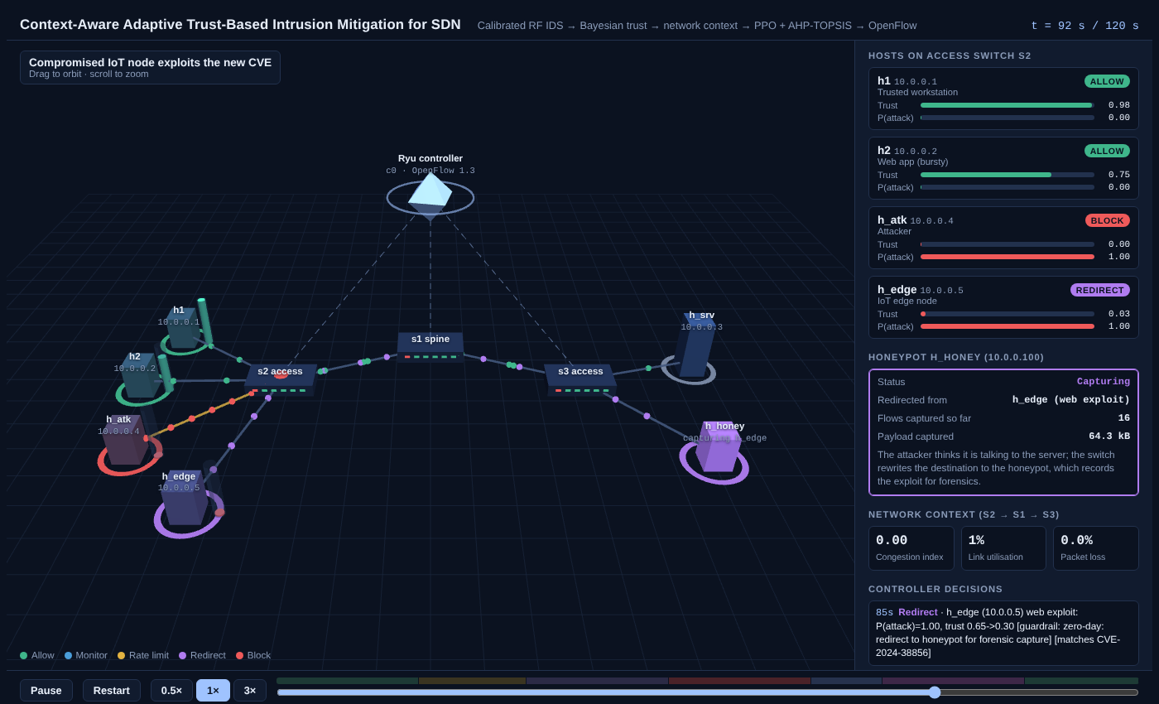
SDN Simulation and 3D Visualisation
Mininet topology: 3 switches, 6 hosts (h1, h2, attacker, IoT node, server, honeypot).
Scripted 120 s scenario:
  flash crowd (20–35 s)
  port scan (35–55 s)
  SYN flood (55–95 s)
  CVE published (75 s)
  exploit (85–105 s)
three.js 3D view: coloured packets, trust columns, live decision feed, honeypot panel.
Result: 100 % attacks stopped, 98.2 % normal traffic served
Main simulator at t = 92 s: h_edge's CVE exploit is redirected to the glowing honeypot

Slide 13
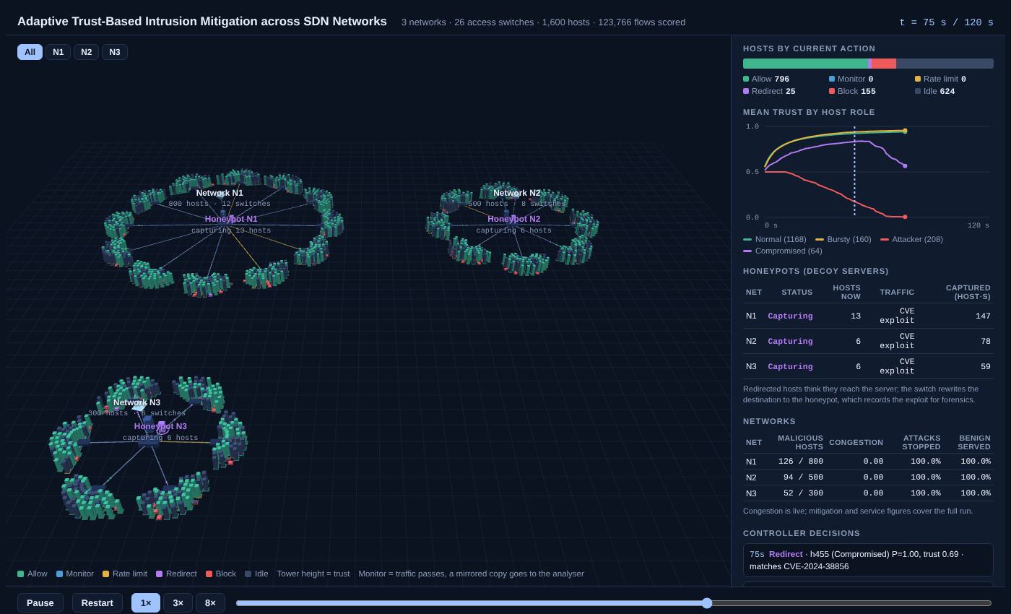
Large Networks and 10 Attack Types
Any number of networks, each with its own Ryu controller, leaf-spine switches and hosts.
Different sizes per network, e.g. 800 / 500 / 300 hosts and 12 / 8 / 6 switches.
10 attack types: port scan, SYN / UDP / ICMP flood, DNS amplification, SSH brute force, slowloris, CVE exploit, data exfiltration, C2 beacon.
272 malicious hosts, 123,766 flows: 100 % stopped, 0 normal flows blocked
1,600 hosts in 3 networks at t = 75 s: all three honeypots capturing exploits

Slide 14
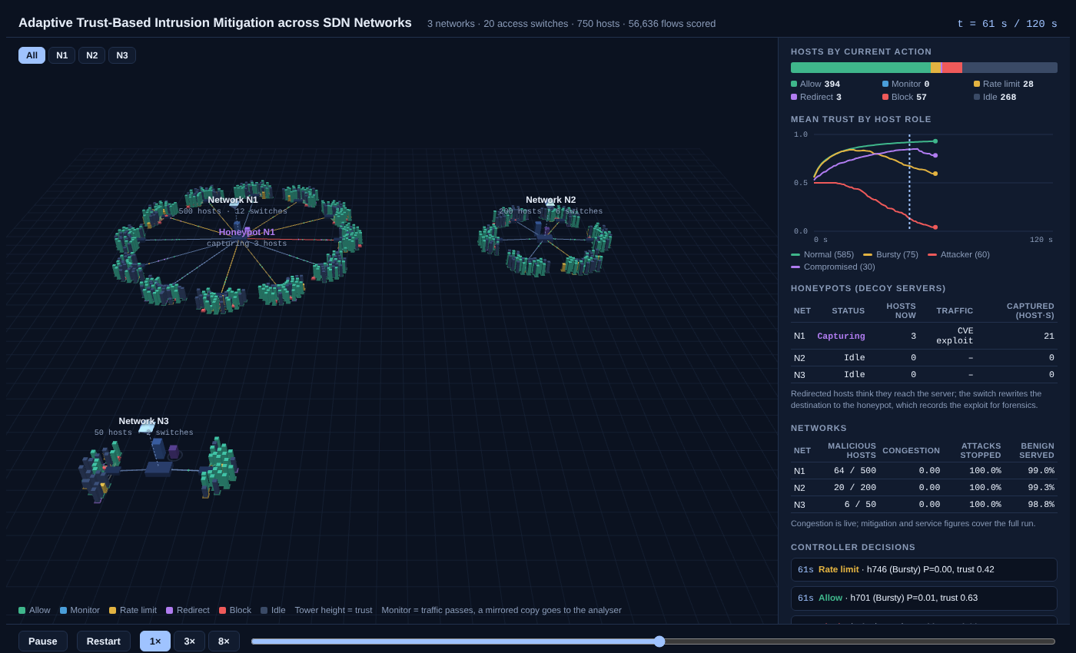
Agentic AI Security Analyst
Reviews the network every 10 s like a SOC analyst: observe → investigate → act → record.
Tools: overview, host details, decision explanations, threat intel, temporary overrides, human-approval requests, incidents.
Brains: offline rule planner, Groq, Claude, OpenAI-compatible or local Ollama (API keys from environment variables).
Safety: never sees ground truth; cannot fully Allow; overrides last ≤ 60 s and need a reason; hard block always wins.
Playbook: throttle false positives, redirect CVE exploits + ask approval, open incidents for coordinated attacks, 90 s probation for recently blocked hosts.
Results: 28 % fewer normal flows wrongly blocked (603 → 434); unseen slowloris attack 0 % → 75 % stopped.
750 hosts with the AI agent (t = 61 s): throttled bursty hosts and N1's honeypot capturing

Slide 15
Results: Decision Algorithms Compared
Algorithm | Disrupted | Reward
Static block | 11.31 % | 1.038
Rule-based trust | 1.12 % | 1.225
AHP-TOPSIS | 5.61 % | 0.654
PPO | 0.06 % | 1.552
Hybrid (proposed) | 0.40 % | 1.541
Same 5,000 steps of traffic for every algorithm.
The hybrid matches PPO and adds TOPSIS explanations and guardrails.

Slide 16
Results: Simulations and Real Data
Simulation | Hosts | Flows | Stopped | Served | Normal blocked
Main scenario | 6 | 708 | 100 % | 98.16 % | 9
3 networks | 750 | 56,636 | 100 % | 98.76 % | 603
3 networks + AI agent | 750 | 56,636 | 100 % | 99.11 % | 434
10 attack types | 1,600 | 123,766 | 100 % | 100 % | 0
Unseen attack (slowloris) | 600 | 46,556 | 91.38 % | 100 % | 0
Unseen attack + AI agent | 600 | 46,556 | 97.85 % | 100 % | 0
Full pipeline on real UNSW-NB15 traffic (40,000 flows, 200 devices)
Strategy | Attacks stopped | Normal served
IDS alone (block at P ≥ 0.5) | 98.88 % | 65.22 %
Proposed, trust penalty 0.5 | 98.05 % | 86.69 %
Proposed, trust penalty 3.5 (default) | 98.18 % | 42.44 %
With a gentler penalty the framework serves 21 points more normal traffic than the IDS alone; the default penalty must be tuned for real data.

Slide 17
Testing and Fixes
60 automated tests, all passing
Bugs found and fixed
Test suite | Covers
IDS, trust, context | Features, calibration, Beta updates, decay
RL | Environment, reward, PPO inference
MCDM | AHP weights, TOPSIS, fusion, guardrails, monitoring
Simulation | Main scenario, 3D trace
Datasets | UNSW-NB15 / CICIDS2017 loaders
Large simulation | Many networks, per-network sizes
Agent | Tools, safety rules, mocked Groq / Claude
Attacks | 10 attack types, unseen-attack holdout
Controller blocked benign traffic on its first packet (1 ms rate window) → 1 s minimum window.
Missing reverse-direction features looked like attacks → median imputation.
TOPSIS vector normalisation chose Block at P = 0.02 → direct 0–1 scores.
RL environment was trivially separable → added noise, retrained PPO.
Trusted host blocked during a flash crowd → trusted-host guardrail.
SQLite file lock on Windows → connections always closed.

Slide 18
Tools and Technologies
Area | Used
Language | Python 3.12
Machine learning | scikit-learn (Random Forest, CalibratedClassifierCV), imbalanced-learn
Reinforcement learning | Gymnasium, Stable-Baselines3 (PPO), PyTorch
SDN | Ryu controller (OpenFlow 1.3), Mininet
Data | NumPy, pandas, SQLite / SQLAlchemy
Threat intelligence | requests, BeautifulSoup, feedparser, spaCy, NLTK
Visualisation | three.js 3D web viewer, Matplotlib
Agentic AI | Groq, Anthropic Claude, OpenAI-compatible and Ollama APIs (tool calling)
Datasets | UNSW-NB15, CICIDS2017
Testing | pytest + custom runner (60 tests)

Slide 19
Conclusion and Future Work
We built a complete context-aware, trust-based intrusion mitigation framework for SDN: detection, trust, context, PPO + AHP-TOPSIS decisions, guardrails and OpenFlow enforcement.
It stops 99.9 – 100 % of attacks while serving 98 – 100 % of normal traffic, beating static detect-and-block (92.5 % / 88.7 %).
It scales to 1,600 hosts in 3 networks with 10 attack types, and every decision is explainable and visible in 3D.
The agentic AI analyst reduces false blocks by 28 % and catches 75 % of an attack the IDS never saw.
Future work:
  Retrain PPO to weigh trust and attack probability more than traffic rate
  Tune the trust penalty on a validation split of real data
  Test on a physical SDN testbed and add cross-network (botnet) attacks

Slide 20
References
N. Moustafa and J. Slay, "UNSW-NB15: a comprehensive data set for network intrusion detection systems," MilCIS, 2015.
I. Sharafaldin, A. H. Lashkari and A. A. Ghorbani, "Toward generating a new intrusion detection dataset and intrusion traffic characterization (CICIDS2017)," ICISSP, 2018.
L. Breiman, "Random Forests," Machine Learning, 45(1), 2001.
J. Platt, "Probabilistic outputs for support vector machines and comparisons to regularized likelihood methods," 1999.
J. Schulman et al., "Proximal Policy Optimization Algorithms," arXiv:1707.06347, 2017.
T. L. Saaty, The Analytic Hierarchy Process, McGraw-Hill, 1980.
C. L. Hwang and K. Yoon, Multiple Attribute Decision Making: Methods and Applications (TOPSIS), Springer, 1981.
A. Jøsang and R. Ismail, "The Beta Reputation System," Bled eConference, 2002.
Open Networking Foundation, OpenFlow Switch Specification 1.3; Ryu SDN Framework; Mininet.

