Slide 1
Sales Data Analysis
Data Storytelling & Statistical Validation
ApexPlanet Data Analytics Internship

Slide 2
Objective
Analyze sales data
Identify patterns
Apply hypothesis testing

Slide 3
Dataset Overview
1000 records
Includes customer & sales data
Key columns: Category, Total Sales, City

Slide 4
Key Insights
Sales vary across categories
Electronics has highest transactions
Customer behavior varies

Slide 5
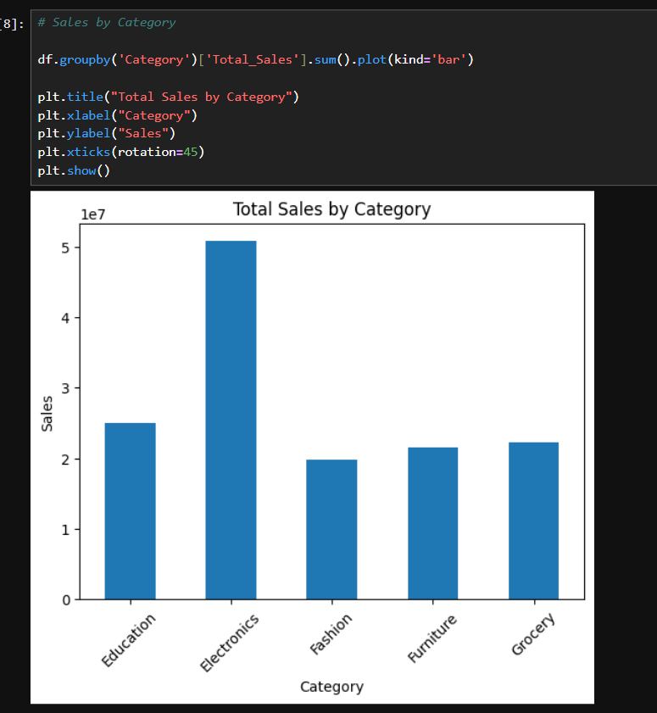
Visualization
Sales distribution across categories

Slide 6
Hypothesis Testing
H0: No significant difference
H1: Significant difference
Test: T-Test

Slide 7
Results
T-Statistic: 0.2616
P-Value: 0.7937
Fail to reject H0

Slide 8
Business Conclusion
Category alone doesn’t impact sales
Focus on marketing & pricing
Use data-driven decisions

