Slide 1

Campus Track
Intelligent Campus Lost & Found System
TEAM - 4
Presented By:
Pavithra Konathala
Gayathri Ravula
Chaithra G
Vaishnavi Anumalasetty
Under the Guidance Of:
Pavithra Kannan

Slide 2

Problem Statement
Current Challenges
Decentralized: Items scattered across various reception desks and campus offices.
Inefficient: Manual reporting via email blasts or paper forms is often ignored.
Unsecured: No consistent verification process for item claims.
Chaotic: Reliance on manual paperwork.

Slide 3

Our Solution
Campus Track is a web-based Lost & Found system designed to help students and staff easily report, search, and track lost items on campus. The platform provides one central place where users can quickly submit details with images, check newly added items, and get notified when their lost item is found.

Slide 4




Technology Stack
Java 17
Spring Boot
MySQL
Bootstrap 5

Slide 5
MILESTONE – 1
Authentication & Campus Verification

Slide 6
Milestone Deliverables
Focus: Complete Static Page Design & High-Quality UI
Registration: The initial registration page for new campus members.
User Login: The gateway to the application, designed for quick and secure access.
Landing page: Provides users with a snapshot of campus activity and direct access to all major features.
Submission Page: A simple and efficient interface for reporting lost or found items.

Slide 7
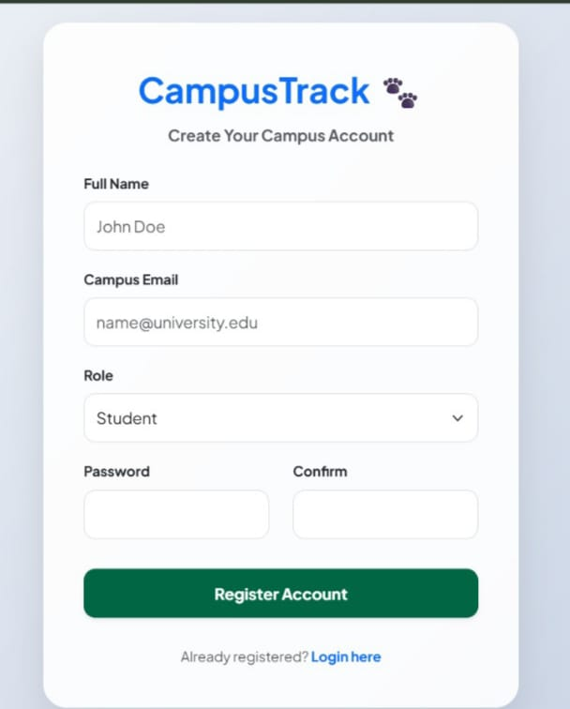
Registration Page
The initial registration page for new campus members.
Function: Collects necessary details (Full Name, Campus Email, Password) to create a new user account.
Key Contents: Input fields for user information, including separate fields for Password and Confirm Password.

Slide 8
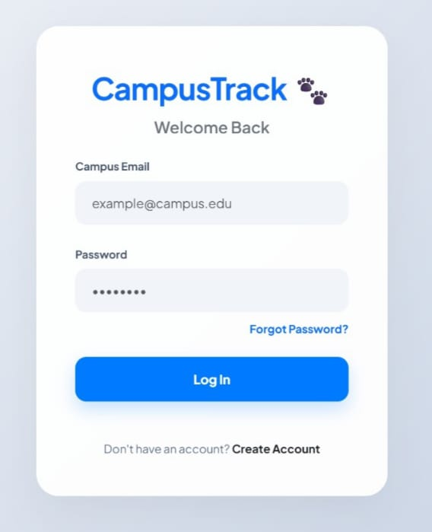
Login Page
The gateway to the application, designed for quick and secure access.
Function: Authenticates verified campus users using their email and password.
Key Content: Fields for Campus Email and Password, along with links to Sign Up and Forgot Password.

Slide 9
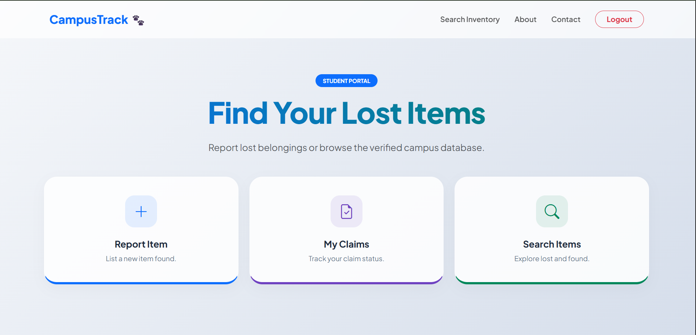
Landing Page
The main application landing page and central user hub.

Slide 10
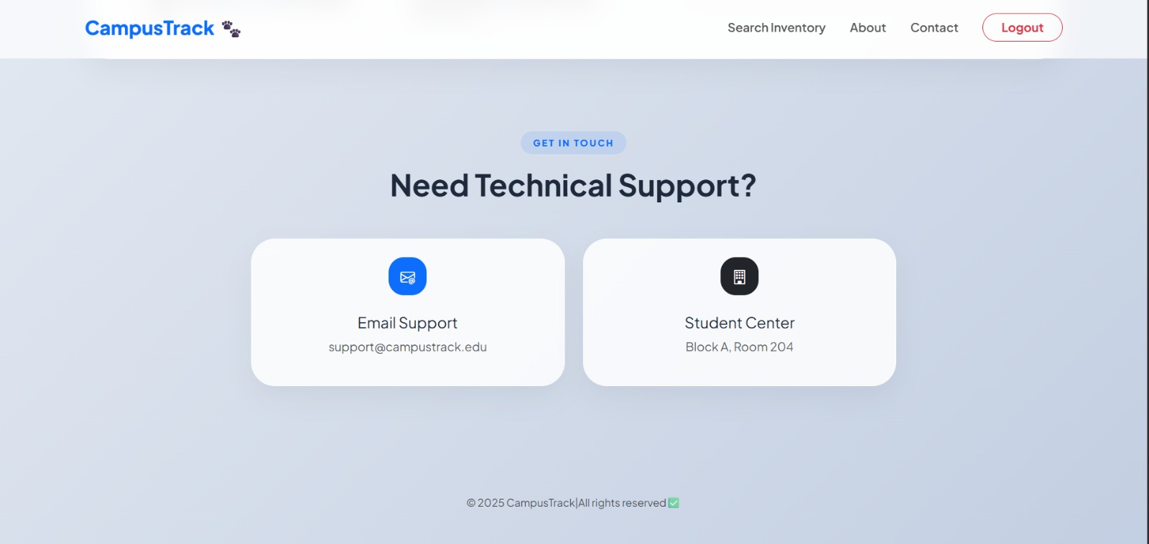
Contact Page
The dedicated page for users needing support or assistance.
Function: Communicates the value proposition of CampusTrack to users.

Slide 11
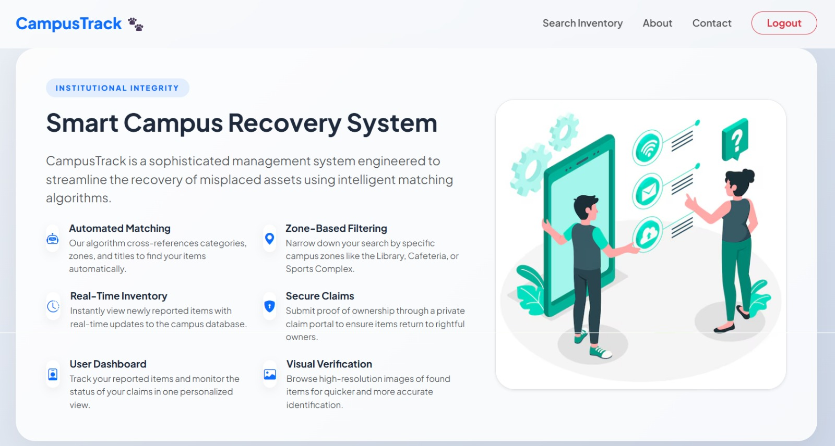
Features/About Page
An informative page detailing the benefits and capabilities of the platform.

Slide 12
MILESTONE -2
Lost/Found Submission Form

Slide 13
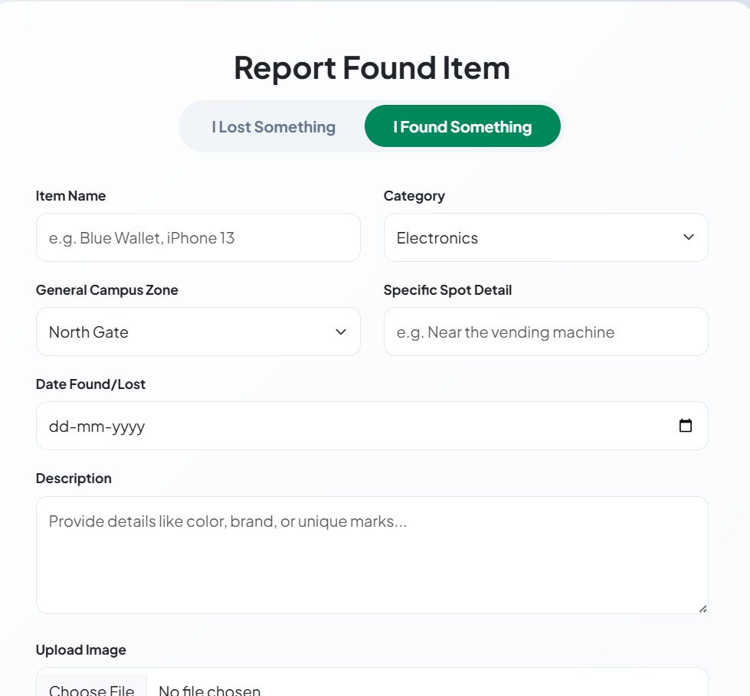
Lost & Found Item Submission Page
Lost/Found Item Submission Module
This module enables users to easily report a lost or found item through a clean and user-friendly interface.
Key Features of the Form
✔ Item Title:
Users enter a clear and concise title for the lost/found item.
✔ Description Field:
Allows detailed explanation of the item including color, brand, and special identifiers.

Slide 14
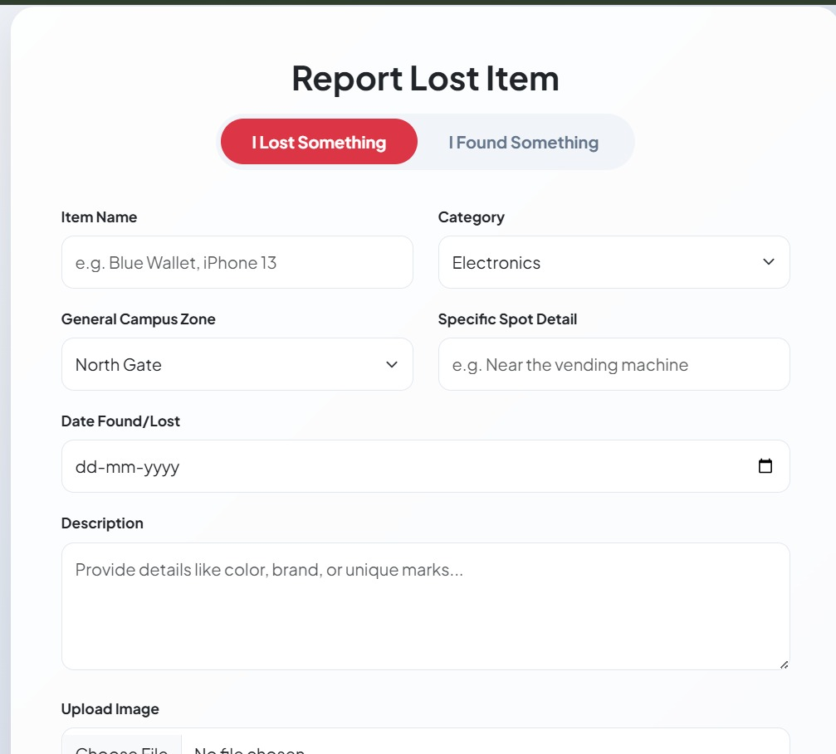
Lost & Found Item Submission Form
✔ Date Picker:
A built-in date selector ensures accurate tracking of when the item was lost or found.
✔ Location Input:
Users specify the exact place on campus where the item was lost/found.
✔ Status Dropdown (Lost/Found):
Helps categorize the item for better searching and filtering.
✔ Image Upload:
Users can upload an image to help identify the item more clearly.
✔ Tags Field :
Enables category-based tagging such as “electronics”, “books”, “clothing” for improved searchability.

Slide 15
MILESTONE – 3
Matching Algorithm
&
Location-Based Suggestions

Slide 16
Bridging the Gap
The Problem: Users having to scroll through hundreds of items to find their own.
The Solution: An Automated Intelligence Layer that connects Lost and Found reports in real-time.
Key Achievement: Developed a "Smart Match" system that suggests items to users based on similarity.

Slide 17
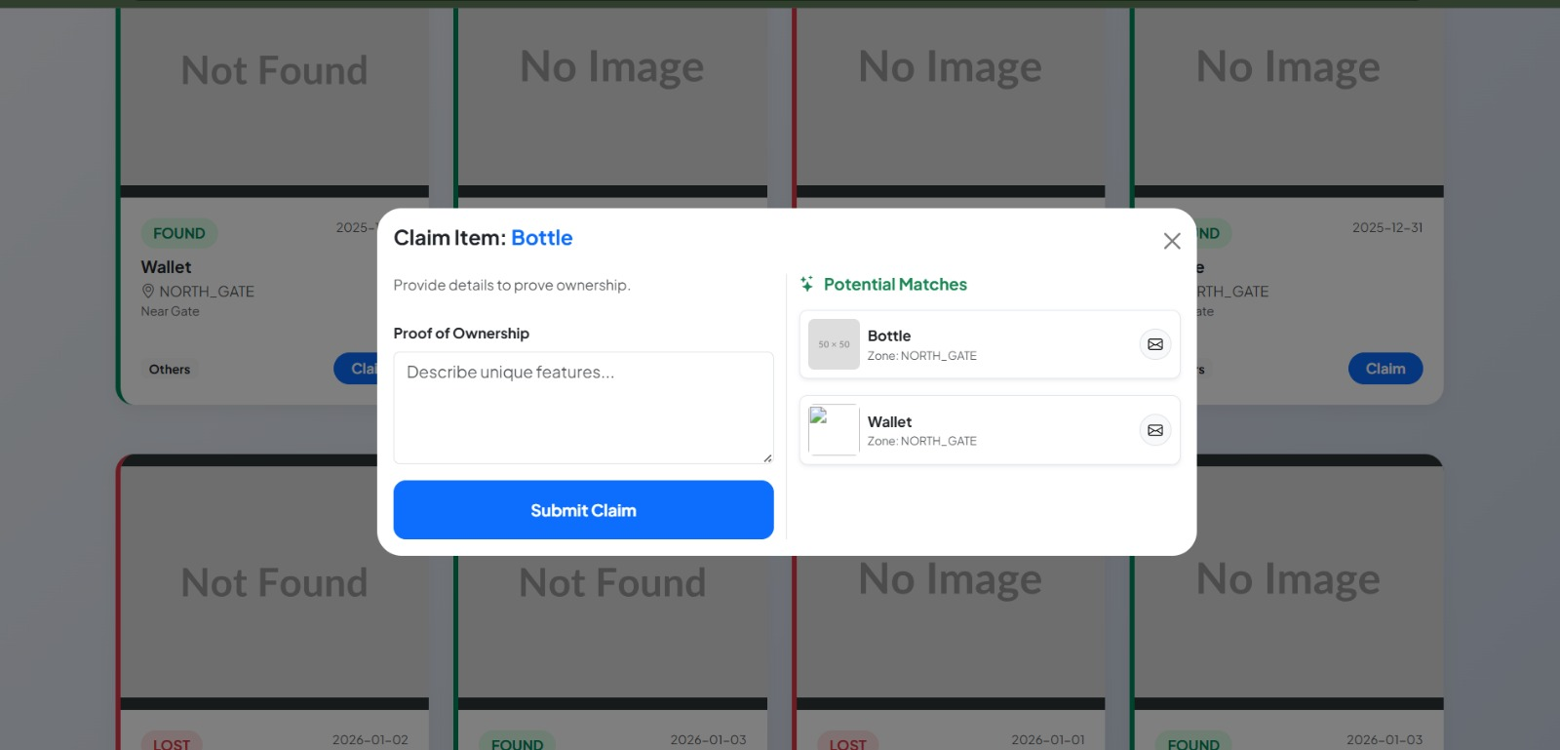
The Core “Intelligence”(Matching Algorithm)
Fuzzy Logic Engine: Uses Levenshtein Distance to calculate string similarity between titles.
Weighted Criteria:
Title Similarity ($60\%$): Handles typos (e.g., "Iphone" vs "i-phone")
Contextual Match: Cross-references Category and Campus Zone.
The Outcome: A "Potential Matches" section that appears automatically when a user attempts to claim an item.

Slide 18
System Architecture & API
RESTful Design: Standardized API endpoints (/api/items, /api/claims) for clean communication.
Live Data Sync: GET Requests: Fetch real-time inventory updates.
POST Requests: Securely transmit ownership proof and claim data.
State Management: Utilizing localStorage to maintain user identity and roles without constant database logins.

Slide 19
Enhanced Search & UX Logic
Multi-Dimensional Filtering: Temporal: Filter by "Date Recorded."
Spatial: Filter by "Campus Zone.“
Categorical: Filter by "Item Type" (Electronics, Clothing, etc.).
Visual Verification: Integrated Lightbox overlays so users can inspect item images in high resolution before claiming.
Robust Search: Case-insensitive, real-time keyword search that updates as the user types.

Slide 20
Secure Claim Management Workflow
Ownership Verification: Mandatory "Proof of Ownership" text field for every claim.
User-Item Mapping: A many-to-one relationship in the database linking multiple claims to a single found item for Admin review.
Data Protection: Role-based access ensures users only see what they need, while Admins oversee the entire claim history.

Slide 21
MILESTONE – 4
Chat Feature
&
Privacy and Controls

Slide 22
Chat Feature- Overview
The chat feature enables secure communication between users after a lost or found item is successfully matched.
It allows users to interact directly within the Campus Track platform without using external communication methods.
The feature helps users discuss item details and coordinate the collection process smoothly.
Communication is restricted to matched users only, ensuring safe and relevant interactions.

Slide 23
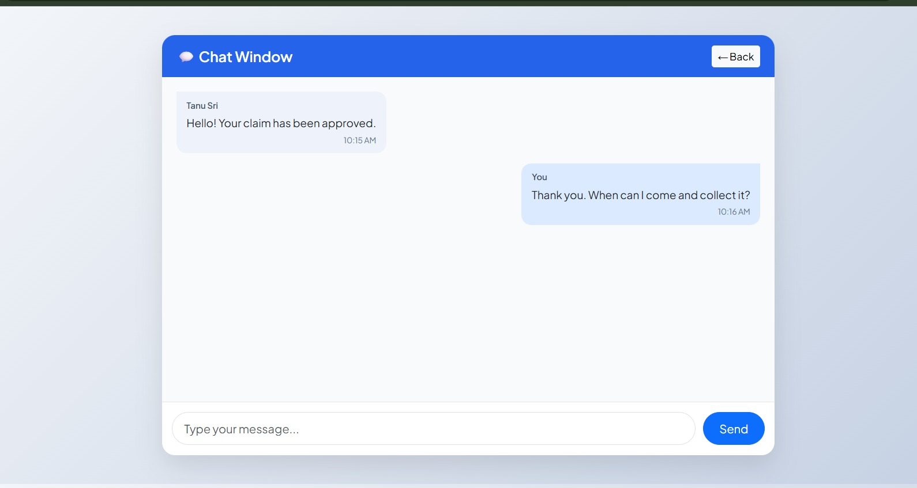
In- App Messaging System
The system supports basic in-app messaging between matched users.
Messages are displayed in a clear chat window with sender information and timestamps.
Users can send and receive text messages in real time for faster communication.
The chat interface is simple, user-friendly, and designed for easy understanding.

Slide 24
Benefits of Chat Feature
Enables quick and direct communication between matched users.
Eliminates the need to share personal contact details externally.
Improves coordination for item verification and collection.
Keeps all lost and found related conversations in one secure platform.
Enhances user trust and overall system usability.

Slide 25
MILESTONE – 5
Admin Pannel

Slide 26
Admin Pannel
Dedicated module for administrators to manage the Campus Track platform.
Allows admins to view and monitor all lost and found posts.
Enables approval, editing, or removal of inappropriate or duplicate entries.
Supports content moderation through user-reported flags.
Helps maintain platform security, quality, and user trust.
Provides access to reports and system performance insights.

Slide 27
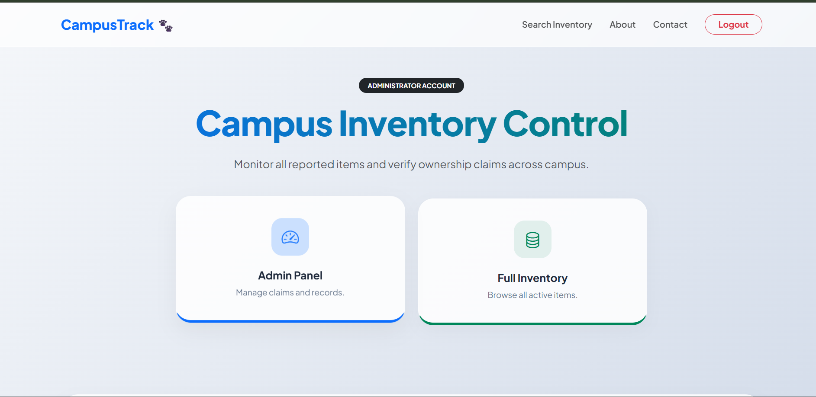
Admin Dashboard
The Admin Dashboard looks like.

Slide 28
MILESTONE – 6
Reporting Dashboard

Slide 29
Reporting Dashboard
Provides insights into overall platform usage and activity.
Tracks the number of lost items reported, matched, and recovered.
Displays statistics based on category, date, and campus location.
Monitors user engagement such as active users and post frequency.
Helps administrators evaluate system performance and effectiveness.

Slide 30
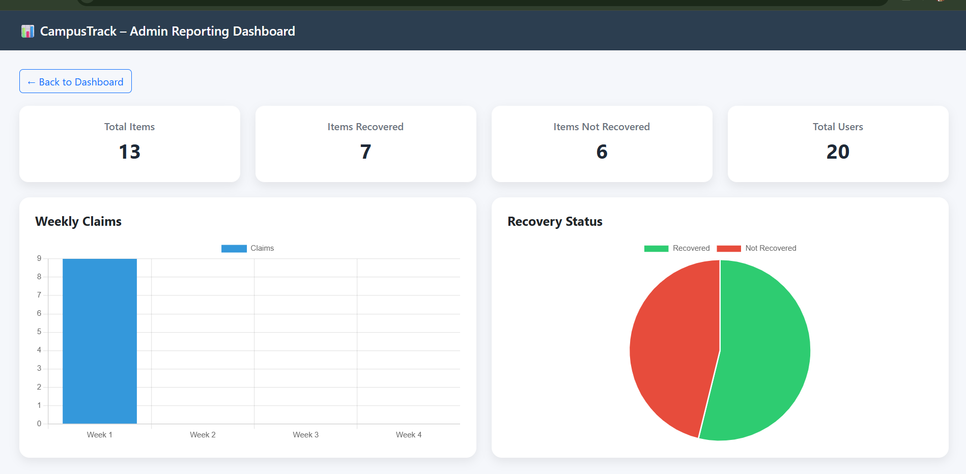
Analysis Page

Slide 31
Thank you

