Slide 1
Knowledge Graph Generator Using LLMs
CIS 598
Caleb Martin
Dr. Hande McGinty

Slide 2
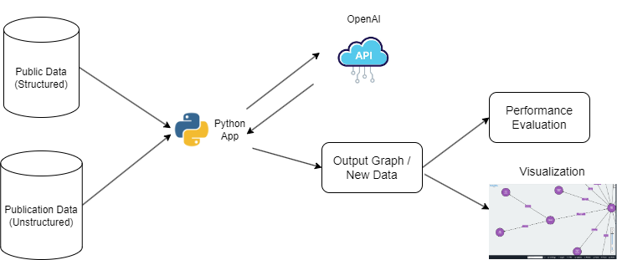
System Diagram

Slide 3
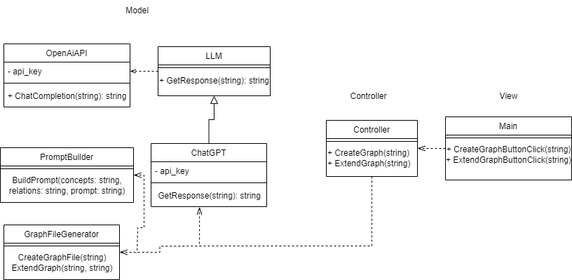
UML Diagram

Slide 4
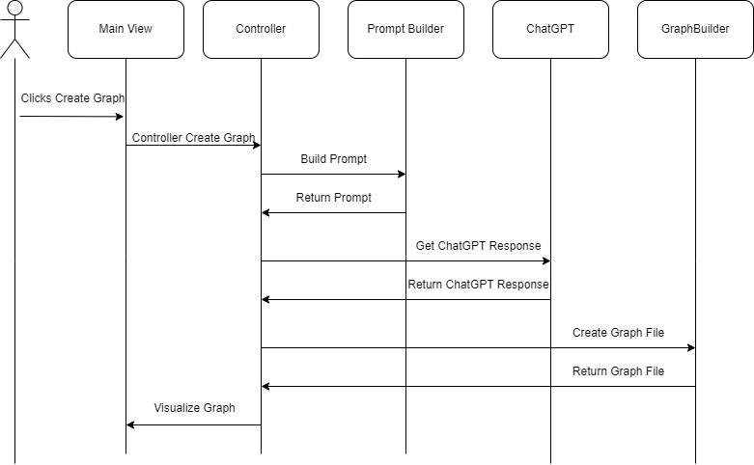
Sequence Diagram

Slide 5
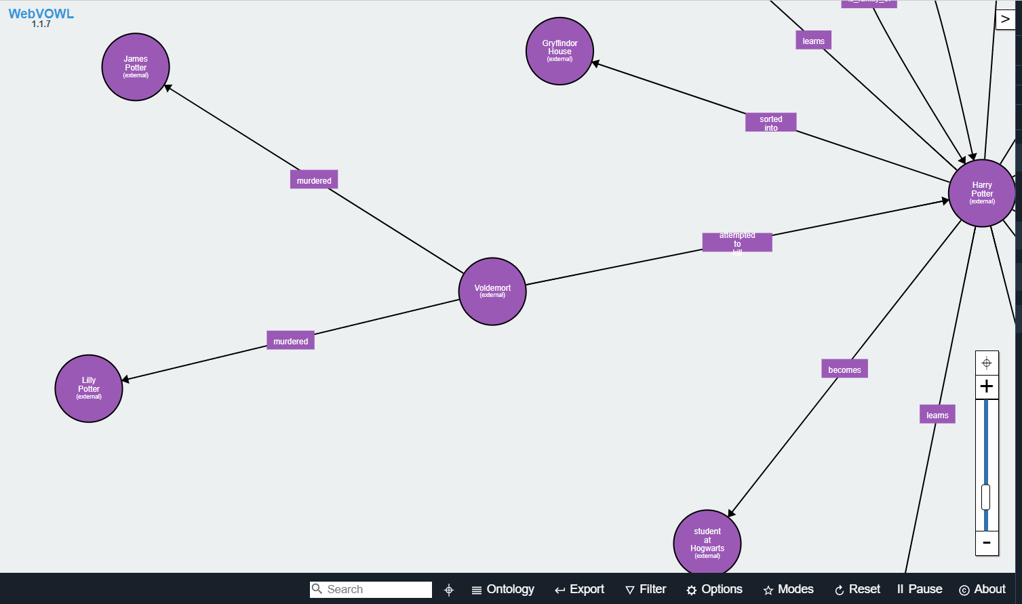
Example Graph

Slide 6


Testing
vs

Slide 7
Questions?
Key Points:
Generating Graphs with LLMs
System Architecture
Testing compared to BERT

