Slide 1
Knowledge Graph Generator
CIS 598
Caleb Martin
Dr. Hande McGinty

Slide 2
Background
It is quite difficult to create and extend knowledge graphs currently (manual creation takes 1-2 years)
LLMs have revolutionized the field and could be used for this task
Using LLMs to create knowledge graphs could save significant manual effort

Slide 3
Overview
Input
Knowledge Graphs
Web application
Neo4j
LLMs
Text
Abstracts
Visualization
Performance Evaluation
Creation Logic
Structured Data

Slide 4
MVP Features
✓ Create knowledge graph from raw text
✓ Extend existing knowledge graph
✓ View visualization of the graph
Input
Web application
Knowledge Graphs
ChatGPT
Text
Creation Logic

Slide 5
1.0 Features
✓ Evaluate performance of graph generation
• Allow the user to edit the graph
✓ Allow the use of other LLM's to generate the graphs.
• Improved visualization
Input
Web application
Knowledge Graphs
LLMs
Performance Evaluation
Creation Logic
Text
Visualization

Slide 6
2.0 Features / New Features
✓ Compare the performance of the different LLM's to see which is best
✓ Extracting new flavonoid cancer relations
✓ Abstract scraping to generate graphs
✓ Neo4j as a graph storage database
Input
Web application
Knowledge Graphs
Neo4j
LLMs
Performance Evaluation
Text
Abstracts
Creation Logic
Visualization
Structured Data

Slide 7






Tools
Python
Flask
HTML/CSS
ChatGPT API
Llama API
Neo4j DB

Slide 8
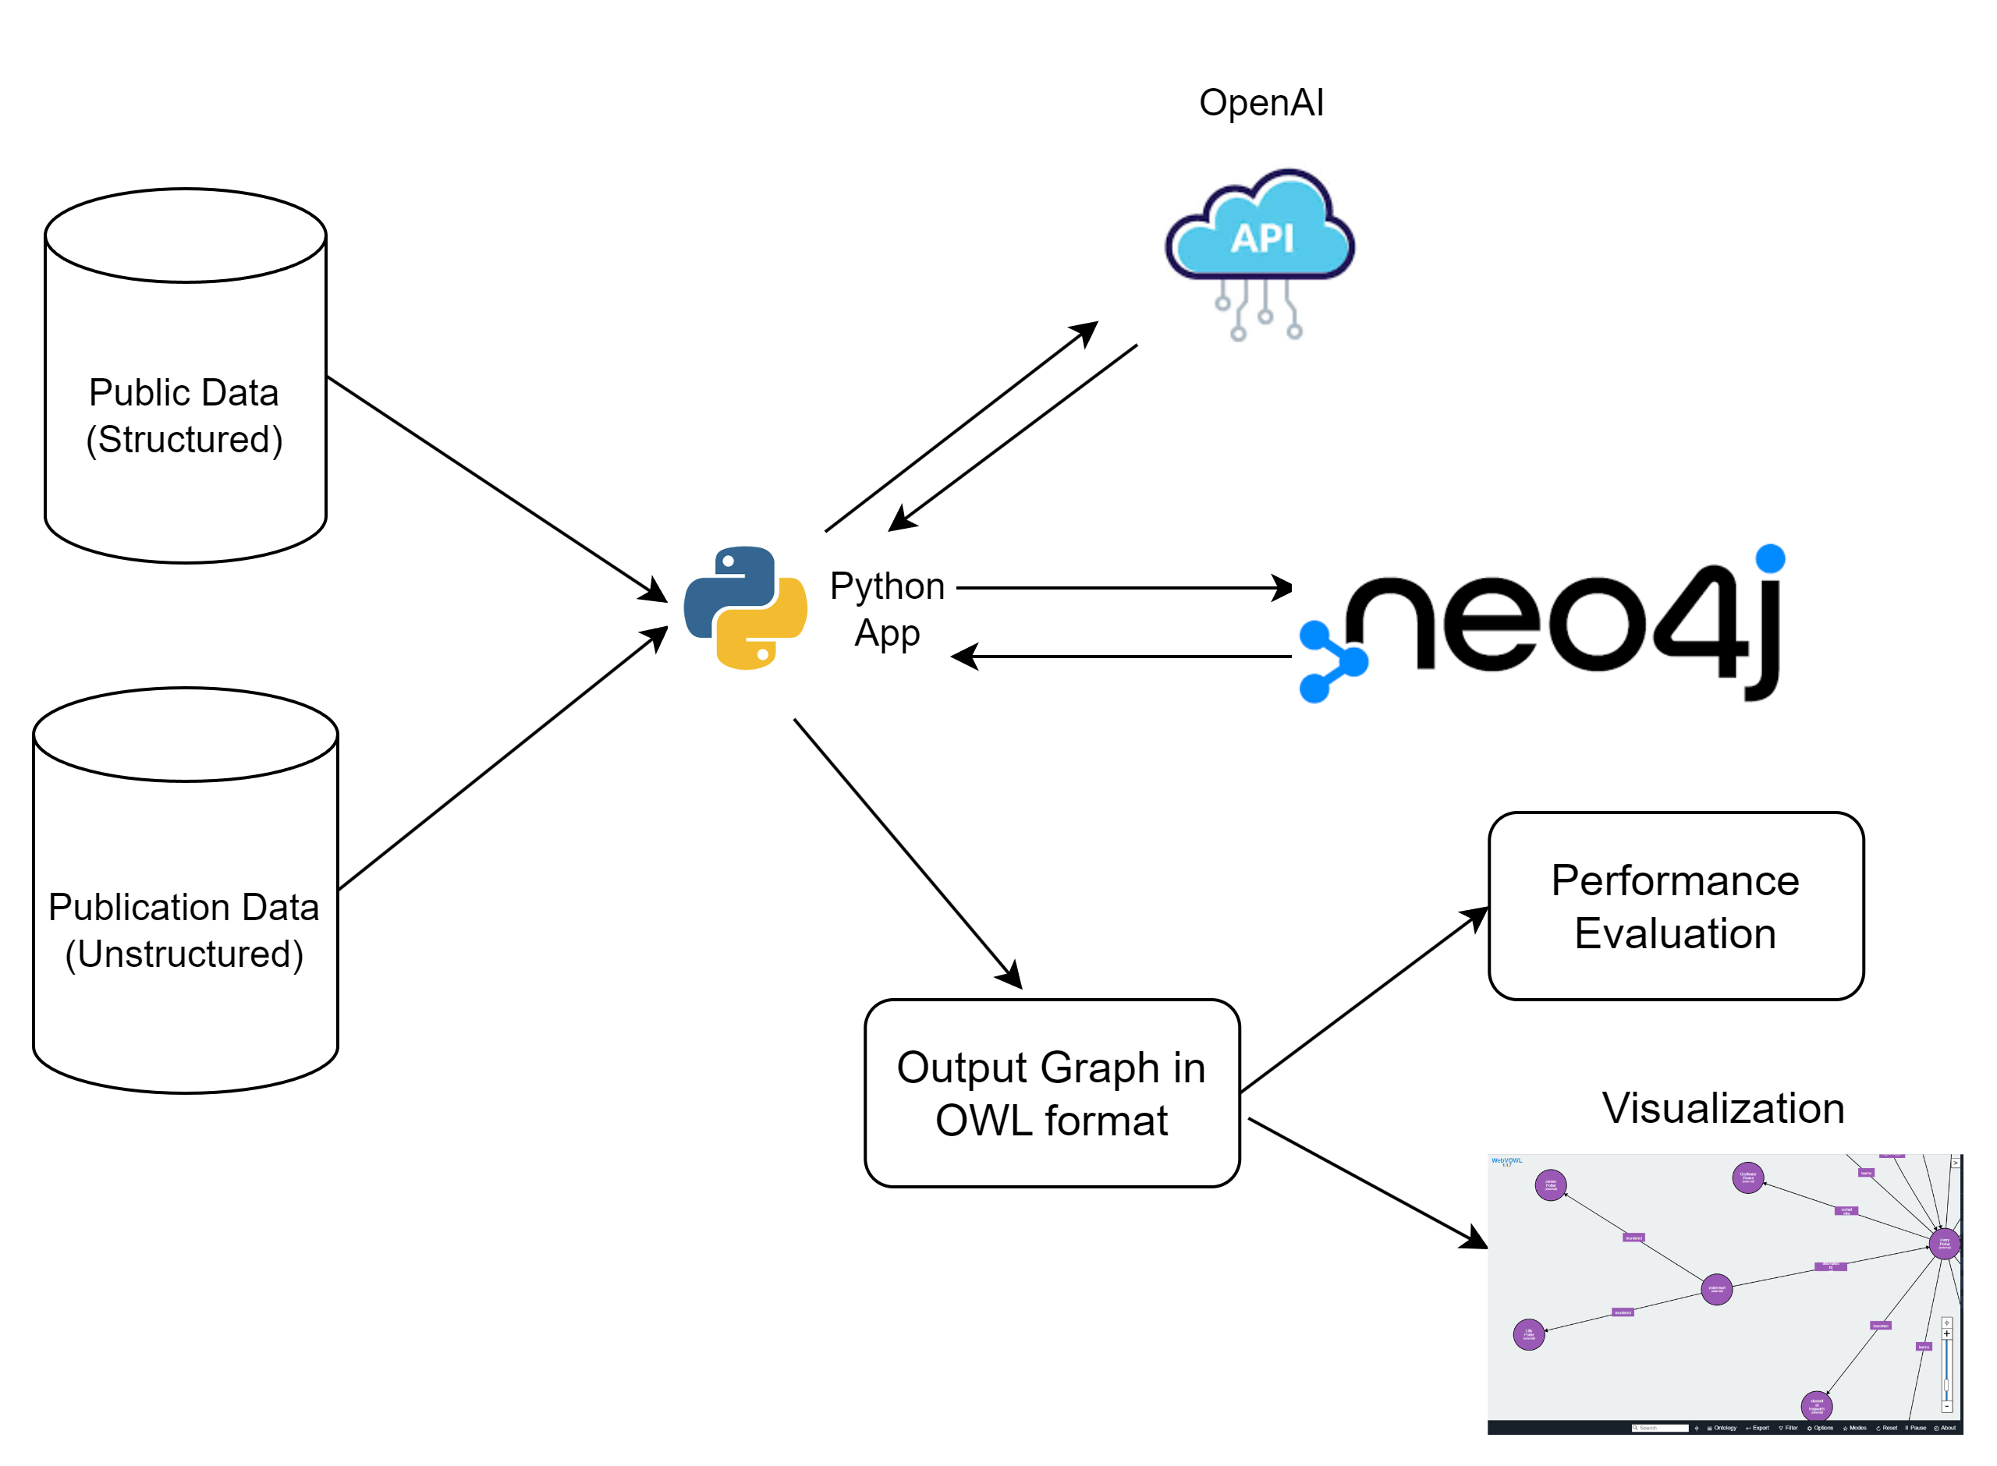
System Diagram

Slide 9
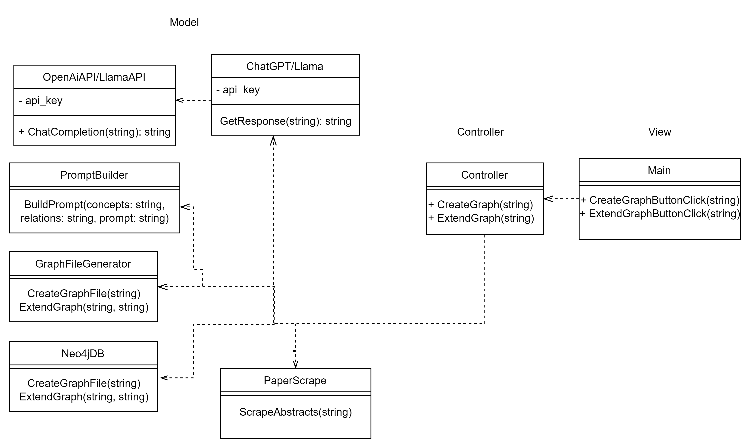
UML Diagram

Slide 10
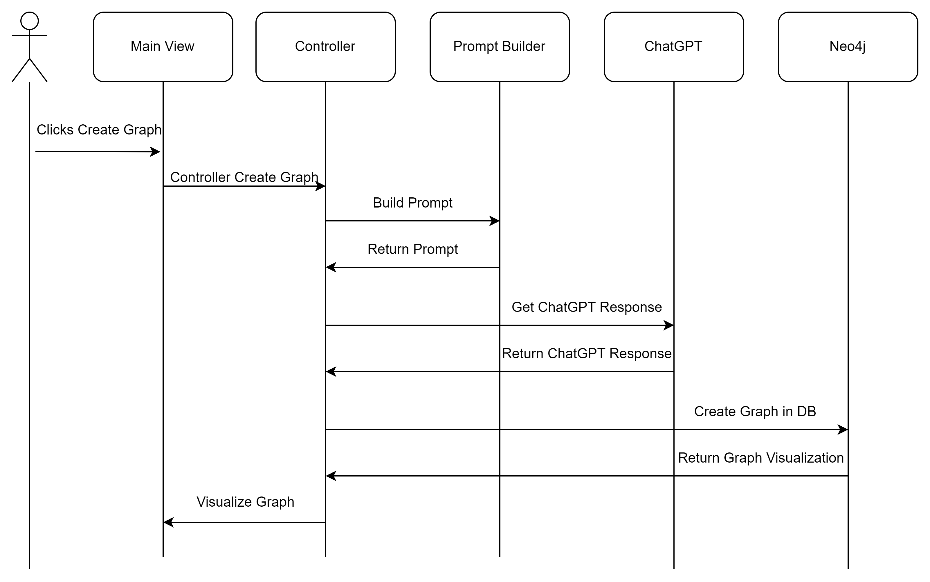
Sequence Diagram Manual

Slide 11
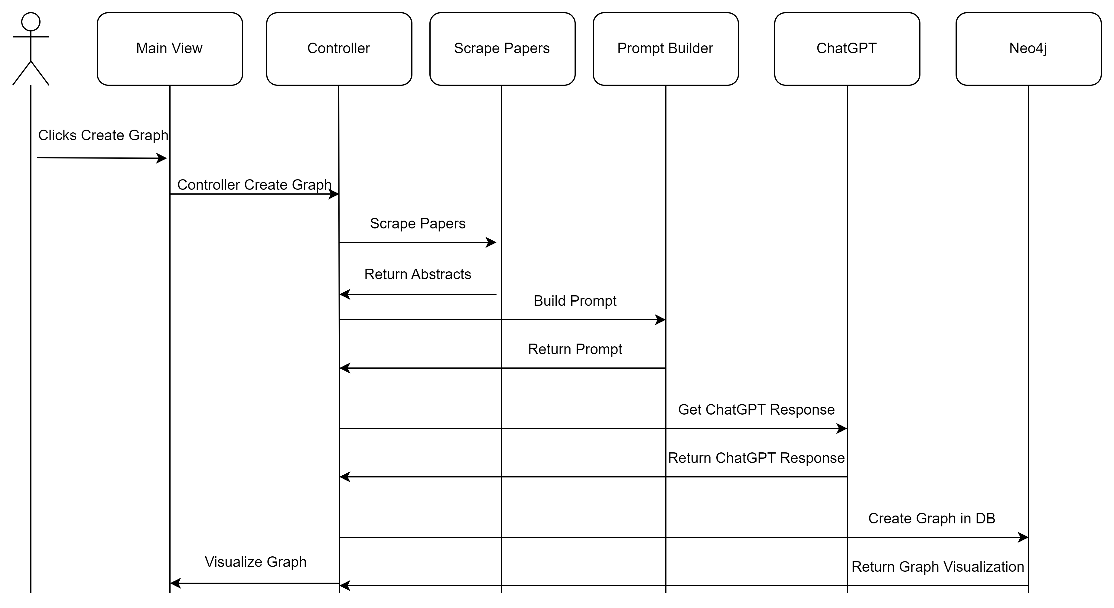
Sequence Diagram Automated

Slide 12
Testing – Performance Evaluation (F1 Score)
Examples | Chat GPT | Bard | Llama
Harry Potter Example | 0.88 | 0.60 | 0.52
Flavonoid Example | 0.94 | 0.94 | 0.57
Climate Change Example | 0.91 | 0.77 | 0.85
Average | 0.91 | 0.77 | 0.65

Slide 13
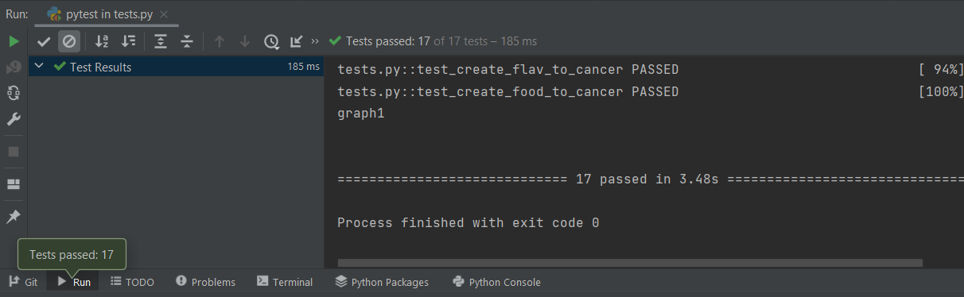
Testing – Unit Tests

Slide 14
Demo

Slide 15
Future Work
Host this web app on a server so it is visible publicly
Upload and export to multiple different types of knowledge graph files
Allow the user to edit the graph using text prompts to Chat-GPT
Conference paper currently in progress

Slide 16
Questions?
Topics:
Text to Knowledge Graphs
Generative AI using LLMs
System Design/Architecture
Web Application Design
Testing

