Slide 1
Knowledge Graph Generator
CIS 598
Caleb Martin
Dr. Hande McGinty

Slide 2
Overview
Web app that allows the creation and extension of knowledge graphs from raw text
Uses Large Language Models (LLMs) like ChatGPT to parse the raw text and create the knowledge graphs
Display the generated knowledge graph on the web application
It is quite difficult to create and extend knowledge graphs currently
Easily allow the creation and extension by simply inputing raw text
Initial Idea / Proof of concept from Antonio Zaitoun here: https://github.com/Minitour/ontology-extension-chatgpt

Slide 3
Example Input
Mindfulness-based stress reduction: Mindfulness-based clinical interventions combine meditation exercises with psychoeducational elements, cognitive-behavioural interventions and movement exercises. The core practices are sitting meditation with breath awareness and focused attention, awareness of sensations in the body (body scan), yoga exercises (e.g. hatha yoga, mindful movement), walking meditation and insight meditation. The two most used mindfulness-based clinical interventions in oncology are mindfulness-based stress reduction (MBSR) and mindfulness-based cognitive therapy (MBCT). MBSR is a specific multimodal programme focused on improving well-being and health. It has been used as an intervention for cancer patients. A meta-analysis showed the effects of MBSR on the mental health of cancer patients (Cohen’s effect size d ¼ 0.18).88 Documented benefits after programme participation include improvements in: stress; mood; anxiety; depressive mood; sleep; fatigue; psychological functioning; psychosocial adjustment; stress reduction; enhancements in coping and well-being symptoms; QoL; fear of recurrence.

Slide 4
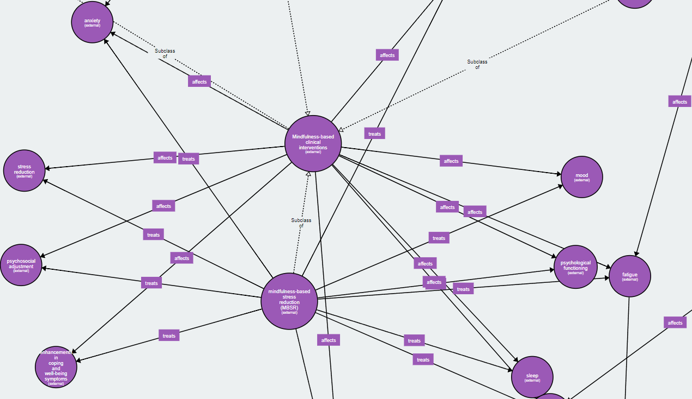
Example Graph

Slide 5
MVP Features
Allow users to create a knowledge graph from raw text from the web app using the Chat-GPT API.
Allow users to extend a knowledge graph from raw text from the web app using the Chat-GPT API.
Investigate the necessity of using seeds words for entities and relations
Allow users to view a static visualization of the knowledge graphs on the web application.

Slide 6
1.0 Features
Evaluate the performance of the knowledge graph generation on some known datasets.
Allow the user to edit the graph.
Allow the use of other LLM's to generate the graphs.
Improve the visualization of the knowledge graph to be dynamic (you can scroll around and zoom in).

Slide 7
2.0 Features
Host this web app on a server so it is visible publicly.
Allow the user to upload and export to multiple different types of knowledge graph files.
Compare the performance of the different LLM's to see which is best.
Allow the user to edit the graph using text prompts to Chat-GPT.

Slide 8
Tools
Python
Flask
HTML/CSS
ChatGPT API
Other LLMs APIs
Azure (for 2.0)

Slide 9
Timeline
Sep. 8th Hello World Finished
Oct. 16th Design Presentation
Dec. 4th 1.0: Evaluate performance, other LLMs, improve visualization, edit graph
Oct. 13th
MVP: Graph creation, extension, visualization
Week of Dec. 11th Final Presentation and Artifacts

Slide 10
Questions?

