Slide 1

Case Study: Presentation 3
Presentation of running workflows

Slide 2


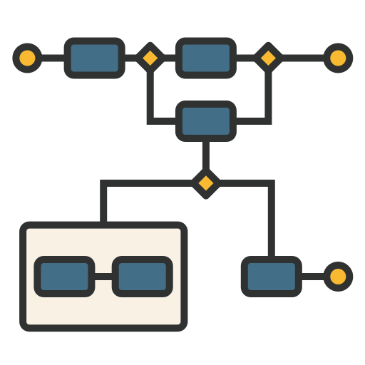



Agenda
BPMN Overview
Data Model
Frontend
Running Workflows

Slide 3
BPMN Overview
Contract Phase
Preselection
Selection
Interview Planning
Interview
Payment
WEPLACM

Slide 4
BPMN Overview
Contract Phase
Selection
Interview Planning
Interview
Payment
WEPLACM

Slide 5
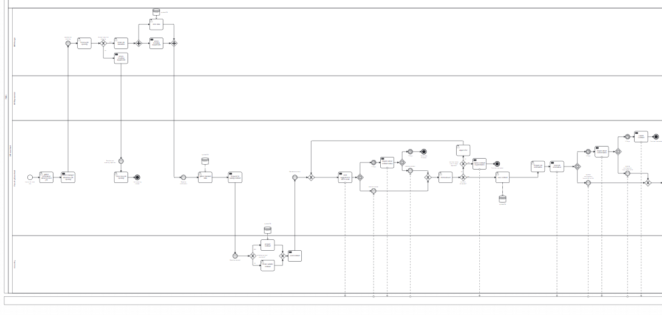
BPMN Overview
Contract-Phase (before):

Slide 6
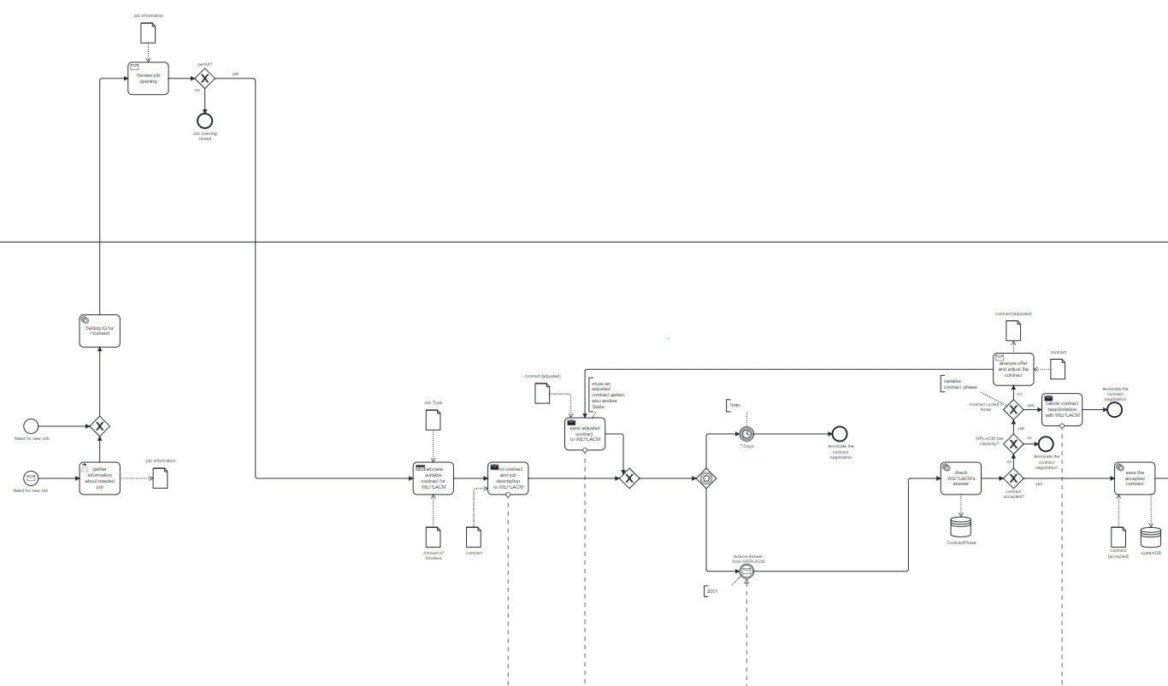
BPMN Overview
Contract-Phase (after):

Slide 7
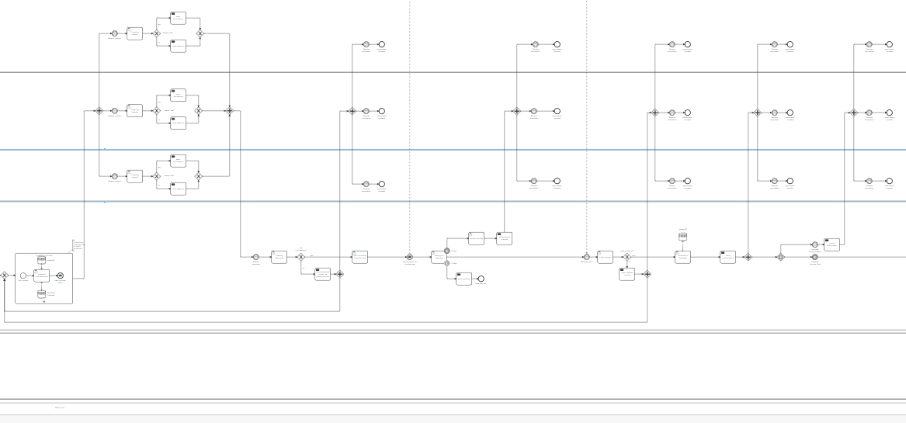
BPMN Overview
Interview Planning-Phase (before):

Slide 8
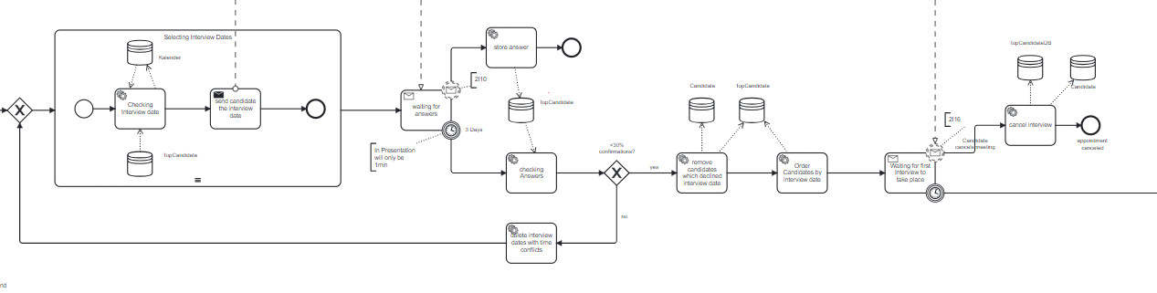
BPMN Overview
Interview Planning-Phase (after):

Slide 9
BPMN Overview
Interview Planning-Phase (before):

Slide 10
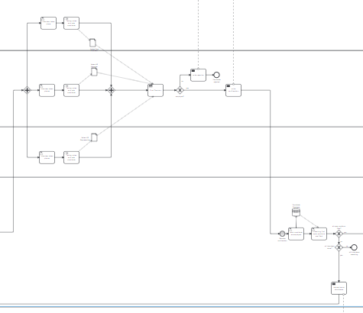
BPMN Overview
Interview Planning-Phase (after):

Slide 11
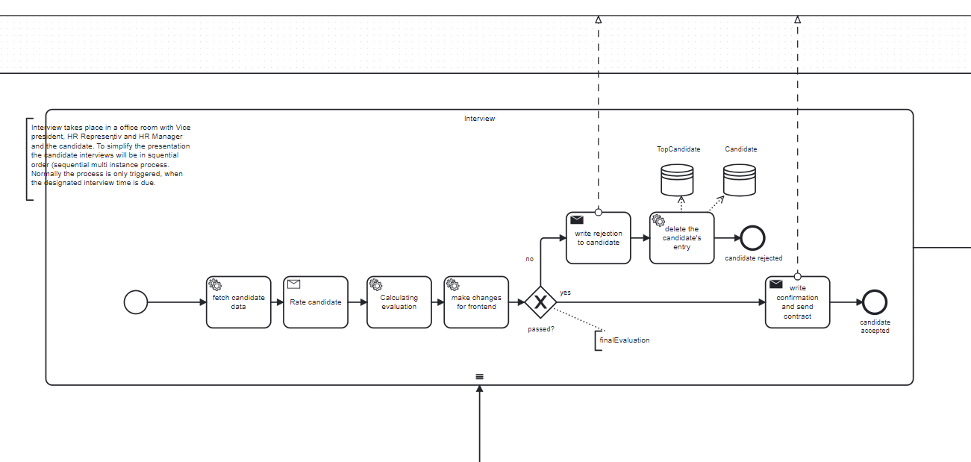
BPMN Overview
Interview Planning-Phase (before):

Slide 12
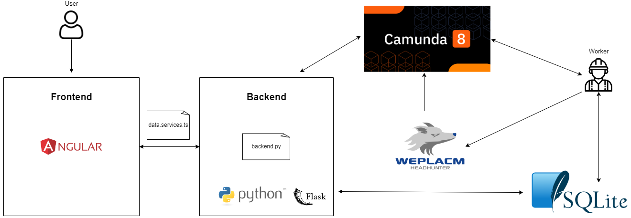
Data Model

Slide 13

Frontend
Company information...
First sketch for the frontend:
Username
Password
Login

Slide 14

Frontend
HR-Department:
Home
Company
information….
Create job offer
Create a new job offer
Check the Compensation
Job offer: IT ProcessID: 1
Job offer: CEO ProcessID: 2
…

Slide 15
Frontend
HR-Department:
Home
Company
information….
Create new job offer
Profession Titel: XY
Profession Type: CEO || Manager...
Description
Number of Positions: X
Send

Slide 16
Frontend
HR-Department:
Home
Company
information….
Create job offer
Create a new job offer
Adjust contract (Compensation)
Job offer: IT ProcessID: 1
Job offer: CEO ProcessID: 2
…

Slide 17
Frontend
HR-Department:
Home
Company
information….
Job offer: IT ProcessID: 1
Profession Titel: IT
Suggestion from WEPLACM: 0.1
Profession Type: CEO
New Suggestion from WBIG: <=0.1
Number of Positions: 2
Send
Job offer: CEO ProcessID: 2
…

Slide 18


Frontend
HR-Manager:
Accouting:
You can see our complete prototype for frontend design in OpenOlat in the file:
WBIG_Frontend_Prototype.pdf

Slide 19
Frontend
Company information...
Username
Live Demo
Password
Login

Slide 20


Running Workflows
Live Demo

Slide 21



Thank you for your Attention!
BPMN Overview
Data Model
Frontend
Running Workflows
Questions?

Slide 22
Sources
Vorlage:
<a href="https://www.flaticon.com/free-icons/bpmn" title="bpmn icons">Bpmn icons created by Alla Afanasenko - Flaticon</a>
<a href="https://www.flaticon.com/free-icons/machine-learning" title="machine learning icons">Machine learning icons created by Freepik - Flaticon</a>
<a href="https://www.flaticon.com/free-icons/ui" title="ui icons">Ui icons created by Infinite Dendrogram - Flaticon</a>
<a href="https://www.flaticon.com/free-icons/backend" title="backend icons">Backend icons created by Flat Icons - Flaticon</a>

